Slide 1
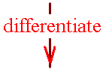


Theorem 1
The chain rule
If k(x) =f (g(x)), then
k’(x) = f ’ ( g(x) ) g’(x)

Slide 2
If k(x) =f (g(x)), then k’(x) = f ’ ( g(x) ) g’(x)
k(x) = ( x² + x)³
k’(x) = 3 ( x² + x)²(2x +1)

Slide 3
The chain rule
If y = (u)³ and u(x) = x² + x
then dy/dx = dy/du du/dx
dy/du = 3(u)² du/dx = 2x + 1
dy/dx = 3(u)² (2x + 1)
= 3(x² + x)² (2x + 1)

Slide 4
#49 y=u^{4/3} u = 3x²-1
dy/dx =

Slide 5
#49 y=u^{4/3} u = 3x²-1
dy/dx = dy/du

Slide 6
#49 y=u^{4/3} u = 3x²-1
dy/dx = dy/du du/dx
dy/dx =

Slide 7
#49 y=u^{4/3} u = 3x²-1
dy/dx = dy/du du/dx
dy/dx = 4/3 u^{1/3}

Slide 8
#49 y=u^{4/3} u = 3x²-1
dy/dx = dy/du du/dx
dy/dx = 4/3 u^{1/3}(6x) but can’t quit

Slide 9
#49 y=u^{4/3} u = 3x²-1
dy/dx = dy/du du/dx
dy/dx = 4/3 u^{1/3}(6x) but can’t quit
dy/dx = 8x

Slide 10
#49 y=u^{4/3} u = 3x²-1
dy/dx = dy/du du/dx
dy/dx = 4/3 u^{1/3}(6x) but can’t quit
dy/dx = 8x(3x²-1)^{1/3}

Slide 11
#49 y=u^{4/3} u = 3x²-1
dy/dx = dy/du du/dx
dy/dx = 4/3 u^{1/3}(6x) but can’t quit
dy/dx = 8x(3x²-1)^{1/3}
or rewrite the problem y=(3x²-1)^{4/3}
y’ = 4/3(3x²-1)^{1/3}(6x)

Slide 12
#81 Number of construction jobs created is N(x) = 1.42x
where x is the number of housing starts.
The number of starts in the next t months is x(t) = million units per year.
How many starts this month?

Slide 13
#81 Number of construction jobs created is N(x) = 1.42x
where x is the number of housing starts.
The number of starts in the next t months is x(t) = million units per year.
How many starts this month? 70/55 million

Slide 14
#81 Number of construction jobs created is N(x) = 1.42x
where x is the number of housing starts.
The number of starts in the next t months is x(t) = million units per year.
How many starts this month? 70/55 million
How many jobs created? 1.42(70/55) million

Slide 15
#81 Number of construction jobs created is N(x) = 1.42x
where x is the number of housing starts.
The number of starts in the next t months is x(t) = million units per year.

Slide 16
#81 Number of construction jobs created is N(x) = 1.42x
where x is the number of housing starts.
The number of starts in the next t months is x(t) = million units per year.
Find dN/dt, the rate of created jobs t months from now.

Slide 17
#81 Number of construction jobs created is N(x) = 1.42x
x(t) = million units per year.
dN/dt = dN/dx

Slide 18
#81 Number of construction jobs created is N(x) = 1.42x
x(t) = million units per year.
dN/dt = dN/dx dx/dt =

Slide 19
#81 Number of construction jobs created is N(x) = 1.42x
x(t) = million units per year.
dN/dt = dN/dx dx/dt = 1.42

Slide 20
#81 Number of construction jobs created is N(x) = 1.42x
x(t) = million units per year.
dN/dt = dN/dx dx/dt
= 1.42

Slide 21
#81 Number of construction jobs created is N(x) = 1.42x
x(t) = million units per year.
dN/dt = dN/dx dx/dt
= 1.42
Find the rate of growth of N, one year from now.

Slide 22
#81 Number of construction jobs created is N(x) = 1.42x
x(t) = million units per year.
dN/dt = dN/dx dx/dt
= 1.42
Set t =

Slide 23
#81 Number of construction jobs created is N(x) = 1.42x
x(t) = million units per year.
dN/dt = dN/dx dx/dt
= 1.42
Set t = 12

Slide 24
#81 Number of construction jobs created is N(x) = 1.42x
x(t) = million units per year.
dN/dt = dN/dx dx/dt
= 1.42

Slide 25
Economics
The total daily cost of manufacturing dryers is given by
C(x) = 6000 + 100 x - 0.2 x².

Slide 26
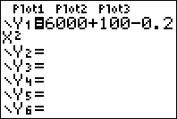
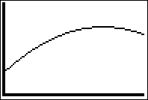
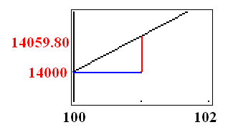
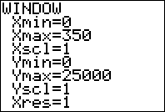
C(x) = 6000 + 100 x - 0.2 x² on [0, 350]
Find the actual cost of producing the 101 st dryer.
C(101) – C(100) =

Slide 27
C(x) = 6000 + 100 x - 0.2 x². on [0, 350]
Find the actual cost of producing the 101 st dryer.
C(101) – C(100) = 14059.80 – 14000.00
= 59.80

Slide 28
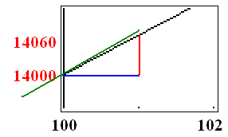
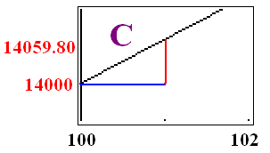
C(x) = 6000 + 100 x - 0.2 x² on [0, 350]
Find the marginal cost. C’(x) =
C’(x) = 100 – 0.40 x
Evaluate C’(100) and interpret
C’(100) = 100 – 40.00 = $60.00

Slide 29
C(x) = 6000 + 100 x - 0.2 x² on [0, 350]
C(101)-C(100) / 1 = 59.80
C’(100) = 60
C’(100) =
C’(100) is approximated with h = 1

Slide 30
C(x) = 6000 + 100 x - 0.2 x² on [0, 350]
C’(100) = 60
Interpret
The cost of producing the 101 st dryer will be approximately $60.00

Slide 31
C’(x) = 100 – 0.40 x
C’(50) = 100 – 20 = 80
Interpret
The cost of producing the 51 st dryer will be approximately $80.00

Slide 32
C’(x) = 100 – 0.40 x Find the approximate cost of producing the 201st dryer.

Slide 33


C’(x) = 100 – 0.40 x Find the approximate cost of producing the 201st dryer.
20.0
4.1

Slide 34
DVD Players

Slide 35
C(x) =
0.0001 x³–0.08 x² +40 x +5000
Daily total cost is given above
Find the marginal cost function
C’(x) =

Slide 36
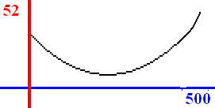
On [0, 500] C(x) = .0001 x³ – 0.08 x² +40 x +5000
C’(x) =
Find the marginal cost for producing 200, 300, 400, 500 DVD players
C’(200) = 20, C’(300) = 19,
C’(400) = 24, C’(600) = 52

Slide 37
C’(200) = 20, C’(300) = 19,
C’(400) = 24, C’(600) = 52
What did it cost to produce the 201st DVD player?
301st ? 401st ? 601st ?

Slide 38
C’(x) =
Cost of producing 101st is

Slide 39
C’(x) =
Cost of producing 101st is
27.00
1.1

Slide 40
Average Cost
If 100 items cost $300, what is the average cost? $ 300 / 100 =
$3

Slide 41
Average Cost
If 100 items cost $300, what is the average cost? $ 300 / 100 =
$3
If x items cost $ C(x), what is the average cost?
Answer is

Slide 42
C(x) = 400 + 20x
Find the average cost function.

Slide 43
Evaluate the average cost in the long run.

Slide 44
Evaluate

Slide 45
Evaluate
20.0
0.1

Slide 46
= $20
Which is expected because the fixed cost remains constant while it is spread over more and more product.

Slide 47
= 400 x⁻¹ + 20
Find the marginal average cost function.

Slide 48
C(x) = 0.0001 x³ – 0.08 x² +40 x +5000
Find the average cost for producing DVD players.
Average cost = (x)=
0.0001 x² – 0.08 x +40 +5000x⁻¹

Slide 49
(x) = 0.0001 x² – 0.08 x +40 +5000/x, find

Slide 50
(x) = 0.0001 x² – 0.08 x +40 +5000/x, find
83.0
0.1

Slide 51
= 0.0001 x² – 0.08 x +40 +5000 x⁻¹, find (x)
0.02x – 0.08 + 40 + 5000 x ⁻²
0.002x – 0.08 + 40 + 5000 x ⁻²
0.0002x – 0.08 + 5000 x ⁻²
0.0002x – 0.08 - 5000 x ⁻²

Slide 52


= 0.0001 x² – 0.08 x +40 +5000 x⁻¹, find (x)
0.02x – 0.08 + 40 + 5000 x ⁻²
0.002x – 0.08 + 40 + 5000 x ⁻²
0.0002x – 0.08 + 5000 x ⁻²
0.0002x – 0.08 - 5000 x ⁻²

Slide 53
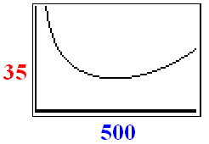

= 0.0002x – 0.08 - 5000 x⁻², find (500)
1
2
3
0

Slide 54
= 0.0002x – 0.08 - 5000 x⁻², find (500)
1
2
3
0

Slide 55
= 0.0002x – 0.08 - 5000 x⁻², find (500)
1
2
3
0

Slide 56
= 0.0002x – 0.08 - 5000 x⁻², find (500)
1
2
3
0

Slide 57
The price is $500
Find the revenue if you sell 1000.
R(x) = x p(x) = 1000 (500)
= $500,000

Slide 58
Loudspeakers

Slide 59
The price function is p(x) = -0.02 x + 400 on [0, 20000]
Find the revenue function.
R(x) = x p(x) =
-0.02 x² + 400 x

Slide 60
R(x) = x p(x) = -0.02 x² + 400 x
Find the marginal revenue function.
R’(x) =

Slide 61
R’(x) = -0.04 x + 400
How much revenue for 2001st one?
320
300
280

Slide 62
R’(x) = -0.04 x + 400
How much revenue for 2001st one?
320
300
280

Slide 63
R(x) = -0.02 x² + 400 x
Suppose the cost function is
C(x) = 100x + 200,000 for the loudspeakers
Find the profit function.

Slide 64
Find the profit function.
R(x) = -0.02 x² + 400 x
C(x) = 100x + 200,000
P(x) = R(x) – C(x) =
-0.02 x² + 400 x – (100x + 200,000 )
P(x) = -0.02 x² + 300 x - 200000

Slide 65
P(x) = -0.02 x² + 300 x - 200000
Find the marginal profit function
P’(2000) = profit for the sale
of the 2001 loudspeaker

Slide 66
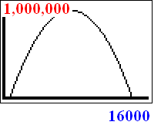
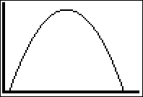
Sketch the graph of P(x)

Slide 67
P(x) = -0.02 x² + 300 x – 200000 Find P’(1000)

Slide 68
P(x) = -0.02 x² + 300 x – 200000 Find P’(1000)
260.0
0.1

Slide 69
P’(1000) = 260 Interpret

Slide 70
P’(1000) = 260 Interpret
Upon building 1001 dreyers, the profit on the sale of the 1001st dryer is $260.

