Slide 1
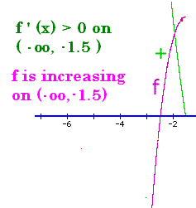
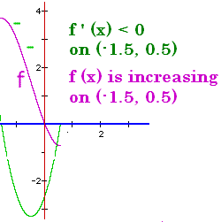
Increasing/Decreasing
If f ’ (x) > 0 on an interval, then f is increasing.
If f ’ (x) < 0 on an interval, then f is decreasing

Slide 2
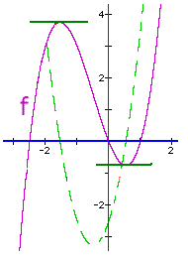
Increasing / Decreasing
1. Take the derivative of the function, f’(x)
2. Set f’(x) = 0
3. Solve for x

Slide 3
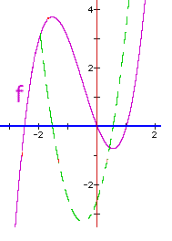
Increasing/Decreasing
Find all x such that f ’(x) = 0 or not continuous {-1.5, 0.5}

Slide 4
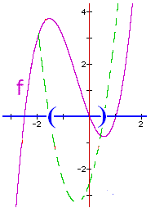
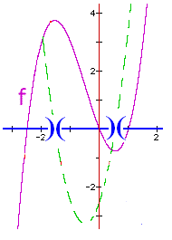
Increasing/Decreasing
Find all x such that f ’(x) = 0 or not continuous {-1.5, 0.5}
Find open intervals on x-axis
(-1.5, 0.5)
(-oo, -1.5) or (0.5, +oo)

Slide 5

Increasing/Decreasing
Find open intervals on x-axis
-oo ---- -1.5 ---- 0.5 ---- +oo
Test f ’(x) in each interval
f’(-2)=3 f’(0)=-2.5 f’(1)=2
+ + + 0 - - - - 0 + + +

Slide 6
Increasing/Decreasing
-oo -------- -1.5 --------- 0.5 ------ +oo
f’(-2)=3 f’(0)=-2.5 f’(1)=2
+ + + 0 - - - - - - - 0 + + +
Increasing Decreasing Increasing

Slide 7
Increasing/Decreasing
f’(-2)=3 f’(0)=-2.5 f’(1)=2
Increasing Decreasing Increasing
(-oo,-1.5) (-1.5,0.5) (0.5, +oo)

Slide 8
Increasing / Decreasing
1. Take the derivative of the function, f’(x)
2. Set f’(x) = 0
3. Solve for x
Example – If f(x) = 4/3x³+2x²-3x+1
f ’(x) = 4x² + 4x – 3 = 0
(2x - 1)(2x + 3) = 0 so
2x – 1 = 0 or 2x + 3 = 0
2x = 1 or 2x = -3
x = ½ or x=-1½

Slide 9

f ’(x) = 4x² + 4x – 3
4.
5. f’(-3)= 21 | f’(0) = -3 | f’(1) = 5
6. increasing | decreasing | increasing

Slide 10
Increasing / Decreasing
4. Graph the solutions
5. Test one value of f’(x) in each interval
6. Test value positive => Increasing
Test value is negative => Decreasing

Slide 11
f(x) = -x³ + 3x² + 24x - 32
Find all x such that f ’(x) = 0 or not continuous
y’=-3x²+6x+24 = 0
y’=-3(x²-2x-8) = 0

Slide 12
f(x) = -x³ + 3x² + 24x - 32
f ’(x)=-3(x² - 2x - 8) = 0
-3(x - 4)(x + 2) = 0
x – 4 = 0 or x + 2 = 0
x = 4 or x = -2

Slide 13

f’(x) = -3x² + 6x + 24
x = -2 or x = 4
Set up the intervals test values
-oo ------ -2 ------ 4 ------ +oo
f’(-10)<0 f’(0)=24 f’(10)<0
Decreasing Increasing Decreasing
(-oo,-2) (-2,4) (4,+oo)

Slide 14
f(x) = x² + 4x + 1

Slide 15

f(x) = x² + 4x + 1 find f ’(x)
2x
x² + 4
2
2x + 4

Slide 16


f(x) = x² + 4x + 1 find f ’(x)
2x
x² + 4
2
2x + 4

Slide 17
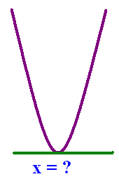
Find the x so f ’(x) = 0.
When is 2x + 4 = 0 ?
x = 4
x = 2
x = -2
x = - ½

Slide 18
Find the x so f ’(x) = 0.
When is 2x + 4 = 0 ?
x = 4
x = 2
x = -2
x = - ½

Slide 19

f ’(x) = 2x + 4
-oo - - - - - - - - +oo
f ’(-10) < 0 f ’(10) < 0
f ’(-10) < 0 f ’(10) > 0
f ’(-10) > 0 f ’(10) < 0
f ’(-10) > 0 f ’(10) > 0

Slide 20
f ’(x) = 2x + 4
-oo - - - - - - - - +oo
f ’(-10) < 0 f ’(10) < 0
f ’(-10) < 0 f ’(10) > 0
f ’(-10) > 0 f ’(10) < 0
f ’(-10) > 0 f ’(10) > 0

Slide 21

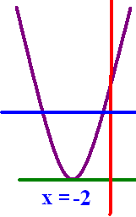
f ’(-10)=-16 f ’(10)=24
f is increasing on (-oo, +oo)
f is increasing on (-oo, -2) only
f is increasing on (-2, + oo) only
f is increasing only at x = -2

Slide 22
f ’(-10)=-16 f ’(10)=24
f is increasing on (-oo, +oo)
f is increasing on (-oo, -2) only
f is increasing on (-2, + oo) only
f is increasing only at x = -2

Slide 23
g(x) = x + 1/x

Slide 24
g(x) = x + 1/x g’(x) =
-1 – 1/x²
1 + 1/x²
1 – 1/x²

Slide 25
g(x) = x + 1/x g’(x) =
-1 – 1/x²
1 + 1/x²
1 – 1/x²

Slide 26
g’(x)=1 - 1/x² add fract.
= x²/x² – 1/x² =
(x² - 1)/ x²
(x² ⁺ 1)/ x²
(1 – x²)/ x²

Slide 27
g’(x)=1 - 1/x² add fract.
= x²/x² – 1/x² =
(x² - 1)/ x²
(x² ⁺ 1)/ x²
(1 – x²)/ x²

Slide 28
(x² - 1)/ x² = 0 when the numerator does. x =
x = 0 or x = 1
x = -1 or x = 1
x = 0 or x = -1

Slide 29
(x² - 1)/ x² = 0 when the numerator does. x =
x = 0 or x = 1
x = -1 or x = 1
x = 0 or x = -1

Slide 30

g’(x) is not continuous when x =

Slide 31


g’(x) is not continuous when x =
0.0
0.1

Slide 32

Where is f increasing?
(-oo, -1) U (1, +oo)
(-oo, -1) U (0, 1)
(-1, 0) U (0, 1)

Slide 33
Where is f increasing?
(-oo, -1) U (1, +oo)
(-oo, -1) U (0, 1)
(-1, 0) U (0, 1)

Slide 34
g has a critical point at x=c means that g’(c)=0 or d.n.e.
The critical points for g are {-1, 0, 1}
Numerator = 0
Denominator = 0

Slide 35
Find the critical points for h(x) = - x³ + 12x - 9
x = 3 or -2
x = - 2 or 2
x = 0 or -3

Slide 36
Find the critical points for h(x) = - x³ + 12x - 9
x = 3 or -2
x = - 2 or 2
x = 0 or -3

Slide 37


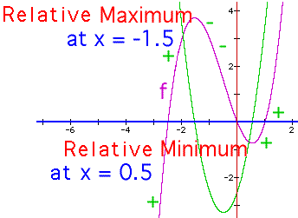
f(x) = 4/3x³+2x²-3x+1 f ’(x) = 4x² + 4x – 3
4.
5. f’(-3)= 21 | f’(0) = -3 | f’(1) = 5
6. increasing | decreasing | increasing
relative max @ -3/2 min @ 1/2

Slide 38
First derivative test
1. Take the derivative of the function, f’(x)
2. Set f’(x) = 0
3. Solve for x – If f(x) = x/(1 + x²)
f ’(x) =
When x = 1 or x = -1

Slide 39

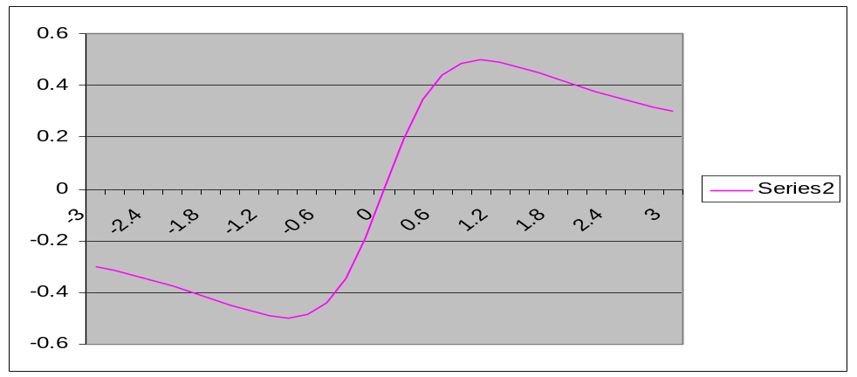
First derivative test (II) f ’(x) = (1-x²)/positive
4.
5. f ’(-3)= -8/p | f ’(0) = 1/p | f ’(3) = -8/p
6. decreasing | increasing | decreasing
relative min @ -1 max @ 1

Slide 40
First derivative test
1. If f(x) = x + 9/x+2 = x + 9x⁻¹ + 2
2. f’(x) = 1 – 9x⁻² = 1 – 9/x²
3. = 0
Numerator = 0 when x = 3 or x = -3

Slide 41

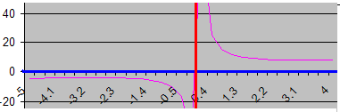
First derivative test f ’(x) =
4.
5. f’(-5)= 16/p f’(-1) = -8/p f’(1) = -8/p f’(5)=16/p
6. increasing | decreasing || decreasing | increasing
relative max @ -3 asymptote min @ 3

Slide 42
h(x) = - x³ + 12x - 9
h’(x) = -3x² + 12 = 0
12 = 3x²
4 = x²
-2 = x or 2 = x

Slide 43

y = - x³ + 12x - 9 has critical points at 2 and -2. Where is y increasing?
(-oo, -2) U (2, +oo)
(-2, 2)
R
(2, -2)

Slide 44
y = - x³ + 12x - 9 has critical points at 2 and -2. Where is y increasing?
(-oo, -2) U (2, +oo)
(-2, 2)
R
(2, -2)

Slide 45
y = - x³ + 12x - 9 has critical points at 2 and -2. Where is y decreasing?
(-oo, -2) U (2, +oo)
(-2, 2)
R
(2, -2)

Slide 46
y = - x³ + 12x - 9 has critical points at 2 and -2. Where is y decreasing?
(-oo, -2) U (2, +oo)
(-2, 2)
R
(2, -2)

Slide 47

y = - x³ + 12x – 9
Where is the local max?

Slide 48
y = - x³ + 12x – 9
Where is the local max?
2.0
0.1

Slide 49

y = - x³ + 12x – 9
Where is the local min?

Slide 50
y = - x³ + 12x – 9
Where is the local min?
-2.0
0.1

Slide 51
Where is f(x) = x/(2x²+3) increasing? No asymptote
f ’(x) = [(2x² + 3)-x(4x)]/(2x² + 3)²
which is zero when the numerator is.
- 2x² + 3 = 0

Slide 52
Where is f(x) = x/(2x²+3) increasing?
- 2x² + 3 = 0 makes f’(x) = 0
3 = 2x² or
+-root(3/2) = x

Slide 53
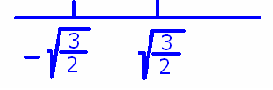
Where is f(x) = x/(2x²+3) increasing?
- 2x² + 3 = 0 makes f’(x) = 0
3 = 2x² or x = +-root(3/2)

Slide 54
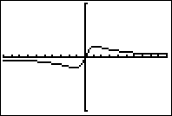
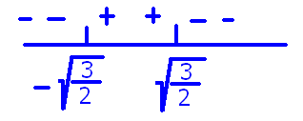
Where is f(x) = x/(2x²+3) increasing?
f ’(x) = (- 2x² + 3)/(2x² + 3)²
f ’(-10) = -197/203²<0
f ’(0)=3/9 >0
f ’(10) = -197/203²<0

Slide 55
Where is f(x) = x/(2x²+3) increasing?
f ’(x) = (- 2x² + 3)/(2x² + 3)²
f ’(-10) = -197/203²<0
f ’(0)=3/9 >0
f ’(10) = -197/203²<0
Answer = ( , )

Slide 56
Where are the relative max and relative min?
Relative min at x= max at x =

