Slide 1
Implicit Differentiation

Slide 2
If h(x) = [g(x)]^{n} then h’(x) = n [g(x)]^{n-1}g’(x)
We review the power rule.

Slide 3
If y = 4(2x + 2)⁵ then y’ =
20 (2x + 2)⁴ 2 = 40 (2x + 2)⁴
20 (2x + 2)⁵ 2 = 40 (2x + 2)⁵
20(2)⁴ = 20 (16) = 320
20 (2x + 2)⁴ = 20 (2x + 2)⁴

Slide 4


If y = 4(2x + 2)⁵ then y’ =
20 (2x + 2)⁴ 2 = 40 (2x + 2)⁴
20 (2x + 2)⁵ 2 = 40 (2x + 2)⁵
20(2)⁴ = 20 (16) = 320
20 (2x + 2)⁴ = 20 (2x + 2)⁴

Slide 5
If h(x) = [3x + 1/x]⁷
^{h’(x) =}
21 x - 7/x²
7 [3x + 1/x]⁶ [3 + 1/x²]
7 [3x + 1/x]⁶ [3 – 1/x²]
7 [3 – 1/x]⁶

Slide 6
If h(x) = [3x + 1/x]⁷
^{h’(x) =}
.
.
7 [3x + 1/x] ⁶[3 – 1/x²]
.

Slide 7
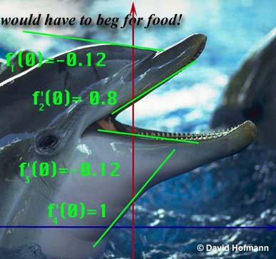
Replace g(x) with y.
Instead of ([g(x)]^{n} )’ = n [g(x)]^{n-1}g’(x)
We get (y ^{n} )’ = n [ y ]^{n-1} y’

Slide 8
Replace g(x) with y.
We get (y ^{n} )’ = n [ y ]^{n-1} y’

Slide 9
Guidelines for Finding the Derivative Implicitly
Let y stand for one of any number of functions.
In this case, 4 different functions.

Slide 10
Number of heart beats per minute, t seconds
after the beginning of a race is given by
What is your heart rate at the beginning of the race?

Slide 11
Number of heart beats per minute, t seconds
after the beginning of a race is given by
What is your heart rate at the beginning of the race?

Slide 12
Number of heart beats per minute, t seconds
after the beginning of a race is given by
What is your heart rate at the end of the race?

Slide 13
Number of heart beats per minute, t seconds
after the beginning of a race is given by
What is your heart rate at the end of the race?

Slide 14
Number of heart beats per minute, t seconds
after the beginning of a race is given by
Find R(0).
R(0) =

Slide 15
Number of heart beats per minute, t seconds
after the beginning of a race is given by
How fast is
your heart rate increasing after 100 sec? [Acceleration]

Slide 16
Number of heart beats per minute, t seconds
after the beginning of a race is given by
Find R’(t).
R’(t) =

Slide 17
Number of heart beats per minute, t seconds
after the beginning of a race is given by
Find R’(t).

Slide 18
Number of heart beats per minute, t seconds
after the beginning of a race is given by
Find R’(t).
R’(t)

Slide 19
Number of heart beats per minute, t seconds
after the beginning of a race is given by
Find R’(t).
R’(100)

Slide 20
Recall [(x+1)(x²-3)]’
= (x+1)(2x)+ (x²-3)
So [(x+1)y]’ = (x+1)y’ + y
[3 y³ ]’ = 9 y² y’

Slide 21
So [(2x+1)y]’ = ?
2y’
(2x+1) y’ + 2y
(2x+1) y’ + 2y’
(2x+1) y’

Slide 22
So [(2x+1)y]’ = ?
2y’
(2x+1) y’ + 2y
(2x+1) y’ + 2y’
(2x+1) y’

Slide 23
Find [2y⁶ + 2y]’
12y⁵ y’ – 2
12y⁵ y’ + 2y’
12y⁵ y’ + 2yy’
12y⁵ + 2y’

Slide 24
Find [2y⁶ + 2y]’
12y⁵ y’ – 2
12y⁵ y’ + 2y’
12y⁵ y’ + 2yy’
12y⁵ + 2y’

Slide 25
Guidelines for Finding the Derivative Implicitly
Let y stand for one of any number of functions.
Differentiate both sides of the equation, using chain rule, power rule, product rule, quotient rule.

Slide 26
If x² + y² = 36 find y’.
What is the derivative of x² ?
2x
What is the derivative of y² ?
2yy’
What is the derivative of 36 ?

Slide 27


What is the derivative of 36?
0.0
0.1

Slide 28
Differentiate both sides x² + y² = 36
2x + 2yy’ = 0
2x + 2yy’ = 36
2x + 2y = 0

Slide 29
Guidelines for Finding the Derivative Implicitly
Let Y stand for one of any number of functions.
Differentiate both sides of the equation, using chain rule, power rule, product rule, quotient rule.
Place all of the terms containing Y' on one side and the other terms on the other.

Slide 30
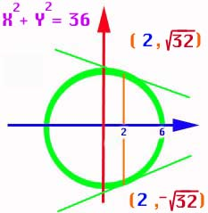
If x² + y² = 36 find y’.
2x + 2yy’ = 0
2yy’ = -2x

Slide 31
Guidelines for Finding the Derivative Implicitly
Differentiate both sides of the equation, using chain rule, power rule, product rule, quotient rule.
Place all of the terms containing y' on one side and the other terms on the other.
Factor the y' out if necessary and solve for y’.

Slide 32
If x² + y² = 36 find y’.
2yy’ = -2x
yy’ = -x
y’ =

Slide 33
Guidelines for Finding the Derivative Implicitly
Place all of the terms containing Y' on one side and the other terms on the other.
Factor the Y ' out if necessary and solve for Y '.
Replace x and y by the values given.

Slide 34
y’ = x² + y² = 36
Top point only!
Find the slope when x = 2.
When x = 2, y = or
Y =
Thus y’ =

Slide 35
y’ =
Y’ = for top point
Y’ = bottom point

Slide 36
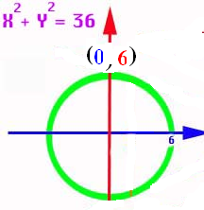
If y’ = find the slope at (-3 , 3)
1.732
0.1

Slide 37
Thus if the dolphins forehead could be approximated by a circle,
we could calculate
the slope there if
we knew the x and
y coordinates.
y’ =

Slide 38
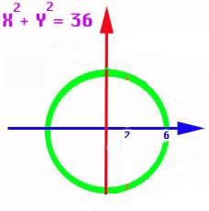
And if the dolphins throat could be approximated by a circle,
we could calculate
the slope there if
we knew the x and
y coordinates.
y’ =

Slide 39
Guidelines for Finding the Derivative Implicitly
Let Y stand for one of any number of functions.
Differentiate both sides of the equation, using
chain rule, power rule, product rule, quotient rule.
Place all of the terms containing y' on one side and the other terms on the other.
Factor the y’ out if necessary and solve for y’.
Replace x and y by the values given.

Slide 40
Let y stand for one of 5 functions.
If 3x² + xy⁵ = 16x find y’.
What is the derivative of 3x² ?
6x
What is the derivative of xy⁵ ?
x5y⁴y’+y⁵
What is the derivative of 16x ?

Slide 41
Differentiate xy⁵ using the product rule and power rule
x5y⁴y’ + y⁵

Slide 42
3x² + xy⁵ = 16x
Differentiate both sides
6x + 5y⁴ y’= 16
6x +5xy⁴ y’= 16
6x +5xy⁴ y’+y⁵ = 16
6 + 6x +5xy⁴ y’+y⁵ = 0

Slide 43
3x² + xy⁵ = 16x
Differentiate both sides
6x + 5y⁴ y’= 16
6x +5xy⁴ y’= 16
6x +5xy⁴ y’+y⁵ = 16
6 + 6x +5xy⁴ y’+y⁵ = 0

Slide 44
Guidelines for finding the derivative implicitly
Let y stand for one of 5 functions.
Differentiate both sides of the equation, using chain rule, power rule, product rule, quotient rule.

Slide 45
If 3xy + x + 5y² = 16 find y’.
3xy’ + 3y + 1 + 10yy’ = 0
Place all (y’)’s on the left and factor
3xy’ + 10yy’ = -1 - 3y
(3x+10y)y’= -1 - 3y
y’ =

Slide 46
If 3xy + x + 5y² = 16 find y’’.
3xy’ + 3y + 1 + 10yy’ = 0
3xy’’ + 3y’ + 3y’ + 10yy’’ + 10(y’)² = 0
Place all (y’’)’s on the left and factor
(3x+10y)y’’= -6y’ - 10(y’)²

Slide 47
If x² + 5y² = 6 find y’.
2x + 10yy’ = 0
y’ = -2x/10y = -x/5y

Slide 48
y’ = -x/5y
Find y’ when x = y = 1
-0.2
0.1

Slide 49
If x² + 5y² = 1 find y’’.
2x + 10yy’ = 0
2 + 10yy’’+ y’10y’ = 0
Place all (y’’)’s on the left and solve
y’’ = (-10(y’)² – 2)/10y

Slide 50
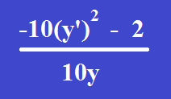
Find y’’ when x = y = 1 and y’ = -0.2 y’’ =
-0.24
0.1

Slide 51
If 3xy + x + 5y² = 16 find y’’.
Place all (y’’)’s on the left and factor
(3x+10y)y’’=-6y’+10(y’)²
Solve for y’’
y’’ = =
=

Slide 52
If 3xy + x + 5y² = 16 find y’’.
y’’=
=
=

Slide 53
Find dy/dx
1. x² y + y² x = 6
6. (3xy + y)³ = 6y

Slide 54
Find the equation of the tangent and the normal
29. x² + xy - y² = 1 at (2, 3)
31. x² y² = 9 at (1, 3)
35. 2xy + π x = 2 π at (1, π /2)

Slide 55
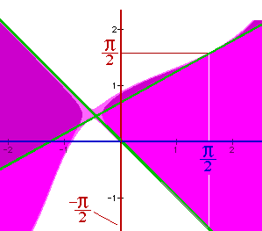
Find the slope of
y² - sin( x + y ) = x² at the points (π/2, π/2) and (π/2, -π/2).
In other words, find the slopes of the two green lines.

Slide 56
y² - sin( x + y ) = x²
Let y stand for the two functions f1 and f2. Differentiating,
2yy' - cos(x + y)[1+y'] = 2x
2yy’ – cos(x+y) – cos(x+y) y’ = 2x
[2y - cos(x+y)]y' = 2x + cos(x+y), or
y' = [2x + cos(x+y)] / [2y - cos(x+y)]

Slide 57
y² - sin( x + y ) = x² y’ =
[2x + cos(x+y)] / [2y - cos(x+y)]
Now substitute (π/2, π/2) and
(π/2, -π/2).
f1 has a slope of [π-1]/[π+1]
and the slope of f2 is [π+1] / [-π-1] =
-1

Slide 58
y’=[2x+cos(x+y)] / [2y-cos(x+y)]
Find y’ at (-π/2,-π/2) to one decimal.
1.933884414
0.1

Slide 59
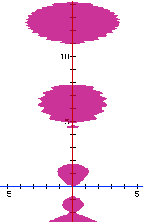
sin(y²) = x² - y cos(y)
Find y’ at the point (0, 0)
cos(y²)2yy’ = 2x – [-y sin(y) y’ + cos(y) y’]
[cos(y²)2y - y sin(y) + cos(y)]y’=2x
(0 + 0 + 1) y’ = 0 so y’ = 0

Slide 60
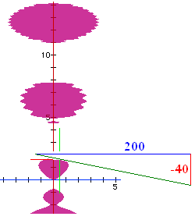
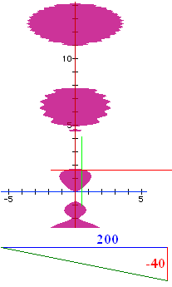
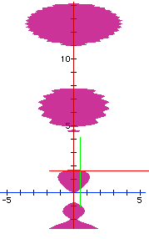
sin(y²) = x² - y cos(y)
Find y’ at the point (.5, 1.65555)
cos(y²)2yy’ = 2x – [-y sin(y) y’ + cos(y) y’]
[cos(y²)2y - y sin(y) + cos(y)]y’=2x
(-3.04876 - 1.64961 -0.08465) y’ = 1
so y’ = -0.2091

Slide 61
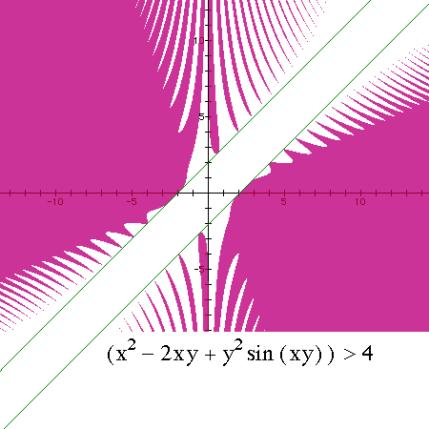
x² – 2xy + y²sin(xy) > 4
Find y’ at the point (-2, 0)
2x -2xy’-2y+y2cos(xy)[xy’+y]+2sin(xy)yy’=0
Example Only

Slide 62
x² – 2xy + y²sin(xy) = 4 implicitly 2x-2xy’-2y + . .
y²cos(xy)+sin(xy)2yy’=0
y²cos(xy)[xy’]+sin(xy)2yy’=0
y²cos(xy)[xy’+y]+sin(xy)yy’=0
y²cos(xy)[xy’+y]+sin(xy)2yy’=0

Slide 63
x² – 2xy + y²sin(xy) = 4
Find y’ at the point (-2, 0)
2x -2xy’-2y+y²cos(xy)[xy’+y]+2sin(xy)yy’=0
Next question is ‘Find y’ at the point (-2,0).’

Slide 64
2x -2xy’-2y+y²cos(xy)[xy’+y]+2sin(xy)yy’=0
^{Find y’ at (-2,0)}
0
1
2
-1

Slide 65
Theorem – If n is an integer, [x^{n}]’ =nx^{n-1}
Use mathematical induction for positive n
Use mathematical induction for nonnegative n
n=0 ; 1’ = 0
Assume [x^{k}]’ =kx^{k-1} for k<0 but fixed
Prove [x^{k-1}]’ =(k-1)x^{k-2}

Slide 66
Theorem – If q is rational, [x^{q}]’ =qx^{q-1}
Since q is rational, there exist integers, m and n such that q = m/n and n is not 0.
Then y = x^{q} = x^{m/n} and y^{n} = x^{m} thus
ny^{n-1} y’ = m x^{m-1}
y’ = qx^{q-1}

Slide 67
Implicit Differentiation
Related Rates
x’ = dx/dx = 1
x’ = dx/dt

Slide 68
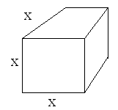
The edge of an ice cube is decreasing at 2mm/sec when x = 400mm,
find the rate the volume is changing at that instant.

Slide 69
The edge of a cube is decreasing at 2mm/sec when x = 400mm, find v’.
v = x³
v’ = 3x²

Slide 70
The edge of a cube is decreasing at 2mm/sec when x = 400mm, find v’.
v = x³
v’ = 3x² x’

Slide 71
The edge of a cube is decreasing at 2mm/sec when x =400mm, find v’.
v = x³
v’ = 3x² x’
v’ = 3(160000)(-2) =
-480000 mm³/ sec

Slide 72
Related Rates
Read the problem, drawing a picture
No non-constants on the picture
Write an equation
Differentiate implicitly
Enter non-constants and solve

Slide 73
The edge of a cube is decreasing at 2mm/sec when x = 400mm, find v’.
find the rate the volume is changing at that instant.
400 does not appear on the drawing
Set x=400 after v’ = 3x² x’

Slide 74
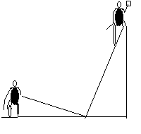
Related Rates
Suppose a painter is standing on a 13 foot ladder and Joe ties a rope to the bottom of the ladder and walks away at the rate of 2 feet per second.

Slide 75
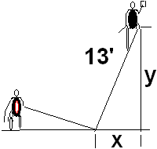
Related Rates
Suppose a painter is standing on a 13 foot ladder and Joe ties a rope to the bottom of the ladder and walks away at the rate of 2 feet per second.
How fast is the painter
falling when x = 5 feet?

Slide 76
Related Rates
13 is a constant and appears
the rate of 2 feet per second [x’ = 2]
How fast is the painter
falling when x = 5 feet?

Slide 77
Related Rates
13 is a constant and appears
the rate of 2 feet per second [x’ = 2]
How fast is the painter
falling when x = 5 feet?
NOT ON THE DRAWING

Slide 78
What does the Pythagorean Theorem say ?
x² + y² = 13
2x² + y² = 169
x² + 2y² =13
x² + y² = 169

Slide 79
What does the Pythagorean Theorem say?
x² + y² = 13
2x² + y² = 169
x² + 2y² =13
x² + y² = 169

Slide 80
Related Rates
Write an equation
Differentiate the equation
implicitly
2x x’ + 2y y’ = 0 or xx’ + yy’ = 0
If Joe pulls at 2 ft./sec., find the speed
of the painter when x = 5.

Slide 81
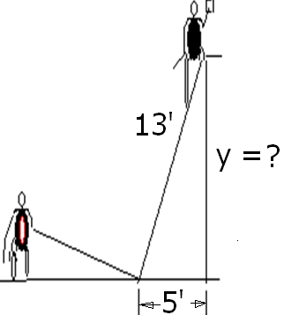
Find y when x = 5
5
8
12
13

Slide 82
Find y when x = 5
5
8
12
13

Slide 83
Related Rates
Use algebra to find y.
x² + y² = 169
5² + y² = 169
y² = 169 – 25 = 144
y = 12

Slide 84
2x x’ + 2y y’ = 0 or xx’ + yy’ = 0
Back to the calculus with y = 12,
x = 5, and x’ = 2 ft/sec
xx’ + yy’ =0
5(2) + 12(y’) = 0
y’ = -10/12 = -5/6 ft./sec.

Slide 85
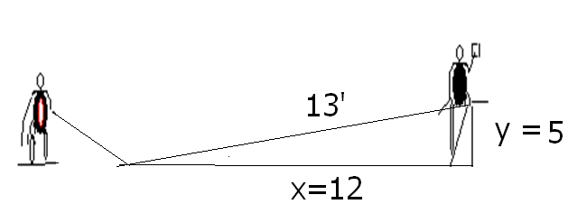
Related Rates
Summary
Even though Joe is walking 2 ft/sec,
the painter is only falling -5/6 ft/sec.
If the x and y values were reversed,

Slide 86
xx’ + yy’ =0 Find y’ if x’=2, y=5, and x = 12
-24/5
5/24
-5/24
-5

Slide 87
xx’ + yy’ =0 Find y’ if x’=2, y=5, and x = 12
-24/5
5/24
-5/24
-5

Slide 88
Related Rates
Summary

Slide 89


Related Rates
Suppose air is entering a balloon at the rate of 25 cubic feet per minute. How fast is the radius changing when r = 30 feet?

Slide 90
Related Rates
r’ = 0.00221
ft per min

Slide 91
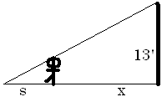
Related Rates
Suppose a 6 ft tall person walks away from a 13 ft lamp post at a speed of 5 ft per sec. How fast is the tip of his shadow moving when 12 ft from the post?

Slide 92
Related Rates
Suppose a 6 ft tall person walks away from a 13 ft lamp post at a speed of 5 ft per sec. How fast is the tip of his shadow moving when 12 ft from the post?

Slide 93
Find ?
s
x
s + x
3

Slide 94
Find ?
s
x
s + x
3

Slide 95
Related Rates
The tip of the shadow has a speed of
(s+x)’, not s’. What is s’ ?
s’ is the growth of the shadow and includes getting shorter on the right.

Slide 96
Related Rates
The tip of the shadow has a speed of
(s+x)’, not s’. What is s’ ?
s’ is the growth of the shadow and includes getting shorter on the right.
Cross multiplying

Slide 97
Cross multiplying

Slide 98
Cross multiplying
Since x’ = 5

Slide 99
Related Rates
Thus s’ is
and
Note that the tip is moving almost
twice as fast as the walker, and more than twice as fast as the shadow regardless of x.

Slide 100
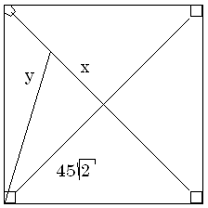

Related Rates
Suppose a radar gun on first base catches a baseball 30 feet away from the pitcher and registers 50 feet per second. How fast is the ball really traveling?

Slide 101
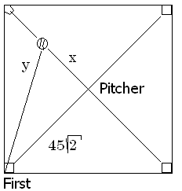
a baseball 30 feet away from the pitcher and registers 50
. feet per second.
x=30 y’=50
x=30 y =50
x’=30 y’=50
x’=30 y=50

Slide 102
Related Rates
The calculus.
x = 30 y’ = 50 y = ?
The algebra.

Slide 103
Differentiate implicitly
2x = 2y y’
2x = y y’
2x x’ = y y’
2x x’ = 2y y’

Slide 104
Differentiate implicitly
2x = 2y y’
2x = y y’
2x x’ = y y’
2x x’ = 2y y’

Slide 105
Related Rates
x = 30 y’ = 50 y = ?
Back to the calculus.

Slide 106
Related Rates
Back to the calculus.
x = 30 y’ = 50 y = ?

Slide 107
Related Rates
Back to the calculus.
x = 30 y’ = 50 y = ?

Slide 108
a baseball 30 feet away from the pitcher and registers 50
. feet per second.
x’ = 0.6 root(4950)
x’ = 50 root(4950)
x’ = 30 root(4950)
x’ = 5/3 root(4950)

Slide 109
a baseball 30 feet away from the pitcher and registers 50
. feet per second.
x’ = 0.6 root(4950)
x’ = 50 root(4950)
x’ = 30 root(4950)
x’ = 5/3 root(4950)

Slide 110

Related Rates
x’ = 117.260 feet/sec.
X = 30 y’ = 50 y = ?

Slide 111
Related Rates
Read the problem, drawing a picture
No non-constants on the picture
Write an equation
Differentiate implicitly
Enter non-constants and solve

