Slide 1
Implicit Differentiation

Slide 2
If 3x² +16x-y-17 = xy⁵ find y’ @ (1,-1)
6x +
16 -
y’ =

Slide 3
[xy⁵ ]’ =
5xy⁴
5xy⁴ y’
x5y⁴ y’+y⁵
x5y⁴ y’+y⁵ y’

Slide 4


[xy⁵ ]’ =
5xy⁴
5xy⁴ y’
x5y⁴ y’+y⁵
x5y⁴ y’+y⁵ y’

Slide 5
If 3x² +16x-y-21 = xy⁵ find y’ @ (1,-1)
6x + 16 – y’ = x5y⁴ y’+y⁵

Slide 6
6x + 16 – y’ = x5y⁴ y’+y⁵
6x + 16 - y⁵ = y’ + 5 x y⁴ y’
6x + 16 - y⁵ = - y’ - 5 x y⁴ y’
6x + 16 + y⁵ = - y’ + 5 x y⁴ y’

Slide 7
6x + 16 – y’ = x5y⁴ y’+y⁵
6x + 16 - y⁵ = y’ + 5 x y⁴ y’
6x + 16 - y⁵ = y’ - 5 x y⁴ y’
6x + 16 + y⁵ = - y’ + 5 x y⁴ y’

Slide 8
6x + 16 - y⁵ = y’ + 5 x y⁴ y’
6x + 16 - y⁵ = y’ (1 + 5 x y⁴ )
6x + 16 - y⁵ = y’ (y’ + 5 x y⁴ )
6x + 16 + y⁵ = y’ ( 5 x y⁴ )

Slide 9
6x + 16 - y⁵ = y’ + 5 x y⁴ y’
6x + 16 - y⁵ = y’ (1 + 5 x y⁴ )
6x + 16 - y⁵ = y’ (y’ + 5 x y⁴ )
6x + 16 + y⁵ = y’ ( 5 x y⁴ )

Slide 10
6x + 16 - y⁵ = y’ (1 + 5 x y⁴ ) y’ =
(6x + 16 - y⁵) / (1 + 5 x y⁴ )
6x + 16 - y⁵ = /(-1 – 5 x y⁴ )

Slide 11
6x + 16 - y⁵ = y’ (1 + 5 x y⁴ ) y’ =
(6x + 16 - y⁵) / (1 + 5 x y⁴ )
6x + 16 - y⁵ = /(-1 – 5 x y⁴ )

Slide 12
y’=(6x+16-y⁵) /(1+5xy⁴)
@ (1,-1)
-23/6
23/6
21/6
-21/6

Slide 13
y’=(6x+16-y⁵) /(1+5xy⁴)
@ (1,-1)
-23/6
23/6
21/6
-21/6

Slide 14
s = 4 π r ²
Relate ds/dt to dr/dt.

Slide 15
s = 4 π r ² ds/dt = 8 π r dr/dt
True
False

Slide 16
s = 4 π r ² ds/dt = 8 π r dr/dt
True
False

Slide 17
ds/dt = 8 π r dr/dt If r=1
& ds/dt = 8 then dr/dt = π
True
False

Slide 18
ds/dt = 8 π r dr/dt If r=1
& ds/dt = 8 then dr/dt = π
True
False

Slide 19
V = I R
R =
#5 Find dR/dt when V is increasing at 1 volt per second and I is decreasing at 1/3 amp per second, V = 12 and I = 2.
Find R when V = 12 and I = 2

Slide 20
V = I R
R = 6 ohms
#5 Find dR/dt when V is increasing at 1 volt per second and I is decreasing at 1/3 amp per second, V = 12 and I = 2.
Do the calculus, V’ =

Slide 21
V = I R
V’ = I R’ + I’ R
#5 Enter answer on next slide.
d) Find dR/dt when V is increasing at 1 volt per second and I is decreasing at 1/3 amp per second, V = 12 and I = 2.

Slide 22


V’ = I R’ + I’ R when V=1
I=-1/3, V=12, I=2 R’ = ?
1.5
1

Slide 23
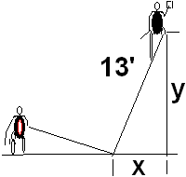
If x’=1 when x=5 find y’
-0.417
0.05

Slide 24
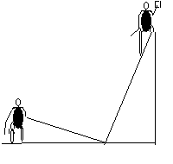
Related Rates
Back to the calculus with y = 12,
x = 5, and x’ = 1 ft/sec
xx’ + yy’ =0
5(1) + 12(y’) = 0
y’ = -5/12 ft./sec.

Slide 25
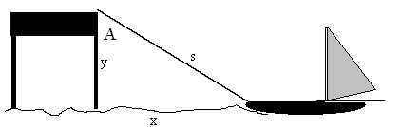
22. The rope is hauled in
At 2 feet/sec and y=6’
is constant.
How fast is the boat approaching the dock when 10’ of rope is out?

Slide 26
rope is hauled in at 2 feet/sec and y=6’ is constant.
How fast is the boat approaching the dock when 10’ of rope is out?

Slide 27
-2.5
0.05

Slide 28
How fast is the area of the triangle changing then?
s’ = -2
x’ = -2.5
A = 0.5 x 6 = 3 x

Slide 29
How fast is the area of the triangle changing then?
s’ = -2
x’ = -2.5
A = 0.5 x 6 = 3 x
A’ = 3 x’ sq. ft. / sec
A’ = -7.5 sq. ft. / sec

Slide 30

Related Rates
Suppose air is entering a balloon at the rate of 25 cubic feet per minute. How fast is the radius changing when r = 30 feet?

Slide 31
[r’ = ? When v’ = 25]
0.00221
0.0005

Slide 32

Related Rates

Slide 33
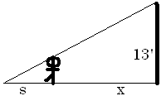
Find ?
s
x
s + x
3

Slide 34
Related Rates
The tip of the shadow has a speed of
(s+x)’, not s’. What is s’?
s’ is the growth of the shadow and includes getting shorter on the right.

Slide 35
Related Rates
Cross multiplying
Since x’ = 5

Slide 36
Related Rates
Thus s’ is
and
Note that the tip is moving almost
twice as fast as the walker, and more than twice as fast as the shadow regardless of x.

Slide 37
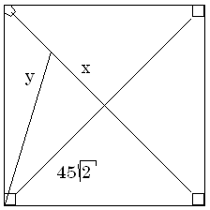

Related Rates
Suppose a radar gun on first base catches a baseball 30 feet away from the pitcher and registers 50 feet per second. How fast is the ball really traveling?

Slide 38
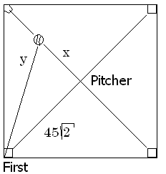
a baseball 30 feet away from the pitcher and registers 50
. feet per second.
x=30 y’=50
x=30 y =50
x’=30 y’=50
x’=30 y=50

Slide 39
a baseball 30 feet away from the pitcher and registers 50
. feet per second.
x=30 y’=50
x=30 y =50
x’=30 y’=50
x’=30 y=50

Slide 40
Related Rates
The calculus.
x = 30 y’ = 50 y = ?
The algebra.

Slide 41
Differentiate implicitly
2x = 2y y’
2x = y y’
2x x’ = y y’
2x x’ = 2y y’

Slide 42
Differentiate implicitly
2x = 2y y’
2x = y y’
2x x’ = y y’
2x x’ = 2y y’

Slide 43
Related Rates
x = 30 y’ = 50 y = ?
Back to the calculus.

Slide 44
a baseball 30 feet away from the pitcher and registers 50
. feet per second.
x’ = 0.6 root(4950)
x’ = 50 root(4950)
x’ = 30 root(4950)
x’ = 5/3 root(4950)

Slide 45
a baseball 30 feet away from the pitcher and registers 50
. feet per second.
x’ = 0.6 root(4950)
x’ = 50 root(4950)
x’ = 30 root(4950)
x’ = 5/3 root(4950)

Slide 46
Related Rates
Back to the calculus.
x = 30 y’ = 50 y = ?

Slide 47
Related Rates
Back to the calculus.
x = 30 y’ = 50 y = ?

Slide 48
Related Rates
x’ = 117.260 feet/sec.
X = 30 y’ = 50 y = ?

Slide 49
Related Rates
Read the problem, drawing a picture
No non-constants on the picture
Write an equation
Differentiate implicitly
Enter non-constants and solve

