Slide 1
Implicit Differentiation

Slide 2
Number of heart beats per minute, t seconds
after the beginning of a race is given by
What is your heart rate at the beginning of the race?

Slide 3
Number of heart beats per minute, t seconds
after the beginning of a race is given by
Find R(0).
R(0) = beats/min.

Slide 4
Number of heart beats per minute, t seconds
How fast is your heart beating after 100 seconds?
How fast is your heart rate increasing after 100 sec? [Acceleration]

Slide 5
Number of heart beats per minute, t seconds
How fast is your heart beating after 100 seconds? R(100)
How fast is your heart rate increasing after 100 sec? [Acceleration]

Slide 6
Number of heart beats per minute, t seconds
How fast is your heart beating after 100 seconds? R(100)
How fast is your heart rate increasing after 100 sec? [Acceleration] R’(100)

Slide 7
Number of heart beats per minute, t seconds
What is your heart rate at the end of the race?

Slide 8
Number of heart beats per minute, t seconds
What is your heart rate at the end of the race?

Slide 9
Number of heart beats per minute, t seconds
What is your heart rate at the end of the race?

Slide 10
If h(x) = [g(x)]^{n} then h’(x) = n [g(x)]^{n-1}g’(x)
We review the power rule.

Slide 11
If y = 4(2x + 2)⁵ then y’ =
20 (2x + 2)⁴ 2 = 40 (2x + 2)⁴
20 (2x + 2)⁵ 2 = 40 (2x + 2)⁵
20(2)⁴ = 20 (16) = 320
20 (2x + 2)⁴ = 20 (2x + 2)⁴

Slide 12


If y = 4(2x + 2)⁵ then y’ =
20 (2x + 2)⁴ 2 = 40 (2x + 2)⁴
20 (2x + 2)⁵ 2 = 40 (2x + 2)⁵
20(2)⁴ = 20 (16) = 320
20 (2x + 2)⁴ = 20 (2x + 2)⁴

Slide 13
If h(x) = [3x + 1/x]⁷
^{h’(x) =}
21 x - 7/x²
7 [3x + 1/x]⁶ [3 + 1/x²]
7 [3x + 1/x]⁶ [3 – 1/x²]
7 [3 – 1/x]⁶

Slide 14
If h(x) = [3x + 1/x]⁷
^{h’(x) =}
21 x - 7/x²
7 [3x + 1/x]⁶ [3 + 1/x²]
7 [3x + 1/x]⁶ [3 – 1/x²]
7 [3 – 1/x]⁶

Slide 15
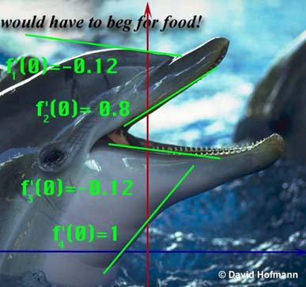
Replace g(x) with y.
Instead of ([g(x)]^{n} )’ = n [g(x)]^{n-1}g’(x)
We get (y ^{n} )’ = n [ y ]^{n-1} y’

Slide 16
Replace g(x) with y.
We get (y ^{n} )’ = n [ y ]^{n-1} y’

Slide 17
Recall [(x+1)(x²-3)]’
= (x+1)(2x)+ (x²-3)
So [(x+1)y]’ = (x+1)y’ + y
[3 y³ ]’ = 9 y² y’

Slide 18
So [(2x+1)y]’ = ?
2y’
(2x+1) y’ + 2y
(2x+1) y’ + 2y’
(2x+1) y’

Slide 19
So [(2x+1)y]’ = ?
2y’
(2x+1) y’ + 2y
(2x+1) y’ + 2y’
(2x+1) y’

Slide 20
Find [2y⁶ + 2y]’
12y⁵ y’ – 2
12y⁵ y’ + 2y’
12y⁵ y’ + 2yy’
12y⁵ + 2y’

Slide 21
Find [2y⁶ + 2y]’
12y⁵ y’ – 2
12y⁵ y’ + 2y’
12y⁵ y’ + 2yy’
12y⁵ + 2y’

Slide 22
Guidelines for Finding the Derivative Implicitly
Let y stand for one of any number of functions.
Differentiate both sides of the equation, using chain rule, power rule, product rule, quotient rule.

Slide 23
If x² + y² = 36 find y’.
What is the derivative of x² ?
2x
What is the derivative of y² ?
2yy’
What is the derivative of 36 ?

Slide 24


What is the derivative of 36?
0.0
0.1

Slide 25
Differentiate both sides x² + y² = 36
2x + 2yy’ = 0
2x + 2yy’ = 36
2x + 2y = 0

Slide 26
Differentiate both sides x² + y² = 36
2x + 2yy’ = 0
2x + 2yy’ = 36
2x + 2y = 0

Slide 27
Guidelines for Finding the Derivative Implicitly
Let Y stand for one of any number of functions.
Differentiate both sides of the equation, using chain rule, power rule, product rule, quotient rule.
Place all of the terms containing Y' on one side and the other terms on the other.

Slide 28
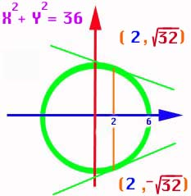
If x² + y² = 36 find y’.
2x + 2yy’ = 0
2yy’ = -2x

Slide 29
Guidelines for Finding the Derivative Implicitly
Differentiate both sides of the equation, using chain rule, power rule, product rule, quotient rule.
Place all of the terms containing y' on one side and the other terms on the other.
Factor the y' out if necessary and solve for y’.

Slide 30
If x² + y² = 36 find y’.
2yy’ = -2x
yy’ = -x
y’ =

Slide 31
Guidelines for Finding the Derivative Implicitly
Place all of the terms containing Y' on one side and the other terms on the other.
Factor the Y ' out if necessary and solve for Y '.
Replace x and y by the values given.

Slide 32
y’ = x² + y² = 36
Top point only!
Find the slope when x = 2.
When x = 2, y = or
Y =
Thus y’ =

Slide 33
y’ =
Y’ = for top point
Y’ = bottom point

Slide 34
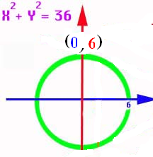
If y’ = find the slope at (-3 , 3)
1.732
0.1

Slide 35
Thus if the dolphins forehead could be approximated by a circle,
we could calculate
the slope there if
we knew the x and
y coordinates.
y’ =

Slide 36
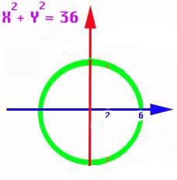
And if the dolphins throat could be approximated by a circle,
we could calculate
the slope there if
we knew the x and
y coordinates.
y’ =

Slide 37
Guidelines for Finding the Derivative Implicitly
Let Y stand for one of any number of functions.
Differentiate both sides of the equation, using
chain rule, power rule, product rule, quotient rule.
Place all of the terms containing y' on one side and the other terms on the other.
Factor the y’ out if necessary and solve for y’.
Replace x and y by the values given.

Slide 38
Let y stand for one of 5 functions.
If 3x² + xy⁵ = 16x find y’.
What is the derivative of 3x² ?
6x
What is the derivative of xy⁵ ?
x5y⁴y’+y⁵
What is the derivative of 16x ?

Slide 39
Differentiate xy⁵ using the product rule and power rule
x5y⁴y’ + y⁵

Slide 40
3x² + xy⁵ = 16x
Differentiate both sides
6x + 5y⁴ y’= 16
6x +5xy⁴ y’= 16
6x +5xy⁴ y’+y⁵ = 16
6 + 6x +5xy⁴ y’+y⁵ = 0

Slide 41
3x² + xy⁵ = 16x
Differentiate both sides
6x + 5y⁴ y’= 16
6x +5xy⁴ y’= 16
6x +5xy⁴ y’+y⁵ = 16
6 + 6x +5xy⁴ y’+y⁵ = 0

Slide 42
Guidelines for finding the derivative implicitly
Let y stand for one of 5 functions.
Differentiate both sides of the equation, using chain rule, power rule, product rule, quotient rule.

Slide 43
If 3xy + x + 5y² = 16 find y’.
3xy’ + 3y + 1 + 10yy’ = 0
Place all (y’)’s on the left and factor
3xy’ + 10yy’ = -1 - 3y
(3x+10y)y’= -1 - 3y
y’ =

Slide 44
If x² + 5y² = 6 find y’.
2x + 10yy’ = 0
y’ = -2x/10y = -x/5y

Slide 45
y’ = -x/5y
Find y’ when x = y = 1
-0.2
0.1

Slide 46
If x² + 5y² = 6 find y’’.
y’ = -x/5y
5y(-1)-(-x)5y’ 5xy’-5y
y’’ = ----------------- = -------------
25 y² 25 y²

Slide 47
Find y’’ when x = y = 1 and y’ = -0.2
-0.24
0.1

Slide 48
Find y’’ when x = y = 1 and y’ = -0.2
-0.24
0.1

Slide 49
Find dy/dx
1. x² y + y² x = 6
6. (3xy + y)³ = 6y

Slide 50
Find the equation of the tangent and the normal
29. x² + xy - y² = 1 at (2, 3)
31. x² y² = 9 at (1, 3)
35. 2xy + π x = 2 π at (1, π /2)

Slide 51
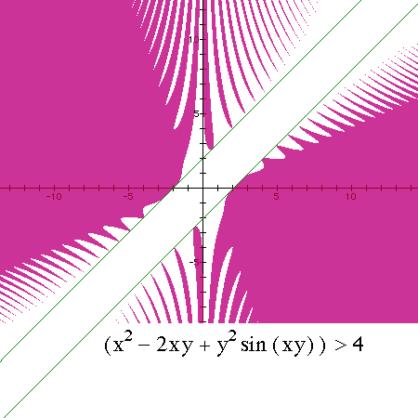
x² – 2xy + y²sin(xy) > 4
Find y’ at the point (-2, 0)
2x -2xy’-2y+y2cos(xy)[xy’+y]+2sin(xy)yy’=0
Example Only

Slide 52
Implicit Differentiation
Related Rates
x’ = dx/dx = 1
x’ = dx/dt

Slide 53
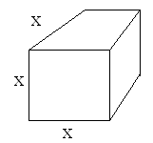
The edge of an ice cube is decreasing at 2mm/sec when x = 400mm,
find the rate the volume is changing at that instant.

Slide 54
The edge of a cube is decreasing at 2mm/sec when x = 400mm, find v’.
v = x³
v’ = 3x²

Slide 55
The edge of a cube is decreasing at 2mm/sec when x = 400mm, find v’.
v = x³
v’ = 3x² x’

Slide 56
The edge of a cube is decreasing at 2mm/sec when x =400mm, find v’.
v = x³
v’ = 3x² x’
v’ = 3(160000)(-2) =
-480000 mm³/ sec

Slide 57
Related Rates
Read the problem, drawing a picture
No non-constants on the picture
Write an equation
Differentiate implicitly
Enter non-constants and solve

Slide 58
The edge of a cube is decreasing at 2mm/sec when x = 400mm, find v’.
find the rate the volume is changing at that instant.
400 does not appear on the drawing
Set x=400 after v’ = 3x² x’

Slide 59
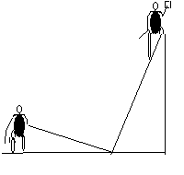
Related Rates
Suppose a painter is standing on a 13 foot ladder and Joe ties a rope to the bottom of the ladder and walks away at the rate of 2 feet per second.

Slide 60
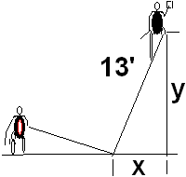
Related Rates
Suppose a painter is standing on a 13 foot ladder and Joe ties a rope to the bottom of the ladder and walks away at the rate of 2 feet per second.
How fast is the painter
falling when x = 5 feet?

Slide 61
Related Rates
13 is a constant and appears
the rate of 2 feet per second [x’ = 2]
How fast is the painter
falling when x = 5 feet?

Slide 62
Related Rates
13 is a constant and appears
the rate of 2 feet per second [x’ = 2]
How fast is the painter
falling when x = 5 feet?
NOT ON THE DRAWING

Slide 63
What does the Pythagorean Theorem say ?
x² + y² = 13
2x² + y² = 169
x² + 2y² =13
x² + y² = 169

Slide 64
What does the Pythagorean Theorem say?
x² + y² = 13
2x² + y² = 169
x² + 2y² =13
x² + y² = 169

Slide 65
Related Rates
Write an equation
Differentiate the equation
implicitly
2x x’ + 2y y’ = 0 or xx’ + yy’ = 0
If Joe pulls at 2 ft./sec., find the speed
of the painter when x = 5.

Slide 66
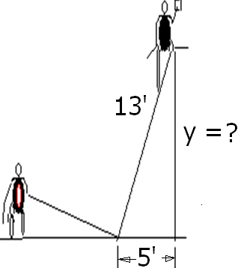
Find y when x = 5
5
8
12
13

Slide 67
Find y when x = 5
5
8
12
13

Slide 68
Related Rates
Use algebra to find y.
x² + y² = 169
5² + y² = 169
y² = 169 – 25 = 144
y = 12

Slide 69
2x x’ + 2y y’ = 0 or xx’ + yy’ = 0
Back to the calculus with y = 12,
x = 5, and x’ = 2 ft/sec
xx’ + yy’ =0
5(2) + 12(y’) = 0
y’ = -10/12 = -5/6 ft./sec.

Slide 70
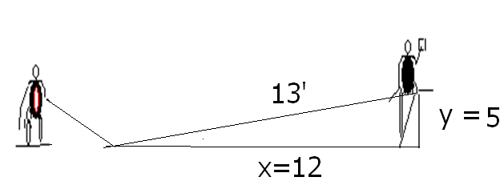
Related Rates
Summary
Even though Joe is walking 2 ft/sec,
the painter is only falling -5/6 ft/sec.
If the x and y values were reversed,

Slide 71
xx’ + yy’ =0 Find y’ if x’=2, y=5, and x = 12
-24/5
5/24
-5/24
-5

Slide 72
xx’ + yy’ =0 Find y’ if x’=2, y=5, and x = 12
-24/5
5/24
-5/24
-5

Slide 73
Related Rates
Summary

Slide 74


Related Rates
Suppose air is entering a balloon at the rate of 25 cubic feet per minute. How fast is the radius changing when r = 30 feet?

Slide 75
Related Rates
r’ = 0.00221
ft per min

Slide 76
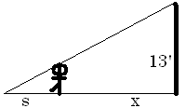
Related Rates
Suppose a 6 ft tall person walks away from a 13 ft lamp post at a speed of 5 ft per sec. How fast is the tip of his shadow moving when 12 ft from the post?

Slide 77
Related Rates
Suppose a 6 ft tall person walks away from a 13 ft lamp post at a speed of 5 ft per sec. How fast is the tip of his shadow moving when 12 ft from the post?

Slide 78
Find ?
s
x
s + x
3

Slide 79
Find ?
s
x
s + x
3

Slide 80
Related Rates
The tip of the shadow has a speed of
(s+x)’, not s’. What is s’ ?
s’ is the growth of the shadow and includes getting shorter on the right.

Slide 81
Related Rates
The tip of the shadow has a speed of
(s+x)’, not s’. What is s’ ?
s’ is the growth of the shadow and includes getting shorter on the right.
Cross multiplying

Slide 82
Cross multiplying

Slide 83
Cross multiplying
Since x’ = 5

Slide 84
Related Rates
Thus s’ is
and
Note that the tip is moving almost
twice as fast as the walker, and more than twice as fast as the shadow regardless of x.

Slide 85
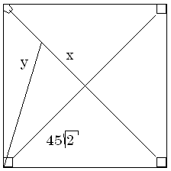

Related Rates
Suppose a radar gun on first base catches a baseball 30 feet away from the pitcher and registers 50 feet per second. How fast is the ball really traveling?

Slide 86
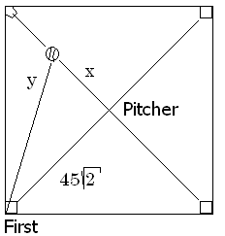
a baseball 30 feet away from the pitcher and registers 50
. feet per second.
x=30 y’=50
x=30 y =50
x’=30 y’=50
x’=30 y=50

Slide 87
Related Rates
The calculus.
x = 30 y’ = 50 y = ?
The algebra.

Slide 88
Differentiate implicitly
2x = 2y y’
2x = y y’
2x x’ = y y’
2x x’ = 2y y’

Slide 89
Differentiate implicitly
2x = 2y y’
2x = y y’
2x x’ = y y’
2x x’ = 2y y’

Slide 90
Related Rates
x = 30 y’ = 50 y = ?
Back to the calculus.

Slide 91
Related Rates
Back to the calculus.
x = 30 y’ = 50 y = ?

Slide 92
Related Rates
Back to the calculus.
x = 30 y’ = 50 y = ?

Slide 93
a baseball 30 feet away from the pitcher and registers 50
. feet per second.
x’ = 0.6 root(4950)
x’ = 50 root(4950)
x’ = 30 root(4950)
x’ = 5/3 root(4950)

Slide 94
a baseball 30 feet away from the pitcher and registers 50
. feet per second.
x’ = 0.6 root(4950)
x’ = 50 root(4950)
x’ = 30 root(4950)
x’ = 5/3 root(4950)

Slide 95

Related Rates
x’ = 117.260 feet/sec.
X = 30 y’ = 50 y = ?

Slide 96
Related Rates
Read the problem, drawing a picture
No non-constants on the picture
Write an equation
Differentiate implicitly
Enter non-constants and solve

