Slide 1
f is decreasing when f’(x)<0
f’ is decreasing when (f’)’(x) = f’’(x) < 0

Slide 2
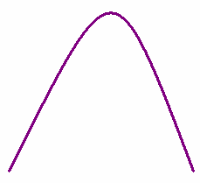

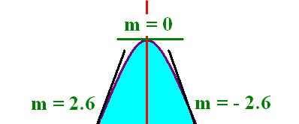
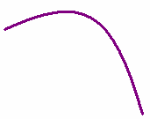
f(x) is concave down means that f ’(x) is decreasing
f’’(x) < 0
f’(-1)=2.6
f’(-½) =1.5
f’(0) = 0
f’(½) = -1.5
f’(1)=-2.6

Slide 3
f is increasing when f’(x)>0
f’ is increasing when (f’)’(x) = f’’(x) > 0

Slide 4
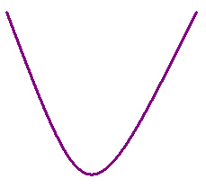

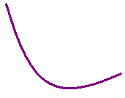
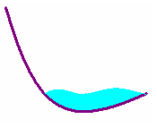

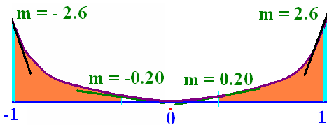
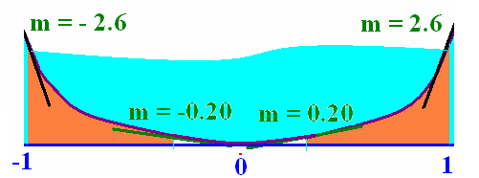
f is concave up means that f ’(x) is increasing
Holds water

Slide 5
f(x) is concave up means that f ’(x) is increasing
f(x) is concave up if f ’’(x) > 0

Slide 6
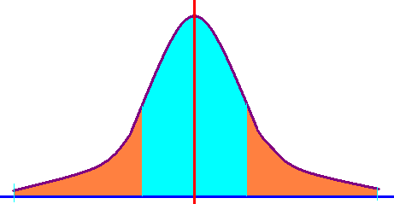
The normal curve
Concave down
Concave up

Slide 7
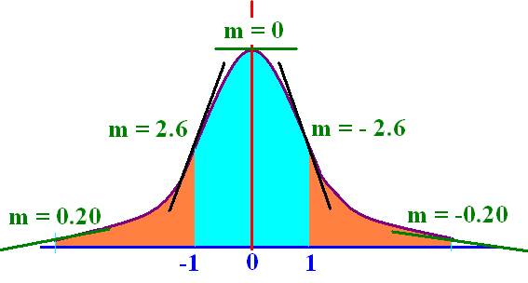
(-oo,-1) U (1,+oo) up
(-1, 1) down

Slide 8
f(x) is concave down means that f ’(x) is decreasing
f(x) is concave down if f ’’(x) <0

Slide 9
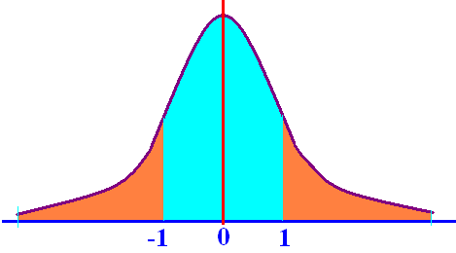
f(x) has an inflection point at x = c means that f(x) switches concavity at x=c.
The normal curve has two inflection points
x = -1 x = 1
f’’(-1) = 0
f’’(1) = 0

Slide 10


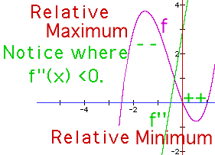
Concavity f ’’(x) = 8x + 4
f’’(x) = 8x + 4 = 0 when x= -½
f’’(-1)= -4 < 0 concave down on (-oo, -½ )
f’’(0) = 4 > 0 concave up on ( -½ , +oo)
x = -½ is an inflection point

Slide 11


h(x) = x³ - 12x + 19 h’’(x) =
3x² - 12
6x - 12
6x

Slide 12
h(x) = x³ - 12x + 19 h’’(x) = 0 when
x = 1
x = 2
x = 0

Slide 13

h’’(x) = 6x h’’(-1) = and h’’(1) =
-1 and 1
-6 and 6
zero and zero

Slide 14

h’’(-1) = -6 and h’’(1) = 6
Where is h concave up?
(0, +oo)
(-oo, 0)
Nowhere

Slide 15
Second derivative test

Slide 16



If c is a critical point of f and
f’’(c) < 0 then f has a relative max at c
f’’(c ) > 0 then f has a relative min at c
f’’(c) = 0 then the test fails
run a first derivative test

Slide 17
Second derivative test
1. Take the derivative of the function, f’(x)
2. Set f’(x) = 0 and solve for x.
Example – If f(x) = 4/3x³+2x²-3x+1
f ’(x) = 4x² + 4x – 3 = 0
(2x - 1)(2x + 3) = 0
so x = ½ or x=-1½ are the critical points

Slide 18
Second derivative test f ’(x) = 4x² + 4x – 3
3. f’’(x) = 8x + 4
4. f’’(-3/2)= -8 <0 f’’(1/2) = 8 > 0
5. max @ -3/2 min @ ½
holds water

Slide 19
Second derivative test
1. Take the derivative of the function, f’(x)
If f(x) = x/(1 + x²)
f ’(x) =
2. Solve for x
x = 1 or x = -1

Slide 20
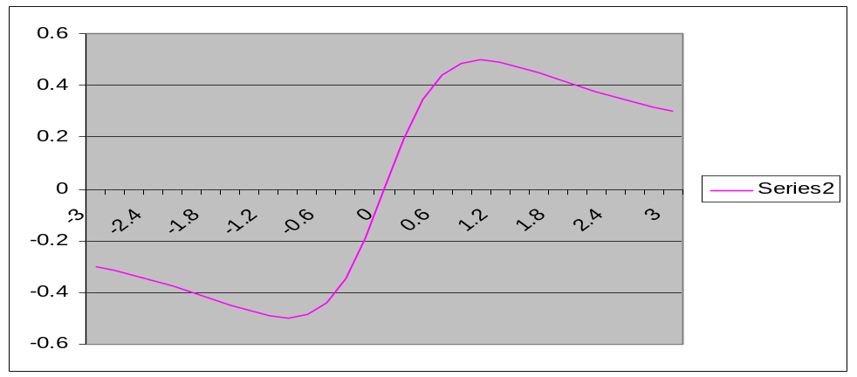
Second derivative test f ’(x) = (1-x²)/(1+x²)²
3.
4. f’’(-1)= 8/16 f’’(1) = -8/16
relative min @ -1 max @ 1
holds water

Slide 21
Second derivative test
1. Take the derivative of the function, f’(x)
2. Set f’(x) = 0
If f(x) = x + 9/x+2 = x + 9x⁻¹ + 2

Slide 22
f(x) = x + 9x⁻¹ + 2 f ’(x) =
1 + 9x⁻²
1 - 9x⁻²
1 - 9x⁻² + 2

Slide 23
f ’(x) = 1 - 9x⁻² = x²/x² – 9/x² f ’(x) = 0 when the numerator is
1 + 9x² = 0
x² – 9 = 0
1 - 9x² = 0

Slide 24
Second derivative test
1. Take the derivative of the function, f’(x)
2. Set f’(x) = 0
If f(x) = x + 9/x+2 = x + 9x⁻¹ + 2
f’(x) = 1 – 9x⁻² = 1 – 9/x²
= = 0
Numerator = 0 when

Slide 25
Numerator x² – 9 = 0 when
x = 3
x = 0
x = -3 or x = 3

Slide 26
Second derivative test
If f(x) = x + 9/x+2 = x + 9x⁻¹ + 2
f’(x) = 1 – 9x⁻² = 1 – 9/x²
= = 0
Numerator = 0 when x = 3 or x = -3

Slide 27
If f’(x) = f’’(x) =
18/x⁵
18/x⁴
18/x³

Slide 28
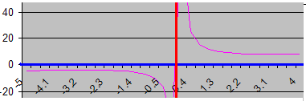
Second derivative test f ’(x) =
3.
4. f’’(-3)= -54 / 81 f’’(3) = 54 / 81
5. max @ x= -3 min @ x = 3

Slide 29
Second derivative test (I)
1. Take the derivative of the function, f’(x)
2. Set f’(x) = 0
If f(x) = (x – 2)⁴
f’(x) = 4(x – 2)³(1)
x – 2 = 0
when x = 2
The only critical pt is x = 2.

Slide 30
Second derivative test f ’(x) = 4(x – 2)³
3. f ’’(x) =12(x – 2)²
4. f’’(2)= 0
5. Test fails

Slide 31


First derivative test f ’(x) = 4(x – 2)³
f’(0) = -32 f’(3) = 4(3-2)³ > 0
decreasing | increasing
relative min @ 2

