Slide 1
g has a critical point at x=c means that c is in the domain and g’(c)=0 or d.n.e.
The critical points for g are {-1, 0, 1}
Numerator = 0
Denominator = 0

Slide 2
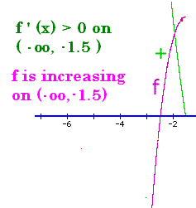
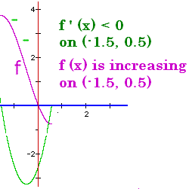
Increasing/Decreasing
If f ’ (x) > 0 on an interval, then f is increasing.
If f ’ (x) < 0 on an interval, then f is decreasing

Slide 3



Shown are f’s critical points and discontinuities. Where is f increasing?
(-oo, -2) U (2, +oo)
(-oo, -2) U (0, 2)
(-2, 0) U (0, 2)

Slide 4
Find the critical points for h(x) = x³ - 12x + 19
x = 3 or -2
x = - 2 or 2
x = 0 or -3

Slide 5
3x² – 12 = 0
3(x² – 4) = 0
(x – 2)(x + 2) = 0
X = 2 or x = -2

Slide 6




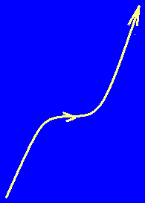
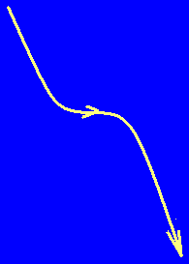
The first derivative test
If f has a critical pt. at c
and f switches from increasing to decreasing at c then f has a relative maximum at c.
and f switches from decreasing to increasing at c then f has a relative minimum at c.
and f doesn’t switch at c then it has neither a relative max nor min

Slide 7

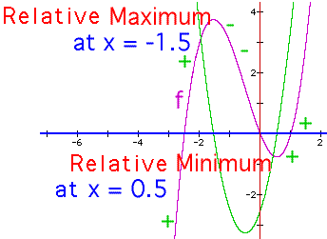
f(x) = 4/3x³+2x²-3x+1 f ’(x) = 4x² + 4x – 3
4.
5. f’(-3)= 21 | f’(0) = -3 | f’(1) = 5
6. increasing | decreasing | increasing
relative max @ -3/2 min @ 1/2

Slide 8
First derivative test
1. Take the derivative of the function, f’(x)
2. Set f’(x) = 0
3. Solve for x
If f(x) = x/(1 + x²)
f ’(x) =
When x = 1 or x = -1

Slide 9

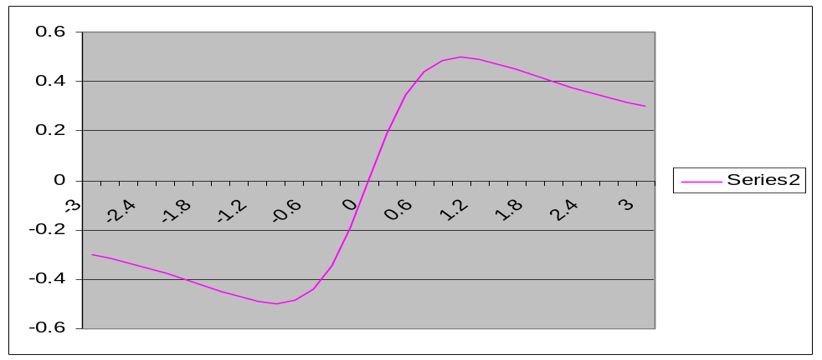
First derivative test f ’(x) = (1-x²)/positive
4.
5. f ’(-3)= -8/p | f ’(0) = 1/p | f ’(3) = -8/p
6. decreasing | increasing | decreasing
relative min @ -1 max @ 1

Slide 10
First derivative test
1. If f(x) = x + 9/x+2 = x + 9x⁻¹ + 2
2. f’(x) = 1 – 9x⁻² = 1 – 9/x²
3. = 0
Numerator = 0 when x = 3 or x = -3

Slide 11

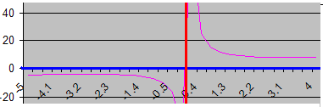
First derivative test f ’(x) =
4.
5. f’(-5)= 16/p f’(-1) = -8/p f’(1) = -8/p f’(5)=16/p
6. increasing | decreasing || decreasing | increasing
relative max @ -3 asymptote min @ 3

Slide 12

y = x³ - 12x + 19 has critical points at 2 and -2. Where is y increasing?
(-oo, -2) U (2, +oo)
(-2, 2)
R
(2, -2)

Slide 13

y = x³ - 12x + 19 Where is the relative max?
Doesn’t have one
x = -2
x = 2
x = 2 and x = -2

Slide 14


y = x³ - 12x + 19
Where is the relative min?
2.0
0.1

Slide 15
y = x³ - 12x + 19
Where is the relative min?
x = 2

Slide 16
Where is f(x) = x/(2x²+3) increasing?
f ’(x) = [(2x² + 3)-x(4x)]/(2x² + 3)²
f’(x) is zero when the numerator is.
- 2x² + 3 = 0
Denominator never zero

Slide 17
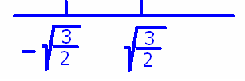
Where is f(x) = x/(2x²+3) increasing?
- 2x² + 3 = 0 makes f’(x) = 0
3 = 2x² or x = +-root(3/2)

Slide 18
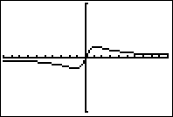
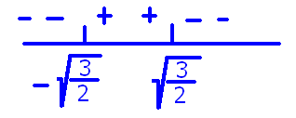
Where is f(x) = x/(2x²+3) increasing?
f ’(x) = (- 2x² + 3)/(2x² + 3)²
f ’(-10) = -197/203²<0
f ’(0)=3/9 >0
f ’(10) = -197/203²<0
Answer = ( , )

Slide 19
Where are the relative max and relative min?
Relative min at x= max at x =

Slide 20
Homework
5, 7, 9, 11, 21 note 2nd derivative is always positive, 31, 37, 45, 61, 67, 82, 83

Slide 21
f is increasing when f’(x)>0
f’ is increasing when (f’)’(x) = f’’(x) > 0
The slope of f is increasing when
f’’(x) > 0
Slopes at x = 1, 2, 3, 4, 5, 6 might be
-3 . . -2 . . -1 . . 0 . . 1 . . 2

Slide 22
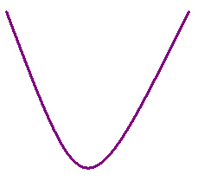
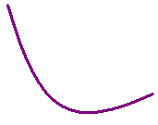

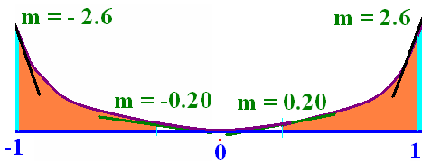
f(x) is concave up means that f ’(x) is increasing
Holds water
or
trying to hold water

Slide 23
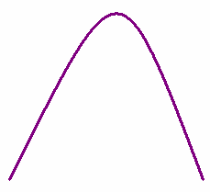
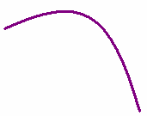

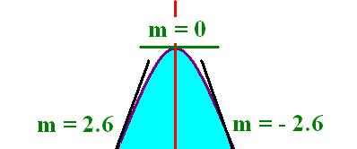
f(x) is concave down means that f ’(x) is decreasing
f’’(x) < 0

Slide 24
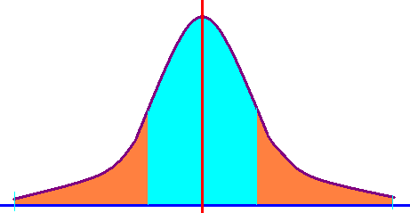
The normal curve
Concave down
Concave up

Slide 25
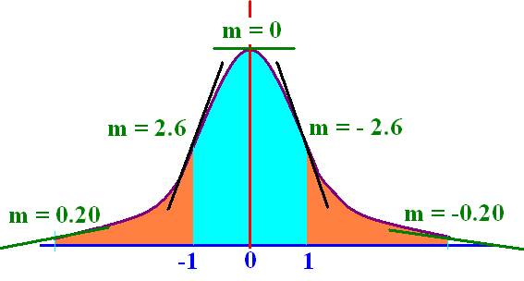
(-oo,-1) U (1,+oo) up
(-1, 1) down
Doesn’t really hold water
but it is trying to

Slide 26
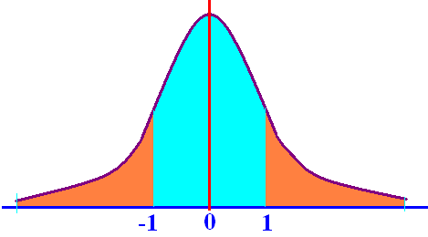
f(x) has an inflection point at x = c means that f(x) switches concavity at x=c.
The normal curve has two inflection points
x = -1 x = 1
f’’(-1) = 0
f’’(1) = 0

Slide 27
h(x) = x³ - 12x + 19 h’’(x) =
3x² - 12
6x - 12
6x

Slide 28


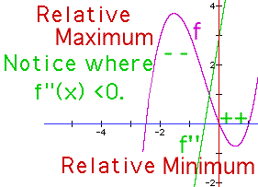
Concavity f ’’(x) = 8x + 4
f’’(x) = 8x + 4 = 0 when x= -½
f’’(-1)= -4 < 0 concave down on (-oo, -½ )
f’’(0) = 4 > 0 concave up on ( -½ , +oo)
x = -½ is an inflection point

Slide 29
h(x) = x³ - 12x + 19 h’’(x) = 6x = 0 when
x = 1
x = 2
x = 0

Slide 30

h’’(x) = 6x h’’(-1) = and h’’(1) =
-1 and 1
-6 and 6
zero and zero

Slide 31

h’’(-1) = -6 and h’’(1) = 6
Where is h concave up?
(0, +oo)
(-oo, 0)
Nowhere

Slide 32
Second derivative test
1. Take the derivative of the function, f’(x)
2. Set f’(x) = 0 and solve for x.
Example – If f(x) = 4/3x³+2x²-3x+1
f ’(x) = 4x² + 4x – 3 = 0
(2x - 1)(2x + 3) = 0
so x = ½ or x=-1½

Slide 33
Second derivative test f ’(x) = 4x² + 4x – 3
3. f’’(x) = 8x + 4
4. f’’(-3/2)= -8 <0 f’’(1/2) = 8 > 0
5. max @ -3/2 min @ ½
holds water

Slide 34
Second derivative test
1. Take the derivative of the function, f’(x)
If f(x) = x/(1 + x²)
f ’(x) =
2. Solve for x
x = 1 or x = -1

Slide 35
Second derivative test f ’(x) = (1-x²)/(1+x²)²
3.
4. f’’(-1)= 8/16 f’’(1) = -8/16
relative min @ -1 max @ 1
holds water

Slide 36
Second derivative test
1. Take the derivative of the function, f’(x)
2. Set f’(x) = 0
If f(x) = x + 9/x+2 = x + 9x⁻¹ + 2
f’(x) = 1 – 9x⁻² = 1 – 9/x²
= = 0
Numerator = 0 when x = 3 or x = -3

Slide 37
Second derivative test f ’(x) =
3.
4. f’’(-3)= -54 f’’(3) = 54
5. max @ x= -3 min @ x = 3

Slide 38
Second derivative test (I)
1. Take the derivative of the function, f’(x)
2. Set f’(x) = 0
If f(x) = (x – 2)⁴
f’(x) = 4(x – 2)³(1)
x – 2 = 0
when x = 2

Slide 39
Second derivative test f ’(x) = 4(x – 2)³
3. f ’’(x) =12(x – 2)²
4. f’’(2)= 0
5. Test fails

Slide 40


First derivative test f ’(x) = 4(x – 2)³
f’(0) = -32 f’(3) = 4(3-2)³ > 0
decreasing | increasing
relative min @ 2

Slide 41
4.2 #82
Avg. amount of C0₂ in the atmosphere is
A(t) = 0.010716 t² + 0.8212 t + 313.4
On [0, 50] where 0 = 1957.
Find the rate of change of A(t).
Find the rate of the rate of change of A(t).
A’(t) = 0.021432 t + 0.8212 positive speed
A’’(t) =0.021432 accelerator is being pushed

