Slide 1


Definitions:
If f : D -> K is a function and a is in D, then f(a) is an absolute minimum on D iff f(a) <= f(x), for every x in D.
If f : D -> K is a function and a is in D, then f(a) is a absolute maximum on D iff f(x) <= f(a), for every x in D.

Slide 2
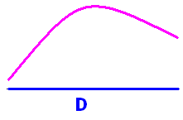
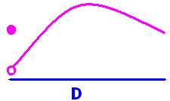
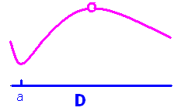
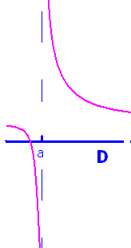
Absolute max and min
Absolute max – no min
Absolute min – no max
Neither

Slide 3
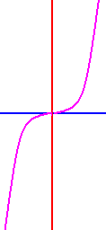
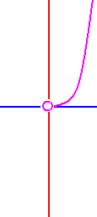
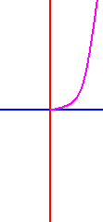
Rule y = x³
Domain Extrema
R = (-oo, +oo) None
[-2, 2] max at 2 min at -2
(0, 2] max at x = 2
[0, +oo) min at x = 0

Slide 4


Definitions:
f : D -> K has a relative extrema at x = c iff there is an open interval, I, containing c for which f(c) is an absolute maximum or an absolute minimum on I.
In the above drawing, f has four relative extrema. They are at the four blue dots.

Slide 5

Definition:
If c is in the domain of f and
f '(c) is undefined, or
f '(c) = 0,
then c is a critical value of f.
f has three critical values in the above drawing.

Slide 6
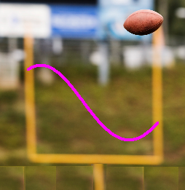
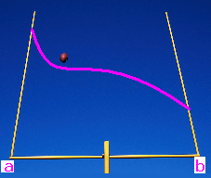
Finding extrema of continuous functions on a closed interval, [a,b]
Differentiate f
Set numerator = 0 and solve for c
Set denominator = 0 and solve if c in the domain
Evaluate f (c) for all critical points and end points

Slide 7
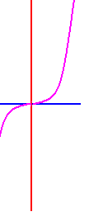
Find absolute extrema of f(x) = x³ on [-1, 2]
f ’ (x) = 3x² = 0 when x = 0
f(-1) = -1 f(0) = 0 f(2) = 8
Absolute minimum Absolute maximum

Slide 8


f(x) = x³ - 6x on [-1, 2] find f ’(x)
x³ - 6
3x² – 6x
3x² – 6
3x – 6

Slide 9
f(x) = x³ - 6x on [-1, 2].
Where is f’(x) equal to zero?
2
.
1
- ½

Slide 10
f(x) = x³ - 6x on [-1, 2].
Evaluate f(-1), f( ), f(2).
5, - 4 , - 4
- 7, - 4 , - 4
5, - 8 , - 4
- 7, - 4 , - 4

Slide 11
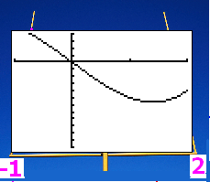
f(-1)=5 f( )=-4 f(2)=- 4 f has an absolute max when x =
-1
.
2
0

Slide 12
f(-1)=5 f( )=-4 f(2)=- 4 f has an absolute min when x =
-1
.
2
0

Slide 13
Find absolute extrema of f(x) = (x²-4x+3)³ on [-1, 2]
f ’ (x) = 3(x² -4x + 3)²(2x – 4)
=3(x-3)(x-1)2(x-2)=0 when
x - 3 = 0 or x - 1 = 0 or x – 2 = 0
x = 3 or x = 1 or x = 2
but 3 is not in the domain

Slide 14


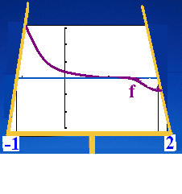
Find absolute extrema of f(x) = (x²-4x+3)³ on [-1, 2]
f(-1)=(1+4+3)³ f(1)=(1-4+3)³ f(2)= -1
8³ @ x = -1 -1 @ x = 2
Absolute maximum Absolute minimum
Nothing at critical pt.

Slide 15
f(x) = (x² - 4x + 3)³ on [-1, 4] find f ’(x)
f ’ (x) = 3(x² - 4x + 3)²(2x – 4)
f ’ (x) = 3(x² - 4x + 3)² (2x – 2)
f ’ (x) = 3(2x - 4)²

Slide 16
Find the critical points of f f ’ (x) = 3(x² -4x + 3)²(2x – 4)
x = 1, 2, 3
x = 1, 3
x = 2, 3

Slide 17
The critical points of f are x=1,2,3
Where is the abs. min on [-1,4]?
x = 1
x = 2
x = 3

Slide 18
The critical points of f are x=1,2,3
Where is the abs. max on [-1,4]?
x = 1
x = -1
x = 4

Slide 19
price p = -0.00042x + 6 [0,12000]
p is the price when x CD’s are demanded each month
Text book #46
Quantity demanded each month of Beethoven’s Moonlight Sonata related to the price/CD.

Slide 20
46. price p=-.00042x+6 [0,12000]
R(x) = p(x) x

Slide 21
46. price p=-.00042x+6 [0,12000]
R(x) = px
C(x) = 600 + 2x - 0.00002 x² [0, 20000]

Slide 22
46. price p=-.00042x+6 [0,12000]
R(x) = px [0,12000]
C(x) = 600 + 2x - 0.00002 x² [0, 20000]
P(x) = R(x) – C(x)

Slide 23
46. price p=-.00042x+6 [0,12000]
R(x) = px
C(x) = 600 + 2x - 0.00002 x² [0, 20000]
P(x) = R(x) – C(x)
= (-0.00042x+6)x – (600 + 2x - 0.00002 x² )
= -0.00040x² +(6-2)x - 600

Slide 24
46. price p=-.00042x+6 [0,12000]
P(x) = (-0.00042x+6)x – (600 + 2x - 0.00002 x² )
P(x) = -0.00040x² +(6-2)x – 600
P’(x) = -0.00080x

Slide 25
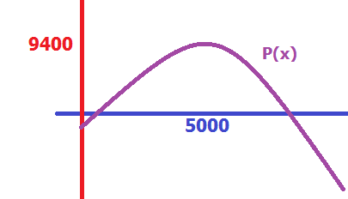
46. price p=-.00042x+6 [0,12000]
P(x) = (-0.00042x+6)x – (600 + 2x - 0.00002 x² )
P(x) = -0.00040x² +(6-2)x – 600
P’(x) = -0.00080x + 4 = 0 when
x = = 5000

Slide 26
46. price p=-.00042x+6 [0,12000]
P(x) = -0.00040x² +(6-2)x – 600
P’(x) = -0.00080x + 4 = 0 when
x = = 5000
P’’(x) = -0.00080

Slide 27
46. price p=-.00042x+6 [0,12000]
P(x) = -0.00040x² +(6-2)x – 600
P’(x) = -0.00080x + 4 = 0 when
x = = 5000
P’’(x) = -0.00080
P’’(5000) = -0.00080

Slide 28
46. price p=-.00042x+6 [0,12000]
P(x) = -0.00040x² +(6-2)x – 600
P’(x) = -0.00080x + 4 = 0 when
x = = 5000
P’’(x) = -0.00080
P’’(5000) = -0.00080
Profit has an absolute
Maximum at x = 5000

Slide 29
46. price p=-.00042x+6 [0,12000]
P(x) = -0.00040x² + 4x – 600
x = = 5000
P(0) = -600

Slide 30
46. price p=-.00042x+6 [0,12000]
P(x) = -0.00040x² + 4x – 600
x = = 5000
P(0) = -600
P(5000)= 9400

Slide 31
46. price p=-.00042x+6 [0,12000]
P(x) = -0.00040x² + 4x – 600
x = = 5000
P(0) = -600
P(5000)= 9400
P(12000) = -10200

