Slide 1
Applied max and min

Slide 2
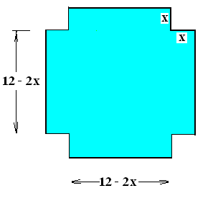
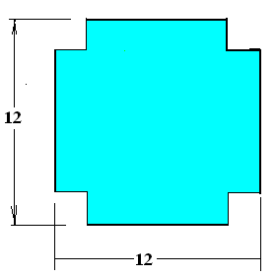
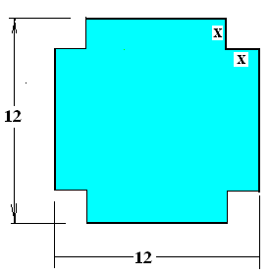
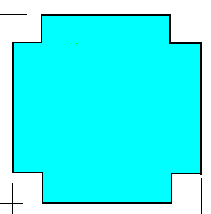
12” by 12” sheet of cardboard
Find the box with the most volume.
V =
x(12 - 2x)(12 - 2x)

Slide 3
12” by 12” sheet of cardboard
Find the box with the most volume.
V = x(12 - 2x)(12 - 2x)
V = 144x - 48x² +4x³

Slide 4


V = 144x - 48x² +4x³
V’ =
144 - 96 x + 12
122 -96 x + 12 x²
144 – 96 x + 12 x²

Slide 5
V = 144x - 48x² +4x³
Find the box with the most volume.
dV/dx =
144 – 96 x + 12 x² = 0 when
12(12 - 8x+ x²) = 0

Slide 6
0 = 144 – 96 x + 12 x²
When 12 - 8x+ x² = 0
x = 0 or x = 6
x = 2 or x = 4
x = 2 or x = 6

Slide 7
dV/dx = 144 – 96 x + 12 x²
12(6 – x)(2 – x) = 0
X = 2 or x = 6
d²V/dx² ⁼
-96 + 24 x
At x = 2 and at x = 6
negative positive

Slide 8
Steps for solving an optimization problem
Write a secondary equation and solve for y
Write the primary equation and replace y
Differentiate the primary equation
Set the derivative equal to zero
Solve for the unknown
Check the endpoints or run a first or second derivative test

Slide 9
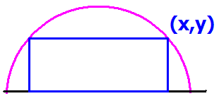
Read the problem drawing a picture as you read
Label all constants and variables as you read
R
Inside a semicircle of radius R construct a rectangle.

Slide 10

Georgia owns a piece of land along the Ogeechee River
She wants to fence in her garden using the river as one side.

Slide 11
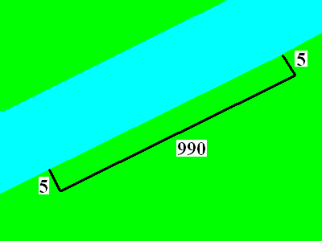
She also owns 1000 ft of fence to make the rectangular garden
She wants to fence in her garden using the river as one side.

Slide 12
What is the area of her garden?
A = L * W
A=5 * 990
A = 4950 sq. ft.

Slide 13
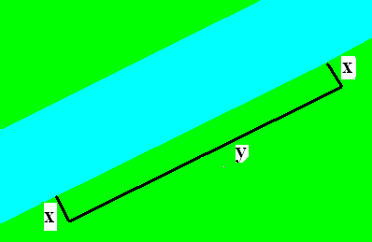
She owns 1000 ft of fence
Write a secondary equation
  Usually the first thing given
  2x + y = 1000 is the secondary
  Solve for y
  y = 1000 – 2x

Slide 14
What is the largest possible area?
Find the variable that you want to optimize and write the primary equation

Slide 15
What is the area of the largest possible garden?
A = x * y primary

Slide 16
Place y into the primary
y = 1000 – 2x (secondary)
A = x * y (primary)
A = x * (1000 – 2x)
A = 1000x – 2x²

Slide 17
A = 1000x – 2x²
x = 250 feet
x = 300 feet
x = 350 feet

Slide 18
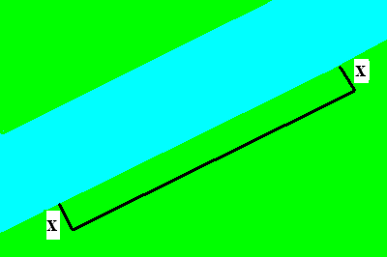
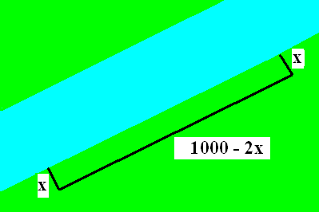
Differentiate the primary and set to zero
A = 1000x – 2x²
A’ = 1000 – 4x = 0
1000 = 4x
250 = x

Slide 19
What is the area of the largest possible garden?
A’ = 1000 – 4x = 0
A’’ = -4 concave down
A’’(250) = -4
Relative max at x = 250
A = 250 * 500 = 125,000 sq. ft.

Slide 20
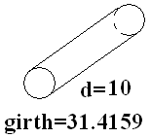
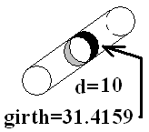


Girth is the smaller distance around the object

Slide 21

Post office says the max Length + girth is 108
108 = L + x
108 = L + 2x
108 = L + 4x

Slide 22
Find x that maximizes the volume
V = 4x + L
V = x² * L
V = 4x * L

Slide 23
V = x² * L
L = 108 – 4x
V = x² * (108 – 4x) = 108 x² - 4 x³
V’ = 216 x – 12 x² = 0
12x(18 – x) = 0
x = 18
V’’ = 216 – 24x and if x = 18, V’’ is
Negative => local max.

Slide 24
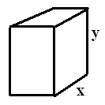
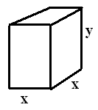
A box with a square base and no top holds 100 in³.
100 =
x²*y
Minimize the construction cost
Cost is based upon ___ areas.
A =
4xy+
x² = 4x[100/ x²] + x²

Slide 25
A = 4x[100/ x²] + x²
= 400/x + x² A’(x) =

Slide 26
A(x) = 400 x⁻¹ + x²
A’(x) =
-400 x⁰ + 2x
400 x⁻² + 2x
-400 x⁻² + 2x
-400 x⁻² - 2x

Slide 27
A’(x) = -400 x⁻² + 2x=0 when x =
x = 200
x =
x =
x =

Slide 28
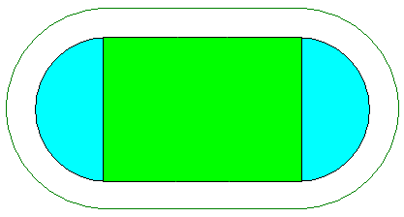
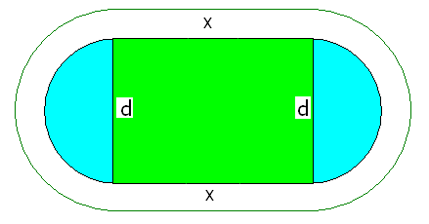
GSU builds new
400 meter track.
400 =

Slide 29
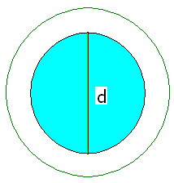
Circumference of a whole circle is πd so for a 400 meter track
400 = x * πd
400 = x + πd
400 = 2x + πd
400 = 2x + 2πd

Slide 30
Solve for d
400 = 2x + πd
d = .
d = .
d =

Slide 31
Soccer requires a maximum green area A = L * W
A = 2x * d
A = x * d
A = x + d
A = 2x + 2d

Slide 32
A = x * d but d =
A =
A =
A =

Slide 33
A = A’ =
A’ =
A’ =
A’ =

Slide 34
A’ = = 0 when
x = 100 meters
x = 200 meters
x = 400 meters

Slide 35
Soccer requires a maximum green rectangle
So A =
and A’ = when x = 100 meters
A” =

Slide 36
A’ = A’’ (100)=
A’’(100) = - 4/π
A’’(100) = 0
A’’(100) = - 400/π

Slide 37
Since A’’(100) < 0 A has a relative
minimum at x = 100 meters
maximum at x = 100 meters
Neither! The second derivative test fails at x = 100 meters

Slide 38
Soccer requires a maximum green area
A is a maximum when
400 = 2x + π d and when x = 100 meters
200 = π d or d = 200 / π

Slide 39
Semicircle of radius 6.
If you have two unknowns, write a secondary equation. Usually
the first thing given.
6

Slide 40
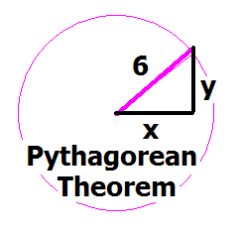
Write the equation of a circle, centered at the origin of radius 6.
x + y = 36
x² + y² = 6
x² + y² = 36
y =

Slide 41
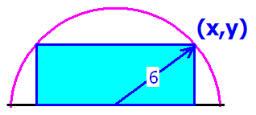
This is the secondary equation. x² + y² = 36
Solving for y² we get
y² = 36 - x²
or y =

Slide 42
We identify the primary equation by the key word maximizes or minimizes
Find the value of x that
maximizes the blue area.

Slide 43
Find the rectangle with the largest area
Find the value of x that
maximizes the blue area.

Slide 44
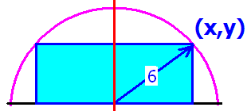
Which of the following is the primary equation?
A = x y
A = 2 x y
A = ½ x y
A = 4 x y

Slide 45
Eliminate one variable from the primary equation using the secondary equation
A(x) = 2xy = 2x(6² - x² )^{½}
A² = 4x²(36 - x²) = 144x² - 4x⁴
R

Slide 46
^{Differentiate} A² = 144x² - 4x⁴
^{implicitly.}
A’ = 288x - 16x³
2AA’ = 144x - 8x
A’ = 144x – 16x
2AA' = 288x - 16x³

Slide 47
AA' = 144x - 8x³ = 0
Solve for x
x= 0, 3 root(2), - 3 root(2)
x = 6 root(2), - 6 root(2)
x = 0, 3, -3
x = 3/root(2), - 3/root(2)

Slide 48

Run a first derivative test
AA' = 18x - x³ = x(18 – x²)
A' = 0 when x = 3 root(2) or x = 0
AA’(3)= 54 - 27 > 0
AA’(6) = 108 - 6³ < 0

Slide 49
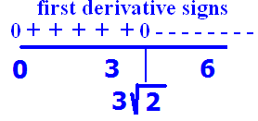
AA’(3)= 54 - 27 > 0
AA’(6) = 108 - 6³ < 0
There is a local max at x =
Neither a max nor min at x =
There is a local min at x =

Slide 50
The blue area is a max when
x =
x² + y² = 36
18 + y² = 36
y =

