Slide 1
Exponential Function
Definition
A function f : R -> (0,+oo) is an exponential function means that
1) a positive b, b 1, and
2) f(x) = b^{x}

Slide 2
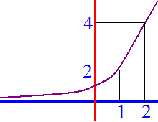
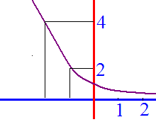
Examples
1. f(x) = 2^{x}
2. f(x) = (½)^{x} = 2^{-x}

Slide 3
Properties
Range =
Domain =
Passes through (0,1)
Increasing if b>1
Decreasing if 0<b<1
Passes through (1,b)
Continuous everywhere
Differentiable everywhere

Slide 4
Exponents
x⁰ = 1

Slide 5
Exponents
3³ = 27
3² = 9
3¹ = 3
3⁰ = 1
3⁻¹ = 1/3
3⁻² = 1/3² = 1/9
3⁻³ = 1/3³ = 1/27

Slide 6
Exponents
2⁸ = 256
2⁴ = 16
2² = 4
2¹ = 2
2^{1/2} =
2^{1/4} =

Slide 7
Exponents
2⁻⁴ = 1/16
2⁻² = 1/4
2⁻¹ = 1/2
2^{-1/2} =
2^{-1/4} =

Slide 8
Theorem on exponents
b^{x}b^{y}=b^{x+y} (ab)^{x}=a^{x}b^{x}
6³6² = (6 6 6)(6 6) (2*5)³ = (2*5)(2*5)(2*5)
(x³ – 3x² + 4 x)³ = x³(x² – 3x + 4)³
(b^{x})^{y} = b^{xy} (2³)² = (2 2 2)(2 2 2)

Slide 9


2³2⁻² =
1
2
3
4

Slide 10
=
256
¼
16
½

Slide 11
Examples

Slide 12
=
1
2
3

Slide 13
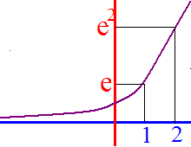
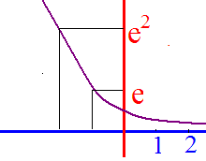
Examples
1. f(x) = e^{x}
2. f(x) = (1/e)^{x} = e^{-x}

Slide 14
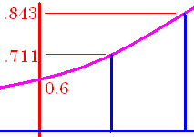

Tracking
GPS
0.6 [2nd][ln] 0.17 * 2 [)] = 0.843
#38 Estimated number of automatic vehicle trackers in US is
where t=0 corresponds to year 2000 and N(t) in millions

Slide 15
Tracking
GPS
What was the number installed in 2000?
0.6 [2nd][ln] 0.17 * 0 [)] = 0.6

Slide 16

N(t) = 0.6 e ^{0.17t} in $10⁶
How many million in 2005?
1.1
1.2
1.4

Slide 17
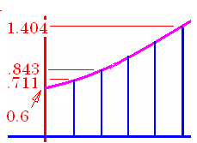
Tracking
GPS
0.6 [2nd][ln] 0.17 * 5 [)] = 1.404
How many were installed in 2005?

Slide 18
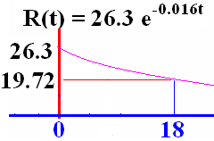
Examples
f(x) = (1/e)^{x} = e^{-x}

Slide 19
The disability rate in percent for over 65 yrs. old
t=0 is 1982
What is the disability rate in
1982?
2000? (-)
26.3 [2nd][ln] -.016*18[)]

Slide 20
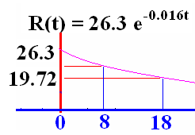


t=0 is 1982. What was the disability rate in 1990?
23.14
0.1

