Slide 1
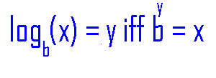
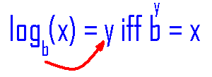
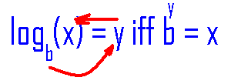
Logarithmic Function
Definition
A function f : (0,+oo) -> R is a logarithmic function means that
1) a positive b, b 1, and
2) f(x) =

Slide 2
Examples
log₂16 = 4 because 2⁴ = 16
log₃81 = 4 because 3⁴ = 81
log₁₀10000 = 4 because 10⁴ = 10000
Log₂(1/16) = -4 because 2⁻⁴ = 1/16
log_{e}e³ = 3 because e³ = e³

Slide 3
log₄16 =
1
2
3
4

Slide 4


log₄16 =
1
2
3
4

Slide 5
log₅5 =
1
2
3
4

Slide 6
log₅5 =
1
2
3
4

Slide 7
Log₂[ ¼ ] =
-1
-2
-3
-

Slide 8
Log₂[ ¼ ] =
-1
-2
-3
-

Slide 9
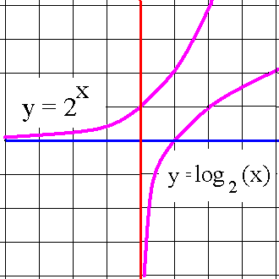
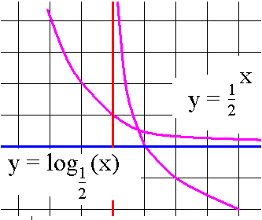
Examples
1. f(x) = log₂(x)
2. f(x) = log_{½}(x)

Slide 10
Examples
1. f(x) = log₂(2^{x}) = x
2. f(x) =

Slide 11
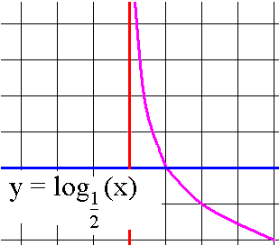
Examples
Domain =
Range =
Passes through (1,0)
Increasing if b>1
Decreasing if 0<b<1
Passes through (b,1)
Continuous everywhere
Differentiable everywhere

Slide 12
Theorem on logarithms
log(xy) = log(x) + log(y)
log(x/y) = log(x) – log(y)
log(x^{p}) = p log(x)
log_{b}(b^{x}) = x because log and exponent kill
b^{logb(x)} = x because exponent and log kill

Slide 13
Theorem on logarithms
log(xy) = log(x) + log(y)
log(x^{p}) = p log(x)
log x(x+1)⁴ = log(x) + log(x+1)⁴.
= log(x) + 4log(x+1)

Slide 14
log
log₄(x²+1)+log₄x⁵
log₄(x²)+log₄(1)+log₄x⁵
[log₄(x²)+log₄(1)]log₄x⁵

Slide 15
log
log₄(x²+1)+log₄x⁵
log₄(x²)+log₄(1)+log₄x⁵
[log₄(x²)+log₄(1)]log₄x⁵

Slide 16
Theorem on logarithms
log(xy) = log(x) + log(y)
log(x^{p}) = p log(x)
log x(x+1)⁴ = log(x) + log(x+1)⁴.
= log(x) + 4log(x+1)

Slide 17
log₄(x²+1)+log₄x⁵ =
5log₄(x²+1)+log₄x⁵
log₄(x²+1)+log₄5x⁴
log₄(x²+1)+5log₄x

Slide 18
log₄(x²+1)+log₄x⁵ =
5log₄(x²+1)+log₄x⁵
log₄(x²+1)+log₄5x⁴
log₄(x²+1)+5log₄x

Slide 19
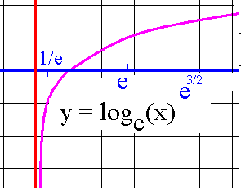
Natural logarithmic fn
f(x) = ln(x)

Slide 20
#41 Solve for t.
50/(1+4e^{0.2t}) = 20
cross multiply
20(1+4e^{0.2t}) = 50

Slide 21
#41 Solve for t.
20(1+4e^{0.2t}) = 50
(1+4e^{0.2t}) = 50 / 20 = 2.5
4e^{0.2t} = 1.5 divide both sides by 4
e^{0.2t} = 0.375

Slide 22
#41 Solve for t.
e^{0.2t} = 0.375 isolate e and take ln of both sides
ln(e^{0.2t}) = ln(0.375) ln kills e
0.2t = ln(0.375) divide both sides by 0.2
t = ln(0.375) / 0.2 = -0.9808/0.2
= -4.904

