Slide 1


2³2⁻² =
1
2
3
4

Slide 2
=
256
¼
16
½

Slide 3
Examples

Slide 4
=
1
2
3

Slide 5
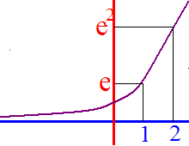
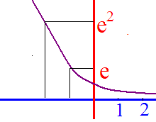
Examples
1. f(x) = e^{x}
2. f(x) = (1/e)^{x} = e^{-x}

Slide 6
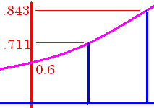

Tracking
GPS
0.6 [2nd][ln] 0.17 * 2 [)] = 0.843
#38 Estimated number of automatic vehicle trackers in US is
where t=0 corresponds to year 2000 and N(t) in millions

Slide 7
Tracking
GPS
What was the number installed in 2000?
0.6 [2nd][ln] 0.17 * 0 [)] = 0.6

Slide 8

N(t) = 0.6 e ^{0.17t} in $10⁶
How many million in 2005?
1.1
1.2
1.4

Slide 9
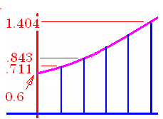
Tracking
GPS
0.6 [2nd][ln] 0.17 * 5 [)] = 1.404
How many were installed in 2005?

Slide 10
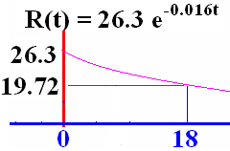
Examples
f(x) = (1/e)^{x} = e^{-x}

Slide 11
The disability rate in percent for over 65 yrs. old
t=0 is 1982
What is the disability rate in
1982?
2000? (-)
26.3 [2nd][ln] -.016*18[)]

Slide 12
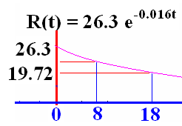


t=0 is 1982. What was the disability rate in 1990?
23.14
0.1

Slide 13
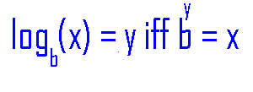
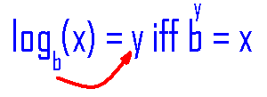
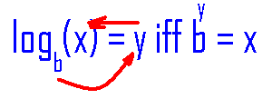
Logarithmic Function
Definition
A function f : (0,+oo) -> R is a logarithmic function means that
1) a positive b, b 1, and
2) f(x) =

Slide 14
Examples
log₂16 = 4 because 2⁴ = 16
log₃81 = 4 because 3⁴ = 81
log₁₀10000 = 4 because 10⁴ = 10000
Log₂(1/16) = -4 because 2⁻⁴ = 1/16
log_{e}e³ = 3 because e³ = e³

Slide 15
log₄16 =
1
2
3
4

Slide 16
log₅5 =
1
2
3
4

Slide 17
Log₂[ ¼ ] =
-1
-2
-3
-

Slide 18
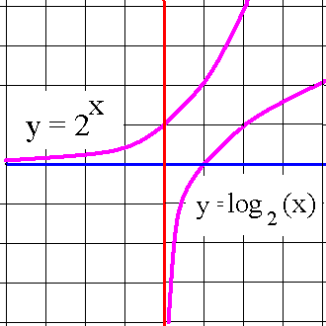
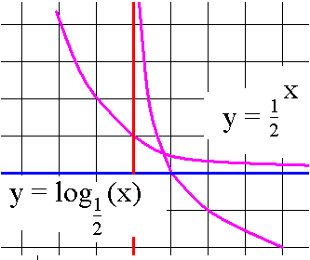
Examples
1. f(x) = log₂(x)
2. f(x) = log_{½}(x)

Slide 19
Examples
1. f(x) = log₂(2^{x}) = x
2. f(x) =

Slide 20
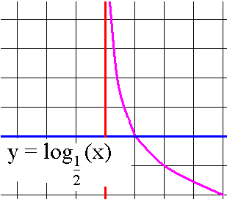
Examples
Domain =
Range =
Passes through (1,0)
Increasing if b>1
Decreasing if 0<b<1
Passes through (b,1)
Continuous everywhere
Differentiable everywhere

Slide 21
Theorem on logarithms
log(xy) = log(x) + log(y)
log(x/y) = log(x) – log(y)
log(x^{p}) = p log(x)
log_{b}(b^{x}) = x because log and exponent kill
b^{logb(x)} = x because exponent and log kill

Slide 22
Theorem on logarithms
log(xy) = log(x) + log(y)
log(x^{p}) = p log(x)
log x(x+1)⁴ = log(x) + log(x+1)⁴.
= log(x) + 4log(x+1)

Slide 23
log
log₄(x²+1)+log₄x⁵
log₄(x²)+log₄(1)+log₄x⁵
[log₄(x²)+log₄(1)]log₄x⁵

Slide 24
Theorem on logarithms
log(xy) = log(x) + log(y)
log(x^{p}) = p log(x)
log x(x+1)⁴ = log(x) + log(x+1)⁴.
= log(x) + 4log(x+1)

Slide 25
log₄(x²+1)+log₄x⁵ =
5log₄(x²+1)+log₄x⁵
log₄(x²+1)+log₄5x⁴
log₄(x²+1)+5log₄x

Slide 26
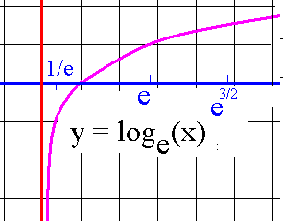
Natural logarithmic fn
f(x) = ln(x)

Slide 27
#41 Solve for t.
50/(1+4e^{0.2t}) = 20
cross multiply
20(1+4e^{0.2t}) = 50

Slide 28
#41 Solve for t.
20(1+4e^{0.2t}) = 50
(1+4e^{0.2t}) = 50 / 20 = 2.5
4e^{0.2t} = 1.5 divide both sides by 4
e^{0.2t} = 0.375

Slide 29
#41 Solve for t.
e^{0.2t} = 0.375 isolate e and take ln of both sides
ln(e^{0.2t}) = ln(0.375) ln kills e
0.2t = ln(0.375) divide both sides by 0.2
t = ln(0.375) / 0.2 = -0.98/0.2
= - 4.90

