Slide 1
5.3
3, 11, 19, 27, 35, 43, 45

Slide 2
I = P r t
$ Interest = $ Principal * rate * time
Rate must be represented as a decimal
If the rate is 8% then r = 0.08

Slide 3


I = P r t
How much simple interest will you earn if you invest $25,000 at 4% for three years?
I = 25000*0.04*3
I = 1000 * 3
I = 3000
$3000 simple interest will be earned.

Slide 4
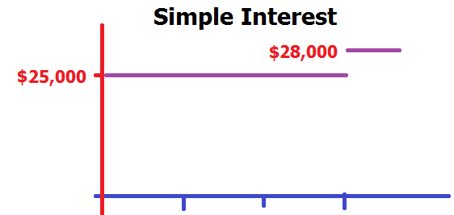
I = P r t
How much simple interest will you earn if you invest $25,000 at 4% for three years?
I = 25000*0.04*3
I = 1000 * 3
I = 3000
$3000 simple interest will be earned.

Slide 5
I = P r t : Invest $100,000 at 3% for three years? I =

Slide 6


I = P r t : Invest $100,000 at 3% for three years? I =
9000.0
0.1

Slide 7
A = P + I I = P r t
Accumulated amount
is the principal plus the interest
A = P + P r t = P(1+r t)
28000 = 25000 + 3000 = 25000(1+0.04*3)

Slide 8
A = P + I : I = $9,000 P=$100,000 A = ?

Slide 9
A = P + I : I = $9,000 P=$100,000 A = ?
109000.0
10.0

Slide 10
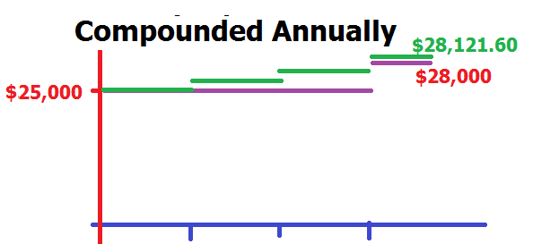
A = P ( 1 + r t)
How much will you accumulate if you invest $25,000 at 4% compounded annually for three years?
At the end of the first year you will have
A₁ = 25000 ( 1 + 0.04) = 26000
A₂ = 26000 ( 1 + 0.04) = 27040
A₃ = 27040 ( 1 + 0.04) = 28121.60 is accumulated
$3121.60 interest will be earned.

Slide 11
A = P ( 1 + r t)
How much will you accumulate if you invest $P at 100r% compounded annually for three years?
At the end of the first year you will have
A₁ = P (1 + r)
A₂ = P(1 + r) (1 + r) = P (1 + r)²
A₃ = P (1 + r)² (1 + r) = P (1 + r)³

Slide 12
A_{n} = P (1 + r)^{n}
Amount after n years compounded annually
$25,000 at 4% compounded annually for three years?
A₃ = 25000(1+0.04)³ = 28121.60

Slide 13
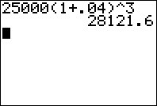
A₃ = 25000(1+0.04)³ = 28121.60
25000 ( 1.04 ) ^ 3 [enter]
25000*1.04^3 [enter]
Excel = 25000*1.04^3 [enter]

Slide 14
A_{n} = P (1 + r)^{n} : 100000 at 4% compounded annually for 5 years. A₅ = ?

Slide 15
A_{n} = P (1 + r)^{n} : 100000 at 4% compounded annually for 5 years. A₅ = ?
121665.29
1.0

Slide 16
A = P ( 1 + r/n)^{nt}
Compound n times per year for t years
The rate is divided by n
But you receive it n times each year
A₁ = P (1 + r/2)
A₂ = P(1 + r/2) (1 + r/2) = P (1 + r/2)² end of one year
A₃ = P (1 + r/2)² (1 + r/2) = P (1 + r/2)³
A₄ = P (1 + r/2)³ (1 + r/2) = P (1 + r/2)⁴ end of second year
A₅ = P (1 + r/2)⁴ (1 + r/2) = P (1 + r/2)⁵
A₆ = P (1 + r/2)⁵ (1 + r/2) = P (1 + r/2)⁶ end of third year

Slide 17
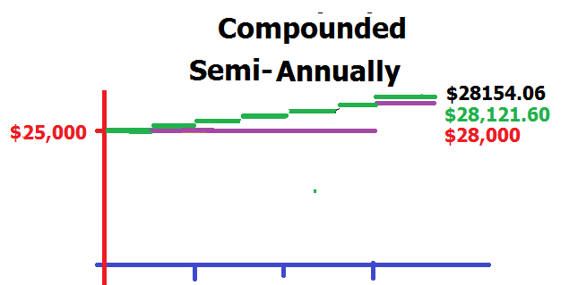
A = P ( 1 + r/n)^{nt}
How much will you accumulate if you invest $25,000 at 4% compounded semi-annually for three years?
The rate is divided by n=2
But you receive it twice each year for t=3 years
A = P (1 + r/2)^{nt}
A = 25000(1 + 0.04/2)^{2*3} =25000(1.02)⁶
A = $28154.06
Graph has more discontinuities, but getting closer
to continuous

Slide 18
A = P ( 1 + r/n)^{nt}
How much will you accumulate if you invest $25,000 at 4% compounded n times a year for t = three years?
n A
1 28121.60 = 25000 (1.04)³ annually
2 28154.06 = 25000 (1.02)⁶ semi-annually
4 28170.63 = 25000(1.01)¹² quarterly
12 28181.80 = 25000(1+.04/12)³⁶ monthly
365 28187.24 = 25000(1+.04/365)¹⁰⁹⁵ daily
+oo 28187.42 = 25000e^{0.12} continuously

Slide 19

$100000 at 6% compounded monthly for 6 years grows to

Slide 20
$100000 at 6% compounded monthly for 6 years grows to
143204.43
1.1

Slide 21
A = P (1 + r_{eff}) A = P ( 1 + r/n)^{n}
Suppose P(1 + r_{eff})= P( 1 + r/n)^{n}
1 + r_{eff} = ( 1 + r/n)^{n}
r_{eff} = ( 1 + r/n)^{n} – 1
Compounding n times per year of rate r
Simple interest of rate r_{eff}

Slide 22
r_{eff} = ( 1 + r/n)^{n} – 1
A bank pays 4% compounded monthly
Find the bank’s effective rate
r_{eff} = ( 1 + r/n)^{n} – 1
r_{eff} = ( 1 + .04/12)¹² – 1
r_{eff} = (1.00333333…)¹² – 1= .0407415

Slide 23
r_{eff} = ( 1 + r/n)^{n} – 1 : What is the effective rate if a bank pays 4% compounded quarterly?
0.04074
0.001

Slide 24
A = P(1+r/n)^{nt}
Example 3 - How much money should be deposited in a bank that pays 6% compounded monthly so that the investor can take out $20000 in 3 years?
20000 = P(1+ .06/12)^{12*3}=P(1.005)³⁶
20000/1.005^(12*3) enter = 16712.90

Slide 25
A = P(1+r/n)^{nt}
Example 4 –Find the present value of $49158.60 due in 5 years at an interest rate of 10% compounded quarterly.
49158.60 = P(1+ .10/4)^{5*4}=P(1.025)²⁰
49158.60/1.025^20 enter = 38402.62

Slide 26
Find the present value of $50000 due in 5 years at an interest rate of 3% compounded daily
43035.66
1.1

Slide 27
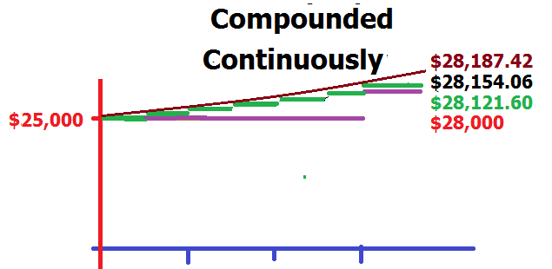
Compounded continuously
A = Pe^{r t}
A = 25000e^{0.04*3}
A = 25000e^{0.12}
A = 28187.42

Slide 28
Compounded continuously A = Pe^{r t}
Invest $1 at 5% compounded continuously for 20 years to end up with $e.
e = 1 e^{0.05*20}

Slide 29
Compounded continuously A = Pe^{r t}
Find how much you need to invest at 5% compounded continuously for 10 years to end up with $100000.
100000 = P e^{0.05*10}
100000/e^{0.5} = P
P = 60653.07

Slide 30
How long will it take for 10000 to grow to 15000 if it is invested at 12% compounded quarterly? A = P (1 + r/n)^{nt}
15000 = 10000(1 + )
1.5 = (1.03)^{4t}
ln(1.5) = ln (1.03)^{4t} = 4t ln(1.03)

Slide 31
How long will it take for 10000 to grow to 15000 if it is invested at 12% compounded quarterly? A = P (1 + r/n)^{nt}
ln(1.5) = 4t ln(1.03)
ln(1.5)/ln(1.03) = 4t
13.71723742 = 4t
3.43 = t in years

Slide 32
A = Pe^{r t} Invest 1000 at 5% for 20 years compounded continuously
2718.28
0.1

Slide 33
log
log₄(x²+1)+log₄x⁵
log₄(x²)+log₄(1)+log₄x⁵
[log₄(x²)+log₄(1)]log₄x⁵

Slide 34


log
log₄(x²+1)+log₄x⁵
log₄(x²)+log₄(1)+log₄x⁵
[log₄(x²)+log₄(1)]log₄x⁵

Slide 35
log₄(x²+1)+log₄x⁵ =
5log₄(x²+1)+log₄x⁵
log₄(x²+1)+log₄5x⁴
log₄(x²+1)+5log₄x

Slide 36
log₄(x²+1)+log₄x⁵ =
5log₄(x²+1)+log₄x⁵
log₄(x²+1)+log₄5x⁴
log₄(x²+1)+5log₄x

Slide 37
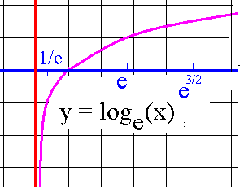
Natural logarithmic fn
f(x) = ln(x)

Slide 38
#41 Solve for t.
50/(1+4e^{0.2t}) = 20
cross multiply
20(1+4e^{0.2t}) = 50

Slide 39
#41 Solve for t.
20(1+4e^{0.2t}) = 50
(1+4e^{0.2t}) = 50 / 20 = 2.5
4e^{0.2t} = 1.5 subtract 1
e^{0.2t} = 0.375 divide both sides by 4

Slide 40
#41 Solve for t.
e^{0.2t} = 0.375 isolate e and take ln of both sides
ln(e^{0.2t}) = ln(0.375) ln kills e
0.2t = ln(0.375) divide both sides by 0.2
t = ln(0.375) / 0.2 = -0.98/0.2
= - 4.90

