Slide 1
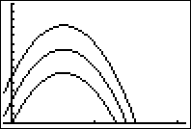

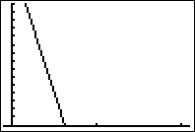

Suppose s’(t) = -32t + 20
Find all s(t)’s or
-16 t² + 20 t + C
-32 t² + 20 t + C
-32

Slide 2
s(t) = -16 t² + 20 t + C
Find C so that s(1) = 10
2
6
0
s

Slide 3
Suppose s’(t) = -32t + 20
Find s(t) so that s(1) = 10
s(t) = -16 t² + 20 t + C
s(t) = -16 t² + 20 t + 6
s(t) = -32

Slide 4
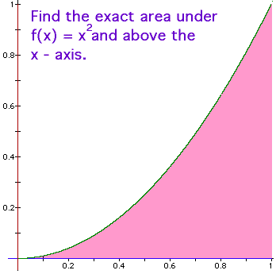
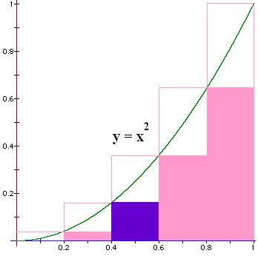
Blue area?
A = H * W
How do we find
the height?
Plug the left end point into the function
f(x) = x².

Slide 5
Blue area?
A = H * W
W = 0.6 – 0.4 = 0.2
H = 0.4² = 0.16
Blue Area = 0.032

Slide 6

Find all 5 bottom areas
LSum = 0 * 0.2 +
0.04 * 0.2 +
0.16 * 0.2 +
0.36 * 0.2 +
0.64 * 0.2 = .2 * 1.2 = 0.24 < A
This is a lower sum.

Slide 7
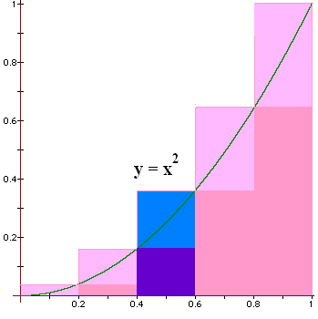
Next we find an upper sum
Plug in the
right pt to
calculate
the height

Slide 8


What is the blue area?
0.072
0.01

Slide 9
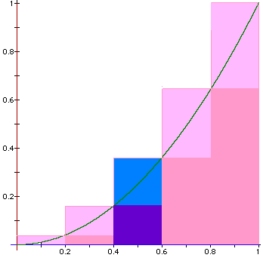
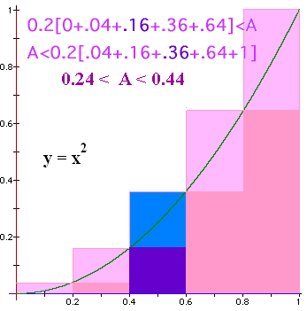
Find all 5 upper areas
USum = 0.04 * 0.2 +
0.16 * 0.2 +
0.36 * 0.2 +
0.64 * 0.2 +
1.00 * 0.2 = 0.2 * 2.2 = 0.44 > A
This is an upper sum.

Slide 10
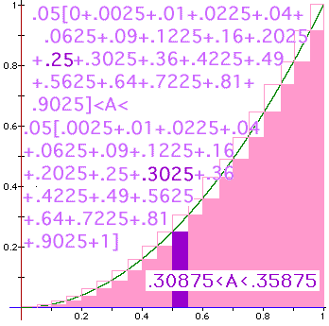
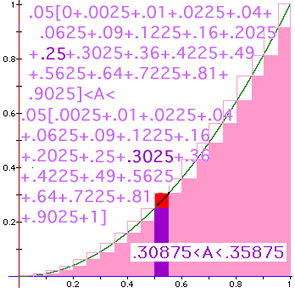

Slide 11

Definite
Integral
We will define
to be the limit as n
approaches oo of
where Δx_{i} = (b-a)/n
and is any point in the ith interval.

Slide 12
where Δx_{i} = (b-a)/n
and is any point in the i^{th} interval, [x_{i-1},x_{i}].

Slide 13
> 0 when f(x) > 0, but it is negative when f(x)<0.
We will define
to be the limit as n
approaches oo of
and is any point in the i^{th} interval, [x_{i-1},x_{i}].

Slide 14
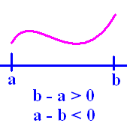
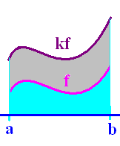
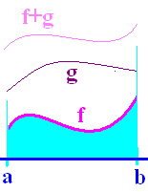
Definition
Theorems
1.
2.
3.
4.

Slide 15
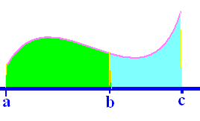
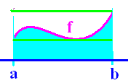
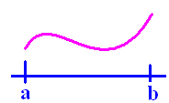
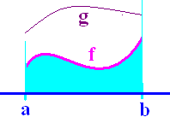
Definition
Theorems
5.
6.
7.
8.

Slide 17
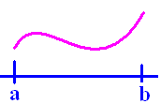
If f(x) >= 0 on [a,b]
then is the area under f(x) and
over the x-axis between a and b.

Slide 18
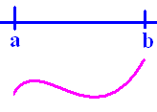
If f(x) <= 0 on [a,b]
then is the negative of the area
over f(x) and under the x-axis between
a and b.

Slide 19
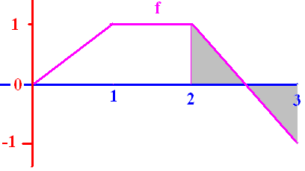

Slide 20
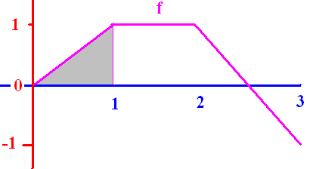
[
0.50
0.1

Slide 21
[
2.0
0.1

Slide 22
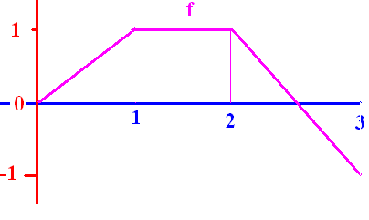
]
0.0
0.1

Slide 23
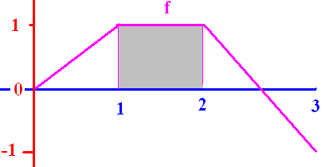
[
1.0
0.1

Slide 24
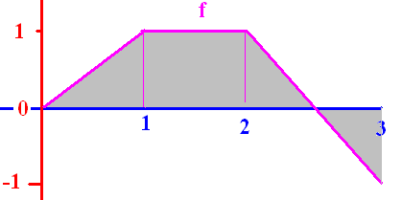
[
1.5
0.1

Slide 25
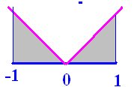
]
1.0
0.1

Slide 26
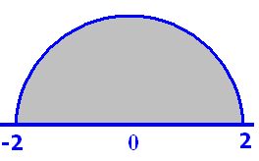
Pi = 3.14
6.28
0.1

Slide 27
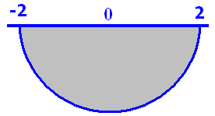
Pi = 3.14
-6.28
0.1

Slide 28
where Δx_{i} = (b-a)/n
and is any point in the i^{th} interval, [x_{i-1},x_{i}].
If the interval is [-4, 4] evaluate
8π

Slide 29
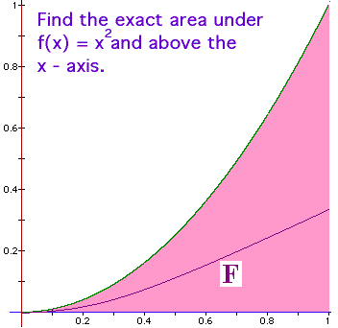
Fundamental Theorem of Calculus
f(x) = x² is continuous on [0, 1] and
An antiderivative of f(x) is
F(x) = x³/3

Slide 30
Traditional Notation

Slide 31
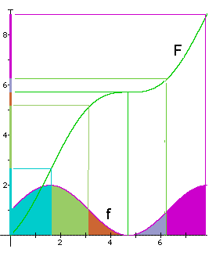
Example
Let f be continuous on
[0,8] and let F be any
antiderivative of f.

Slide 32
What is the total area?
By the F.T.C.,
sq. in.
0 8

Slide 33
What is the green area?
By the F.T.C.,
sq. in.
1.6 3.1

Slide 34
Fundamental Theorem of Calculus
If f is continuous on [a, b] and F is any antiderivative of f, then

Slide 35
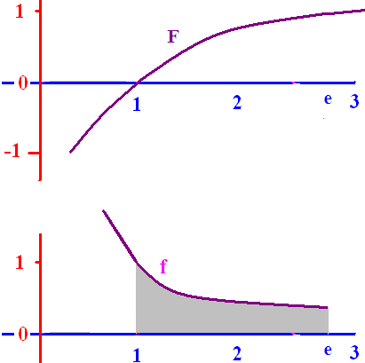
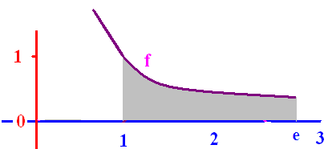
Fundamental
Theorem of Calculus
f(x) = 1/x is continuous
on [1, e] and
F(x) = ln(x) is an
antiderivative of f(x), so

Slide 36
f(x) = 1/x is continuous
on [1, e] and
F(x) = ln(x) is an
antiderivative of f(x), so

Slide 37

Find the area under y=-x(x-3) on [0, 3]
= [-54 + 81]/6 = 27/6
= 9/2 = 4.5 sq. in.

Slide 38
Evaluate
1.5
0.1

Slide 40
Evaluate
4.5
0.1

Slide 42
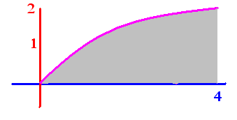
Evaluate
5.33
0.1

Slide 43
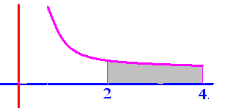
Evaluate
.25
0.1

Slide 44
Get from
Rewriting 1 over x squared as x to the negative two we get

Slide 45
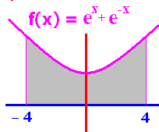
To evaluate we need an antiderivate of e^{x}+e^{-x}
F(X) = e^{x}-e^{-x}
F(X) = e^{x}+e^{-x}
F(x) = 2e^{x}
F(x) = 2e^{-x}

Slide 46
F(x) = e^{x} - e^{-x} is an antiderivative of e^{x} + e^{-x}
F(-4) + F(4)
F(-4) - F(4)
F(4) + F(-4)
F(4) - F(-4)

Slide 47
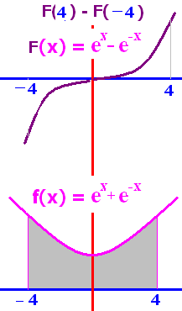
F(x) = e^{x} - e^{-x}
F(4) - F(-4) =
0
1
2e⁴ + 2e⁻⁴
2e⁴ – 2e⁻⁴

Slide 48
F(x) = e^{x} - e^{-x}
F(4) - F(-4)
= [e⁴ - e⁻⁴ ]-[e-⁴ - e⁴ ]
= 2 [e⁴ - e⁻⁴ ]

Slide 49

Evaluate
2.0
0.1

Slide 50
.

Slide 51

Evaluate
2.0
0.1

Slide 52
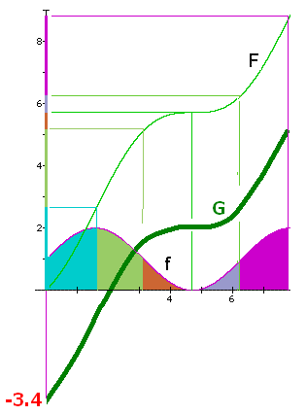
Draw a different
antiderivative G
Evaluate
5.2 – 0 = 5.2
1.8 – (-3.4) = 5.2 square inches

Slide 53
Evaluate
F(6.28) – F(3.14) =
6.3 - 5.2 = 1.1
The orange and grey
area is 1.1 square
inches.

