Slide 1
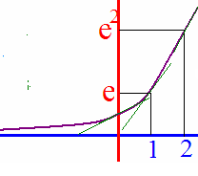
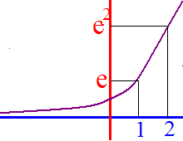
If y = e^{x} then y’ = e^{x}
If x = 0, y’ = 1
If x = 1, y’ = e
If x = 2, then y’ = e²

Slide 2
f ’(x)=
If f(x) = e^{x}, f’(x) =

Slide 3
If y = e^{x} then y’ = e^{x}
If x = 0 y = 1, y’ = 1
If x = 1 y = e, y’ = e
If x = 2 y = e² y’ = e²

Slide 4
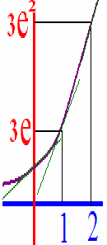
If y = ke^{x} then y’ = ke^{x}
y = 3e^{x}
y’ = 3[e^{x}]’
y’ = 3e^{x}

Slide 5


y =1.2 e^{x} y’ =
y’ = 1.2 e^{x}
y’ = 1.2 + e^{x}
y’ = e^{x}

Slide 6
If y = x²e^{x} then y’=
y’ = x²e^{x} + e^{x}2x

Slide 7
y = xe^{x} y ’=
e^{x} + xe^{x}
e^{x}
xe^{x-1}

Slide 8
y =e^{x}/(x+1) y’ =
y’ = [e^{x} – (x+1)] / (x+1)²
y’ = [(x+1)e^{x} – e^{x}] / (x+1)²
y’ = e^{x}

Slide 9
y = e^{g(x)} then y’= e^{g(x)}g’(x)
[f(g(x)]’ = f’(g(x))g’(x)
[ ]’ =

Slide 10
y = e^{g(x)} then y’= e^{g(x)}g’(x)
[e^{2x}]’ = e^{2x} * 2
.
[ ]’ =

Slide 11
y =(e^{x} + e^{-x})/2 = e^{x} /2 + e^{-x} /2 y’ =
y’ = [e^{x} + e^{-x}]/(x+1)²
y’ = [e^{x} + e^{-x}] /2
y’ = [e^{x} – e^{-x}]/2

Slide 12
y = 4e^{x}(1 + e^{-x})= 4e^{x} + 4 y’ =
y’ = 4e^{x}
y’ = 4e^{x} + 4
y’ = e^{x} + 4

Slide 13
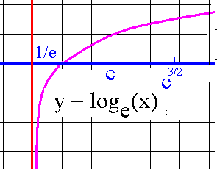
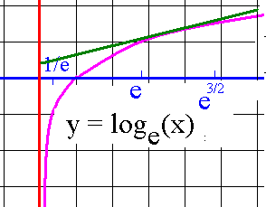
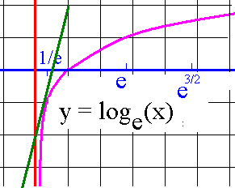
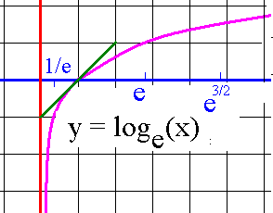
Natural logarithmic fn
f(x) = ln(x)
f ’(1) = 1/1
f ’(4) = ¼
f ’(¼) = 4
= 1/¼

Slide 14
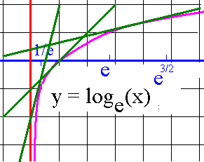
If y = ln(x), then y’ = 1/x
If x = ¼ y’ = 4
If x = 1 y’ = 1
If x = 4 y’ = ¼
As x increases, y’ ________
decreases so concave

Slide 15
If y = ln(x), then y’ = 1/x
decreases so concave
down everywhere
y’’ =
-1/x² which is negative at x = 1 and hence everywhere -1 is never 0

Slide 16
f ’(x)=
If f(x) = ln(x), f’(x) =
e^{y} = x
e^{y} y’ =
= 1
y’ = 1/e^{y}
y’ = 1/x

Slide 17
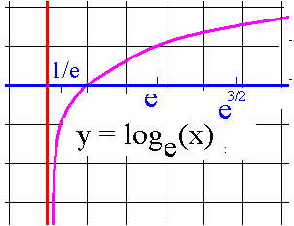
If y = kln(x) then y’ = k/x
y = 3ln(x)
y’ = 3/x

Slide 18
y =21 ln(x) y’ =
y’ = 21 ln(x)
y’ = 21 / x
y’ = 1 / x

Slide 19
y = e^{x} ln(x) y’ =
y’ = e^{x} /x +
y’ = e^{x} /x + ln(x) e^{x}

Slide 20
y = e^{x} / ln(x) y’ =
y’ = [ln(x) e^{x} -
y’ = [ln(x) e^{x} - e^{x} /x] /
y’ = [ln(x) e^{x} - e^{x} /x] / ln²(x)

Slide 21
y =x³ ln(x) y’ =
y’ = x² + 3x² ln(x)
y’ = 3x
y’ = 3x² + ln(x)

Slide 22
y =(x³ + 2x + 1) ln(x) y’ =
y’ = x² + 2 + 1/x + ln(x)[3 x² + 2]
y’ = 3x² + 2
y’ = 3x² + 2 (1/x)

Slide 23
y = ln(g(x)) y’= g’(x)/g(x)
[f(g(x)]’ = f’(g(x))g’(x)
[ln(x)] = 1/x
[ ]’ =

Slide 24
y = ln(g(x)) y’= g’(x)/g(x)
y = ln(2x² + 3x + 1)
y’ = 1/(2x² + 3x + 1) * [4x + 3]
= [4x + 3] /(2x² + 3x + 1)

Slide 25
y = ln(2x³ + 3x + 1) y’ =
[6x² + 3]/(2x³ + 3x +1)
[6x + 3]/(2x³ + 3x +1)
1 / (2x³ + 3x +1)

Slide 26
y = ln(2x³ + 1/x) y’ =
[6x² + 1/x²]/(2x³ + 1/x)
[6x + 3]/(2x³ + 1)
[6x² - 1/x²] / (2x³ + 1/x)

Slide 27
Logarithmic differentiation
y = [x² - 4]^x
ln y = ln [x² - 4x]^x
ln y = x ln [x² - 4]
y’ / y =

Slide 28
Logarithmic differentiation
ln y = x ln [x² - 4]
y’ / y = x 2x/ [x² - 4] + ln [x² - 4]
y’ = y[x 2x/ [x² - 4] + ln [x² - 4x]]
y’ = [x² - 4]^x[2x²/ [x² - 4] + ln [x² - 4x]]

Slide 29
y = x^{x}
ln(y) = x
ln(y) = ln(x)
ln(y) = x ln(x)

Slide 30
ln(y) = x ln(x) differentiate both sides imp.
y’ / y = 1/x
y’ / y = 1/x + ln(x)
y’ / y = 1 + ln(x)

Slide 31
y’ / y = 1 + ln(x) & y = x^{x}
y’ = x^{x} (1 + ln(x))
y’ = x^{x} + ln(x)
y’ = x x^{x-1}

Slide 32
# (in millions) of Yahoo households in W. Europe is N(t)=34+24 ln(t+5)
If t = 0 is 2004, how many W. Eupopean households used Yahoo in 2005?
34 + 24 ln(6)

Slide 33
N(t)=34+24 ln(t+5)
If t = 0 is 2004, how fast was the number of households rising in 2005?
y’ = 24/(t+5)
y’(1) = 24 / 6 = 4 million per year

Slide 34
Antiderivative

Slide 35
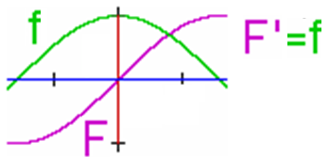
Definition:
F is an antiderivative of f on D if F' = f on D.
I need a purple function whose derivative is green.

Slide 36
Definition:
F is an antiderivative of f on D
means the same as
f is the derivative of F on D.

Slide 37

Definition:
An antiderivative of f (x) = -3x² + 9?
F(x) = -x³ + 9x because F’(x) = f (x).

Slide 38
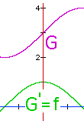
G = F + 3 is also an antiderivative of f
because G' = (F + 3)' = f + 0 = f.
F(x) = -x³+9x and G(x) = -x³+9x+3 are
both antiderivatives of the f(x) = -3x²+9
on R because when you differentiate either one you get f(x).

Slide 39
Square
3² = 9
The 2 square roots of 9 are 3, -3
What are the antiderivatives of 0?

Slide 40
Which of the following is an antiderivative of y = 2x
F(x) = 1 – x²
F(x) = x² + x
F(x) = x² + 73
F(x) = x - x²

Slide 41
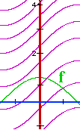
G = F + k is also an antiderivative of f
How many antiderivatives of f(x) are there?
If you said infinite, you are correct.
G(x) = F(x) + k is one for every real number k.
Find the one that satisfies G(0) = 3

Slide 42
Which of the following are antiderivatives of y = 4?
4x
4x + 2
4x - 7
All of the above

Slide 43
Theorem:
If F and G are antiderivatives of f on an interval I, then F(x) - G(x) = k where k is a real number.

Slide 44
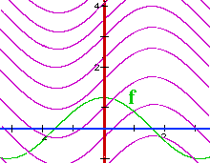
= F(x) + C
Antiderivatives differ by a constant on intervals. We will use the notation f(x)dx to represent the family of all antiderivatives of f. When written this way, we call this family the indefinite integral of f.

Slide 45
Using our new notation, evaluate

Slide 46
Using our new notation, evaluate
G(x) =
Which G is the one for which G(1)=3?
G(1) = -1 + 1.2 + C = 3
G(x) =

Slide 47
Theorems
because [x + c]’ = 1
What is the integral of dx?
x grandpa, x

Slide 48
.
x + c
x² + c
3x + c
-x + c

Slide 49
Theorems
Let F be an antiderivative of f => F’=f
Thus kF is an antiderivative of kf
because [kF]’ = k F’ = k f

Slide 50
Theorems

Slide 51
.
12x + c
12x² + c
24x² + c
24x + c

Slide 52
Theorem
Proof:
F(x)
F’(x) =

Slide 53
Examples

Slide 54
.
3 x² + c
9 x² + c
x³ + c
3 x³ + c

Slide 55
Examples

Slide 56
.
4/x + c
-4/x + c
4/x³ + c
-4/x³ + c

Slide 57
Theorem
If k(x) = x³ + 3x² – 4,
evaluate

Slide 59
Theorem
=
=

Slide 60
.

Slide 61
.
-2e^{x} + 3/x³ + c
2e^{x} – 3 + c
2e^{x} – 3/x + c
2e^{x} + 3/x + c

Slide 62
.
ln(x) + x³ + c
0.5 ln(x) + x³ + c
2/x + 3 x³ + c
2 ln(x) + x³ + c

Slide 63
Initial value problems
.

Slide 64
Current circulation is 3000 per month. Growth rate is C’(t)= . Find C(t).
C(t) =
C(0) = c = 3000 C(t) =

Slide 65
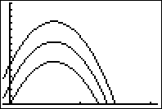
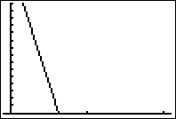
Suppose s’(t) = -32t + 20
Find all s(t)’s or
-16 t² + 20 t + C
-32 t² + 20 t + C
-32

Slide 66
s(t) = -16 t² + 20 t + C
Find C so that s(1) = 10
2
6
0
s

Slide 67
Suppose s’(t) = -32t + 20
Find s(t) so that s(1) = 10
s(t) = -16 t² + 20 t + C
s(t) = -16 t² + 20 t + 6
s(t) = -32

