Slide 1
Theorem
=
=
.

Slide 2
Theorem
=
=
.

Slide 3
Cover section 6.3 lightly
HW All multiples of 5 in section 6.4
6.3 is the next quick 10 slides

Slide 4
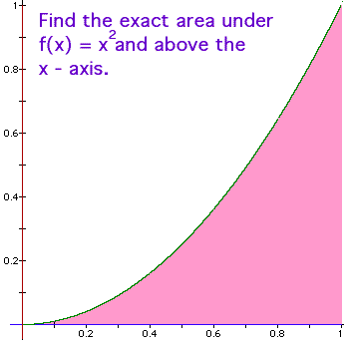
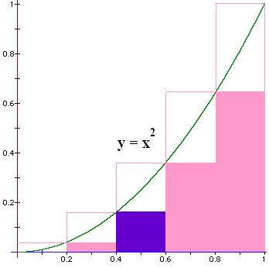
Blue area?
A = L * H
How do we find
the height?
Plug the left end point into the function
f(x) = x².

Slide 5
Blue area?
A = L * H
L = 0.6 – 0.4 = 0.2
H = 0.4² = 0.16
Blue Area = 0.032

Slide 6

Find all 5 bottom areas
BA = 0 * 0.2 +
0.04 * 0.2 +
0.16 * 0.2 +
0.36 * 0.2 +
0.64 * 0.2 = .2 * 1.2 = 0.24 < A
This is a lower sum.

Slide 7
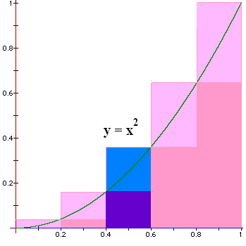
Next we find an upper sum
Plug in the
right pt to
calculate
the height

Slide 8
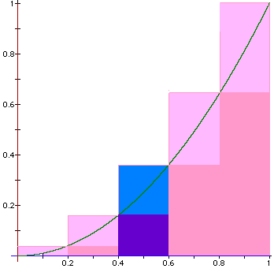
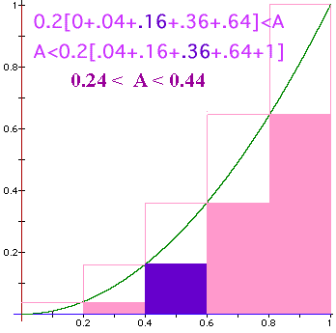
Find all 5 upper areas
UA = 0.04 * 0.2 +
0.16 * 0.2 +
0.36 * 0.2 +
0.64 * 0.2 +
1.00 * 0.2 = 0.2 * 2.2 = 0.44 > A
This is an upper sum.

Slide 9


When x = 0.6 blue area = ?
0.072
0.001

Slide 10
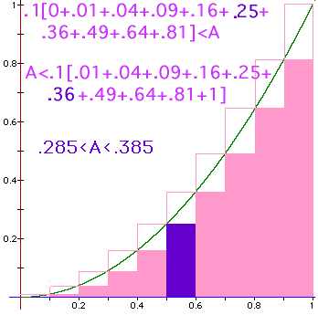
Lower sum
Lower sum for
n = 10
LS = .285

Slide 11
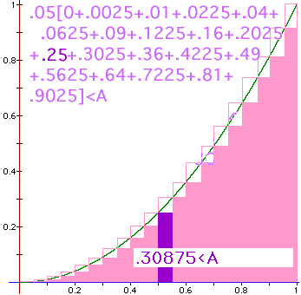
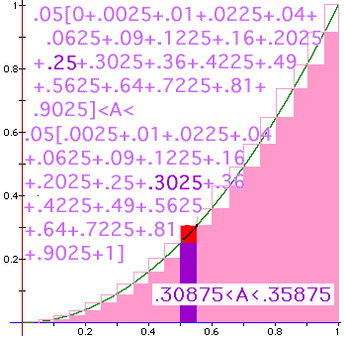

Slide 12
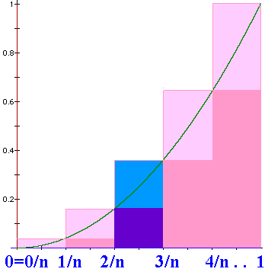
Upper sum
N = n
N=n => width = 1/n
US = 1/n [(1/n)² +(2/n)². .+(i/n)² +. . +1²]
US =

Slide 13
=

Slide 14

Definite
Integral
We will define
to be the limit as n
approaches +oo of
where Δx_{i} = (b-a)/n
and is any point in the ith interval.

Slide 15
where Δx_{i} = (b-a)/n
and is any point in the i^{th} interval, [x_{i-1},x_{i}].

Slide 16
> 0 when f(x) > 0, but it is negative when f(x)<0.
We will define
to be the limit as n
approaches +oo of
and is any point in the i^{th} interval, [x_{i-1},x_{i}].

Slide 17
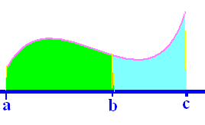
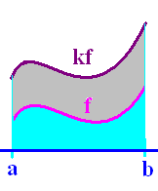
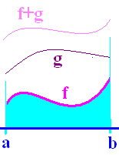
Definition
Theorems
1.
2.
3.
4.

Slide 18
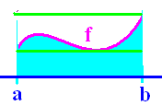
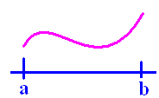
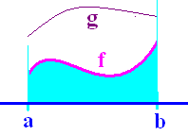
Definition
Theorems
5.
6.
7.
8.

Slide 19
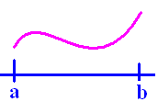
If f(x) >= 0 on [a,b]
then is the area under f(x) and
over the x-axis between a and b.

Slide 20
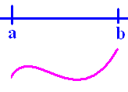
If f(x) <= 0 on [a,b]
then is the negative of the area
over f(x) and under the x-axis between
a and b.

Slide 21
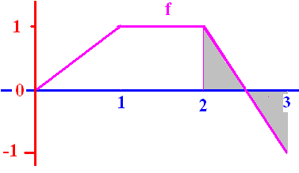
.
¼ + (-¼) = 0
The definite integral of f from 2 to 3 is 0

Slide 22
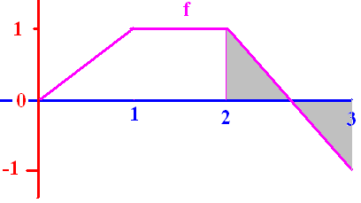

Slide 23
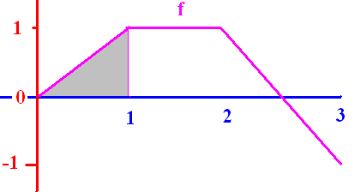
[

Slide 24
[
0.50
0.1

Slide 25
[

Slide 26
[
2.0
0.1

Slide 27
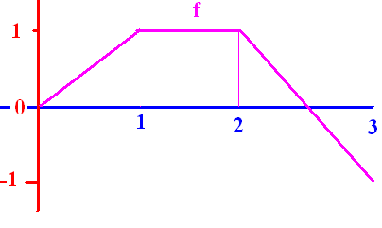
]

Slide 28
]
0.0
0.1

Slide 29
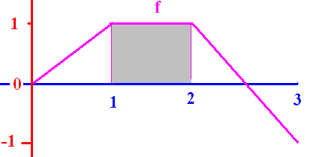
[

Slide 30
[
1.0
0.1

Slide 31
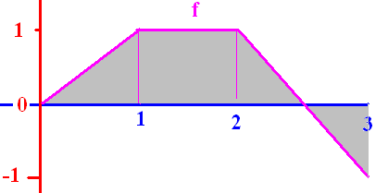
[

Slide 32
[
1.5
0.1

Slide 33
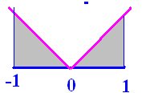
]

Slide 34
]
1.0
0.1

Slide 35
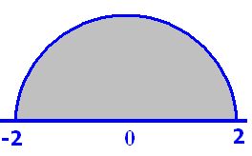
Pi = 3.14

Slide 36
Pi = 3.14
6.28
0.1

Slide 37
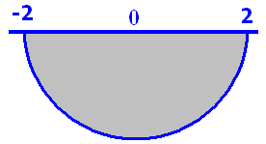
Pi = 3.14

Slide 38
Pi = 3.14
-6.28
0.1

Slide 39
Fundamental Theorem of Calculus
If f is continuous on [a, b] and F is any antiderivative of f, then

Slide 40
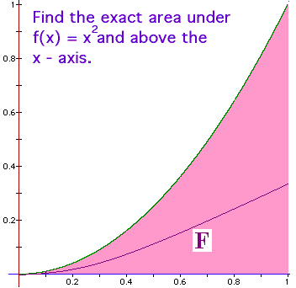
Fundamental Theorem of Calculus
f(x) = x² is continuous on [0, 1] and
An antiderivative of f(x) is
F(x) = x³/3

Slide 41
Traditional Notation
.

Slide 42
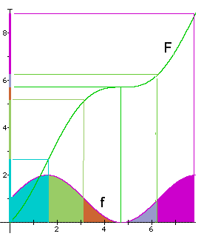
Example
Let f be continuous on
[0,8] and let F be any
antiderivative of f.

Slide 43
What is the total area?
By the F.T.C.,
sq. in.
0 8

Slide 44
What is the green area?
By the F.T.C.,
sq. in.
1.6 3.1

Slide 45
Fundamental Theorem of Calculus
If f is continuous on [a, b] and F is any antiderivative of f, then

Slide 46
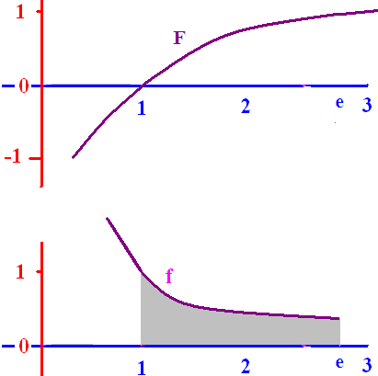
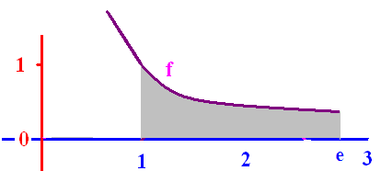
f(x) = 1/x is continuous on [1, e] and
F(x) = ln(x) is an
antiderivative of f(x), so

Slide 47
Because f(x) > 0, the
area under f and over
the x-axis is exactly
1 square unit.

Slide 48

Find the area under y=-x(x-3) on [0, 3]
= [-54 + 81]/6 = 27/6
= 9/2 = 4.5 sq. in.

Slide 49
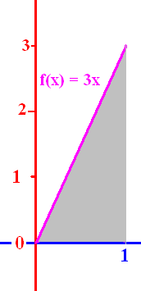
Evaluate

Slide 50
Evaluate
1.5
0.1

Slide 52
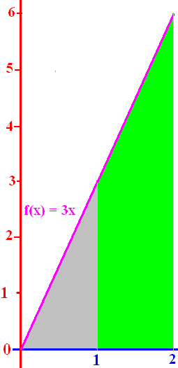
Evaluate

Slide 53
Evaluate
4.5
0.1

Slide 55
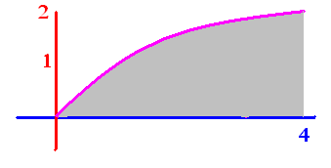
.
.
.
.

Slide 56


.
.
.
.

Slide 57
.
1.333
3.333
5.333

Slide 58
.
1.333
3.333
5.333

Slide 59
.
.

Slide 60
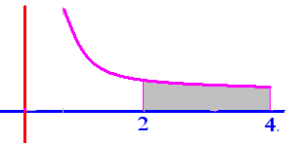
Evaluate

Slide 61
Evaluate
.25
0.1

Slide 62
Get from
Rewriting 1 over x squared as x to the negative two we get

Slide 63
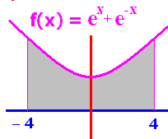
To evaluate we need
F so that F’(x) = e^{x} + e^{-x}
F(X) = e^{x} - e^{-x}
F(X) = e^{x} + e^{-x}
F(x) = 2e^{x}
F(x) = 2e^{-x}

Slide 64
To evaluate we need
F so that F’(x) = e^{x} + e^{-x}
F(X) = e^{x} - e^{-x}
F(X) = e^{x} + e^{-x}
F(x) = 2e^{x}
F(x) = 2e^{-x}

Slide 65
F(x) = e^{x} - e^{-x} is an antiderivative of e^{x} + e^{-x}
F(-4) + F(4)
F(-4) - F(4)
F(4) + F(-4)
F(4) - F(-4)

Slide 66
F(x) = e^{x} - e^{-x} is an antiderivative of e^{x} + e^{-x}
F(-4) + F(4)
F(-4) - F(4)
F(4) + F(-4)
F(4) - F(-4)

Slide 67
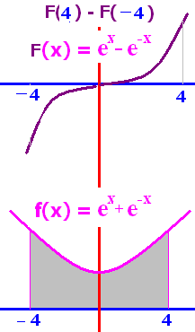
F(x) = e^{x} - e^{-x}
F(4) - F(-4) =
0
1
2e⁴ + 2e⁻⁴
2e⁴ – 2e⁻⁴

Slide 68
F(x) = e^{x} - e^{-x}
F(4) - F(-4) =
0
1
2e⁴ + 2e⁻⁴
2e⁴ – 2e⁻⁴

Slide 69
F(x) = e^{x} - e^{-x}
F(4) - F(-4)
= [e⁴ - e⁻⁴ ]-[e-⁴ - e⁴ ]
= 2 [e⁴ - e⁻⁴ ]

Slide 70

Evaluate

Slide 71
Evaluate
2.0
0.1

Slide 72
.

Slide 73

Evaluate

Slide 74
Evaluate
2.0
0.1

Slide 75
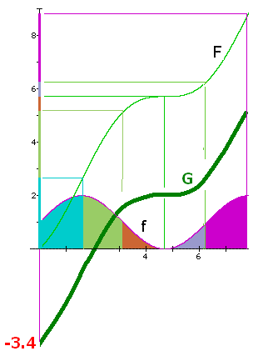
Draw a different
antiderivative G
Evaluate
5.2 – 0 = 5.2
1.8 – (-3.4) = 5.2 square inches

Slide 76
Evaluate
F(6.28) – F(3.14) =
6.3 - 5.2 = 1.1
The orange and grey
area is 1.1 square
inches.

