Slide 1
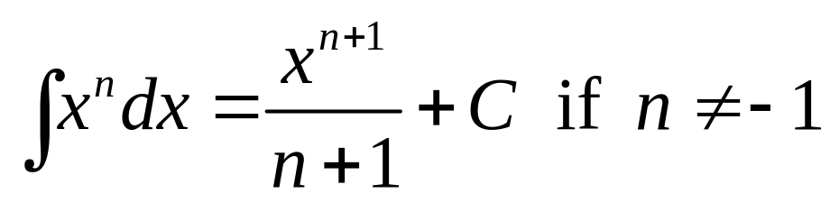
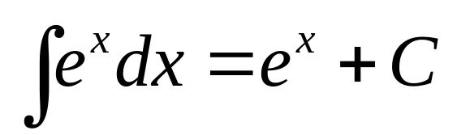
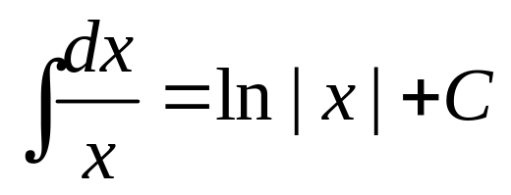

Slide 2
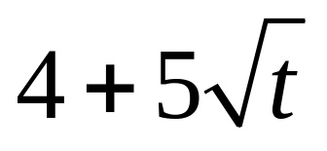
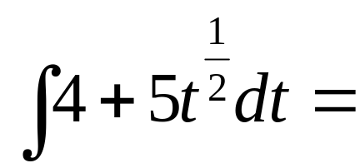
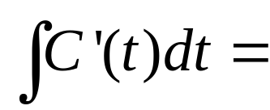
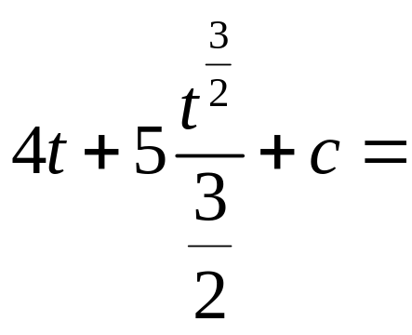
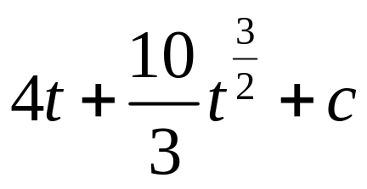
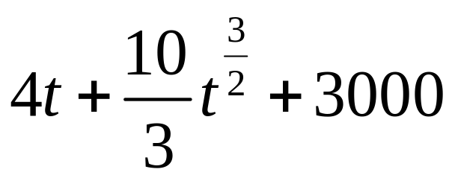

Current circulation is 3000 per month. Growth rate is C’(t)= . Find C(t).
C(t) =
C(0) = c = C(t) =

Slide 3
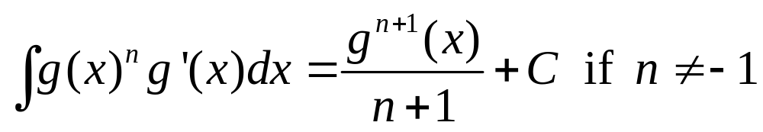
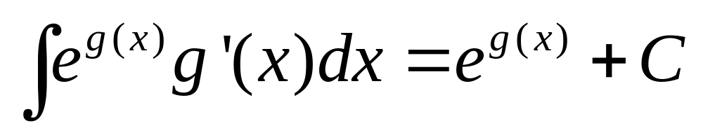
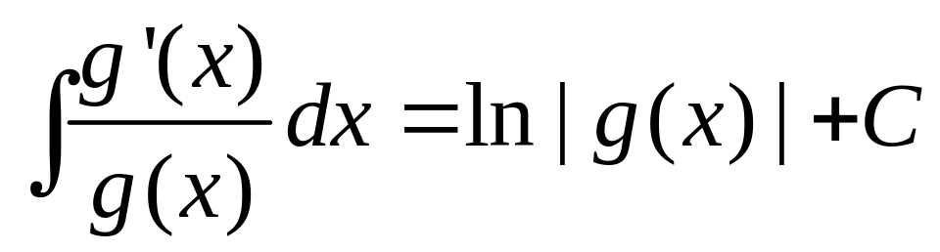

Slide 4
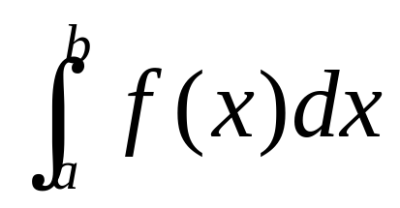
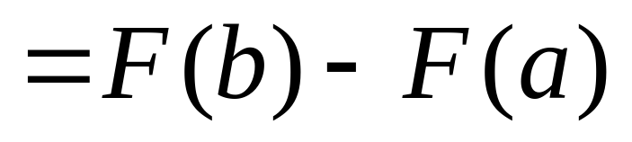
Fundamental Theorem of Calculus
If f is continuous on [a, b] and F is any antiderivative of f, then

Slide 5
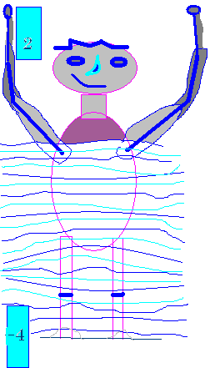
How tall am I?
My head is 232 feet above sea level.
My feet are 226 feet above sea level.
My head is 2 feet above sea level.
My feet are (-4) feet ‘above’ sea level.

Slide 6
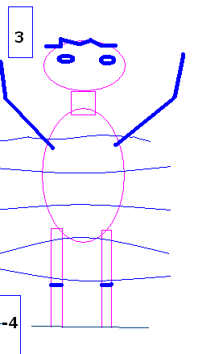


How many feet tall am I?
7.0
0.1

Slide 7
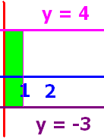
What is the area of the green rectangle?
7.0
0.1

Slide 8
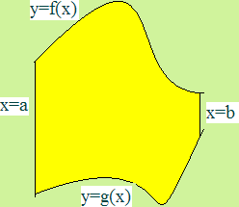
What is the area
below f(x), above g(x) and
between x=a and x=b ?

Slide 9
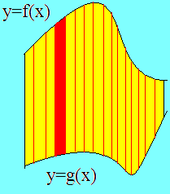
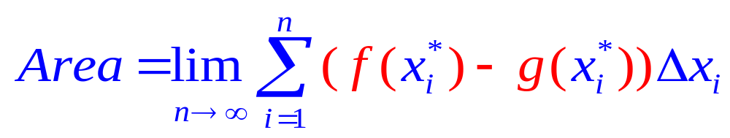
Set up n rectangles of width Δx
And height is top – bottom or f(x) – g(x)

Slide 10
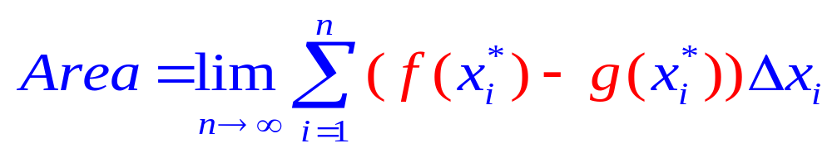
The area of one rectangle is height times width

Slide 11
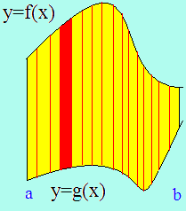
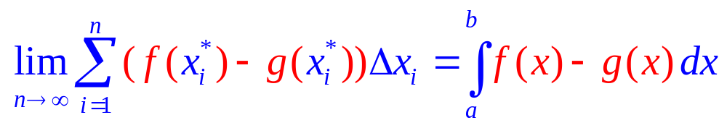
By the definition of the definite integral
Area =

Slide 12
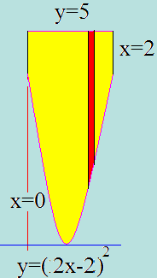
Example 1
Find the area over y=(2x-2)² and under y=5
Between x=0 and x=2
Just add up all of the red rectangles
As they slide from x=0 to x=2
The top function is . . .
Y=5
And the bottom function is . . .
Y=(2x-2)²

Slide 13
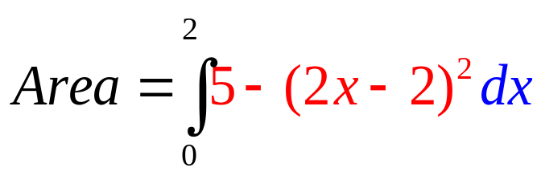
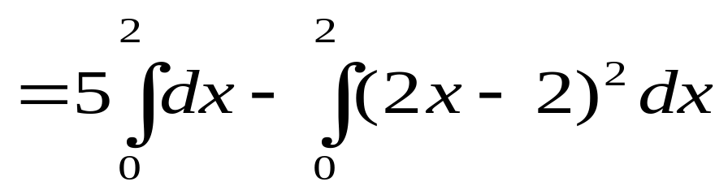
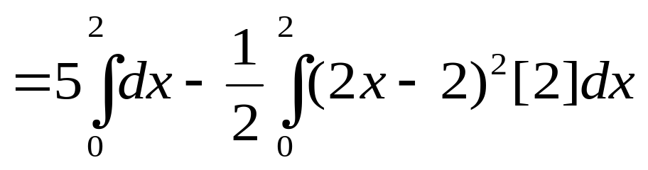
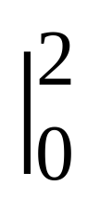
Example 1
Find the area over y=(2x-2)² and under y=5
Between x=0 and x=2
=5x-1/2 (2x-2)³/3
=10 - 0.5 8/3-[0 - 0.5 (-8/3)]

Slide 14
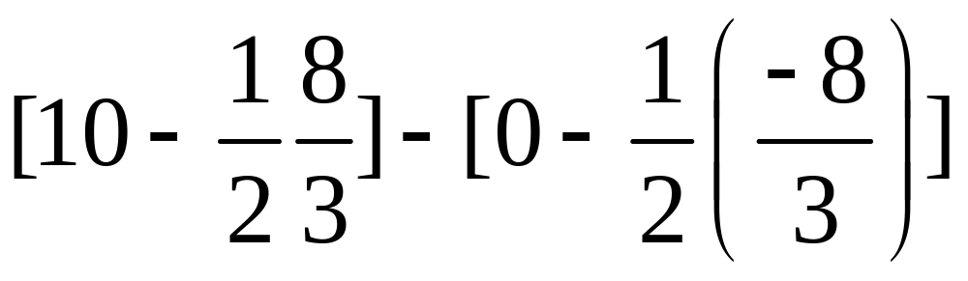
[5x- 0.5 (2x-2)³/3]
[10 - 0.5 (8/3)] - [0 - 0.5 (-8/3)]=
7.33333
0.1

Slide 15
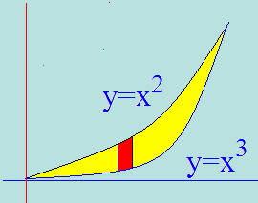
Example 2
Set the two functons equal to each other
Solve for x x² = x³ or 0 = x³ - x²
By factoring 0 = x² ( x – 1 )
so x² =0 or x–1=0
Next we add up all of the red rectangles
From 0 to 1
Area =

Slide 16
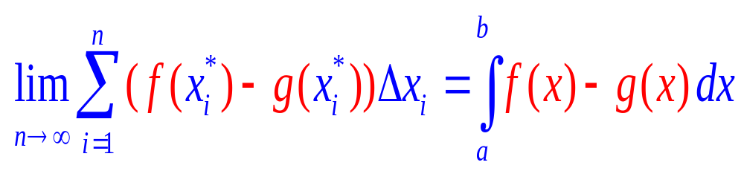
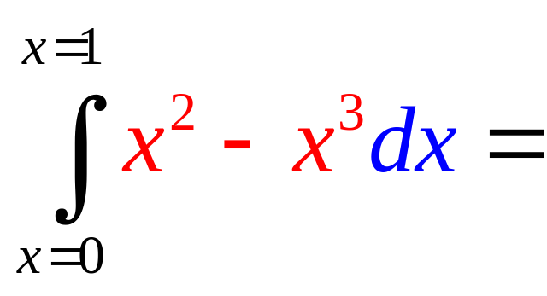
Area =

Slide 17

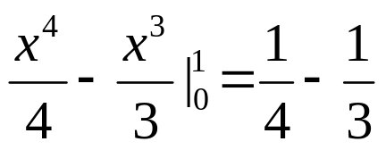
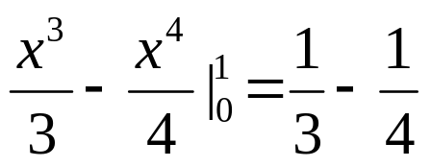
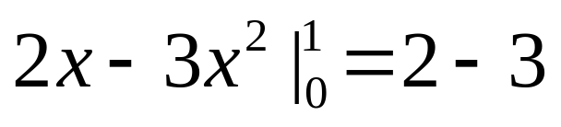
.
.
.
..

Slide 18
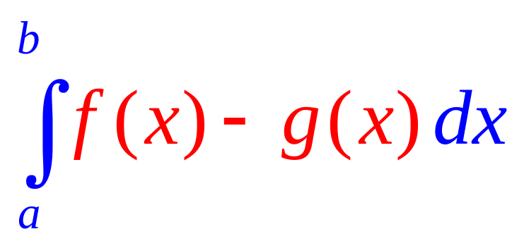
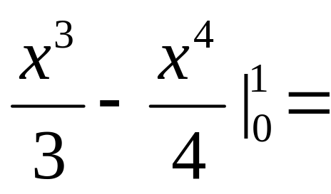
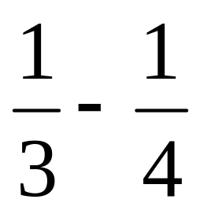
Area =
= 1/12

Slide 19
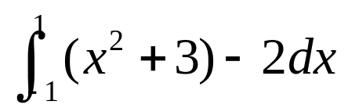
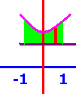
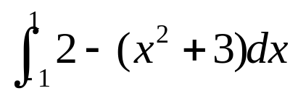
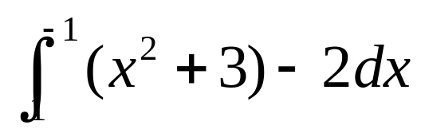
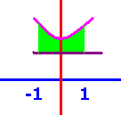
The area over y=2 and under y=x²+3 between x=-1 and x=1
[
[
[

Slide 20
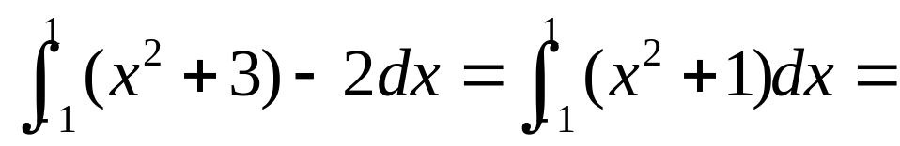
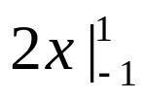
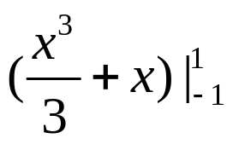
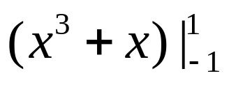
.
[
[
[

Slide 21
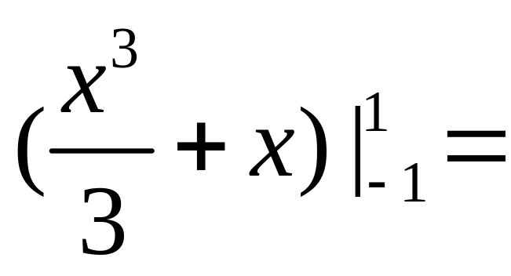
]
2.667
0.1

Slide 22
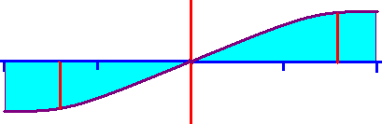
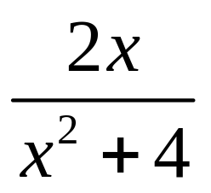



Find the enclosed area.
y = x = -2 x = 2
Area =
=

Slide 23


Find the enclosed area.
Area =
= -ln + ln
= - ln(4) + ln(8) + ln(8) – ln(4)
= ln(8/4) + ln (8/4) = 2ln(2)= ln2²
= ln(4) = 1.386 sq. ft.

Slide 24


Find the enclosed area.
Area = ln(4) = 1.386 sq. ft.
= ln(8) - ln(8) = 0

Slide 25

Example 4
Find the area bounded by y² = 2x + 6 and y = x – 1.
Solve for x = 0.5 y² – 3 and we see a parabola opening to the right with the vertex at (-3, 0).
Replacing y by (x-1) gives (x-1)²=2x + 6
x² - 2x + 1 = 2x + 6
x² - 4x – 5 = (x - 5)(x + 1) = 0
x = 5 or x = -1

Slide 26





Example 4
Find the area bounded by y² = 2x + 6 and y = x – 1.
vertex at (-3, 0).
x = 5 or x = -1
Area =
=

Slide 27
.
16/3 – 0 + 1/3 (64) - 12.5 + 5 –[8/3-1/2-1]
72/3 – 12 + 6 = 24 – 6 = 18

Slide 28


X² - 2x + 1 = 2x + 6
X² - 4x – 5 = (x - 5)(x + 1) = 0
X = 5 or x = -1
y = x – 1 so y = 4 or y = -2.

Slide 29














x = y + 1.
x = 0.5 y² – 3 .

