Slide 1
Power Rule
If H(x) = (3x⁷-4x)¹²/12
then H’(x) = (3x⁷ - 4x)¹¹(21x⁶ - 4)
When differentiating, the first answer is multiplied by the derivative, g’(x).

Slide 2

Power Rule
If H(x) = (3x⁷-4x)¹²/12
then H’(x) = (3x⁷-4x)¹¹(21x⁶-4)
H is an antiderivative of (3x⁷-4x)¹¹(21x⁶-4)

Slide 3

Anti Power Rule
Thus that term must be removed when antidifferentiating.

Slide 4

Anti Power Rule
copy
derivative
is here
Add one
Copy

Slide 5

Anti Power Rule
Copy g(x)
If derivative is here
Add one to exponent
Divide by new exponent

Slide 6

The derivative of (2x-3).
What is 2?

Slide 7


The derivative of (2x-3).

Slide 8
Anti Power Rule
Copy g(x)
If derivative is here
Add one to exponent
Divide by new exponent

Slide 9



=
(7x+2)¹³/13
(7x+2)¹³/13 + C
(7x+2)¹¹/13 + C
(7x+2)¹¹/11 + C

Slide 10

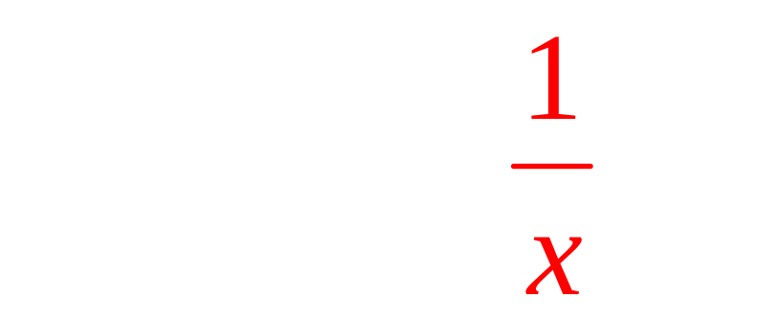
➔

Slide 11
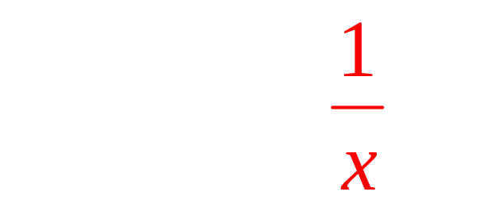
Anti Power Rule
Copy ln(x)
Derivative is here
Add one to exponent
Divide by new exponent

Slide 12
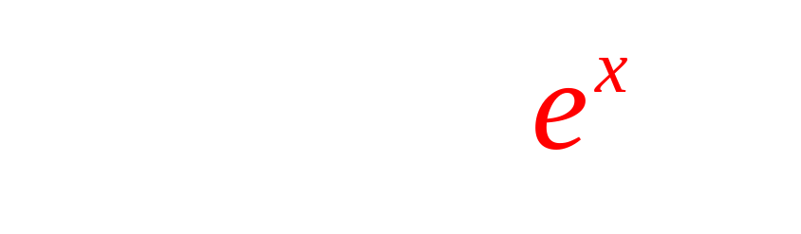
=
(e^{x} + 1)¹³/13 + C
(e^{x} + 1)¹¹/11 + C
(e^{x} + 1)¹³/11 + C

Slide 13

What is the derivative of
12x + 3 ?

Slide 14
U substitution
Let u = 12x + 3
du = 12 dx

Slide 15
U substitution
Let u = 12x + 3
du = 12 dx

Slide 16
U substitution
Let u = 12x + 3
du = 12 dx

Slide 17
U substitution
Let u = 12x + 3
du = 12 dx

Slide 18
No U substitution

Slide 19
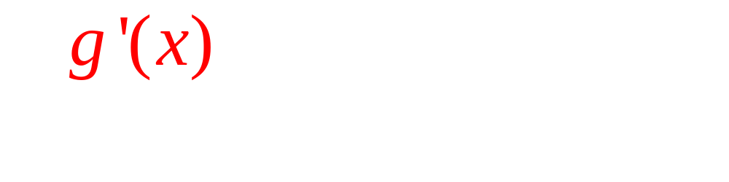

Copy g(x)
If derivative is here
Add one to exponent
Divide by new exponent

Slide 20
=
Let u = 2x - 3

Slide 21
=
Let u = 2x - 3

Slide 22
=
Let u = 2x - 3

Slide 23
= =
Let u = 2x - 3

Slide 24
= =
Let u = 2x - 3

Slide 25
Anti Power Rule
Copy 5x³ - 1
Derivative is here
Add one to exponent
Divide by new exponent

Slide 26
Anti Power Rule
If H(x) = (3x⁷-4x)¹²
H’(x) = 12(3x⁷-4x)¹¹(21x⁶-4)

Slide 27
Chain Rule
If H(x) =F(g(x)) then H’(x) = F’(g(x)) g’(x)
H(x) is an antiderivative of F ’(g(x)) g’(x)

Slide 28
Anti – Chain Rule
Make sure g’(x) is there
Antidifferentiate F’ giving F
Copy g(x) giving F(g(x))

Slide 29
Anti Chain Rule

Slide 30

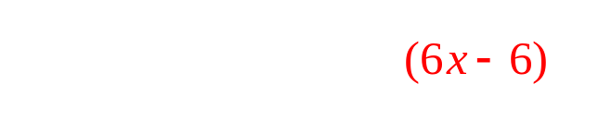
Anti Chain Rule

Slide 31

Anti Chain Rule

Slide 32
=

Slide 33
=
u =
du/dx = 6x – 3

Slide 34
=
u =
du/dx = 6x – 3
du = (6x – 3) dx

Slide 35
=
u =
du/dx = 6x – 3
du = (6x – 3) dx

Slide 36
=
u =
du/dx = 6x – 3
du = (6x – 3) dx

Slide 37
Number of cable telephones 3.2 million in 2004 (t=0)
Rate of growth r(t) = 3.36(t+1)^{0.05}
How fast is it growing in 2008?
How many cable phones in 2008?

Slide 38
Rate r(t)=3.36 (t+1) ^{0.05}. How fast is it growing in 2008?
r(4) = 3.36(4+1) ^{0.05} = million/yr

Slide 39


r(t)=3.36 (t+1) ^{0.05}
Find r(4) = mill./yr.
3.64
0.2

Slide 40
Number of cable telephones 3.2 million in 2004 (t=0)
Rate of growth r(t) = 3.36(t+1)^{0.05}
How fast is it growing in 2008?
How many cable phones in 2008?

Slide 41
N(t) =
N(t)= .
N(t) .
N(t)

Slide 42
Rate r(t)=3.36 (t+1) ^{0.05}. How many phones are there in 2008?
N(t) =
= 3.36(t+1)^{1.05}/1.05 + C
= 3.2(t+1)^{1.05} + C
N(0) = 3.2 + C = 3.2 so

Slide 43
N(0) = 3.2 + C = 3.2
C = million
0.0
0.1

Slide 44
N(t) = 3.2(t+1)^{1.05}. How many phones are there in 2008?
N(t) = 3.2(t+1)^{1.05}
N(4) = 3.2(5)^{1.05}
N(4) = million subscribers

Slide 45
N(t) = 3.2(t+1)^{1.05}
N(4) = millions
17.34
1.0

