Slide 1
Power Rule
If H(x) = (3x⁷-4x)¹²/12
then H’(x) = (3x⁷ - 4x)¹¹(21x⁶ - 4)
When differentiating, the first answer is multiplied by the derivative, g’(x).

Slide 2
Power Rule
If H(x) = (3x⁷-4x)¹²/12
then H’(x) = (3x⁷-4x)¹¹(21x⁶-4)
H is an antiderivative of (3x⁷-4x)¹¹(21x⁶-4)

Slide 3
Anti Power Rule
Thus that term must be removed when antidifferentiating.

Slide 4
Anti Power Rule
copy
derivative
is here
Add one
Copy

Slide 5
Anti Power Rule
Copy g(x)
If derivative is here
Add one to exponent
Divide by new exponent

Slide 6
The derivative of (2x-3).
What is 2?

Slide 7
The derivative of (2x-3).

Slide 8
Anti Power Rule
Copy g(x)
If derivative is here
Add one to exponent
Divide by new exponent

Slide 9


=
(7x+2)¹³/13
(7x+2)¹³/13 + C
(7x+2)¹¹/13 + C
(7x+2)¹¹/11 + C

Slide 10
What is the derivative of ln(x)?

Slide 11
➔

Slide 12
Anti Power Rule
Copy ln(x)
Derivative is here
Add one to exponent
Divide by new exponent

Slide 13
=
(e^{x} + 1)¹³/13 + C
(e^{x} + 1)¹¹/11 + C
(e^{x} + 1)¹³/11 + C

Slide 14
What is the derivative of
12x + 3 ?

Slide 15
Copy g(x)
If derivative is here
Add one to exponent
Divide by new exponent

Slide 16
Number of cable telephones 3.2 million in 2004 (t=0)
Rate of growth r(t) = 3.36(t+1)^{0.05}
How fast is it growing in 2008?
How many cable phones in 2008?

Slide 17
Rate r(t)=3.36 (t+1) ^{0.05}. How fast is it growing in 2008?
r(4) = 3.36(4+1) ^{0.05} = million/yr

Slide 18


r(t)=3.36 (t+1) ^{0.05}
Find r(4) = mill./yr.
3.64
0.2

Slide 19
Number of cable telephones 3.2 million in 2004 (t=0)
Rate of growth r(t) = 3.36(t+1)^{0.05}
How fast is it growing in 2008?
How many cable phones in 2008?

Slide 20
N(t) =
N(t)= .
N(t) .
N(t)

Slide 21
Rate r(t)=3.36 (t+1) ^{0.05}. How many phones are there in 2008?
N(t) =
= 3.36(t+1)^{1.05}/1.05 + C
= 3.2(t+1)^{1.05} + C
N(0) = 3.2 + C = 3.2 so

Slide 22
N(0) = 3.2 + C = 3.2
C = million
0.0
0.1

Slide 23
N(t) = 3.2(t+1)^{1.05}. How many phones are there in 2008?
N(t) = 3.2(t+1)^{1.05}
N(4) = 3.2(5)^{1.05}
N(4) = million subscribers

Slide 24
N(t) = 3.2(t+1)^{1.05}
N(4) = millions
17.34
1.0

Slide 25
=
-10.0
0.1

Slide 26
What is the derivative of
4x² + 12x + 3 ?

Slide 27
What is the exponent?

Slide 28
Now it is in the correct form.

Slide 29
Anti Power Rule
Copy 4x²+12x+3
Derivative is here
Add one to exponent
Divide by new exponent

Slide 31
Anti Power Rule
Copy 5x³ - 1
Derivative is here
Add one to exponent
Divide by new exponent

Slide 32
Anti Power Rule
If H(x) = (3x⁷-4x)¹²
H’(x) = 12(3x⁷-4x)¹¹(21x⁶-4)

Slide 33
Chain Rule
If H(x) =F(g(x)) then H’(x) = F’(g(x)) g’(x)
H(x) is an antiderivative of F ’(g(x)) g’(x)

Slide 34
Anti – Chain Rule
Make sure g’(x) is there
Antidifferentiate F’ giving F
Copy g(x) giving F(g(x))

Slide 35
Anti Chain Rule

Slide 36
Anti Chain Rule
Antidifferentiate 1/x
Derivative of x³ -3x is here
Copy x³-3x

Slide 37
Anti Chain Rule
Antidifferentiate
Derivative of x³ -3x is here
Copy x³-3x

Slide 38
Theorem
=
=
.

Slide 39
Theorem
=
=
.

Slide 40
Fundamental Theorem of Calculus
If f is continuous on [a, b] and F is any antiderivative of f, then

Slide 41
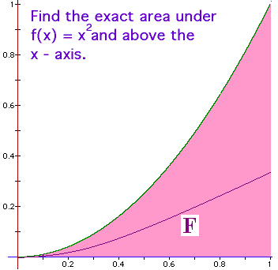
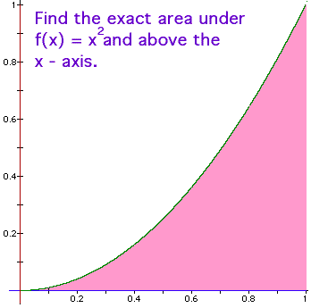
Fundamental Theorem of Calculus
f(x) = x² is continuous on [0, 1] and
An antiderivative of f(x) is
F(x) = x³/3

Slide 42
Traditional Notation
.

Slide 43
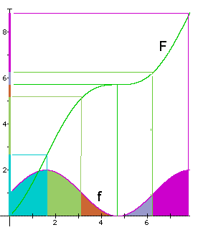
Example
Let f be continuous on
[0,8] and let F be any
antiderivative of f.

Slide 44
What is the total area?
By the F.T.C.,
sq. in.
0 8

Slide 45
What is the green area?
By the F.T.C.,
sq. in.
1.6 3.1

Slide 46
Fundamental Theorem of Calculus
If f is continuous on [a, b] and F is any antiderivative of f, then

Slide 47
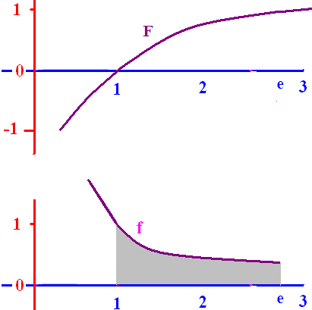
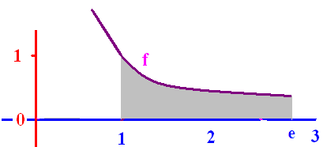
f(x) = 1/x is continuous on [1, e] and
F(x) = ln(x) is an
antiderivative of f(x), so

Slide 48
Because f(x) > 0, the
area under f and over
the x-axis is exactly
1 square unit.

Slide 49

Find the area under y=-x(x-3) on [0, 3]
= [-54 + 81]/6 = 27/6
= 9/2 = 4.5 sq. in.

Slide 50
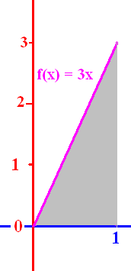
Evaluate
1.5
0.1

Slide 52
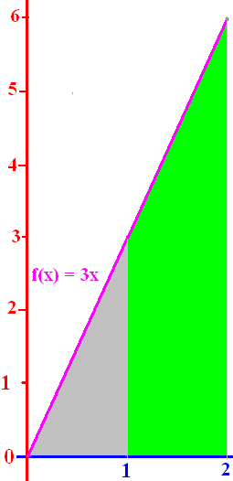
Evaluate
4.5
0.1

Slide 54
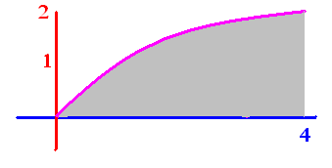
.
.
.
.

Slide 55
.
1.333
3.333
5.333

Slide 56
.
.

Slide 57
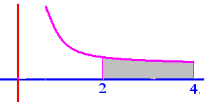
Evaluate
.25
0.1

Slide 58
Get from
Rewriting 1 over x squared as x to the negative two we get

Slide 59
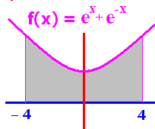
To evaluate we need
F so that F’(x) = e^{x} + e^{-x}
F(X) = e^{x} - e^{-x}
F(X) = e^{x} + e^{-x}
F(x) = 2e^{x}
F(x) = 2e^{-x}

Slide 60
F(x) = e^{x} - e^{-x} is an antiderivative of e^{x} + e^{-x}
F(-4) + F(4)
F(-4) - F(4)
F(4) + F(-4)
F(4) - F(-4)

Slide 61
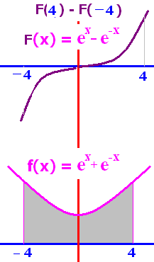
F(x) = e^{x} - e^{-x}
F(4) - F(-4) =
0
1
2e⁴ + 2e⁻⁴
2e⁴ – 2e⁻⁴

Slide 62
F(x) = e^{x} - e^{-x}
F(4) - F(-4)
= [e⁴ - e⁻⁴ ]-[e⁻⁴ - e⁴ ]
= 2 [e⁴ - e⁻⁴ ]

Slide 63
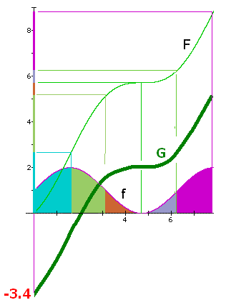
Draw a different
antiderivative G
Evaluate
5.2 – 0 = 5.2
1.8 – (-3.4) = 5.2 square inches

Slide 64
Evaluate
F(6.28) – F(3.14) =
6.3 - 5.2 = 1.1
The orange and grey
area is 1.1 square
inches.

