Slide 1
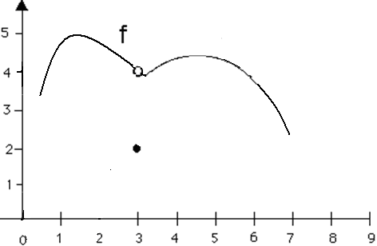
.
d.n.e.
2
3
4

Slide 2


.
d.n.e.
2
3
4

Slide 3
.
1
2
3
d.n.e.

Slide 4
.
1
2
3
d.n.e.

Slide 5
On [a,b], ARC =
On [1, 16], find ARC for
ARC = =

Slide 6
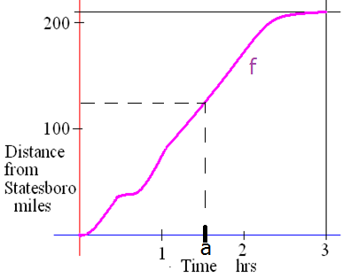
Continuity
This function is continuous on [0,3]
Definition
A function f is continuous at x = a means three things.
1) a is in the domain of f,
2)
3)

Slide 7
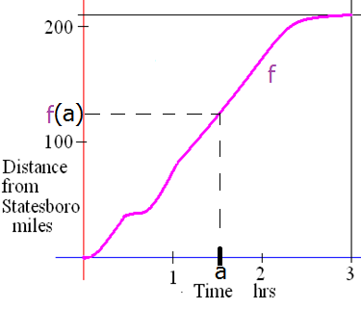
Continuity
This function is continuous on [0,3]
Definition
A function f is continuous at x = a means three things.
1) a is in the domain of f,
2)
3)

Slide 8
Continuity
f is continuous on [0, 3] means that f is
continuous at a for every a in [0, 3].

Slide 9
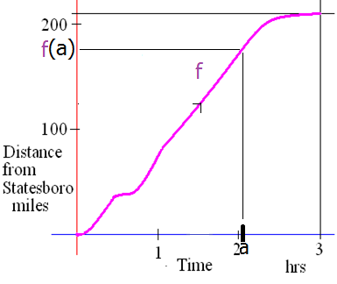
Continuity
f is continuous on [0, 3] means that f is
continuous at a for every a in [0, 3].

Slide 10
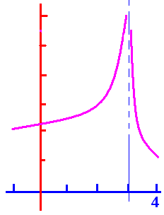
Continuity
f is continuous on [-1, 3) U (3, 4] means that f is continuous at x = a
for every a in [-1, 3) U (3, 4] .

Slide 11
Continuity
1) a is in the domain of f,
2)
3)

Slide 12
Continuity
Why wasn’t f continuous when x = 3?
Must lift your pencil
Not a valid reason

Slide 13
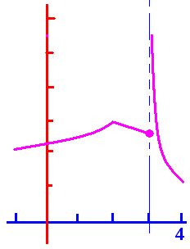
Continuity
1) a is in the domain of f,
2)
3)
Why not at x = 3?

Slide 14
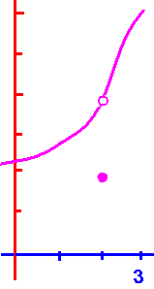
Continuity
1) a is in the domain of f,
2)
3)
Yes on [-.2, 2) U (2, 3.1]
Why not at x = 2?

Slide 15
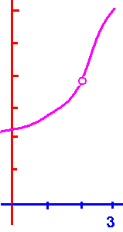
Continuity
1) a is in the domain of f,
2)
3)
Yes on [-.2, 2) U (2, 3.1]
Why not at x = 2?
Hole in the graph
Not a valid reason

Slide 16
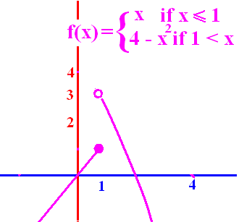
Why is f not continuous at x = 1?
1 is not in the domain of f
.
.
There is a hole in the graph
Must lift your pencil

Slide 17
Why is f not continuous at x = 1?
1 is not in the domain of f
.
.
There is a hole in the graph
Must lift your pencil

Slide 18
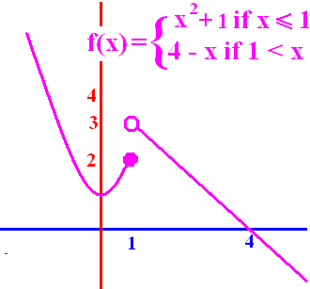
f is continuous at x = 1.
True
False

Slide 19
f is continuous at x = 1.
True
False

Slide 20
f is continuous at x = 4.
True
False

Slide 21
f is continuous at x = 4.
True
False

Slide 22
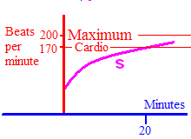
Why is s continuous at 20?
20 is in the domain
.
.
a, b, and c above
none of the above

Slide 23
Why is s continuous at 20?
20 is in the domain
.
.
a, b, and c above
none of the above

Slide 24
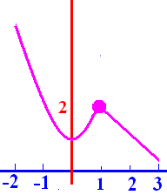
f is continuous on [-2, 3].
Yes
No

Slide 25
f is continuous on [-2, 3].
Yes
No

Slide 26
Why is f not continuous at x=1?
1 is not in the domain
.
.
All of the above

Slide 27
Why is f not continuous at x=1?
1 is not in the domain
.
.
All of the above

Slide 28
Why is f not continuous at x=2?
2 is not in the domain
.
.
All of the above

Slide 29
Why is f not continuous at x=2?
2 is not in the domain
.
.
All of the above

Slide 30

Why is f not continuous at x=2?
2 is not in the domain
.
.
All of the above

Slide 31
Why is f not continuous at x=2?
2 is not in the domain
.
.
All of the above

Slide 32
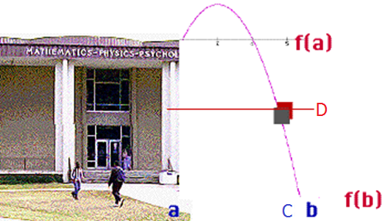
Having thrown a pebble from the roof of MP, will it pass the floor of the 3rd floor?
The domain of this function is [a, b] representing the time it was thrown until the time the pebble struck the ground. The rule of the function, f, is "height of the pebble at time x".

Slide 33
Intermediate Value Theorem
If f is continuous on [a, b] and d is inbetween f(a) and f(b),
then c (a,b) such that f (c) = d.

Slide 34
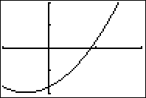
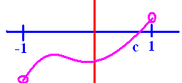
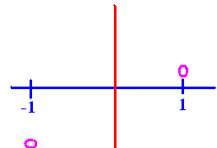
f(x) = x² + x – 1.7
Prove f has a zero on [-1, 1]
f(-1) = -1.7, f(1) = 0.3
f is continuous on [-1, 1]
0 (-1.7, 0.3) so by the IVT
a c (-1, 1) so that f(c)= 0.

Slide 35
f(x) = x² + x – 1.7
Prove f has a zero on [-1, 1]
-1.896424 is not a zero in [-1, 1]

Slide 36
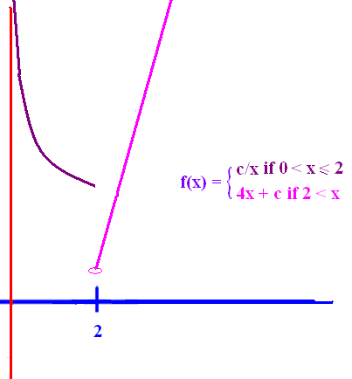
Find c to make f continuous
Part 3 says
or
c/x must equal 4x + c when x = 2

Slide 37
Find c to make f continuous
c/x = 4x + c
when x = 2
c/2 = 8 + c
-8 = c/2
-16 = c
f(2) = -8

Slide 38
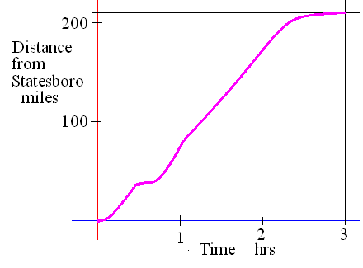
Continuity
This function is continuous on [0,3]
d.n.e.
Similarly,
even though
d.n.e.

