Slide 1

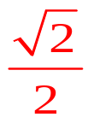
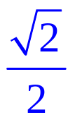

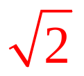

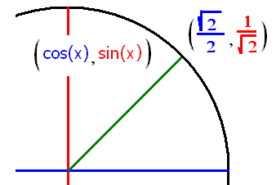

Trigonometry Review
Find sin(π/4) = cos(π/4) = tan(π/4) =
csc(π/4) = sec(π/4) = cot(π/4) =

Slide 2
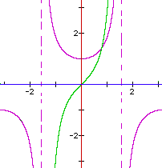
Evaluate tan(π/4)
Root 2
2
Root 2 /2
2 / Root 2
1

Slide 3


Evaluate tan(π/4)
Root 2
2
Root 2 /2
2 / Root 2
1

Slide 4

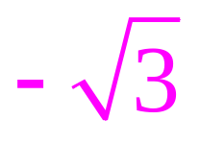


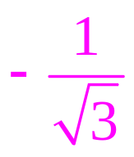


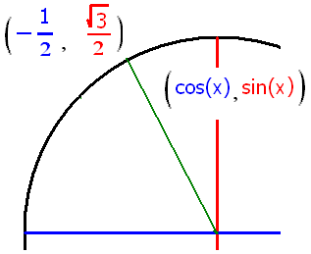
Trigonometry Review
sin(2π/3) = cos(2π/3) = tan(2π/3) =
csc(2π/3) = sec(2π/3) = cot(2π/3) =

Slide 5
Evaluate sec(2π/3)
-1
-2
-3
Root(3)
2 / Root(3)

Slide 6
Evaluate sec(2π/3)
-1
-2
-3
Root(3)
2 / Root(3)

Slide 7

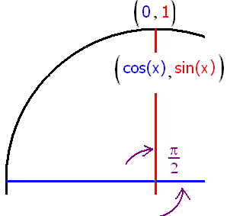
Evaluate cos(π/2)
-1
-.707
1
0.0

Slide 8
Evaluate cos(π/2)
-1
-.707
1
0.0

Slide 9
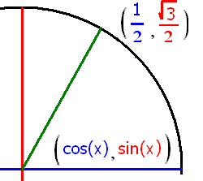
Evaluate sin(π/3)
- 0.5
0.5
0.707
0.866

Slide 10
Evaluate sin(π/3)
- 0.5
0.5
0.707
0.866

Slide 11

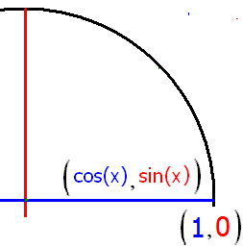
If y = sec(ξ), find y if ξ = 0

Slide 12


If y = sec(ξ), find y if ξ = 0
1.0
0.1

Slide 13
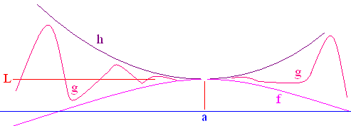
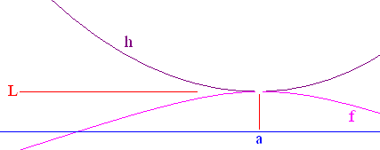
Squeeze Theorem
If f(x) g(x) h(x) on an open interval containing a, and
then

Slide 14
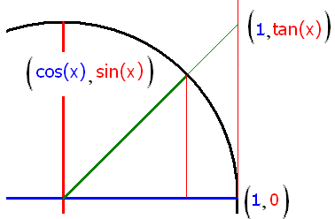
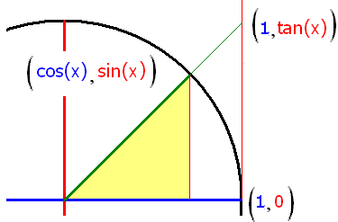
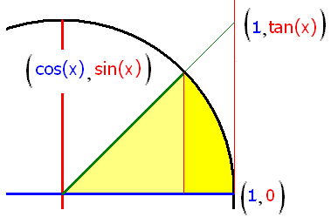
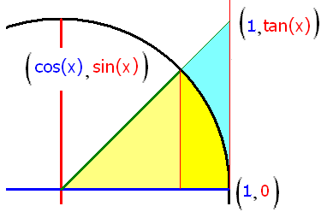
½ sin(x)cos(x) ½ x ½ sin(x)/cos(x)
cos(x) x/sin(x) 1/cos(x)
1
therefore 1

Slide 15
Rule 4

Slide 16


Slide 17
.

Slide 18
.
5.0
0.1

Slide 19

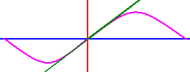
sin(.1)=
sin(.01)=
sin(.001=
sin(.0001)=
sin(.0000001)=

Slide 20
.

Slide 21
.
0.01
0.005

Slide 22
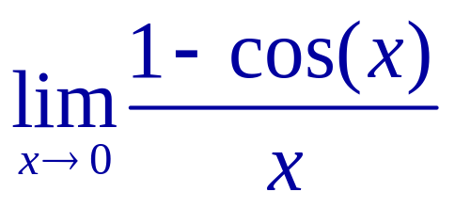
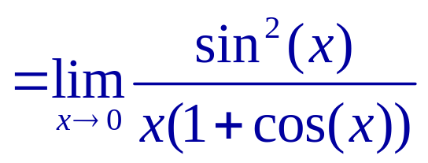
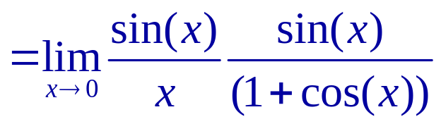
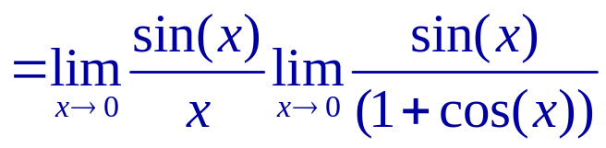
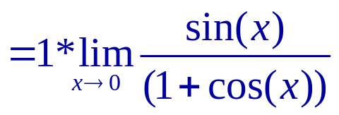
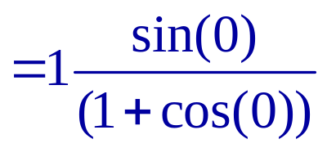
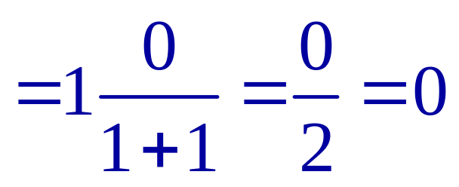
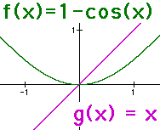
Evaluate

Slide 23
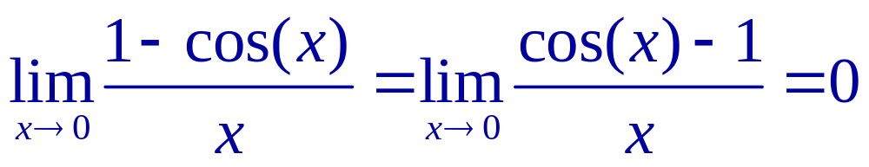
Rule 5

Slide 24

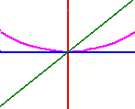


= 0

Slide 25
.

Slide 26
.
0.0
0.1

Slide 27
.

Slide 28
.
0.0
0.1

Slide 29




Slide 30

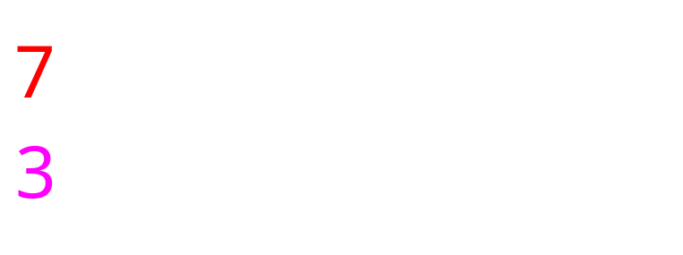


Slide 31
.

Slide 32
.
0.5
0.1

Slide 33
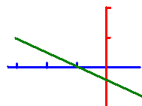
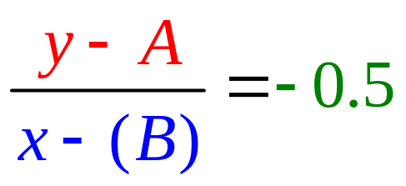

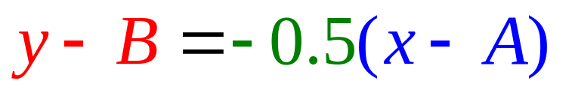
Equation of Lines

Slide 34
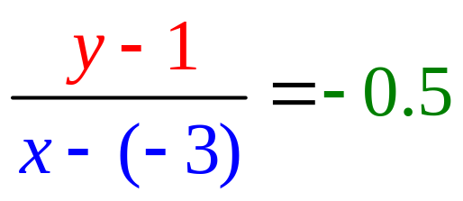
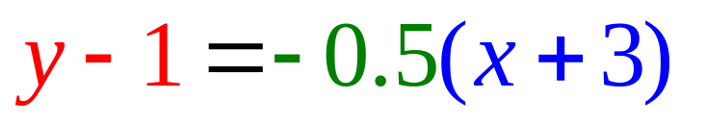
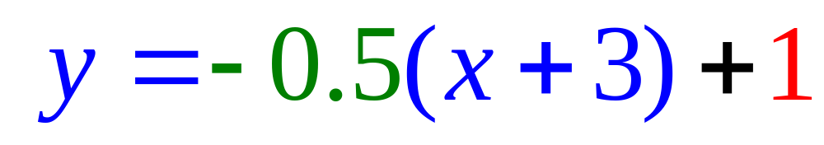
Equation of Lines
Write the equation of a line that passes through (-3, 1) with a slope of – ½ .
or
or

Slide 35
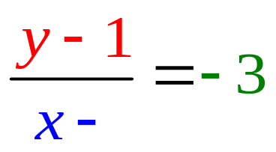
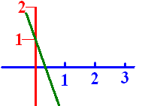
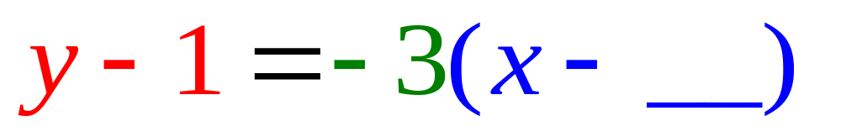
Passes through (0, 1) with a slope of -3. What is the missing blue number?

Slide 36
Passes through (0, 1) with a slope of -3. What is the missing blue number?
0.0
0.1

Slide 37
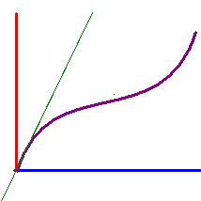
Write the equation of the line tangent to y = x + sin(x) when x = 0 given the slope there is 2.
y = 2x + 1
y = 2x + 0.5
y = 2x

Slide 38
Write the equation of the line tangent to y = x + sin(x) when x = 0 given the slope there is 2.
y = 2x + 1
y = 2x + 0.5
y = 2x

Slide 39
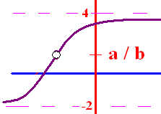
Limit Algebraic Rules
Rule 1 – Plug the x xalue
  into the equation
If you get a/b and
b 0, the answer is a/b
b = 0 and a 0, the answer is d.n.e
you get 0/0 then go to higher rules

Slide 40
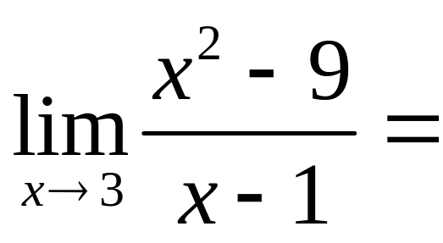
.

Slide 41
.
0.0
0.1

Slide 42
Limit Algebraic Rules
Rule 2 – Factor and cancel
  return to Rule 1
SOAP (a³ + b³) = (a + b)(a² – ab + b²)
Diff of 2 squares (a² - b²) = (a + b)(a – b)
a x² + bx + c Find two numbers whose product is ac, but add to b

Slide 43
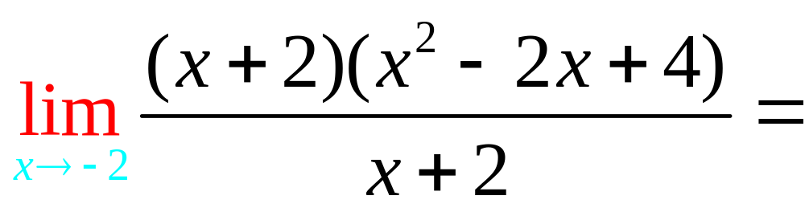
.

Slide 44
.
12.0
0.1

Slide 45
Limit Algebraic Rules
Rule 1 – Plug the x xalue
  into the equation
If you get a/b and
b 0, the answer is a/b
b = 0 and a 0, the answer is d.n.e
you get 0/0 then go to higher rules

Slide 46
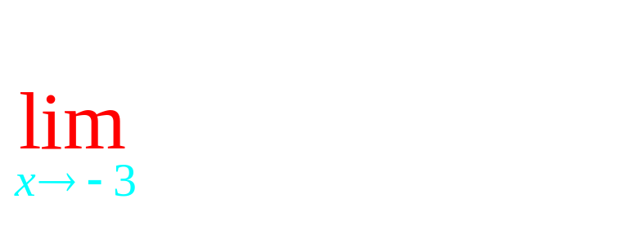
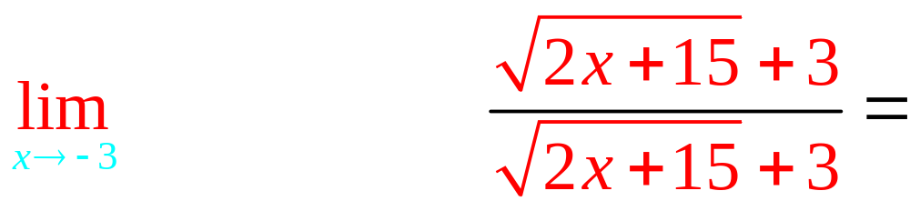
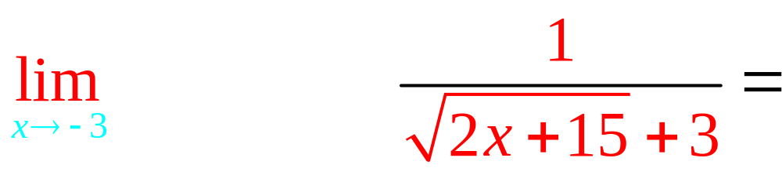
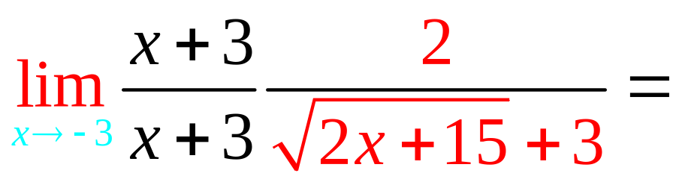
Rule 3 – Conjugate

Slide 47
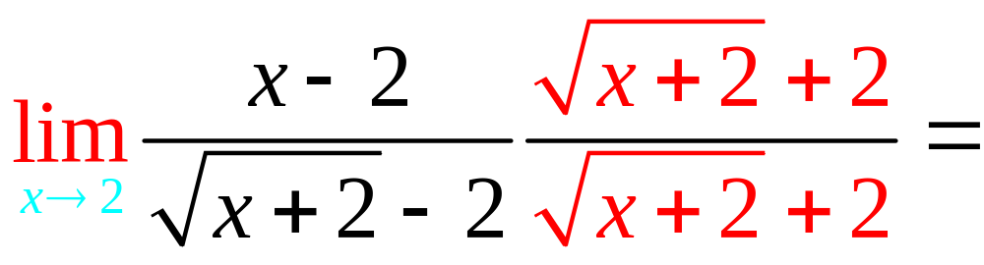
.

Slide 48
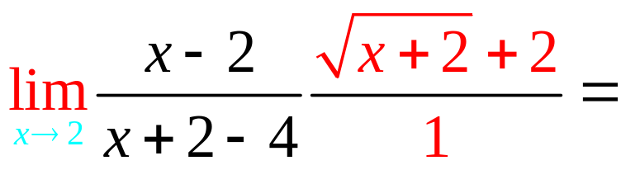
.

Slide 49
. 4
4.0
0.1

Slide 50
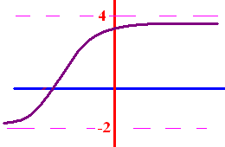
Limits as x goes to
+ or - infinity
What does y get close to
as x goes to + infinity?
What does y get close to
as x goes to - infinity?

Slide 51
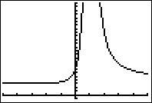






Limits as x goes to
+ or - infinity
To calculate the limit as x
goes to infinity, remember
if n > 0.

Slide 52





Limits as x goes to
+ or - infinity

Slide 53






Limits as x goes to
+ or - infinity

Slide 54


5
f(x)=3x⁵ - 3x³ + 2
g(x) = 2x⁵ - 4x + 2

Slide 55

Evaluate .
3
1/3
d.n.e
0

Slide 56
Evaluate .
3
1/3
d.n.e
0

Slide 57

Evaluate .
3
1/3
d.n.e
0

Slide 58
Evaluate .
3
1/3
d.n.e
0

Slide 59

Evaluate .
3
1/3
d.n.e
0

Slide 60
Evaluate .
3
1/3
d.n.e
0

Slide 61

Evaluate
3
1/3
d.n.e
0

Slide 62
Evaluate
3
1/3
d.n.e
0

Slide 63

0
d.n.e.
7

Slide 64
0
d.n.e.
7

Slide 65

9/8
d.n.e.
0

Slide 66





x, if 0 < x
-x, if x < 0

Slide 67





x, if 0 < x
-x, if x < 0

Slide 68

.
3.0
0.1

Slide 69

.
-3.0
0.1

