Slide 1
Tangent Lines
Equation of lines
Equation of secant lines
Equation of tangent lines

Slide 2
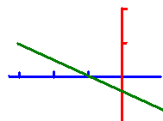
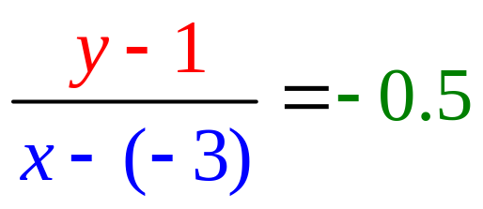
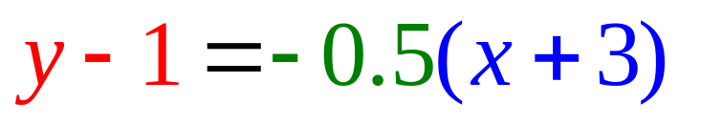
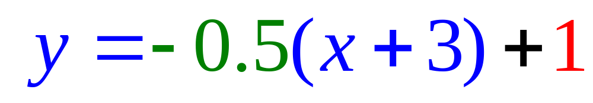
Equation of Lines
Write the equation of a line that passes through (-3, 1) with a slope of – ½ .
or
or

Slide 3
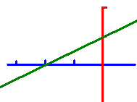
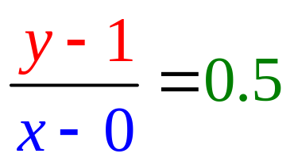
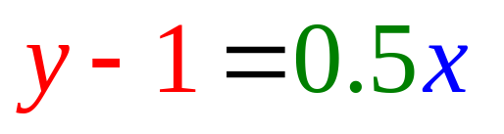
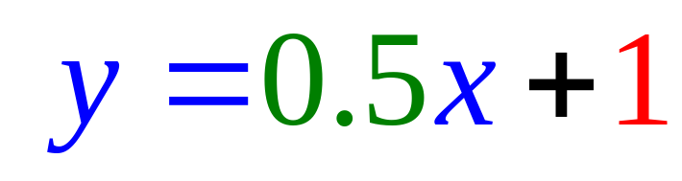
Equation of Lines
Write the equation of a line that passes through (0, 1) with a slope of ½ .
or
or

Slide 4
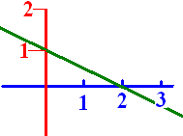
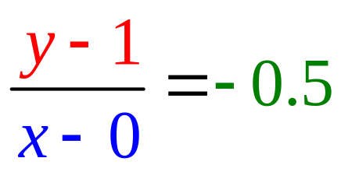
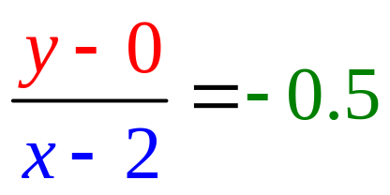
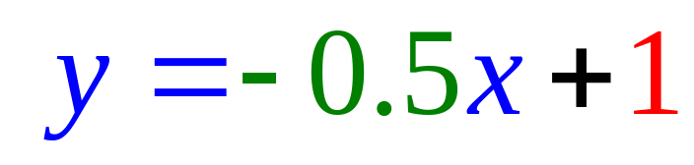
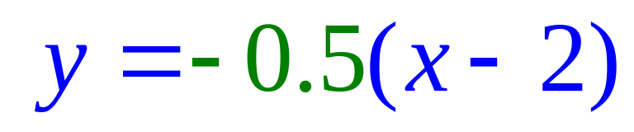
Equation of Lines
Write the equation of the line .
or
or

Slide 5
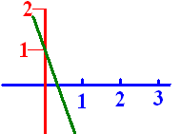
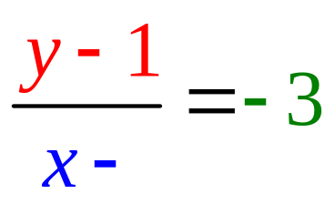
Lines
When writing the equation of a line that passes through (0, 1) with a slope of -3 .
What is the missing blue number?
A -3
B -1
C 0
D 1

Slide 6


Lines
When writing the equation of a line that passes through (0, 1) with a slope of -3 .
What is the missing blue number?
A -3
B -1
C 0
D 1

Slide 7

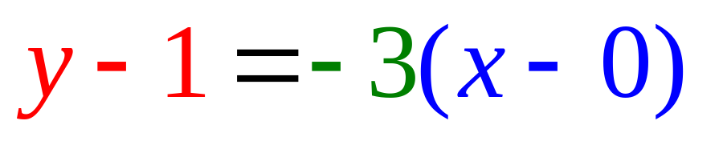
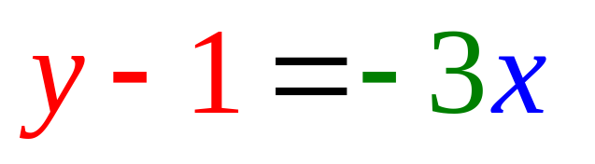
Passes through (0, 1) with a slope of -3. The missing blue number was zero. . . . . . . . . . . . . . . . . .

Slide 8
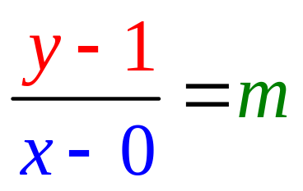

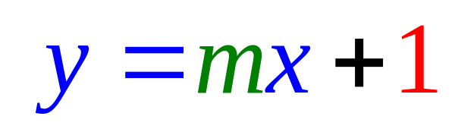
Write the equation of a green line that passes through (0, 1) with a slope of -3 .
What is the missing green number m?
A -3
B -1
C 0
D 1

Slide 9
Write the equation of a green line that passes through (0, 1) with a slope of -3 .
What is the missing green number m?
A -3
B -1
C 0
D 1

Slide 10
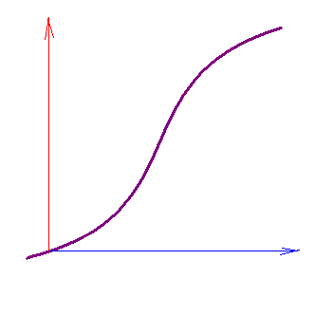
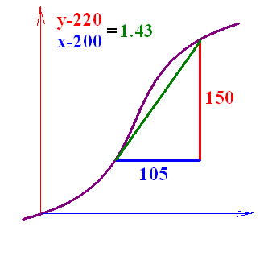
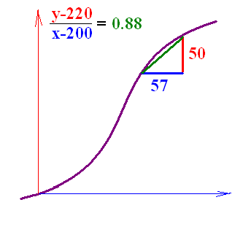
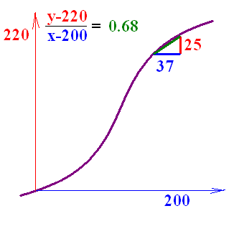
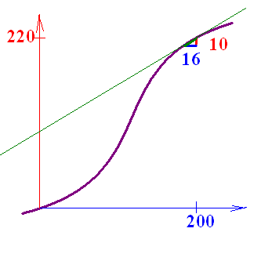
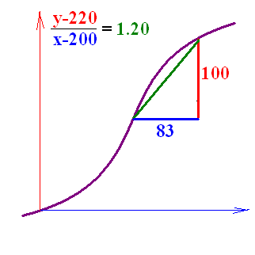
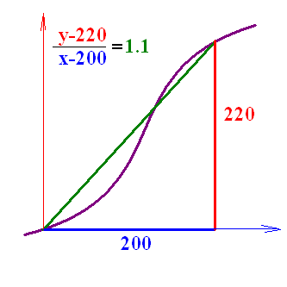
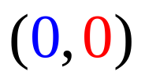





Secant Lines
Write the equation of the secant line that passes through
and (200, 220).

Slide 11
What is the slope of this secant line that passes through (200, 220) and (184, 210) ?

Slide 12
What is the slope of this secant line that passes through (200, 220) and (184, 210) ?
A 5/9
B 5/7
C 5/8
D 10/6
E 10/12

Slide 13
What is the slope of this secant line that passes through (200, 220) and (184, 210) ?
A 5/9
B 5/7
C 5/8
D 10/6
E 10/12

Slide 14
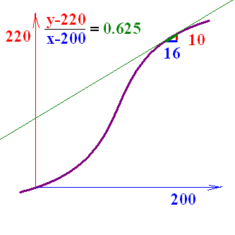
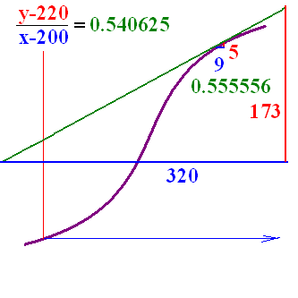
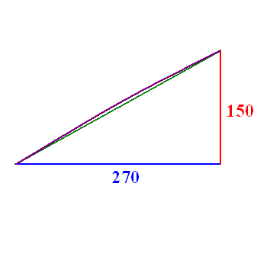
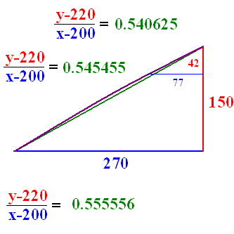
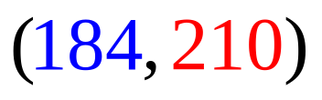
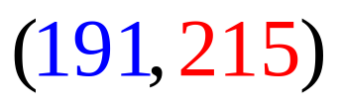
Secant Lines
Write the equation of the secant line that passes through
and (200, 220).

Slide 15
http://math.georgiasouthern.edu/~bmclean/java/p6.html Secant Lines
http://www.youtube.com/watch?v=P9dpTTpjymE Derive

Slide 16
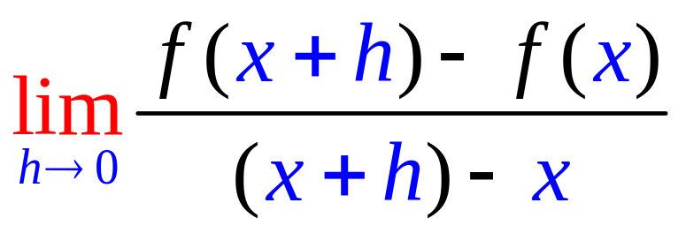
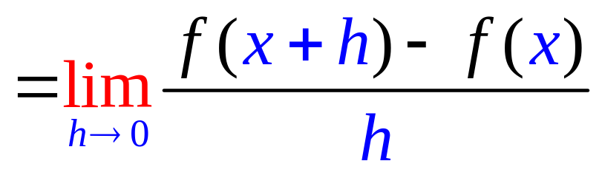
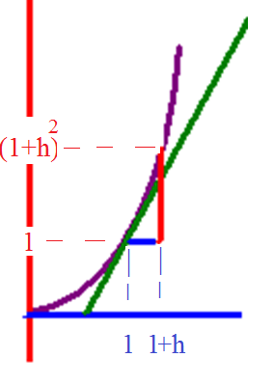
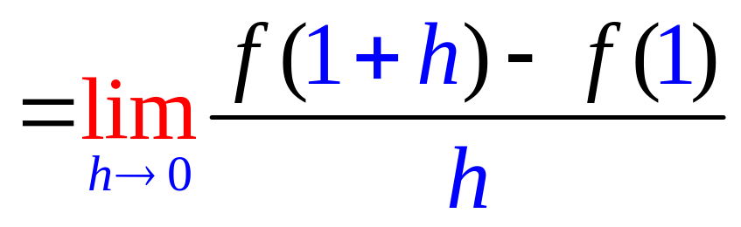
The slope of f(x) =x²
and when x = 1

Slide 17
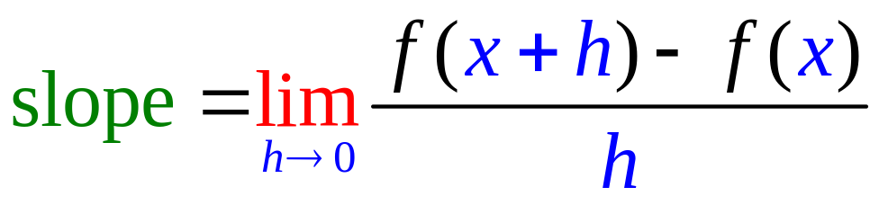
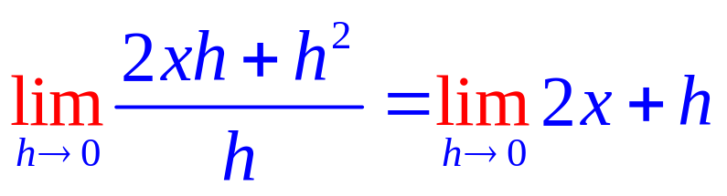
Find the slope of the tangent line of f(x) = x² when x = x.
1. Calculate f(x+h) – f(x)
f(x+h) = x² + 2xh + h²
f(x) = x²
f(x+h) – f(x) = 2xh + h² .
2. Divide by h and get 2x + h
3. Let h go to 0

Slide 18
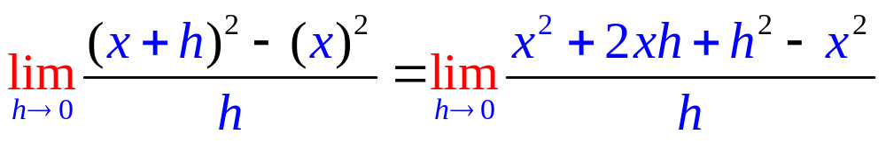
Find the slope of f(x)=x²
2x+h
2x
x²

Slide 19
Find the slope of f(x)=x²
2x+h
2x
x²

Slide 20
Find the slope of the tangent line of f(x) = x² when x = x.
1. Calculate f(x+h) – f(x)
f(x+h) = x² + 2xh + h²
f(x) = x²
f(x+h) – f(x) = 2xh + h² .
2. Divide by h and get 2x + h
3. Let h go to 0 and get 2x

Slide 21
Finding the slope of the tangent line of f(x) = x², f(x+h) - f(x) =
(x+h)² – x²
x² + h² – x²
(x+h)(x – h)

Slide 22
Finding the slope of the tangent line of f(x) = x², f(x+h) - f(x) =
(x+h)² – x²
x² + h² – x²
(x+h)(x – h)

Slide 23
(x+h)² – x² =
x² + 2xh + h²
h²
2xh + h²

Slide 24
(x+h)² – x² =
x² + 2xh + h²
h²
2xh + h²

Slide 25
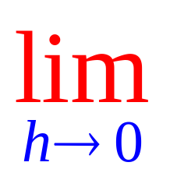
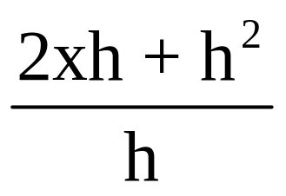
⁼
2x
2x + h²
2xh

Slide 26
⁼
2x
2x + h²
2xh

Slide 27
Find the slope of the tangent line of f(x) = 2x + 3 when x = 1.
1. Calculate f(1+h) – f(1)
f(1+h) = 2(1+h) + 3
f(1) = 5
f(1+h) – f(1) = 2 + 2h + 3 – 5 =2h
2. Divide by h and get 2
3. Let h go to 0 and get 2

Slide 28
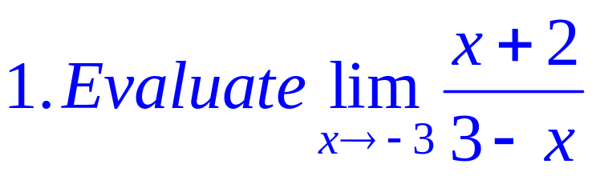
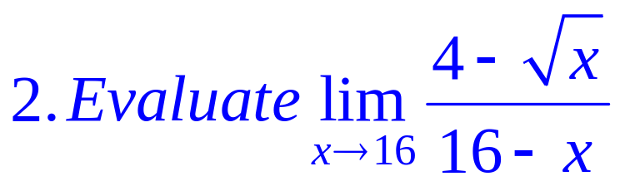
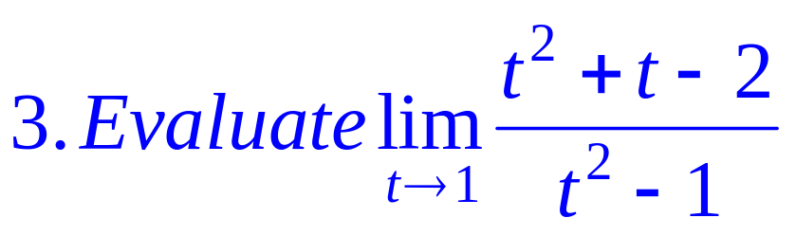

Slide 29
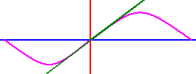
sin(0.0018) =

Slide 30

sin(0.0018) =
0.0018
0.0005

Slide 31
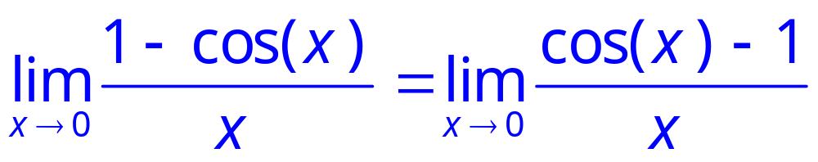
= 0
Rule 5

Slide 32

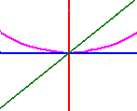


= 0

Slide 33
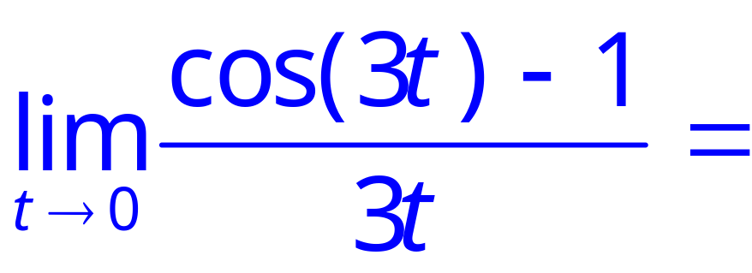
.

Slide 34
.
0.0
0.1

Slide 35
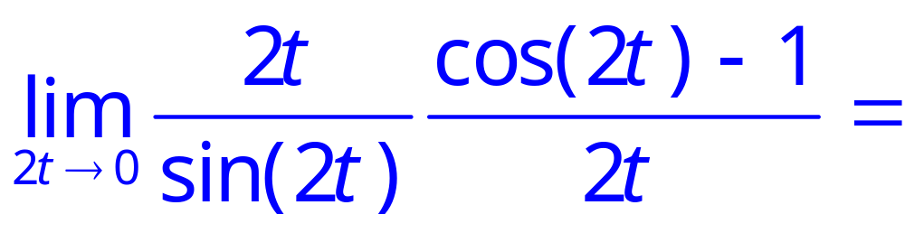
.

Slide 36
.
0.0
0.1

Slide 37


.

Slide 38

.

Slide 39

.

Slide 40






Slide 41




Slide 42

.

Slide 43
.
0.5
0.1

Slide 44
Equation of Lines
Write the equation of a line that passes through (-3, 1) with a slope of – ½ .
or
or

Slide 45

Passes through (0, 1) with a slope of -3. What is the missing blue number?
0.0
0.1

Slide 46

Write the equation of the line tangent to y = x + sin(x) when x = 0 given the slope there is 2.
y = 2x + 1
y = 2x + 0.5
y = 2x

Slide 47
Write the equation of the line tangent to y = x + sin(x) when x = 0 given the slope there is 2.
y = 2x + 1
y = 2x + 0.5
y = 2x

Slide 48
sin(0.0018) =
A 1.8
B 0.18
C 0.018
D 0.0018
E 0.00018

Slide 49
sin(0.0018) =
A 1.8
B 0.18
C 0.018
D 0.0018
E 0.00018

Slide 50
= 0
Rule 5

Slide 51
.
A 12
B 6
C 1
D 0
E -1

Slide 52
.
A 12
B 6
C 1
D 0
E -1

Slide 53
.
A 12
B 6
C 1
D 0
E -1

Slide 54
.
A 12
B 6
C 1
D 0
E -1

Slide 55
.

Slide 56

.

Slide 57

.

Slide 58

.

Slide 59

.

Slide 62
.
A 0
B ½
C 1
D 4
E 8

Slide 63
.
A 0
B ½
C 1
D 4
E 8

Slide 64
Write the equation of the line tangent to y = x + sin(x) when x = 0 given the slope there is 2.
y = 2x + 1
y = 2x + 0.5
y = 2x

Slide 65
Write the equation of the line tangent to y = x + sin(x) when x = 0 given the slope there is 2.
y = 2x + 1
y = 2x + 0.5
y = 2x

