Slide 1

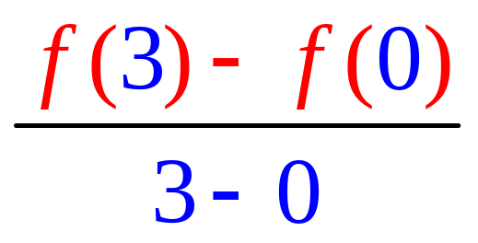
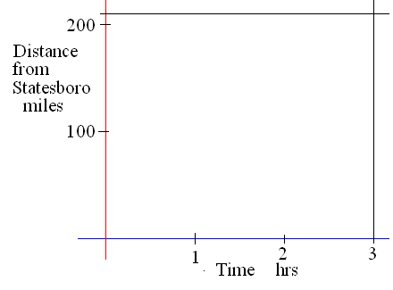
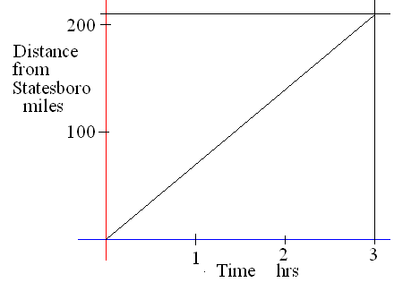
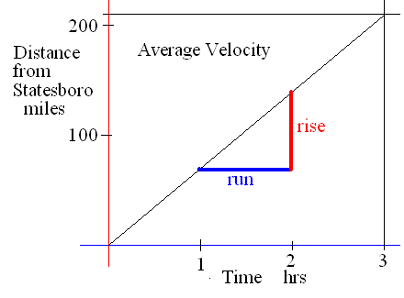
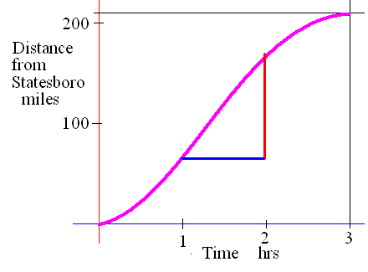
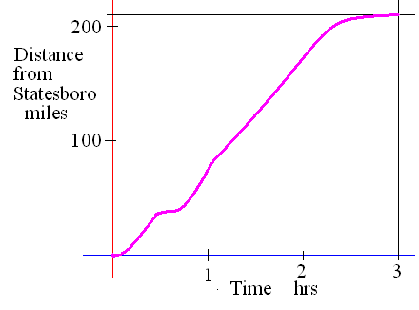
Average slope
Find the rate of change if it takes 3 hours to drive 210 miles.
What is your average speed or velocity?

Slide 2


If it takes 3 hours to drive 210 miles then we average
1 mile per minute
2 miles per minute
70 miles per hour
55 miles per hour

Slide 3
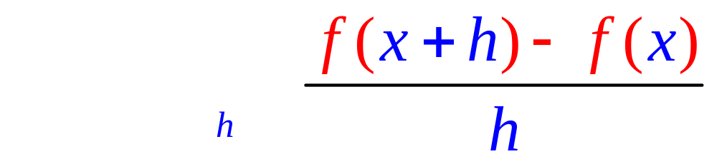
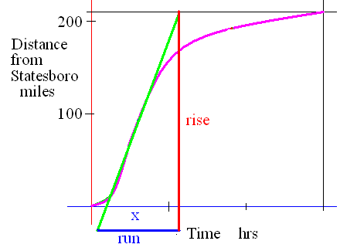
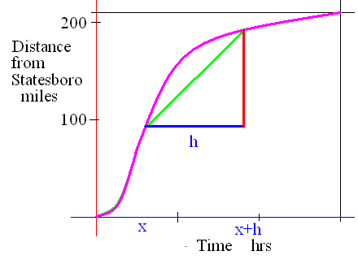
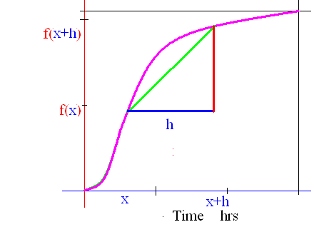
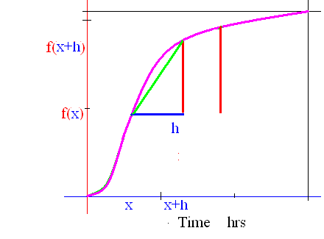
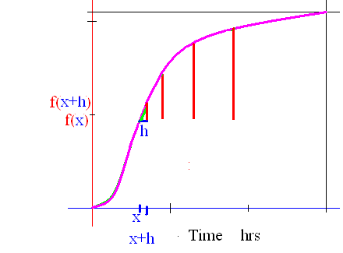
Instantaneous slope
What if h went to zero?

Slide 4
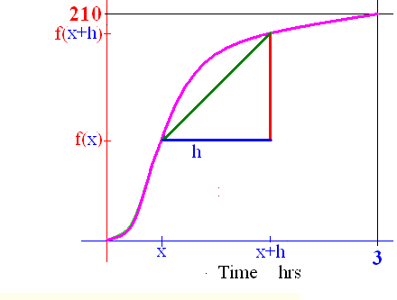
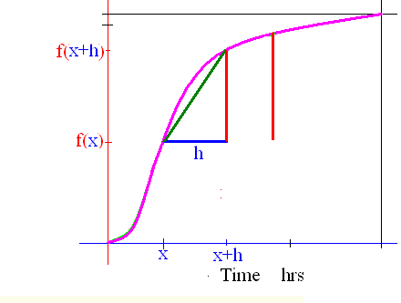
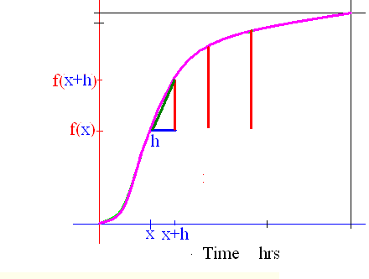
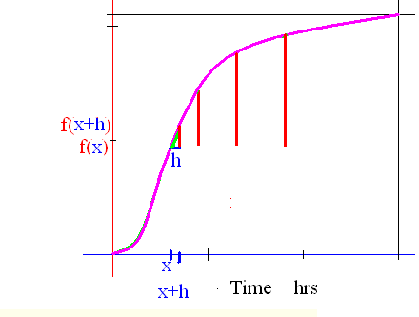
Derivative
if the limit exists as one real number.

Slide 5
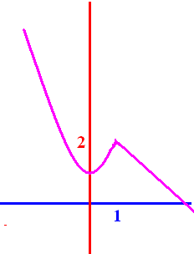
Definition
If f : D -> K is a function then the derivative of f is a new function,
f ' : D' -> K' as defined above if the limit exists.
Here the limit exists every where except at x = 1

Slide 6
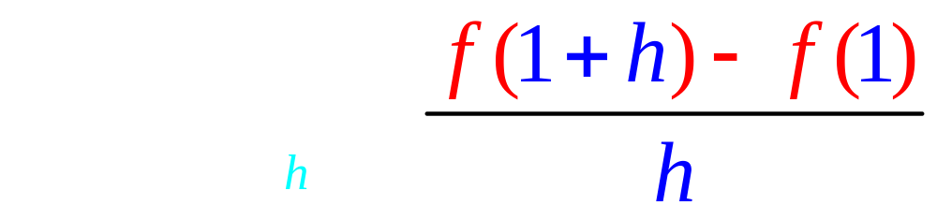
Guess at

Slide 7

Guess at

Slide 8
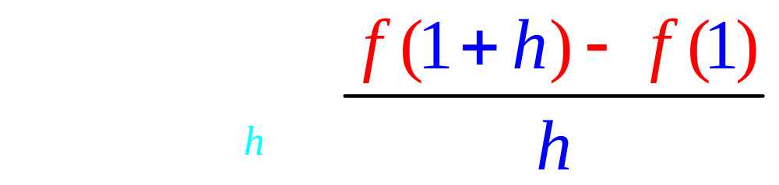
Thus
d.n.e.

Slide 9
Guess at
f’(0) – slope of f when x = 0

Slide 10


Guess at f ’(3)
-1.0
0.49

Slide 11
Guess at f ’(-2)
-4.0
2.99

Slide 12
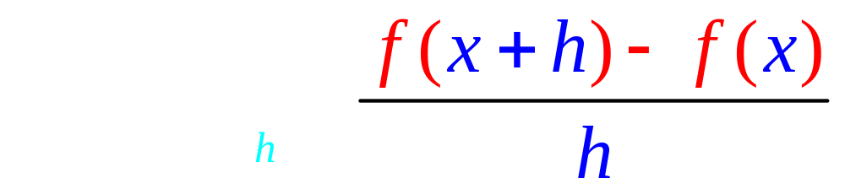
Note that the rule is
f '(x) is the slope at the point ( x, f(x) ),
D' is a subset of D, but
K’ has nothing to do with K

Slide 13
K is the set of distances from home
K' is the set of speeds
K is the set of temperatures
K' is the set of how fast they rise
K is the set of today's profits ,
K' tells you how fast they change
K is the set of your averages
K' tells you how fast it is changing.

Slide 14
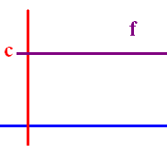
Theorem If f(x) = c where c is a real number, then f ' (x) = 0.
Proof : Lim [f(x+h)-f(x)]/h =
Lim (c - c)/h = 0.
Examples
If f(x) = 34.25 , then f ’ (x) = 0
If f(x) = π² , then f ’ (x) = 0

Slide 15
If f(x) = 1.3 , find f’(x)
0.0
0.1

Slide 16
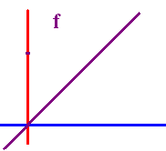
Theorem
If f(x) = x, then f ' (x) = 1.
Proof : Lim [f(x+h)-f(x)]/h =
Lim (x + h - x)/h = Lim h/h = 1
What is the derivative of x grandson?
One grandpa, one.

Slide 17
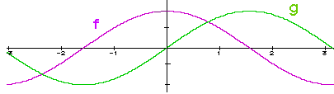
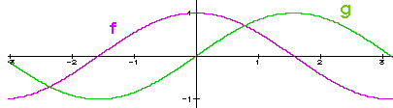
Theorem If c is a constant,
(c g) ' (x) = c g ' (x)
Proof : Lim [c g(x+h)-c g(x)]/h =
c Lim [g(x+h) - g(x)]/h = c g ' (x)

Slide 18
Theorem If c is a constant,
(cf) ' (x) = cf ' (x)
( 3 x)’ = 3 (x)’ = 3 or
If f(x) = 3 x then
f ’(x) = 3 times the derivative of x
And the derivative of x is . .
One grandpa, one !!

Slide 19
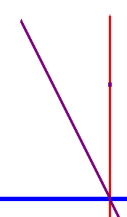
If f(x) = -2 x then f ’(x) =
-2.0
0.1

Slide 20
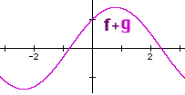
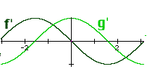


Theorems
1. (f + g) ' (x) = f ' (x) + g ' (x), and
2. (f - g) ' (x) = f ' (x) - g ' (x)

Slide 21
1. (f + g) ' (x) = f ' (x) + g ' (x)
2. (f - g) ' (x) = f ' (x) - g ' (x)
If f(x) = 3² x + 7, find f ’ (x)
f ’ (x) = 9 + 0 = 9
If f(x) = x - 7, find f ’ (x)
f ’ (x) = - 0 =

Slide 22
If f(x) = -2 x + 7, find f ’ (x)
-2.0
0.1

Slide 23
If f(x) = then f’(x) =
Proof : f’(x) = Lim [f(x+h)-f(x)]/h =

Slide 24
If f(x) = then f’(x) =
.
.
.
.

Slide 25
If f(x) = x^{n} then f ' (x) = n x ^{(n-1)}
If f(x) = x⁴ then f ' (x) = 4 x³
If

Slide 26

If f(x) = x^{n} then f ' (x) = n x^{n-1}
If f(x) = x⁴ + 3 x³ - 2 x² - 3 x + 4
f ' (x) = 4 x³ + . . . .
f ' (x) = 4x³ + 9 x² - 4 x – 3 + 0
f(1) = 1 + 3 – 2 – 3 + 4 = 3
f ’ (1) = 4 + 9 – 4 – 3 = 6

Slide 27
If f(x) = x^{n} then f ' (x) = n x ^{(n-1)}
If f(x) = πx⁴ then f ' (x) = 4π x³
If f(x) = π⁴ then f ' (x) = 0
If

Slide 28
If f(x) = then f ‘(x) =

Slide 29
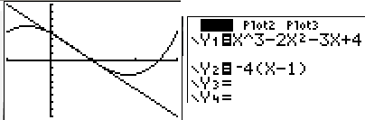
Find the equation of the line tangent to g when x = 1.
If g(x) = x³ - 2 x² - 3 x + 4
g ' (x) = 3 x² - 4 x – 3 + 0
g (1) =
g ' (1) =

Slide 30
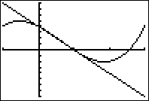
If g(x) = x³ - 2 x² - 3 x + 4 find g (1)
0.0
0.1

Slide 31
If g(x) = x³ - 2 x² - 3 x + 4 find g’ (1)
-4.0
0.1

Slide 32
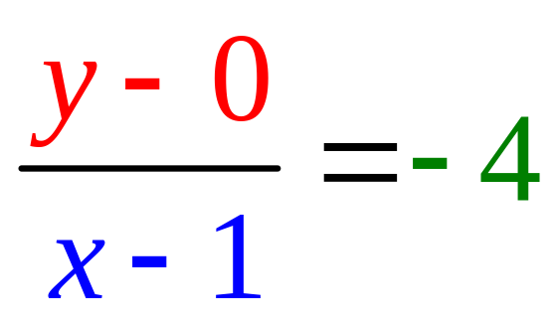
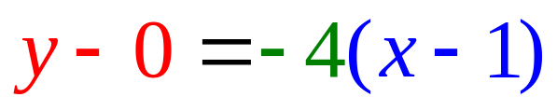
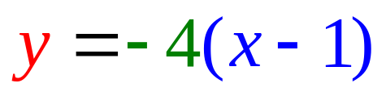
Find the equation of the line tangent to f when x = 1.
g(1) = 0
g ' (1) = – 4

Slide 33
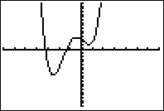
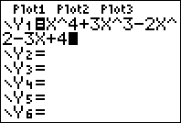
Find the equation of the line tangent to f when x = 1.
If f(x) = x⁴ + 3 x³ - 2 x² - 3 x + 4
f ' (x) = 4x³ + 9 x² - 4 x – 3 + 0
f (1) = 1 + 3 – 2 – 3 + 4 = 3
f ' (1) = 4 + 9 – 4 – 3 = 6

Slide 34
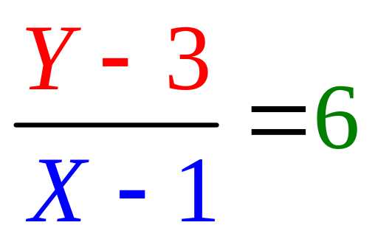
Find the equation of the line tangent to f when x = 1.
f(1) = 1 + 3 – 2 – 3 + 4 = 3
f ' (1) = 4 + 9 – 4 – 3 = 6

Slide 35
Write the equation of the tangent line to f when x = 0.
If f(x) = x⁴ + 3 x³ - 2 x² - 3 x + 4
f ' (x) = 4x³ + 9 x² - 4 x – 3 + 0
f (0) = write down
f '(0) = for last question

Slide 36

Write the equation of the line tangent to f(x) when x = 0.
y - 4 = -3x
y - 4 = 3x
y - 3 = -4x
y - 4 = -3x + 2

Slide 37
http://www.youtube.com/watch?v=P9dpTTpjymE Derive
http://www.9news.com/video/player.aspx?aid=52138&bw= Kids
http://math.georgiasouthern.edu/~bmclean/java/p6.html Secant Lines

