Slide 1

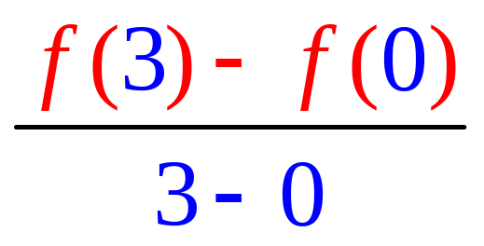
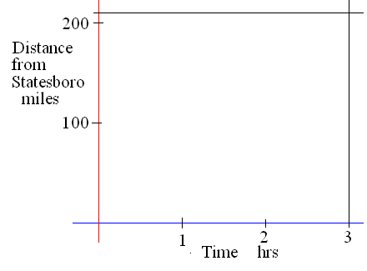
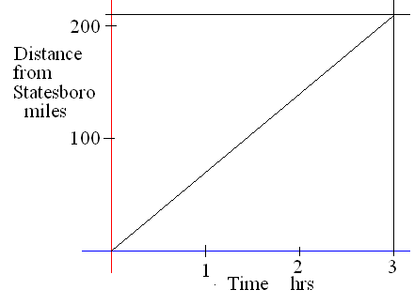
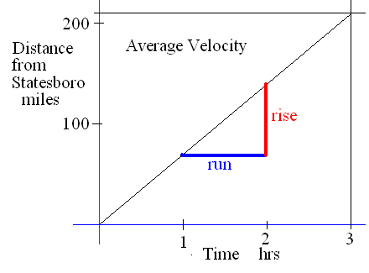
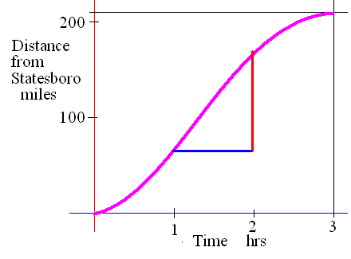
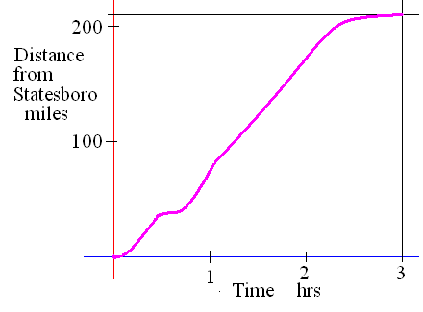
Average rate of change
Find the rate of change if it takes 3 hours to drive 210 miles.
What is your average speed or velocity?

Slide 2
If it takes 3 hours to drive 210 miles then we average
1 mile per minute
2 miles per minute
70 miles per hour
55 miles per hour

Slide 3


If it takes 3 hours to drive 210 miles then we average
1 mile per minute
2 miles per minute
70 miles per hour
55 miles per hour

Slide 4
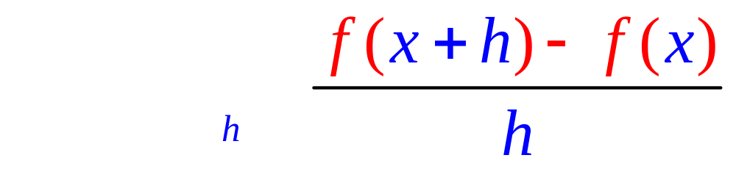
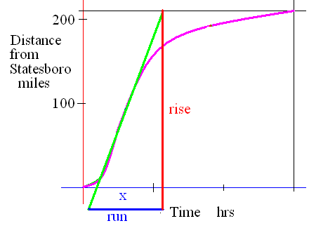
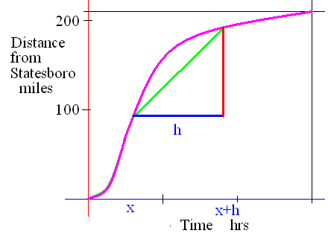
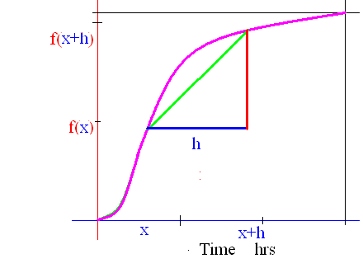
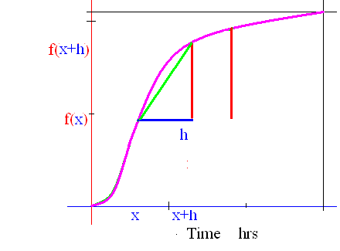
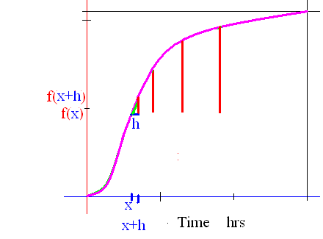
Instantaneous slope
What if h went to zero?

Slide 5
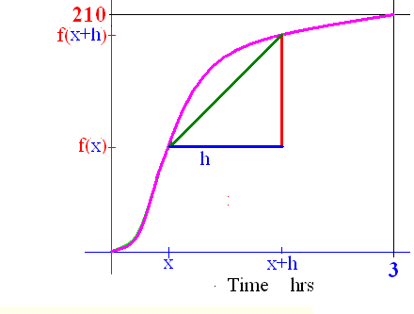
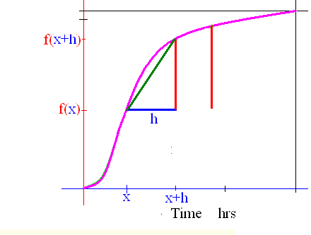
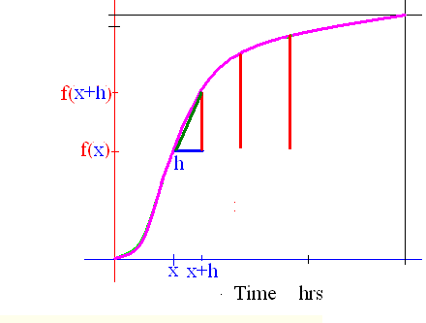
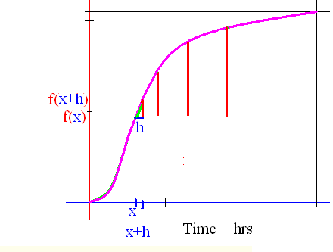
Derivative
if the limit exists as one real number.

Slide 6
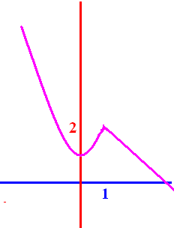
Definition
If f : D -> K is a function then the derivative of f is a new function,
f ' : D' -> K' as defined above if the limit exists.
Here the limit exists every where except at x = 1

Slide 7
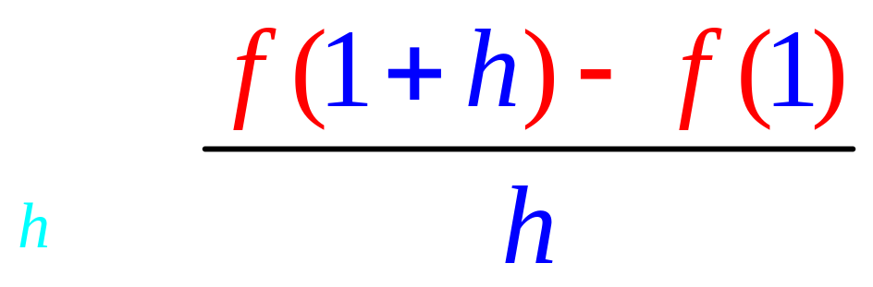
Guess at

Slide 8
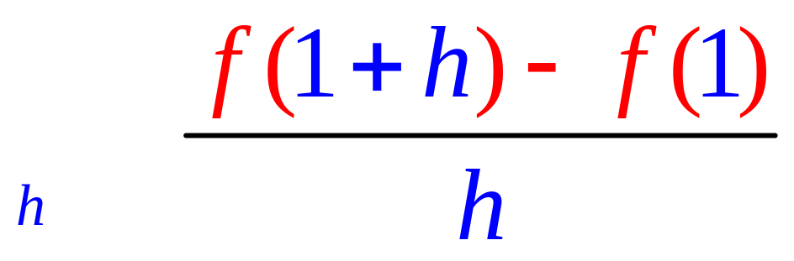
Guess at

Slide 9
Evaluate

Slide 10
Evaluate
A 20
B 5
C 2
D 0
E -2

Slide 11
Evaluate
A 20
B 5
C 2
D 0
E -2

Slide 12
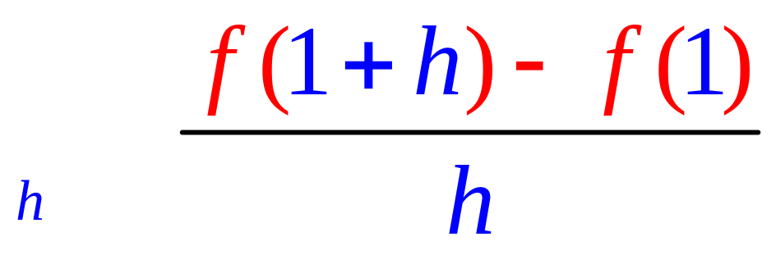
Evaluate
A 2
B 1
C 0
D -1
E -2

Slide 13
Evaluate
A 2
B 1
C 0
D -1
E -2

Slide 14
Evaluate
-1 =

Slide 15
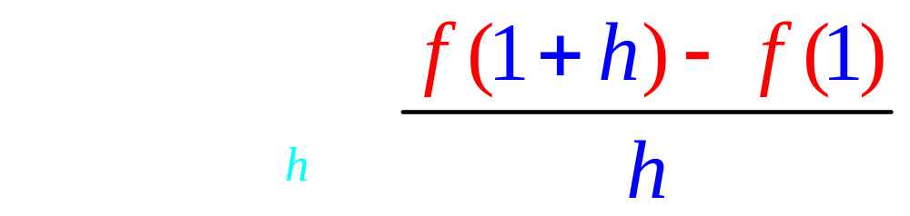
Evaluate
A 2
B 1
C 0
D -1
E d.n.e.

Slide 16
Evaluate
A 2
B 1
C 0
D -1
E d.n.e.

Slide 17
Returning from Atlanta, we smoothly
turn back to Atlanta at noon.

Slide 18
Returning from Atlanta, we smoothly
turn back to Atlanta at noon.
At 1:00 pm, log truck hits us and drags us back to the boro

Slide 19
Thus

Slide 20
Thus
d.n.e.

Slide 21
Guess at
f’(0.2) – slope of f when x = 0.2
A 2
B 0.4
C 0
D -1
E d.n.e.

Slide 22
Guess at
f’(0.2) – slope of f when x = 0.2
A 2
B 0.4
C 0
D -1
E d.n.e.

Slide 23
Guess at f ’(3)
A 2
B 1
C 0
D -1
E -2

Slide 24
Guess at f ’(3)
A 2
B 1
C 0
D -1
E -2

Slide 25
Guess at f ’(-2)
A 4
B 1
C 0
D -1
E -4

Slide 26
Guess at f ’(-2)
A 4
B 1
C 0
D -1
E -4

Slide 27
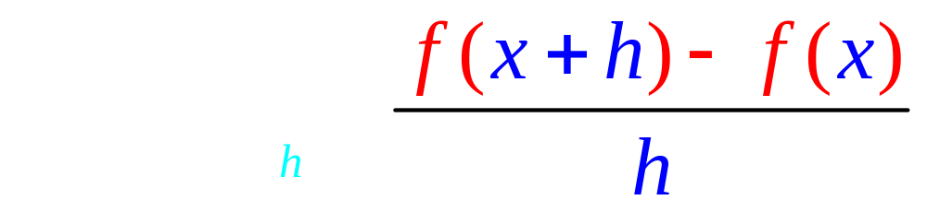
Note that the rule is
f '(x) is the slope at the point ( x, f(x) ),
D' is a subset of D, but
K’ has nothing to do with K

Slide 28
K is the set of distances from home
K' is the set of speeds
K is the set of temperatures
K' is the set of how fast they rise
K is the set of today's profits ,
K' tells you how fast they change
K is the set of your averages
K' tells you how fast it is changing.

Slide 29
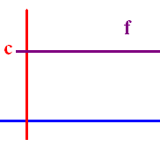
Theorem If f(x) = c where c is a real number, then f ' (x) = 0.
Proof : Lim [f(x+h)-f(x)]/h =
Lim (c - c)/h = 0.
Examples
If f(x) = 34.25 , then f ’ (x) = 0
If f(x) = π² , then f ’ (x) = 0

Slide 30
If f(x) = 1.3 , find f’(x)
A 2
B 1
C 0
D -1
E -2

Slide 31
If f(x) = 1.3 , find f’(x)
A 2
B 1
C 0
D -1
E -2

Slide 32
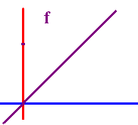
Theorem
If f(x) = x, then f ' (x) = 1.
Proof : Lim [f(x+h)-f(x)]/h =
Lim (x + h - x)/h = Lim h/h = 1
What is the derivative of x grandson?
One grandpa, one.

Slide 33
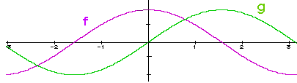
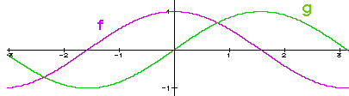
Theorem If c is a constant,
(c g) ' (x) = c g ' (x)
Proof : Lim [c g(x+h)-c g(x)]/h =
c Lim [g(x+h) - g(x)]/h = c g ' (x)

Slide 34
Theorem If c is a constant,
(cf) ' (x) = cf ' (x)
( 3 x)’ = 3 (x)’ = 3 or
If f(x) = 3 x then
f ’(x) = 3 times the derivative of x
And the derivative of x is . .
One grandpa, one !!

Slide 35
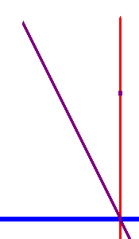
If f(x) = -2 x then f ’(x) =
numeric

Slide 36


If f(x) = -2 x then f ’(x) =
-2.0
0.1

Slide 37
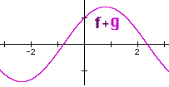
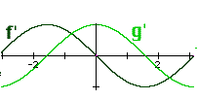


Theorems
1. (f + g) ' (x) = f ' (x) + g ' (x), and
2. (f - g) ' (x) = f ' (x) - g ' (x)

Slide 38
1. (f + g) ' (x) = f ' (x) + g ' (x)
2. (f - g) ' (x) = f ' (x) - g ' (x)
If f(x) = 3² x + 7, find f ’ (x)
f ’ (x) = 9 + 0 = 9
If f(x) = x - 7, find f ’ (x)
f ’ (x) = - 0 =

Slide 39
If f(x) = -2 x + 7, find f ’ (x)
-2.0
0.1

Slide 40
If f(x) = then f’(x) =
Proof : f’(x) = Lim [f(x+h)-f(x)]/h =

Slide 41
If f(x) = then f’(x) =
.
.
.
.

Slide 42
If f(x) = then f’(x) =
.
.
.
.

Slide 43
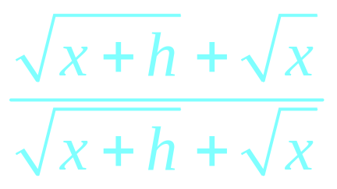
f’(x) = =
.
.
.
.

Slide 44
f’(x) = =
.
.
.
.

Slide 45
f’(x) = =
.
.
.

Slide 46
f’(x) = =
.
.
.

Slide 47
f’(x) = =
.
0
.

Slide 48
f’(x) = =
.
0
.

Slide 49
g(x) = 1/x, find g’(x)
g(x+h) = 1/(x+h)
g(x) = 1/x
g’(x) =

Slide 50
If f(x) = x^{n} then f ' (x) = n x ^{(n-1)}
If f(x) = x⁴ then f ' (x) = 4 x³
If

Slide 51

If f(x) = x^{n} then f ' (x) = n x^{n-1}
If f(x) = x⁴ + 3 x³ - 2 x² - 3 x + 4
f ' (x) = 4 x³ + . . . .
f ' (x) = 4x³ + 9 x² - 4 x – 3 + 0
f(1) = 1 + 3 – 2 – 3 + 4 = 3
f ’ (1) = 4 + 9 – 4 – 3 = 6

Slide 52
If f(x) = x^{n} then f ' (x) = n x ^{(n-1)}
If f(x) = πx⁴ then f ' (x) = 4π x³
If f(x) = π⁴ then f ' (x) = 0
If

Slide 53
If f(x) = then f ‘(x) =

Slide 54
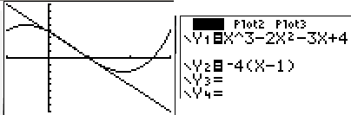
Find the equation of the line tangent to g when x = 1.
If g(x) = x³ - 2 x² - 3 x + 4
g ' (x) = 3 x² - 4 x – 3 + 0
g (1) =
g ' (1) =

Slide 55
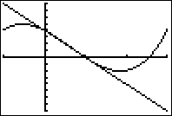
If g(x) = x³ - 2 x² - 3 x + 4 find g (1)
A 2
B 1
C 0
D -1
E -2

Slide 56
If g(x) = x³ - 2 x² - 3 x + 4 find g (1)
0.0
0.1

Slide 57
If g(x) = x³ - 2 x² - 3 x + 4 find g’ (1)
A 4
B 2
C 0
D -2
E -4

Slide 58
If g(x) = x³ - 2 x² - 3 x + 4 find g’ (1)
-4.0
0.1

Slide 59
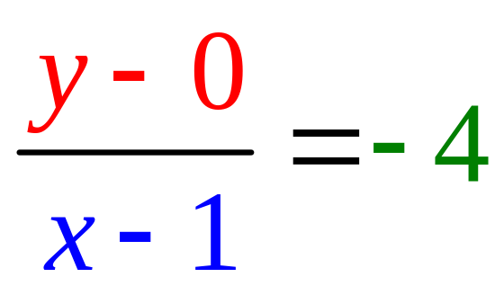
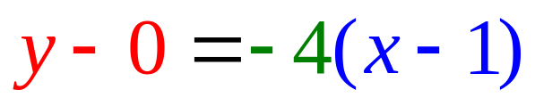
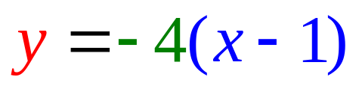
Find the equation of the line tangent to f when x = 1.
g(1) = 0
g ' (1) = – 4

Slide 60
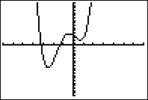
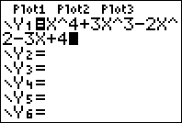
Find the equation of the line tangent to f when x = 1.
If f(x) = x⁴ + 3 x³ - 2 x² - 3 x + 4
f ' (x) = 4x³ + 9 x² - 4 x – 3 + 0
f (1) = 1 + 3 – 2 – 3 + 4 = 3
f ' (1) = 4 + 9 – 4 – 3 = 6

Slide 61
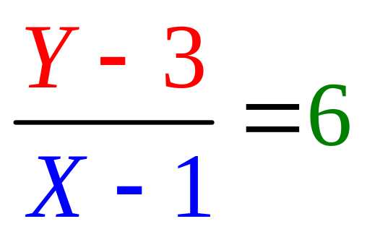
Find the equation of the line tangent to f when x = 1.
f(1) = 1 + 3 – 2 – 3 + 4 = 3
f ' (1) = 4 + 9 – 4 – 3 = 6

Slide 62
Write the equation of the tangent line to f when x = 0.
If f(x) = x⁴ + 3 x³ - 2 x² - 3 x + 4
f ' (x) = 4x³ + 9 x² - 4 x – 3 + 0
f (0) = write down
f '(0) = for last question

Slide 63

Write the equation of the line tangent to f(x) when x = 0.
y - 4 = -3x
y - 4 = 3x
y - 3 = -4x
y - 4 = -3x + 2

Slide 64
Write the equation of the line tangent to f(x) when x = 0.
y - 4 = -3x
y - 4 = 3x
y - 3 = -4x
y - 4 = -3x + 2

Slide 65
http://www.youtube.com/watch?v=P9dpTTpjymE Derive
http://www.9news.com/video/player.aspx?aid=52138&bw= Kids
http://math.georgiasouthern.edu/~bmclean/java/p6.html Secant Lines

Slide 66
Find the derivative of each of the following. 3.1

Slide 67
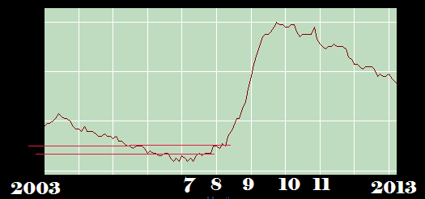
Old News
On June 6, 2008, the jobless rate hit 5.5%. This was the highest value since 2006.
The increase was 0.5%. This was the highest rate increase since 1986.

Slide 68
53. Millions of cameras t=1 means 2001
N(t)=16.3t^{0.8766}.
How many sold in 2001?
How fast was sales increasing in 2001?
How many sold in 2005?
How fast was sales increasing in 2005?

Slide 69
53. Millions of cameras t=1 means 2001
N(t)=16.3t^{0.8766}.
How many sold in 2001?
N(1)= 16.3 million camera sold

Slide 70
53. Millions of cameras t=1 means 2001
N(t) =16.3t^{0.8766}
How fast was sales increasing in 2001?
N’(t) =

Slide 71
53. Millions of cameras t=1 means 2001
N(t) =16.3t^{0.8766}
How fast was sales increasing in 2001?
N’(t) = 0.8766*16.3t^{-0.1234}

Slide 72
53. Millions of cameras t=1 means 2001
N(t) =16.3t^{0.8766}
How fast was sales increasing in 2001?
N’(t) = 0.8766*16.3t^{-0.1234}
N’(1) = 14.2886 million per year

Slide 73
53. Millions of cameras t=1 means 2001
N(t)=16.3t^{0.8766}.
How many sold in 2005?
N(5) =
A 65 million
B 66 “
C 67 “
D 68 “
E 69 “

Slide 74
53. Millions of cameras t=1 means 2001
N(t)=16.3t^{0.8766}.
How many sold in 2005?
N(5)= 66.8197 million cameras sold

Slide 75
53. Millions of cameras t=1 means 2001
N(t) =16.3t^{0.8766}
How fast was sales increasing in 200t?
N’(t) =
A 16.3t^{-0.1234}
B 0.8766*16.3t^{-0.1234}
C 0.8766*16.3t^{-0.8766}
D 16.3t^{-0.8766}

Slide 76
53. Millions of cameras t=1 means 2001
N(t) =16.3t^{0.8766}
How fast was sales increasing in 200t?
N’(t) = 0.8766*16.3t^{-0.1234}

Slide 77
53. Millions of cameras t=1 means 2001
How fast was sales increasing in 2005?
N’(t) = 0.8766*16.3t^{-0.1234}
N’(5) =
A 8 million / year
B 10 million / year
C 12 million / year
D 14 million / year

Slide 78
53. Millions of cameras t=1 means 2001
How fast was sales increasing in 2005?
N’(t) = 0.8766*16.3t^{-0.1234}
N’(5) = .8766*16.3/5^{0.1234}
11.7148 million per year

Slide 79
Dist trvl by X-2 racing car t seconds after braking.#59
x(t) = 120 t – 15 t².
Find the velocity for any t.
Find the velocity when brakes applied.
When did it stop?

Slide 80
Dist trvl by X-2 racing car t seconds after braking. 59.
x(t) = 120 t – 15 t².
Find the velocity for any t.
x’(t) = 120 - 30 t

Slide 81
Dist trvl by X-2 racing car t seconds after braking. 59.
x(t) = 120 t – 15 t².
x’(t) = 120 - 30 t
Find the velocity when brakes applied.
x’(0) = 120 ft/sec

Slide 82
Dist trvl by X-2 racing car t seconds after braking. 59.
x(t) = 120 t – 15 t².
x’(t) = 120 - 30 t
Find the velocity when t = 2.
x’(2) = 120 – 30(2) = 60 ft/sec

Slide 83
Dist trvl by X-2 racing car t seconds after braking. 59.
x(t) = 120 t – 15 t².
x’(t) = 120 - 30 t
Find the velocity when t = 2.
x’(2) = 120 – 30(2) = 60 ft/sec
What does positive 60 mean?

Slide 84
Dist trvl by X-2 racing car t seconds after braking. 59.
x(t) = 120 t – 15 t².
x’(t) = 120 - 30 t
Find the velocity when t = 2.
x’(2) = 120 – 30(2) = 60 ft/sec
What does positive 60 mean?
Car is increasing its distance from home.

Slide 85
Dist trvl by X-2 racing car t seconds after braking. 59.
x(t) = 120 t – 15 t².
x’(t) = 120 - 30 t
When did it stop?

Slide 86
Dist trvl by X-2 racing car t seconds after braking. 59.
x(t) = 120 t – 15 t².
x’(t) = 120 - 30 t
When did it stop?
When the velocity is zero.
A 4
B 2
C 0
D -2

Slide 87
Dist trvl by X-2 racing car t seconds after braking. 59.
x(t) = 120 t – 15 t².
x’(t) = 120 - 30 t
When did it stop?
x’(t) = 120 - 30 t = 0

Slide 88
Dist trvl by X-2 racing car t seconds after braking. 59.
x(t) = 120 t – 15 t².
x’(t) = 120 - 30 t
When did it stop?
x’(t) = 120 - 30 t = 0
120 = 30 t
4 = t

Slide 89
Dist trvl by X-2 racing car t seconds after braking. 59.
x(t) = 120 t – 15 t².
x’(t) = 120 - 30 t
When did it stop?
x’(t) = 120 - 30 t = 0
120 = 30 t
4 = t
This changes the domain of x to

Slide 90
Dist trvl by X-2 racing car t seconds after braking. 59.
x(t) = 120 t – 15 t².
x’(t) = 120 - 30 t
When did it stop?
x’(t) = 120 - 30 t = 0
120 = 30 t
4 = t
This changes the domain of x to [0,4].

Slide 91
Dist trvl by X-2 racing car t seconds after braking. 59.
x(t) = 120 t – 15 t² defined on [0,4].
x’(t) = 120 - 30 t
How far did it travel after hitting the brakes?

Slide 92
Dist trvl by X-2 racing car t seconds after braking. 59.
x(t) = 120 t – 15 t² defined on [0,4].
x’(t) = 120 - 30 t
How far did it travel after hitting the brakes?
x(4) =
A 240
B 120
C 100

Slide 93
Dist trvl by X-2 racing car t seconds after braking. 59.
x(t) = 120 t – 15 t² defined on [0,4].
x’(t) = 120 - 30 t
How far did it travel after hitting the brakes?
x(4) = 480 – 15*16 = 240 feet

Slide 94
Dist trvl by X-2 racing car t seconds after braking. 59.
x(t) = 120 t – 15 t²
x’(t) = 120 - 30 t
Find the acceleration, x’’(t).
A 120 – 30 t
B – 15 t
C -30
D 120 - 30

Slide 95
Dist trvl by X-2 racing car t seconds after braking. 59.
x(t) = 120 t – 15 t².
x’(t) = 120 - 30 t
Find the acceleration, x’’(t).
x’’(t) = -30

Slide 96
Dist trvl by X-2 racing car t seconds after braking. 59.
x(t) = 120 t – 15 t².
x’(t) = 120 - 30 t
Acceleration, x’’(t) = -30.
What does the negative sign mean?

Slide 97
Dist trvl by X-2 racing car t seconds after braking. 59.
x(t) = 120 t – 15 t².
x’(t) = 120 - 30 t
Acceleration, x’’(t) = -30.
What does the negative sign mean?
Your foot is on the brakes.

Slide 98
Dist trvl by X-2 racing car t seconds after braking. 59.
x(t) = 120 t – 15 t².
x’(t) = 120 - 30 t
What is the range on [0,4]?

Slide 99
Dist trvl by X-2 racing car t seconds after braking. 59.
x(t) = 120 t – 15 t².
x’(t) = 120 - 30 t
What is the range on [0,4]?
[0, 240]

