Slide 1


.
0.01
0.005

Slide 2
= 0
cos(A+B)=cos(A)cos(B)-sin(A)sin(B)
If A = B = x
cos(2x)=1-sin²x-sin²x
Replacing x with x/2 gives

Slide 3
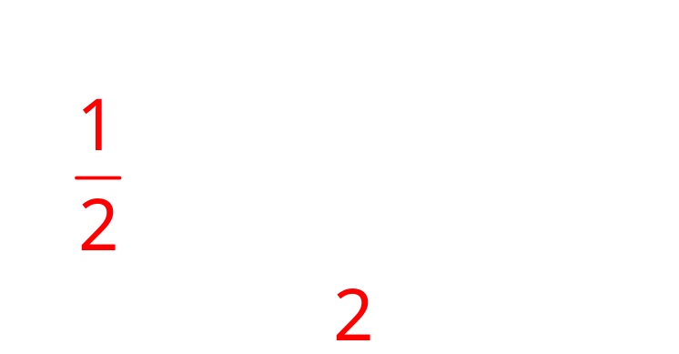
cos(2x)=1-sin²x-sin²x
2sin²(x/2)= 1-cos(x)

Slide 4

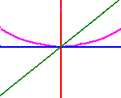

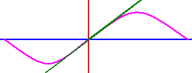

= 0

Slide 5

.
0.0
0.1

Slide 6
.
0.0
0.1

Slide 7




Slide 8

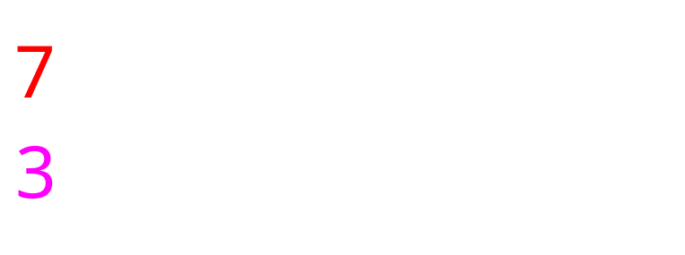


Slide 9
.
0.5
0.1

Slide 10
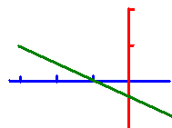
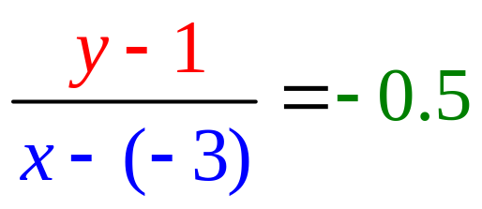
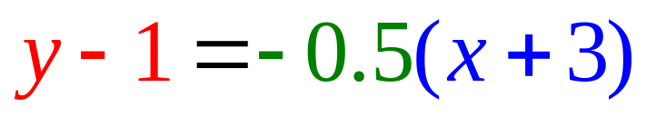
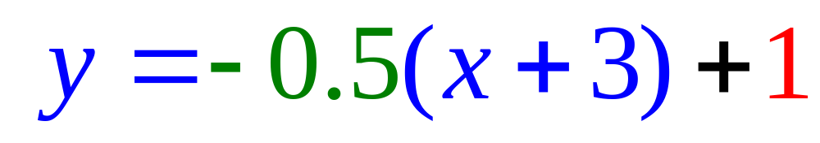
Equation of Lines
Write the equation of a line that passes through (-3, 1) with a slope of – ½ .
or
or

Slide 11
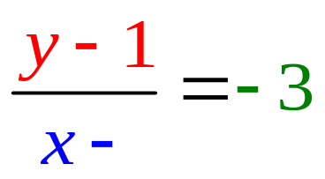
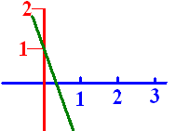
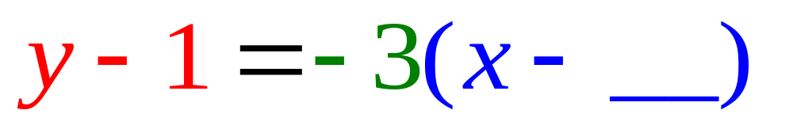
Passes through (0, 1) with a slope of -3. What is the missing blue number?
0.0
0.1

Slide 12

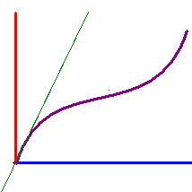

Write the equation of the line tangent to y = x + sin(x) when x = 0 given the slope there is 2.
y = 2x + 1
y = 2x + 0.5
y = 2x

Slide 13
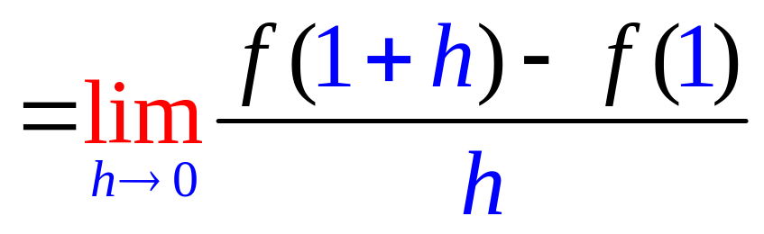
Find the slope of the tangent line of f(x) = 2x + 3 when x = 1.
1. Calculate f(1+h) – f(1)
f(1+h) = 2(1+h) + 3
f(1) = 5
f(1+h) – f(1) = 2 + 2h + 3 – 5 =2h
2. Divide by h and get 2
3. Let h go to 0 and get 2

Slide 14
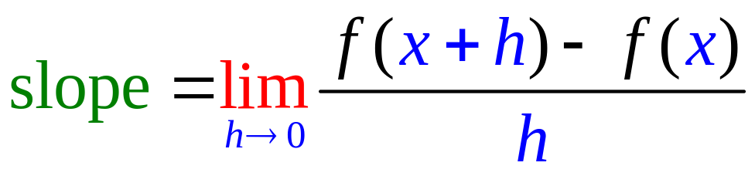
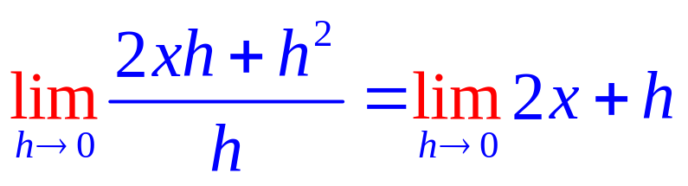
Find the slope of the tangent line of f(x) = x² when x = x.
1. Calculate f(x+h) – f(x)
f(x+h) = x² + 2xh + h²
f(x) = x²
f(x+h) – f(x) = 2xh + h² .
2. Divide by h and get 2x + h
3. Let h go to 0

Slide 15
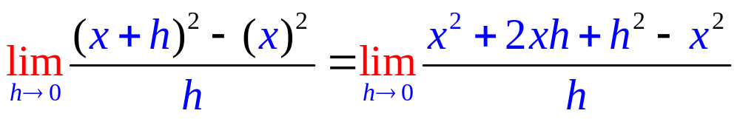
Find the slope of f(x)=x²
2x+h
2x
x²

Slide 16
Find the slope of the tangent line of f(x) = x² when x = x.
1. Calculate f(x+h) – f(x)
f(x+h) = x² + 2xh + h²
f(x) = x²
f(x+h) – f(x) = 2xh + h² .
2. Divide by h and get 2x + h
3. Let h go to 0 and get 2x

Slide 17
Finding the slope of the tangent line of f(x) = x², f(x+h) - f(x) =
(x+h)² – x²
x² + h² – x²
(x+h)(x – h)

Slide 18
(x+h)² – x² =
x² + 2xh + h²
h²
2xh + h²

Slide 19
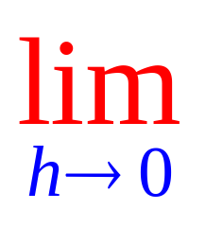
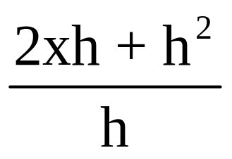
⁼
2x
2x + h²
2xh

Slide 20
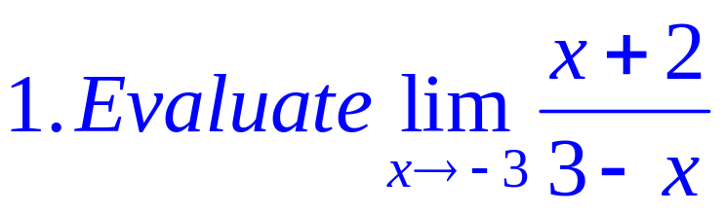
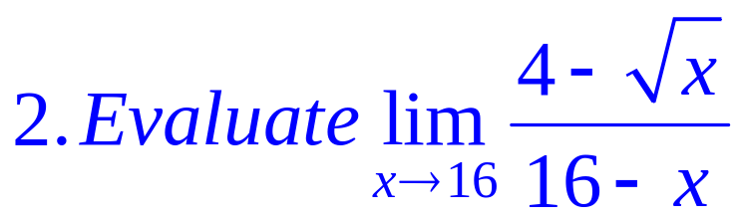
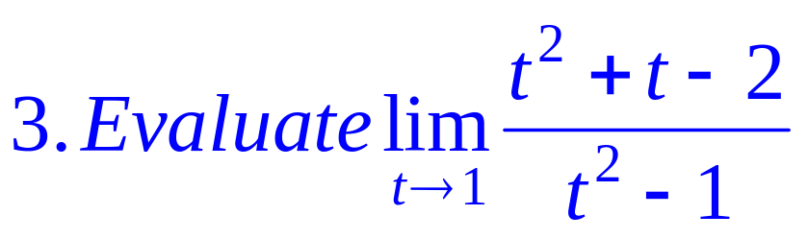

Slide 21
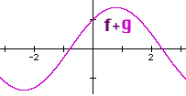
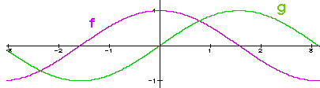
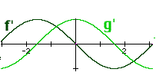


Theorems
1. (f + g) ' (x) = f ' (x) + g ' (x), and
2. (f - g) ' (x) = f ' (x) - g ' (x)

Slide 22
1. (f + g) ' (x) = f ' (x) + g ' (x)
2. (f - g) ' (x) = f ' (x) - g ' (x)
If f(x) = 3² x + 7, find f ’ (x)
f ’ (x) = 9 + 0 = 9
If f(x) = x - 7, find f ’ (x)
f ’ (x) = - 0 =

Slide 23
If f(x) = -2 x + 7, find f ’ (x)
-2.0
0.1

Slide 24
If f(x) = then f’(x) =
Proof : f’(x) = Lim [f(x+h)-f(x)]/h =

Slide 25
If f(x) = then f’(x) =
.
.
.
.

Slide 26
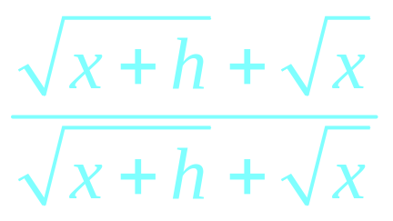
f’(x) = =
.
.
.
.

Slide 27
f’(x) = =
.
.
.

Slide 28
f’(x) = =
.
0
.

Slide 29
g(x) = 1/x, find g’(x)
g(x+h) = 1/(x+h)
g(x) = 1/x
g’(x) =

Slide 30
If f(x) = x^{n} then f ' (x) = n x ^{(n-1)}
If f(x) = x⁴ then f ' (x) = 4 x³
If

Slide 31

If f(x) = x^{n} then f ' (x) = n x^{n-1}
If f(x) = x⁴ + 3 x³ - 2 x² - 3 x + 4
f ' (x) = 4 x³ + . . . .
f ' (x) = 4x³ + 9 x² - 4 x – 3 + 0
f(1) = 1 + 3 – 2 – 3 + 4 = 3
f ’ (1) = 4 + 9 – 4 – 3 = 6

Slide 32
If f(x) = x^{n} then f ' (x) = n x ^{(n-1)}
If f(x) = πx⁴ then f ' (x) = 4π x³
If f(x) = π⁴ then f ' (x) = 0
If

Slide 33
If f(x) = then f ‘(x) =

Slide 34
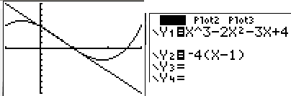
Find the equation of the line tangent to g when x = 1.
If g(x) = x³ - 2 x² - 3 x + 4
g ' (x) = 3 x² - 4 x – 3 + 0
g (1) =
g ' (1) =

Slide 35
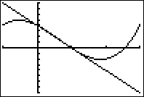
If g(x) = x³ - 2 x² - 3 x + 4 find g (1)
0.0
0.1

Slide 36
If g(x) = x³ - 2 x² - 3 x + 4 find g’ (1)
-4.0
0.1

Slide 37

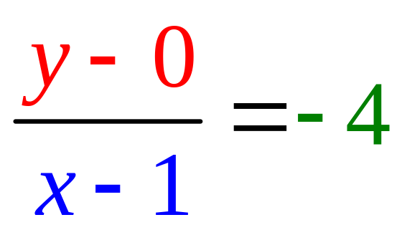
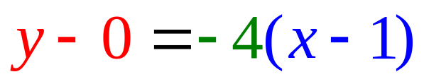
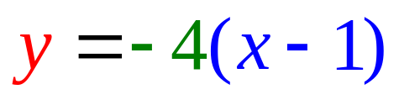
Find the equation of the line tangent to f when x = 1.
g(1) = 0
g ' (1) = – 4

Slide 38
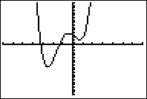
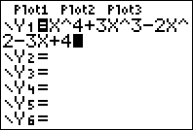
Find the equation of the line tangent to f when x = 1.
If f(x) = x⁴ + 3 x³ - 2 x² - 3 x + 4
f ' (x) = 4x³ + 9 x² - 4 x – 3 + 0
f (1) = 1 + 3 – 2 – 3 + 4 = 3
f ' (1) = 4 + 9 – 4 – 3 = 6

Slide 39
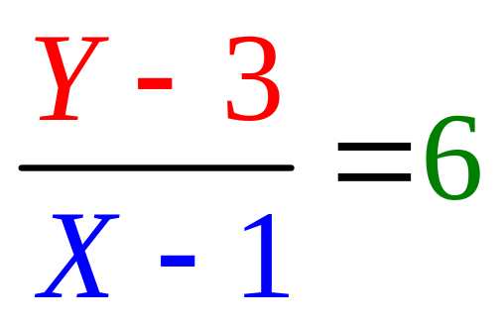
Find the equation of the line tangent to f when x = 1.
f(1) = 1 + 3 – 2 – 3 + 4 = 3
f ' (1) = 4 + 9 – 4 – 3 = 6

Slide 40
Write the equation of the tangent line to f when x = 0.
If f(x) = x⁴ + 3 x³ - 2 x² - 3 x + 4
f ' (x) = 4x³ + 9 x² - 4 x – 3 + 0
f (0) = write down
f '(0) = for last question

Slide 41

Write the equation of the line tangent to f(x) when x = 0.
y - 4 = -3x
y - 4 = 3x
y - 3 = -4x
y - 4 = -3x + 2

Slide 42
http://www.youtube.com/watch?v=P9dpTTpjymE Derive
http://www.9news.com/video/player.aspx?aid=52138&bw= Kids
http://math.georgiasouthern.edu/~bmclean/java/p6.html Secant Lines

