Slide 1
If f(x) = x^{n} then f ' (x) = n x ^{(n-1)}
If f(x) = πx⁴ then f ' (x) = 4π x³
If f(x) = π⁴ then f ' (x) = 0
If

Slide 2
If f(x) = x^{n} then f ' (x) = n x ^{(n-1)}
If
then

Slide 3
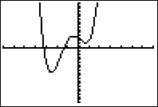
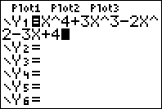
Find the equation of the line tangent to f when x = 1.
If f(x) = x⁴ + 3 x³ - 2 x² - 3 x + 4
f ' (x) = 4x³ + 9 x² - 4 x – 3 + 0
f (1) = 1 + 3 – 2 – 3 + 4 = 3
f ' (1) = 4 + 9 – 4 – 3 = 6

Slide 4
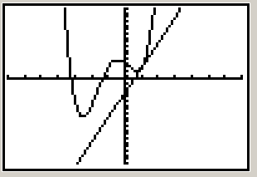

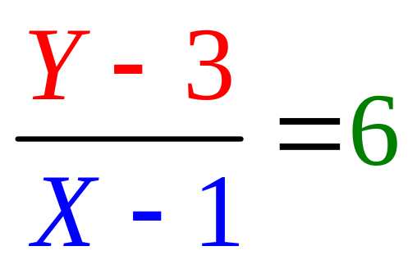
Find the equation of the line tangent to f when x = 1.
f(1) = 1 + 3 – 2 – 3 + 4 = 3
f ' (1) = 4 + 9 – 4 – 3 = 6

Slide 5
Write the equation of the tangent line to f when x = 0.
If f(x) = x⁴ + 3 x³ - 2 x² - 3 x + 4
f ' (x) = 4x³ + 9 x² - 4 x – 3 + 0

Slide 6
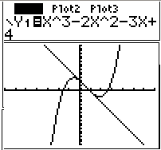


If g(x) = x³ - 2 x² - 3 x + 4 find g (1)
0.0
0.1

Slide 7
If g(x) = x³ - 2 x² - 3 x + 4 find g’ (1)
-4.0
0.1

Slide 8


Write the equation of the line tangent to g when x=1. Recall g(1)=0 and g’(1)=-4
Y = -4
Y = -4x + 1
Y = -4x - 4
Y = -4x + 4

Slide 9
Theorem 1
The product rule
[f(x) g(x)]’ =
f(x) g’(x) + g(x) f ’(x)

Slide 10
The product rule
If k(x) = f(x) g(x) , then
k’(x) = f(x) g’(x) + g(x) f ’(x)
Suppose k(x) = (3x²-2x) (4x⁴+1)
k’(x) = (3x²-2x) (16x³) + (4x⁴+1)(6x-2)

Slide 11
Theorem 1
The product rule
[f(x) g(x)]’ =
f(x) g’(x) + g(x) f ’(x)

Slide 12
The product rule
[f(x) g(x)]’=f(x)g’(x) + g(x)f ’(x)
If y =(x²-3x+1)(1/x+3x) find dy/dx
dy/dx =
(x²-3x+1)(-x⁻²+3) +(1/x+3x) (2x-3)

Slide 13
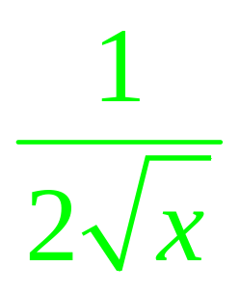
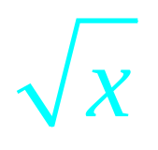
The product rule
[f(x) g(x)]’ = f(x) g’(x) + g(x) f ’(x)
[ (3x-1)]’ = (3) +(3x-1)

Slide 14
If y = (x²-x)(x³-3x²+2) find dy/dx or y’
(x²-x) (3x² - 6x) + (x³ - 3x²+2) (2x-1)
(x²-x) (2x-1) + (x³ - 3x² ⁺²) (3x² - 6x)
(x²-x) (3x² - 6x) - (x³ - 3x²+2) (2x-1)
(x²-x) (3x² - 6x) (x³ - 3x²+2) (2x-1)

Slide 15
If y = (x²-x)(-3x²+2) find dy/dx or y’
(2x-1) (-6x)
(x²-x)(-3x+2) + (-3x²+2)(2x-1)
(x²-x)(-6x) + (-3x²+2)(2x-1)

Slide 16
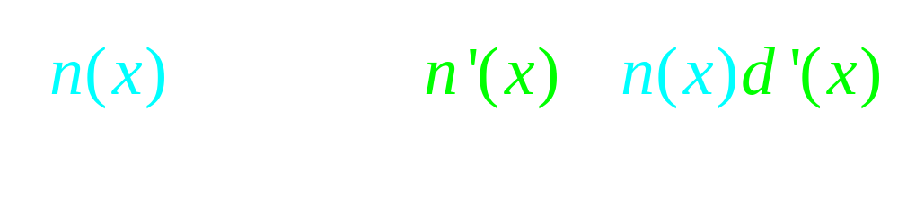
Theorem 2
The quotient rule

Slide 17
Theorem 2
The quotient rule
Never cancel across minus sign

Slide 18


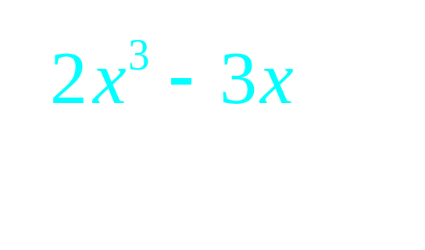
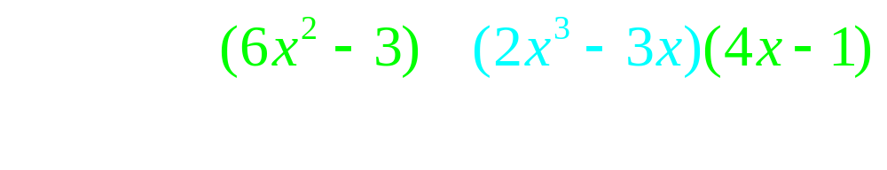
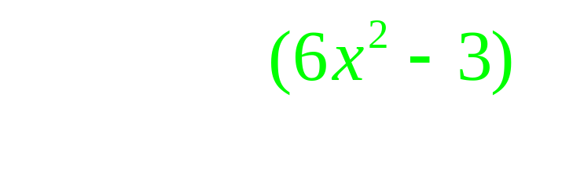
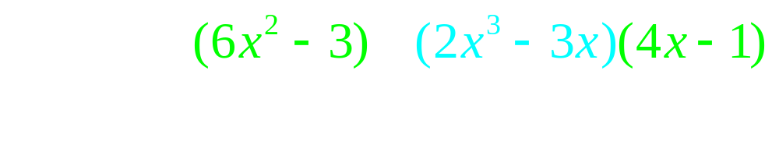
The quotient rule

