Slide 1
Power Rule
If f(x) = x^{n} then f ' (x) = n x ^{(n-1)}
If
then

Slide 2
Theorem 1
The product rule
[f(x) g(x)]’ =
copy diff. copy diff.
f(x) g’(x) + g(x) f ’(x)

Slide 3
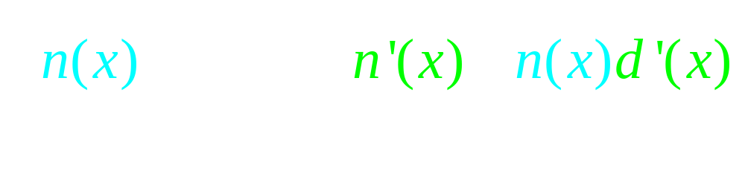

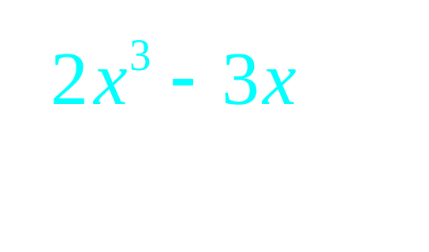
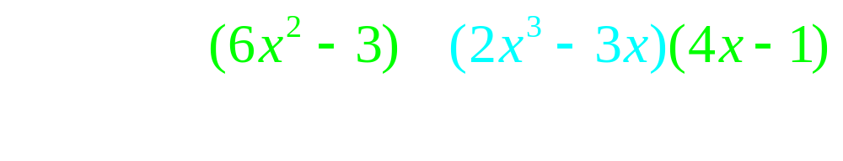

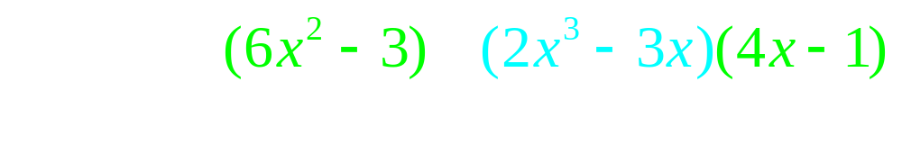
The quotient rule

Slide 4
If f(x) = x^{n} then f ' (x) = n x ^{(n-1)}
Proof, when n is a natural number.
n = 1
Proof : Lim [f(x+h)-f(x)]/h =
Lim (x + h - x)/h = Lim h/h = 1
What is the derivative of x grandson?
One grandpa, one.

Slide 5
If f(x) = x^{n} then f ' (x) = n x ^{(n-1)}
Assume true when n = k
Assume that k is fixed and k >= 1 and
f(x) = x^{k} and that f '(x) = k x ^{(k-1)}

Slide 6
If f(x) = x^{n} then f ' (x) = n x ^{(n-1)}
Prove true when n = k + 1
Proof : Suppose f(x) = x^{k+1} = x x ^{k}
f ’(x) = x [x ^{k}]’ + [x ^{k}] 1
= x [kx ^{k-1}] + x ^{k}
= k x ^{k} + x ^{k} = (k+1) x ^{k}

Slide 7
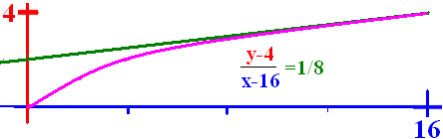
If g(t) = t^{n} then g'(t) = n t ^{(n-1)}
If (16) = 4
then
and
The slope of at the point (16, 4) is 1/8.

Slide 8
sin’(x) = cos(x)
sin’(x) =
=

Slide 9
sin’(x) = cos(x)
sin’(x) =

Slide 10
sin’(x) = cos(x)
sin’(x) =

Slide 11
cos’(x) = - sin(x)
cos’(x) =
=

Slide 12
cos’(x) = - sin(x)
cos’(x) =
=

Slide 13
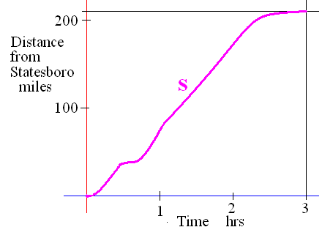
If s is the distance from home
Velocity v(t) = s ’(t) - stopped <=> v(t)= 0
Speed = |v(t)|

Slide 14
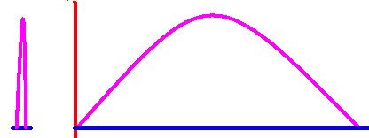
v(t) = s ’(t) stop <=> v(t)= 0
If a ball is thrown straight up and the height is always s(t) = -16t² + 64t

Slide 15
s(t) = -16t² + 64t
Find velocity as a function of t.
v(t) =

Slide 16
v(t) = -32t + 64
What was the initial veolcity?
v(0) = feet/sec

Slide 17
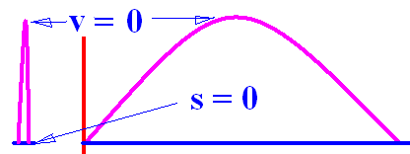

s(t) = -16t² + 64t v(t) = -32t + 64
How high did it go?
v(t) = -32t + 64 = 0 feet/sec
64 = 32t or 2 = t
s(t) = -16t² + 64t or
s(2) = -64 +128 = 64

Slide 18
s(t) = -16t² + 64t v(t) = -32t + 64
Find velocity and speed when t = 3
v(t) = -32t + 64 feet/sec so v(3) =
v(3) = -96 + 64 = -32 feet/sec
Speed= | v(3) | = 32 feet/sec

Slide 19
s(t) = -16t² + 64t v(t) = -32t + 64
How high was the ball after 3 seconds?
s(t) = -16t² + 64t or s(3) =
s(3) = -144 + 192 = 48

Slide 20
Find the total distance traveled.
| s(0) – s(2) | + |s(4) – s(2) | =
64 + 64 = 128

Slide 21
If s is the distance from home
Acceleration is a(t) = v’(t) = [f ’(t)]’ = f’’(t)
Jerk is j(t) = a’(t) = v’’(t) = f’’’(t)

Slide 22
v(t) = -32t + 64
Find the acceleration as a function of t.
a(t) = v’(t) =
-32 feet/sec per sec at every value of t

Slide 23
v(t) = -32t + 64
Find the jerk as a function of t.
j(t) = a’(t) = v’’(t) =
0 feet/sec² per sec at every value of t

Slide 24
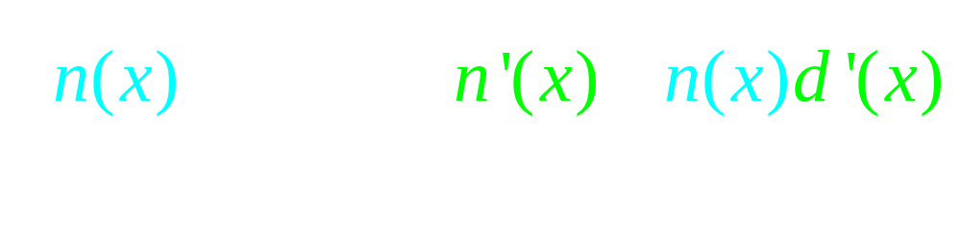
Theorem 2
The quotient rule

