Slide 1
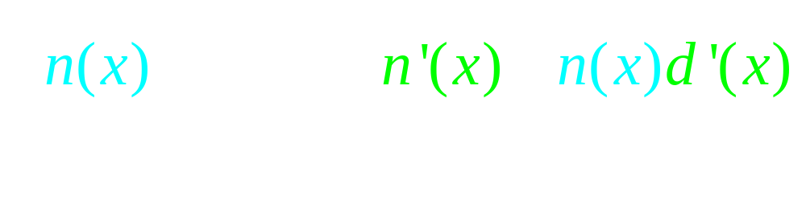

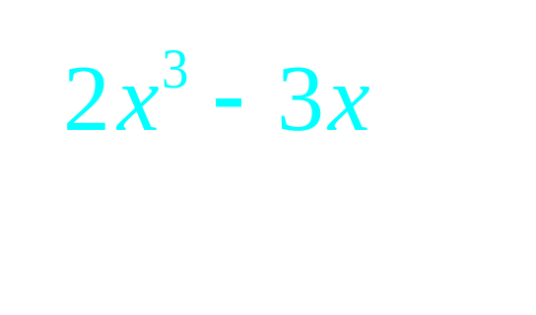
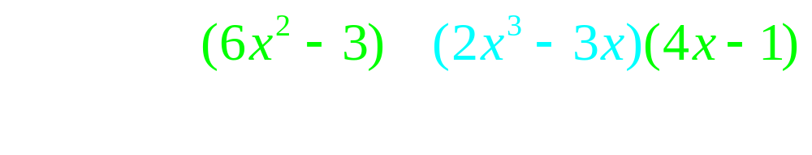

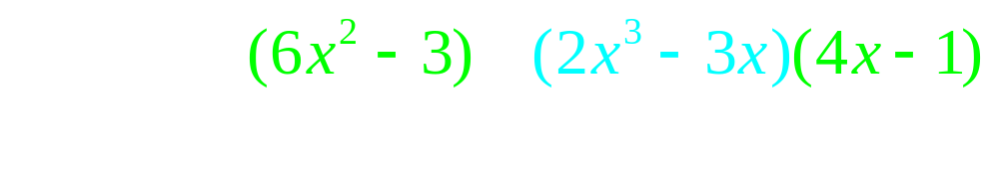
The quotient rule

Slide 2


If f(x)= find f ’(-1)
-11
-5
-5/49

Slide 3


If f(x)= find f ’(-1)
-11
-5
-5/49

Slide 4
If f(x) = x^{n} then f ' (x) = n x ^{(n-1)}
If
then
and g’(16) =

Slide 5
If , find g’(4)
½
¼
1
2

Slide 6
If , find g’(4)
½
¼
1
2

Slide 7
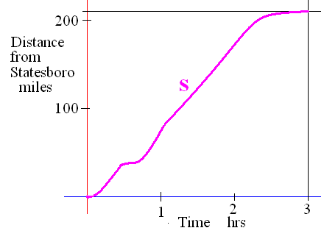
If s is the distance from home
Velocity v(t) = s ’(t) - stopped <=> v(t)= 0
Speed = |v(t)|

Slide 8
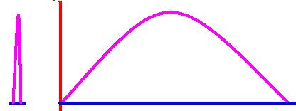
v(t) = s ’(t) stop <=> v(t)= 0
If a ball is thrown straight up and the height is always s(t) = -16t² + 64t

Slide 9
s(t) = -16t² + 64t
Find velocity as a function of t.
v(t) =

Slide 10
v(t) = -32t + 64
What was the initial veolcity?
v(0) = feet/sec

Slide 11
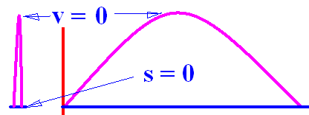

s(t) = -16t² + 64t v(t) = -32t + 64
How high did it go?
v(t) = -32t + 64 = 0 feet/sec
64 = 32t or 2 = t
s(t) = -16t² + 64t or
s(2) = -64 +128 = 64

Slide 12
s(t) = -16t² + 64t v(t) = -32t + 64
Find velocity and speed when t = 3
v(t) = -32t + 64 feet/sec so v(3) =
v(3) = -96 + 64 = -32 feet/sec
Speed= | v(3) | = 32 feet/sec

Slide 13
s(t) = -16t² + 64t How high when t = 3?
1
24
48
56

Slide 14
s(t) = -16t² + 64t How high when t = 3?
1
24
48
56

Slide 15
s(t) = -16t² + 64t v(t) = -32t + 64
How high was the ball after 3 seconds?
s(t) = -16t² + 64t or s(3) =
s(3) = -144 + 192 = 48
v(3)=

Slide 16
Find the total distance traveled.
| s(2) – s(0) | + |s(4) – s(2) | =
64 + 64 = 128

Slide 17
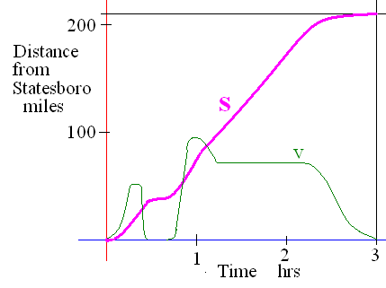
If s is the distance from home
Acceleration is a(t) = v’(t) = [s’(t)]’ = s’’(t)
Jerk is j(t) = a’(t) = v’’(t) = s’’’(t)

Slide 18
v(t) = -32t + 64
Find the acceleration as a function of t.
a(t) = v’(t) =
-32 feet/sec per sec at every value of t

Slide 19
v(t) = -32t + 64
Find the jerk as a function of t.
j(t) = a’(t) = v’’(t) =
0 feet/sec² per sec at every value of t

Slide 20
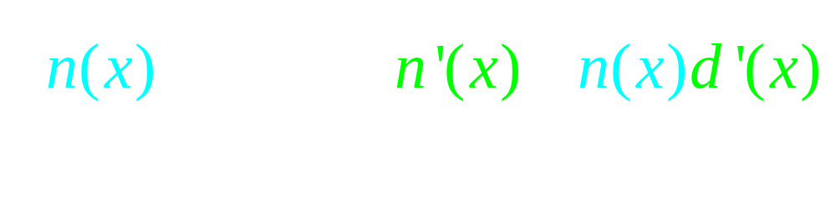
Theorem 2
The quotient rule

Slide 21


If s(t) = find the velocity when t=-2
-0.22
0.1

Slide 22
If s(t) = find the acceleration when t=-2
-0.15
0.1

Slide 23
Theorem 1
The product rule
[f(x) g(x)]’ =
copy diff. copy diff.
f(x) g’(x) + g(x) f ’(x)

Slide 24
If s(t) = ( t² - 3 )( t + 3) find the acceleration when t = 1
12.0
0.2

Slide 25
s(t) = ( t² - 3 )( t + 3)
Find the velocity when the acceleration is zero.
-6.0
0.1

Slide 26
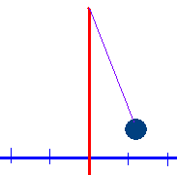
Displacement x(t) = 2 cos(t)
What is the x coordinate when t = 0?
t = π/2 ?
t = π?

Slide 27
If f(x) = x^{n} then f ' (x) = n x ^{(n-1)}
Proof, when n is a natural number.
n = 1
Proof : Lim [f(x+h)-f(x)]/h =
Lim (x + h - x)/h = Lim h/h = 1
What is the derivative of x grandson?
One grandpa, one.

Slide 28
If f(x) = x^{n} then f ' (x) = n x ^{(n-1)}
Assume true when n = k
Assume that k is fixed and k >= 1 and
f(x) = x^{k} and that f '(x) = k x ^{(k-1)}

Slide 29
If f(x) = x^{n} then f ' (x) = n x ^{(n-1)}
Prove true when n = k + 1
Proof : Suppose f(x) = x^{k+1} = x x ^{k}
f ’(x) = x [x ^{k}]’ + [x ^{k}] 1
= x [kx ^{k-1}] + x ^{k}
= k x ^{k} + x ^{k} = (k+1) x ^{k}

Slide 30
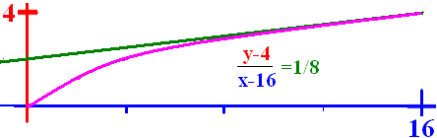
If g(t) = t^{n} then g'(t) = n t ^{(n-1)}
If (16) = 4
then
and
The slope of at the point (16, 4) is 1/8.

Slide 31
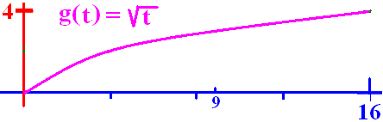
If g(t) = evaluate g (9)
1
2
3
4

Slide 32
If g(t) = evaluate g (9)
1
2
3
4

Slide 33
If g (t) = evaluate g’(9)
1/6
1/3
1/2
1

Slide 34
If g (t) = evaluate g’(9)
1/6
1/3
1/2
1

Slide 35
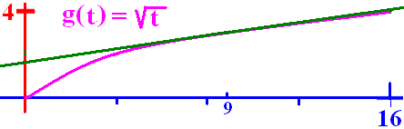
g(9)=3 & g’(9) = 1/6 Write the equation of the tangent line
y - 3 = (t-9)/6
y - 6 = (t-9)/3
y - 9 = (t-3)/6
y - 3 = (t-9)/3

Slide 36
g(9)=3 & g’(9) = 1/6 Write the equation of the tangent line
y - 3 = (t-9)/6
y - 6 = (t-9)/3
y - 9 = (t-3)/6
y - 3 = (t-9)/3

Slide 37
Displacement x(t) = 2 cos(t) find x(0) .
x(0) = 2 cos(t)
x(0) = -2
x(0) = 2

Slide 38
Displacement x(t) = 2 cos(t) find x(0) .
x(0) = 2 cos(t)
x(0) = -2
x(0) = 2

Slide 39
Displacement x(t) = 2 cos(t) find x(π/2).
x(π/2) = 1
x(π/2) = 0
x(π/2) =

Slide 40
Displacement x(t) = 2 cos(t) find x(π/2).
x(π/2) = 1
x(π/2) = 0
x(π/2) =

Slide 41
Displacement x(t) = 2 cos(t) find x’’(t) = a(t)
a(t) = 2 sin(t)
a(t) = 2 cos(t)
a(t) = -2 cos(t)

