Slide 1


Power Rule
k(x) = g^{n}(x) = [g(x)]^{n}
k’(x) = n [g (x)] ^{n-1} g’(x)

Slide 2

Power Rule
k(x) = [x² + x ] ³
k’(x) = 3 [x² + x] ² (2x+1)

Slide 3
Power Rule
k(x) = 2[3x³ + x ] ⁴
k’(x) = 8 [3x³ + x] ³ (9x²+1)

Slide 4


k(x) = (x³ + 2x)⁴ k’(x)=
4 (x³ + 2x)³ (3x² + 2)
4 (x³ + 2x)³ (3x + 2)
4 (x³ + 2x)³ (3x + 2x)

Slide 5
Power Rule
k(x) = 2[3x³ - x⁻² ]²⁰
k’(x) = 40 [3x³ - x⁻²] ¹⁹ (9x²+2x⁻³)

Slide 6
t(x) = (2x⁵ + 3x² + 2)⁴ t’(x)=
4 (2x⁵ + 3x² + 2)³(10x + 6x + 2)
4 (10x⁴ + 6x)³
4 (2x⁵ + 3x² + 2)³ (10x⁴ + 6x)

Slide 7
s(t)=3(t-2/t)⁷ = 3(t-2t⁻¹)⁷ s’(t) =
21t - 42
21(t - 2/t)⁶ (1 + 2t ⁰)
21(t - 2/t)⁶ (1 - 2t ⁻¹)
21(t - 2/t)⁶ (1 + 2t ⁻²)

Slide 8
Power Rule
=[3x³ - x² ]^{1/2}
k’(x) = ½ [3x³ - x²]^{-1/2} (9x²-2x)

Slide 9
rewrite y using algebra .
.
.
.

Slide 10
= dy/dx=
.
.
.

Slide 11
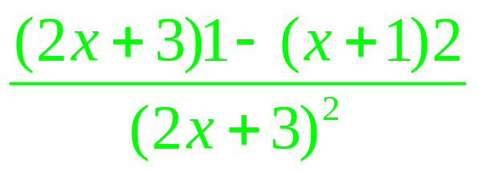

Slide 12
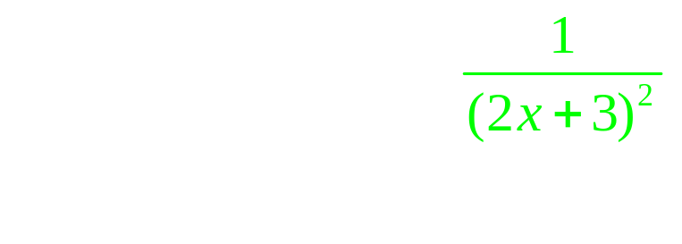
.
.

Slide 13
.
.
.
.

Slide 14
k(x) = ( x² + x)³
Evaluate k’(1)
22
24
36
38

Slide 15
t(x) = t’(x)=
.
.

Slide 16
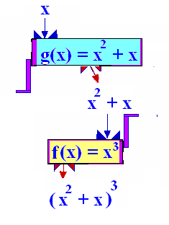
The composition function
k(x) = (f º g)(x) = f (g(x))
g
R--->[-¼,+oo)
f
---->[-1/64 , +oo)

Slide 17
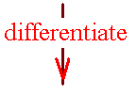
Theorem 1
The chain rule
If k(x) =f (g(x)), then
k’(x) = f ’ ( g(x) ) g’(x)

Slide 18
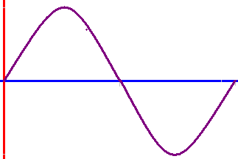
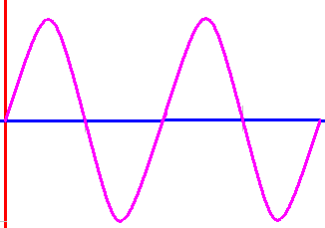
y = sin(x/2)
y = sin (x)

Slide 19
y = sin(x/4)
y = sin (x/2)

Slide 20
y = sin (x) y’ = cos (x)
y = sin (2x)
y’ = cos (2x) 2

Slide 21
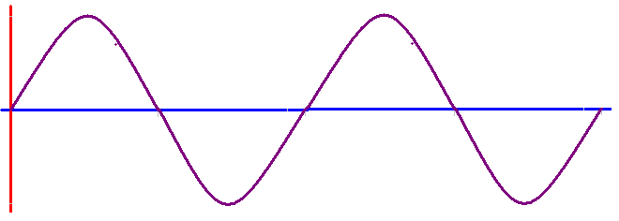
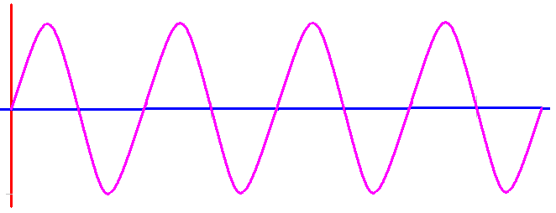
y = sin(2x) y = cos(2x) 2
y = sin(4x)
y’ = cos(4x) 4

Slide 22
y = sin(4x)
y = sin(8x)

Slide 23
y = sin(4x) y’ = cos(4x) 4
y = sin(8x)
dy/dx = cos(8x) 8

Slide 24
y = sin(3πx)
y’ = 3π cos(3πx)
y = cos(5πx)
y’ = -5π sin(5πx)

Slide 25


If f(x) = sin(10x) , find f’(0)
10.0
0.1

Slide 26
If f(x) = cos(12x) , find f’(0)
0.0
0.1

Slide 27
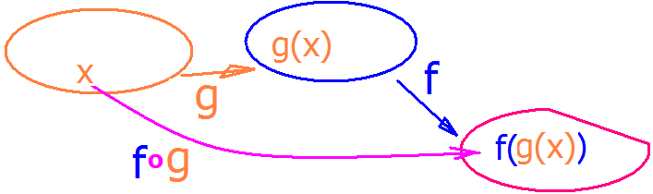
Theorem :
Chain Rule
[f o g ]' (x) = f '[g(x)]g'(x).

Slide 28
Chain Rule
[f o g ]' (x) = f '[g(x)]g'(x)
The derivative of the composite is
the derivative of the outside
evaluated at the inside
times the derivative of the inside
evaluated at x

Slide 29
Theorem :
Chain Rule
[f o g ]' (x) = f '[g(x)]g'(x)
Differentiate f(x),
replacing x by g(x),
differentiate g(x), and
multiply.

Slide 30
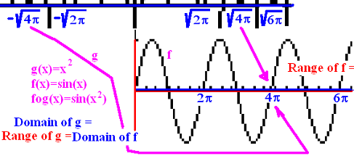
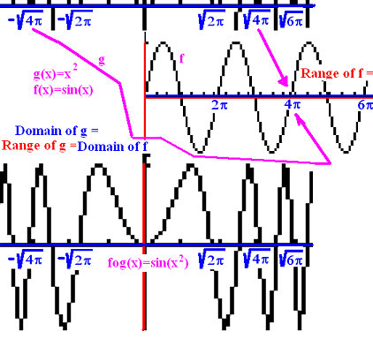
Theorem :
Chain Rule
Thus to find y’
y = sin(x²)
y' = cos(x²) (2x)

Slide 31
y = sin(x²) y’ = cos(x²)2x
y(sqrt(π)/2) = sin(π/4) = sqrt(2)/2
y'(sqrt(π)/2) = cos(π/4) 2 sqrt(π)/2 =
sqrt(2)/2 [2] sqrt(π)/2 = sqrt(2π)/2

Slide 32
Theorem :
Chain Rule
y' = cos(x²) (2x) and when x = sqrt(π)/2,
y'(sqrt(π)/2) = cos(π/4) 2 sqrt(π)/2 =
sqrt(2)/2 [2] sqrt(π)/2 = sqrt(2π)/2
The equation of the tangent line would be
[y - sqrt(2)/2] / [x - sqrt(π)/2] = sqrt(2π)/2

Slide 33
Differentiate f(x), replacing x by g(x),
differentiate g(x), and
multiply the preceding answers together.

Slide 34
If f(x) = x^{n} then [f(g(x))]’= f ' (g(x))g’(x) = n g(x)^{n-1} g’(x)
y = (csc(x)+x³)⁵ then y’ =
5(csc(x)+x³)⁴ (-csc(x)cot(x)+3x²)
and
y’(π/2) = 5(1 + (π/2)³ )⁴ (0 + 3(π/2)² )

