Slide 1
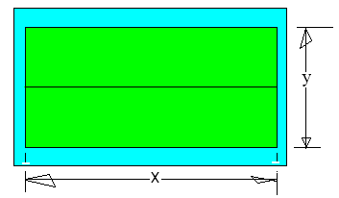
216 m² pea patch is enclosed by fence
216 = 2 x y
216 = x y
216 = 3 x y
216 = 3x + 2y

Slide 2


216 m² pea patch is enclosed by fence
216 = 2 x y
216 = x y
216 = 3 x y
216 = 3x + 2y

Slide 3
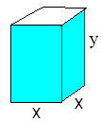
A 500 ft³ rectangular tank with a sq. base and open top
x² = 500
x³ = 500
x²*y= 500
4x + y = 500

Slide 4
A 500 ft³ rectangular tank with a sq. base and open top
x² = 500
x³ = 500
x²*y= 500
4x + y = 500

Slide 5
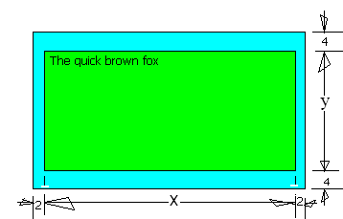
50 in² of writing with 4” top & bottom border & 2” sides
x² = 50
x² * y= 50
x*y= 50
(x+4)(y+8) = 50

Slide 6
50 in² of writing with 4” top & bottom border & 2” sides
x² = 50
x² * y= 50
x*y= 50
(x+4)(y+8) = 50

Slide 7
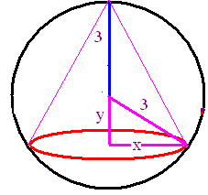
Rt. Circular cone is in a sphere of radius 3”
x² + y² = 3
(1/2)x(y+3) = 3
1/3 π x² (y+3) = 3
x² + y² = 9

Slide 8
Rt. Circular cone is in a sphere of radius 3”
x² + y² = 3
(1/2)x(y+3) = 3
1/3 π x² (y+3) = 3
x² + y² = 9

Slide 9
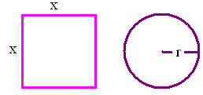
10’ of wire makes a circle and a square
4x + 2πr = 10
10 x = 2πr
x²πr² = 10
x² + πr² = 10

Slide 10
10’ of wire makes a circle and a square
4x + 2πr = 10
10 x = 2πr
x²πr² = 10
x² + πr² = 10

Slide 11
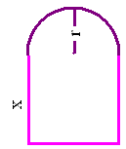
A Norman window has a perimeter of 20’
2x + πr = 20
x² + πr² = 20
2x + πr + 2r= 20
2x + πr + r= 20

Slide 12
A Norman window has a perimeter of 20’
2x + πr = 20
x² + πr² = 20
2x + πr + 2r= 20
2x + πr + r= 20

Slide 13
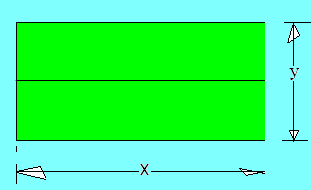
Minimize the fence.
F = 3 x + 2 y
F = x y
F = 3 x y
F = 3 x + 4 y

Slide 14
Minimize the fence.
F = 3 x + 2 y
F = x y
F = 3 x y
F = 3 x + 4 y

Slide 15
Minimize the metal container [no lid]
A = x² y
A = x² + xy
A = x² + 4xy
A = x² y + 4xy

Slide 16
Minimize the metal container [no lid]
A = x² y
A = x² + xy
A = x² + 4xy
A = x² y + 4xy

Slide 17
Minimize the area of the poster
A = (x+4)(y+8)
A = (x+2)(y+4)
A = x * y
A = (y+4)(x+8)

Slide 18
Minimize the area of the poster
A = (x+4)(y+8)
A = (x+2)(y+4)
A = x * y
A = (y+4)(x+8)

Slide 19
Maximize the volume of the cone
V = 1/3 π x² y
V = (1/2)x(y+3)
V = 1/3 π x² (y+3)
x² + y² = 9

Slide 20
Maximize the volume of the cone
V = 1/3 π x² y
V = (1/2)x(y+3)
V = 1/3 π x² (y+3)
x² + y² = 9

Slide 21
Find x to minimize the total area
A = x² + 2πr
A = 10 x² - πr²
A = x²πr²
A = x² + πr²

Slide 22
Find x to minimize the total area
A = x² + 2πr
A = 10 x² - πr²
A = x²πr²
A = x² + πr²

Slide 23
Maximize the brightness of the room
A = 2 x r + π r²
A = 2 x²r + 0.5πr²
A = 2 x r + 0.5 π r²
A = x r + 2 π r

Slide 24
Maximize the brightness of the room
A = 2 x r + π r²
A = 2 x²r + 0.5πr²
A = 2 x r + 0.5 π r²
A = x r + 2 π r

Slide 25
Science news for kids
Oct. 8, 2003

Slide 26
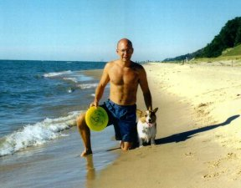
"I would throw a ball into the water," Pennings says. "I noticed he'd run along the beach and then jump into the water and swim at an angle toward the ball."

Slide 27
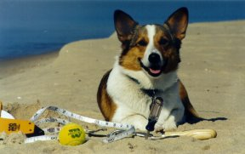
Man and dog ran back and forth like this for more than 3 hours. After throwing out trials with bad tosses or high waves, Pennings had 35 sets of measurements. Then, he went home and did some calculations, using calculus to find the fastest route.

Slide 28
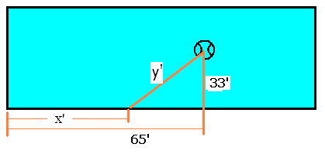
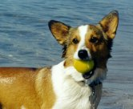
Ball lands 33’ from shore and 65’ along shore from Elvis
x² + y² = 1089
y² = [65-x]² +1089
y² = [65-x]² - 1089
x² - y² = 1089

Slide 29
Ball lands 33’ from shore and 65’ along shore from Elvis
x² + y² = 1089
y² = [65-x]² +1089
y² = [65-x]² - 1089
x² - y² = 1089

Slide 30
If Elvis runs at 20 ft/sec swims at 4 ft/sec, minimize total time
T = x² + y²
T = 20/x +4/y
T = 20x + 4y
T = x/20 + y/4

Slide 31
If Elvis runs at 20 ft/sec swims at 4 ft/sec, minimize total time
T = x² + y²
T = 20/x +4/y
T = 20x + 4y
T = x/20 + y/4

Slide 32
y = Root([65-x]² +1089)
T = x/20 + y/4
T ’ =
T ’ =
T ’ =

Slide 33
y = Root([65-x]² +1089)
T = x/20 + y/4
T ’ =
T ’ =
T ’ =

Slide 34
If then x =

Slide 35


If then x =
58.264
0.1

Slide 38
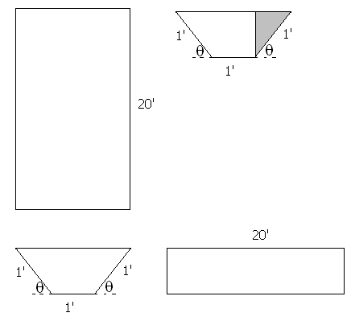
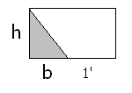


Build a rain gutter with the dimensions shown.
Base Area = h(b+1)
BA = sin(θ)[cos(θ)+1]
V=

Slide 39
BA = sin(θ)[cos(θ)+1]
V=
20 sin(θ)[cos(θ)+1]
20 sin(θ)²[cos(θ)+1]²
sin(θ)[cos(θ)+1]²
sin(θ)²[cos(θ)+1]

Slide 40
BA = sin(θ)[cos(θ)+1]
V=
20 sin(θ)[cos(θ)+1]
20 sin(θ)²[cos(θ)+1]²
sin(θ)[cos(θ)+1]²
sin(θ)²[cos(θ)+1]

Slide 41
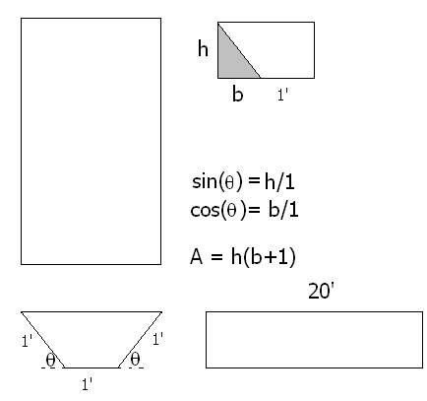
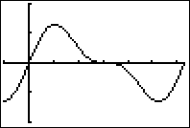
Find θ that maximizes the volume
V = 20 BA
V = 20 sin(θ)[cos(θ) + 1 ]
V’ =

Slide 42
V=20 sinθ[cosθ+1] dV/dθ =
20 sinθ[cosθ+1]
20[sinθsinθ+(cosθ+1)(-cosθ)]
20[sinθ(-sinθ)+(cosθ+1)cosθ]
- 20 cosθ sinθ

Slide 43
V=20 sinθ[cosθ+1] dV/dθ =
20 sinθ[cosθ+1]
20[sinθsinθ+(cosθ+1)(-cosθ)]
20[sinθ(-sinθ)+(cosθ+1)cosθ]
- 20 cosθ sinθ

Slide 44
Find θ that maximizes the volume
V’ = 20sin(θ)[-sin(θ)]+[cos(θ) + 1]20 cos(θ)
= 20 cos²(θ) - 20 sin²(θ) + 20 cos(θ)
= 20[2 cos(θ) - 1][cos(θ) + 1] = 0

Slide 45
20[2 cos θ - 1][cos θ + 1] = 0
Solve for θ on [0, π].
θ = π/3 or θ = 0
θ = π/2 or θ = 0
θ = π/6 or θ = π
θ = π/3 or θ = π

Slide 46
20[2 cos θ - 1][cos θ + 1] = 0
Solve for θ on [0, π].
θ = π/3 or θ = 0
θ = π/2 or θ = 0
θ = π/6 or θ = π
θ = π/3 or θ = π

Slide 47
Find θ that maximizes the volume of the gutter
V’ = 20[2 cos(θ) - 1][cos(θ) + 1] = 0
2 cos(θ) = 1 or cos(θ) = -1
θ = π/3 or θ = π

Slide 48
Find θ that maximizes the volume of the gutter
V’ = 20 cos²(θ) - 20 sin²(θ) + 20 cos(θ)
V’’ = -40 cos(θ)sin(θ) – 40 sin(θ)cos(θ) -20 sin(θ)
V’’(π/3) = -40(½) – 40 (½) - 20
a local maximum at x = π/3
V”(π) = 0 -> Test fails

Slide 49
Local max at θ = π/3
V’ = 20 cos²(θ) - 20 sin²(θ) + 20 cos(θ)
First Derivative test
V’(π/2) = -20 V’(3π/2) = -20
Second derivative test failed
First derivative test says decreasing on [π/3, π]

