Slide 1
Applied max and min

Slide 2

Georgia owns a piece of land along the Ogeechee River
She wants to fence in her garden using the river as one side.

Slide 3
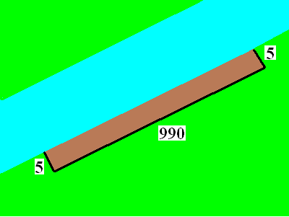
She also owns 1000 ft of fence to make the rectangular garden
She wants to fence in her garden using the river as one side.
F = 1 + 998 + 1
F = 5 + 990 + 5
F = 20 + 960 + 20

Slide 4
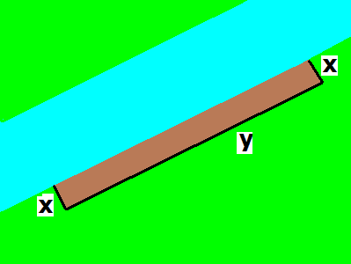
She owns 1000 ft of fence
Write a secondary equation
  Usually the first thing given
  F = x +

Slide 5
She owns 1000 ft of fence
Write a secondary equation
  Usually the first thing given
  F = x + y + x
  1000 = 2x + y is the secondary

Slide 6
She owns 1000 ft of fence
Write a secondary equation
  Usually the first thing given
  F = x + y + x
  1000 = 2x + y is the secondary
  Solve for y
  y = 1000 – 2x

Slide 7
What is the area of a possible garden?
A = L * W
A= 5 * 990
A = 4950 sq. ft.

Slide 8
What is the largest possible area?
Find the variable that you want to optimize and write the primary equation

Slide 9
What is the area of the shown garden?
A = 2xy sq. feet
A = 2x + y feet
A = xy sq. feet

Slide 10
What is the area of the largest possible garden?
A = x * y primary

Slide 11
Place y into the primary
y = 1000 – 2x (secondary)
A = x * y (primary)
A = x * (1000 – 2x)
A = 1000x – 2x²

Slide 12
A = 1000x – 2x²
If A’ = 0, find x.
x = 250 feet
x = 300 feet
x = 350 feet

Slide 13
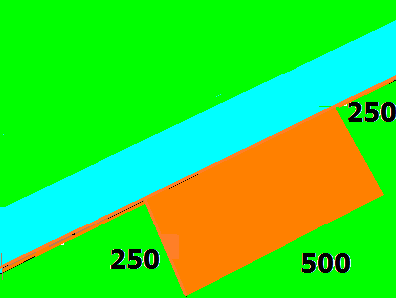
Differentiate the primary and set to zero
A = 1000x – 2x²
A’ = 1000 – 4x = 0
1000 = 4x
250 = x

Slide 14
What is the area of the largest possible garden?
A’ = 1000 – 4x = 0
A’’ = -4 concave down
A’’(250) = -4
Relative max at x = 250
A = 250 * 500 = 125,000 sq. ft.

Slide 15
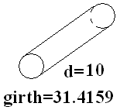
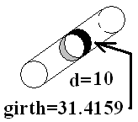


Girth is the smaller distance around the object

Slide 16

Post office says the max Length + girth is 108
108 = L + x
108 = L + 2x
108 = L + 4x

Slide 17
Find x that maximizes the volume
V = 4x + L
V = x² * L
V = 4x * L

Slide 18
V = x² * L
L = 108 – 4x
V = x² * (108 – 4x) = 108 x² - 4 x³
V’ = 216 x – 12 x² = 0
12x(18 – x) = 0
x = 18
V’’ = 216 – 24x and if x = 18, V’’ is
Negative => local max.

Slide 19
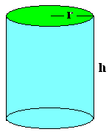
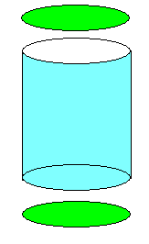
If the volume is 357 cm³
Minimize the aluminum.

Slide 20
V =
V = πr²
V = hr³
V = πr²h

Slide 21
If the volume is 357 cc³
Minimize the aluminum.
V = πr²h = 357
h = 357/(πr²)
A = πr² +
πr² +
2πrh

Slide 22
A =
A = πr²+2πrh
A = 2πr²+2πrh
A = πr²h+2πh

Slide 23
h = 357/(πr²)
A = πr² + πr² + 2πrh
Minimize the aluminum.
A = 2 πr² + 2πr 357 /(πr²)
= 2 πr² + 714r⁻¹
A’ = 4πr - 714r⁻²=0
4πr³ = 714

Slide 24

4π r³ = 714
r³ =
714/(4π)
r =
Diameter = 7.6888 cm = 3.0271 in

Slide 25
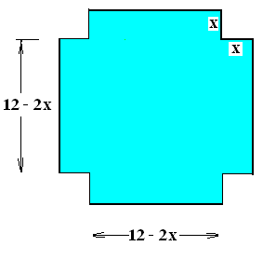
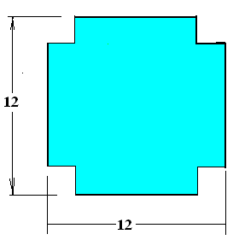
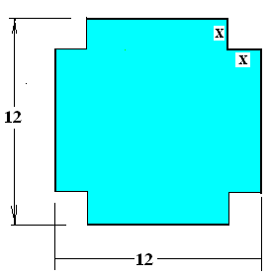
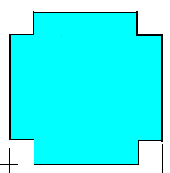
12” by 12” sheet of cardboard
Find the box with the most volume.
V =
x(12 - 2x)(12 - 2x)

Slide 26
12” by 12” sheet of cardboard
Find the box with the most
volume.
V = x(12 - 2x)(12 - 2x)
V’=x(12 - 2x)(-2)+

Slide 27
12” by 12” sheet of cardboard
Find the box with the most
volume.
V = x(12 - 2x)(12 - 2x)
V’=x(12 - 2x)(-2)+x(-2) (12 - 2x)+

Slide 28
12” by 12” sheet of cardboard
Find the box with the most
volume.
V = x(12 - 2x)(12 - 2x)
V’=x(12-2x)(-2)+x(-2)(12-2x)+(12-2x)(12-2x)

Slide 29
12” by 12” sheet of cardboard
Find the box with the most
volume.
V = x(12 - 2x)(12 - 2x)
V’=x(12-2x)(-2)+x(-2)(12-2x)+(12-2x)(12-2x)
=(12-2x)(-2x-2x+(12-2x))

Slide 30
12” by 12” sheet of cardboard
Find the box with the most
volume.
V = x(12 - 2x)(12 - 2x)
V’=x(12-2x)(-2)+x(-2)(12-2x)+(12-2x)(12-2x)
=(12-2x)(-2x-2x+(12-2x))
=(12-2x)(12-6x)=144-24x-72x+12x²
=12(12-8x+x²)

Slide 31
12” by 12” sheet of cardboard
Find the box with the most
V’=x(12-2x)(-2)+x(-2)(12-2x)+(12-2x)(12-2x)
=(12-2x)(-2x-2x+(12-2x))
=(12-2x)(12-6x)=144-24x-72x+12x²
=12(12-8x+x²) = 12(x-6)(x-2) = 0

Slide 32
12” by 12” sheet of cardboard
Find the box with the most
V’ = 12(12-8x+x²) = 12(x-6)(x-2) = 0
x = 2 or x = 6

Slide 33
V = (12-2x)(12-2x) x
= 144x - 48x² + 4x³
Find the box with the most volume.
dV/dx =
144 – 96 x + 12 x² = 0 when
12(12 - 8x+ x²) = 0
(6 – x)(2 – x) = 0

Slide 34
dV/dx = 144 – 96 x + 12 x²
X = 2 or x = 6
d²V/dx² ⁼
-96 + 24 x
At x = 2 or at x = 6
negative positive

Slide 35
dV/dx = 144 – 96 x + 12 x²
X = 2 or x = 6
d²V/dx² ⁼
-96 + 24 x
At x = 2 or at x = 6
negative positive
Local max local min

Slide 36
Steps for solving an optimization problem
Read the problem drawing a picture as you read
Label all constants and variables as you read
If you have two unknowns, write a secondary equation
  Usually the first thing given
Find the variable that you want to optimize and write the primary equation
Eliminate one variable from the primary equation using the secondary equation
Determine the domain of the new primary equation
Differentiate the primary equation
  Set the derivative equal to zero
  Solve for the unknown
  Check the endpoints or run a first or second derivative test

Slide 37
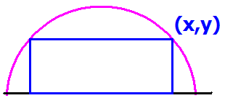
Read the problem drawing a picture as you read
Label all constants and variables as you read
R
Inside a semicircle of radius R.

Slide 38
Semicircle of radius 6.
If you have two unknowns, write a secondary equation. Usually
the first thing given.
6

Slide 39
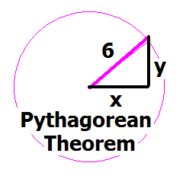
Write the equation of a circle, centered at the origin of radius 6.
x + y = 36
x² + y² = 6
x² + y² = 36
y =

Slide 40
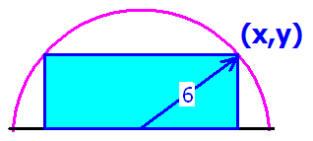
We identify the primary equation by the key word maximizes or minimizes
Find the value of x that
maximizes the blue area.

Slide 41
Find the rectangle with the largest area
Find the value of x that
maximizes the blue area.

Slide 42
Which of the following is the primary equation?
A = x y
A = 2 x y
A = ½ x y
A = 4 x y

Slide 43
Eliminate one variable from the primary equation using the secondary equation
A(x) = 2xy = 2x(6² - x² )^{½}
A² = 4x²(36 - x²) = 144x² - 4x⁴
R

Slide 44
^{Differentiate} A² = 144x² - 4x⁴
^{implicitly.}
A’ = 288x - 16x³
2AA’ = 144x - 8x
A’ = 144x – 16x
2AA' = 288x - 16x³

Slide 45
AA' = 144x - 8x³ = 0
Solve for x
x= 0, 3 root(2), - 3 root(2)
x = 6 root(2), - 6 root(2)
x = 0, 3, -3
x = 3/root(2), - 3/root(2)

Slide 46

Check the endpoints or run a first or second derivative test
AA' = 18x - x³ = x(18 – x²)
A' = 0 when x = 3 root(2) or x = 0
AA’(3)= 54 - 27 > 0
AA’(6) = 108 - 6³ < 0

Slide 47
Check the endpoints or run a first or second derivative test
AA' = 18x - x³ = x(18 – x²)
A' = 0 when x = 3 root(2) or x = 0
AA’(3)= 54 - 27 > 0
AA’(6) = 108 - 6³ < 0
AA”+A’A’ = 18 – 3 x² =0 when ??

Slide 48
Check the endpoints or run a first or second derivative test
AA' = 18x - x³ = x(18 – x²)
A' = 0 when x = 3 root(2) or x = 0
AA’(3)= 54 - 27 > 0
AA’(6) = 108 - 6³ < 0
AA”+A’A’ = 18 – 3 x² =0 when
AA” = (18 – 3x² ) – x²(18 – x²)²

Slide 49
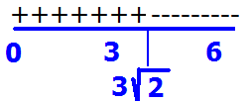
AA’(3)= 54 - 27 > 0
AA’(6) = 108 - 6³ < 0
There is a local max at x = 3 root(2)
Neither a max nor min at 3 root(2)
There is a local min at x = 3 root(2)
Inflection point at x = 3 root(2)

Slide 50
Steps for solving an optimization problem
Read the problem drawing a picture as you read
Label all constants and variables as you read
If you have two unknowns, write a secondary equation
  Usually the first thing given
Find the variable that you want to optimize and write the primary equation
Eliminate one variable from the primary equation using the secondary equation
Determine the domain of the new primary equation
Differentiate the primary equation
  Set the derivative equal to zero
  Solve for the unknown
  Check the endpoints or run a first or second derivative test

Slide 51
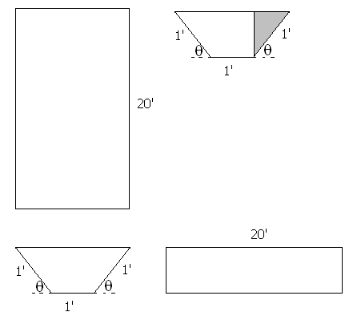
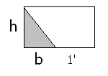


Build a rain gutter with the dimensions shown.
Base Area = h(b+1)
BA = sin(θ)[cos(θ)+1]
V=

Slide 52
BA = sin(θ)[cos(θ)+1]
V=
20 sin(θ)[cos(θ)+1]
20 sin(θ)²[cos(θ)+1]²
sin(θ)[cos(θ)+1]²
sin(θ)²[cos(θ)+1]

Slide 53
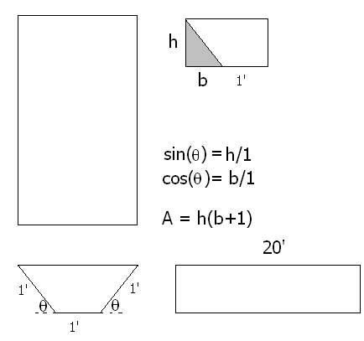
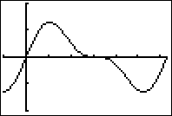
Find θ that maximizes the volume
V = 20 BA
V = 20 sin(θ)[cos(θ) + 1 ]
V’ =

Slide 54
V=20 sin(θ)[cos(θ)+1] dV/dθ =
20 sin(θ)[cos(θ)+1]
20 cos(θ) sin(θ)
20[sin(θ)(-sin(θ))+(cos(θ)+1)cos(θ)]
- 20 cos(θ) sin(θ)

Slide 55
Find θ that maximizes the volume
V’ = 20sin(θ)[-sin(θ)]+[cos(θ) + 1]20 cos(θ)
= 20 cos²(θ) - 20 sin²(θ) + 20 cos(θ)
= 20[2 cos(θ) - 1][cos(θ) + 1] = 0

Slide 56
20[2 cos(θ) - 1][cos(θ) + 1] = 0
Solve for θ on [0, π].
θ = π/3 or θ = 0
θ = π/2 or θ = 0
θ = π/6 or θ = π
θ = π/3 or θ = π

Slide 57
Find θ that maximizes the volume of the gutter
V’ = 20[2 cos(θ) - 1][cos(θ) + 1] = 0
2 cos(θ) = 1 or cos(θ) = -1
θ = π/3 or θ = π

Slide 58
Find θ that maximizes the volume of the gutter
V’ = 20 cos²(θ) - 20 sin²(θ) + 20 cos(θ)
V’’ = -40 cos(θ)sin(θ) – 40 sin(θ)cos(θ) -20 sin(θ)
V’’(π/3) = -40(½) – 40 (½) - 20
a local maximum at x = π/3
V”(π) = 0 -> Test fails

Slide 59
Local max at θ = π/3
V’ = 20 cos²(θ) - 20 sin²(θ) + 20 cos(θ)
V’(π/2) = -20 V’(3π/2) = -20
Second derivative test failed
First derivative test says decreasing on [π/3, π]

Slide 60
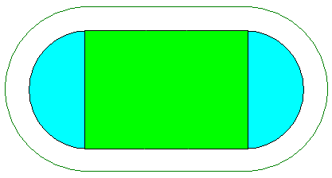
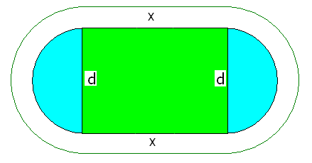
GSU builds 400 meter track.
400 =
2x + π d

Slide 61
Soccer requires a maximum of green area
A =
xd, but d = because 400 = 2x + π d
So A =

Slide 62
Soccer requires a maximum green rectangle
So A =
and A’ = when x = 100 meters
A” =

Slide 63
Soccer requires a maximum green area
400 = 2x + π d and when x = 100 meters
200 = π d or d = 200 / π

