Slide 1
If f(x) = x^{n} then f ' (x) = n x ^{(n-1)}
If f(x) = x⁴ then f ' (x) = 4 x³
If

Slide 2

If f(x) = x^{n} then f ' (x) = n x^{n-1}
If f(x) = x⁴ + 3 x³ - 2 x² - 3 x + 4
f ' (x) = 4 x³ + . . . .
f ' (x) = 4x³ + 9 x² - 4 x – 3 + 0
f(1) = 1 + 3 – 2 – 3 + 4 = 3
f ’ (1) = 4 + 9 – 4 – 3 = 6

Slide 3
If f(x) = x^{n} then f ' (x) = n x ^{(n-1)}
If f(x) = πx⁴ then f ' (x) = 4π x³
If f(x) = π⁴ then f ' (x) = 0
If

Slide 4
If f(x) = then f ‘(x) =

Slide 5
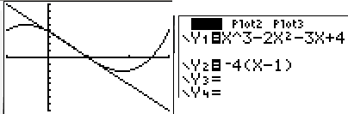
Find the equation of the line tangent to g when x = 1.
If g(x) = x³ - 2 x² - 3 x + 4
g ' (x) = 3 x² - 4 x – 3 + 0
g (1) =
g ' (1) =

Slide 6
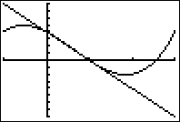


If g(x) = x³ - 2 x² - 3 x + 4 find g (1)
0.0
0.1

Slide 7
If g(x) = x³ - 2 x² - 3 x + 4 find g’ (1)
-4.0
0.1

Slide 8

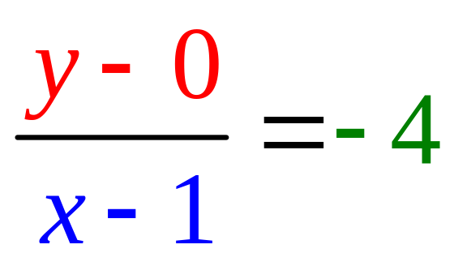
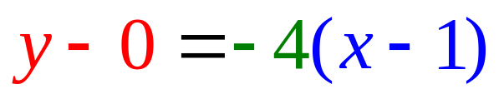
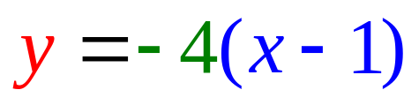
Find the equation of the line tangent to f when x = 1.
g(1) = 0
g ' (1) = – 4

Slide 9
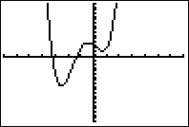
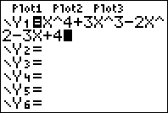
Find the equation of the line tangent to f when x = 1.
If f(x) = x⁴ + 3 x³ - 2 x² - 3 x + 4
f ' (x) = 4x³ + 9 x² - 4 x – 3 + 0
f (1) = 1 + 3 – 2 – 3 + 4 = 3
f ' (1) = 4 + 9 – 4 – 3 = 6

Slide 10
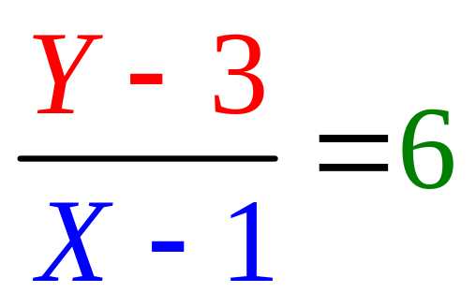
Find the equation of the line tangent to f when x = 1.
f(1) = 1 + 3 – 2 – 3 + 4 = 3
f ' (1) = 4 + 9 – 4 – 3 = 6

Slide 11
Write the equation of the tangent line to f when x = 0.
If f(x) = x⁴ + 3 x³ - 2 x² - 3 x + 4
f ' (x) = 4x³ + 9 x² - 4 x – 3 + 0
f (0) = write down
f '(0) = for last question

Slide 12



If g’(t) = 4t³ + 3, find g’’(t)
4t³ + 3
12t² + 3
12t²
4t If f(t) = t^{n} then f ' (t) = n t ^{(n-1)}

Slide 13
Theorem 1
The product rule
[f(x) g(x)]’ =
copy diff. copy diff.
f(x) g’(x) + g(x) f ’(x)

Slide 14
The product rule
If k(x) = f(x) g(x) , then
k’(x) = f(x) g’(x) + g(x) f ’(x)
Suppose k(x) = (3x²-2x) (4x⁴+1)
k’(x) = (3x²-2x) (16x³) + (4x⁴+1)(6x-2)

Slide 15
Theorem 1
The product rule
[f(x) g(x)]’ =
f(x) g’(x) + g(x) f ’(x)

Slide 16
The product rule
[f(x) g(x)]’=f(x)g’(x) + g(x)f ’(x)
If y =(x²-3x+1)(1/x+3x) find dy/dx
dy/dx =
(x²-3x+1)(-x⁻²+3) +(1/x+3x) (2x-3)

Slide 17
If f(x) = x^{n} then f ' (x) = n x ^{(n-1)}
If
then

Slide 18
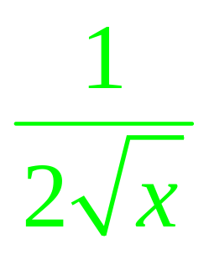
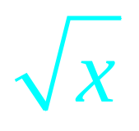
The product rule
[f(x) g(x)]’ = f(x) g’(x) + g(x) f ’(x)
[ (3x-1)]’ = (3) +(3x-1)

Slide 19
If y = (x-1)(3x²+2) find dy/dx or y’
6x
(x-1) 6x + (3x²+2)
(x-1) 6x
3x²+2

Slide 20
If y = (x²-x)(-3x²+2) find dy/dx or y’
(2x-1) (-6x)
(x²-x)(-3x+2) + (-3x²+2)(2x-1)
(x²-x)(-6x) + (-3x²+2)(2x-1)

Slide 21
If y = (x²-x)(x³-3x²+2) find dy/dx or y’
(x²-x) (3x² - 6x) + (x³ - 3x²+2) (2x-1)
(x²-x) (2x-1) + (x³ - 3x² ⁺²) (3x² - 6x)
(2x-1) (3x² - 6x)
(x²-x) (3x² - 6x) - (x³ - 3x²+2) (2x-1)

Slide 22
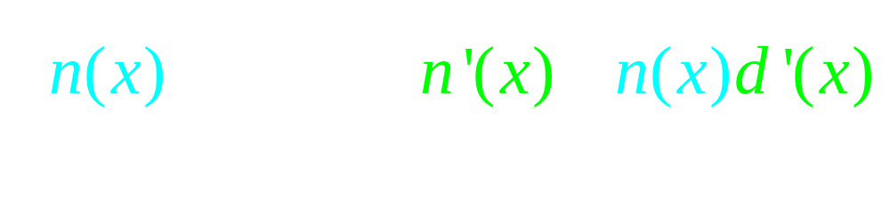
Theorem 2
The quotient rule

Slide 23
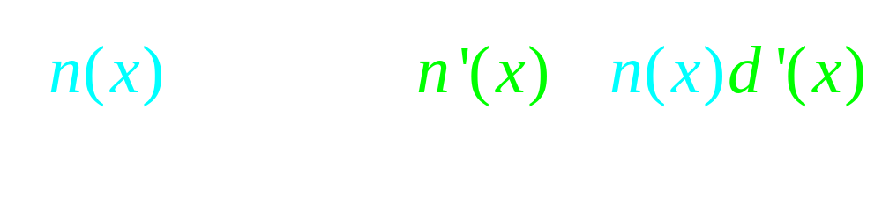
Theorem 2
The quotient rule
Never cancel across the minus sign

Slide 24


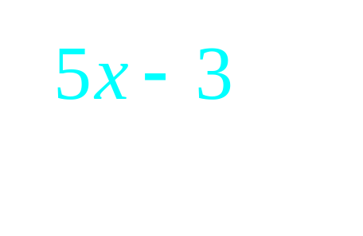

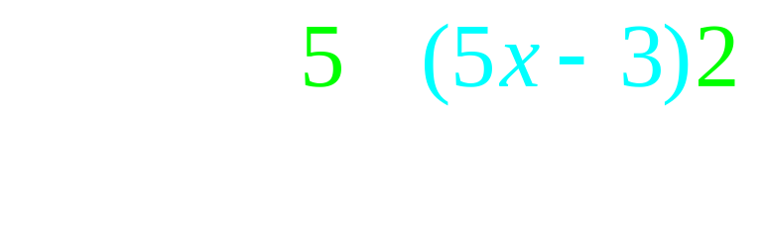
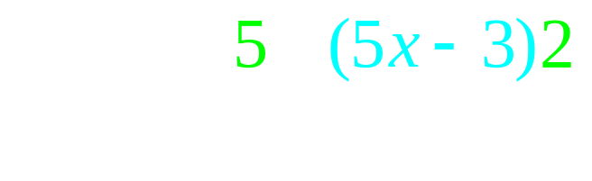
The quotient rule

Slide 25
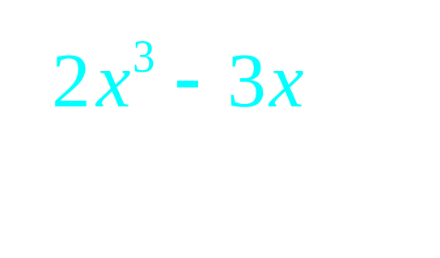
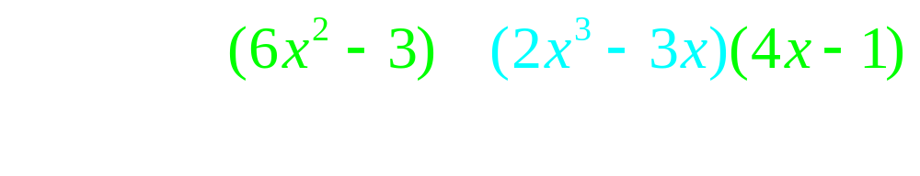
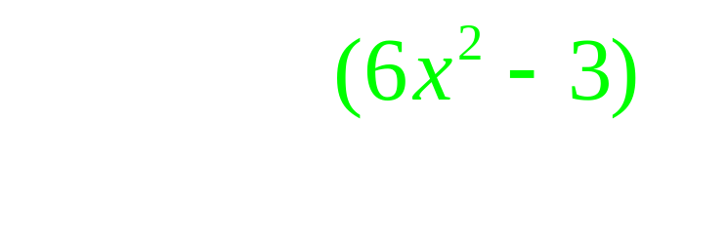
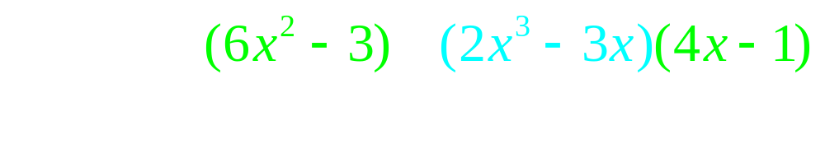
The quotient rule

Slide 26
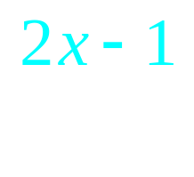
If f(x)= find f ’(x)
[(3x-4)2 – (2x-1)3] /(3x-4)²
(3x-4)2 – (2x -1)(3)
[(2x-1)3 – (3x-4)2] /(3x-4)²

Slide 27
If f(x)= find f ’(1)
-11
-5

Slide 28
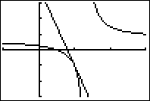
If f(x)= & f ’(1) = -5
Write the eq. of the tan. line
y + 1 = -5(x-1)
y – 1 = -5(x-1)
y = -5(x-1)
y = 5(x-1) - 1
when x = 1.

Slide 29
If f(x)= where is the horizontal asymptote?
d. n. e.
y = 0
y = 2/3
y = 1

Slide 30
If f(x)= where is the vertical asymptote?
d. n. e.
x = 1
x = 4/3
x = 3/2

Slide 31

Proof of the product rule
k(x) = f(x) g(x)

Slide 32
Proving the product rule

Slide 33
The product rule

Slide 34
The product rule
k’(x) = f(x) g’(x) + g(x) f ’(x)

Slide 35

Write the equation of the line tangent to f(x) when x = 0.
y - 4 = -3x
y - 4 = 3x
y - 3 = -4x
y - 4 = -3x + 2

Slide 36
http://www.youtube.com/watch?v=P9dpTTpjymE Derive
http://www.9news.com/video/player.aspx?aid=52138&bw= Kids
http://math.georgiasouthern.edu/~bmclean/java/p6.html Secant Lines

Slide 37
If f(x) = then f’(x) =
Proof : f’(x) = Lim [f(x+h)-f(x)]/h =

Slide 38
If f(x) = then f’(x) =
.
.
.
.

Slide 39
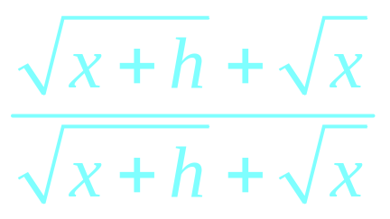
f’(x) = =
.
.
.
.

Slide 40
f’(x) = =
.
.
.

Slide 41
f’(x) = =
.
0
.

Slide 42
g(x) = 1/x, find g’(x)
g(x+h) = 1/(x+h)
g(x) = 1/x
g’(x) =

