Slide 1

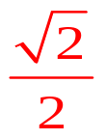
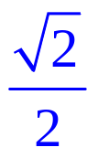

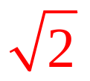

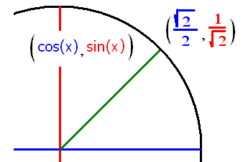

Trigonometry Review
Find sin(π/4) = cos(π/4) = tan(π/4) =
csc(π/4) = sec(π/4) = cot(π/4) =

Slide 2
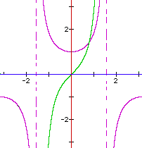
Evaluate tan(π/4)
Root 2
2
Root 2 /2
2 / Root 2
1

Slide 3

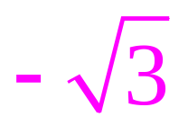


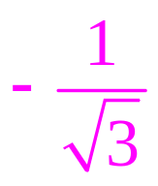


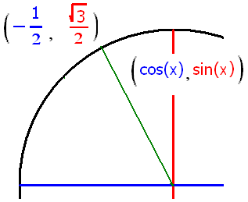
Trigonometry Review
sin(2π/3) = cos(2π/3) = tan(2π/3) =
csc(2π/3) = sec(2π/3) = cot(2π/3) =

Slide 4
Evaluate sec(2π/3)
-1
-2
-3
Root(3)
2 / Root(3)

Slide 5
Trig. Derivatives
sin’(x) = cos(x) cos’(x) = - sin(x)

Slide 6
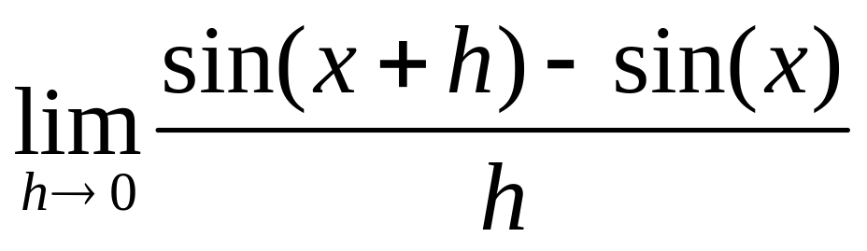
Trig. Derivatives
sin’(x) = cos(x)
sin’(x) =

Slide 7
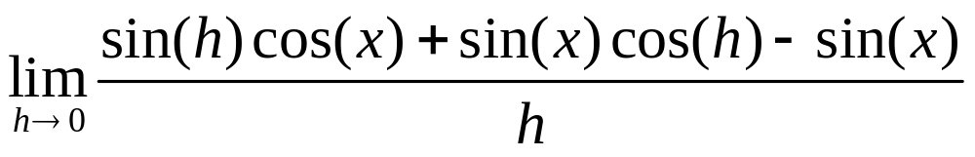
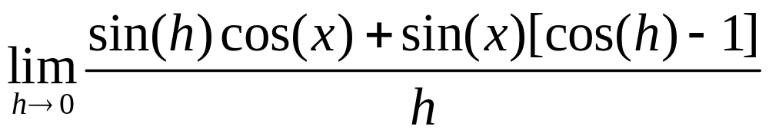
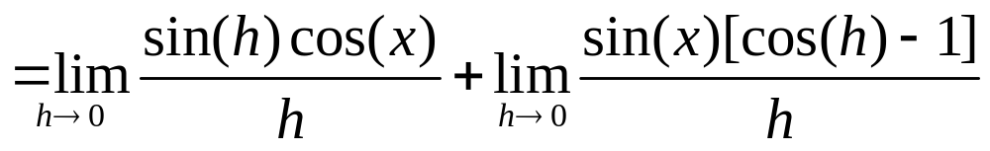
sin’(x) = .
sin’(x) =
sin’(x) =

Slide 8
Rule 4 says .
0
0.5
1
1.5

Slide 9
Rule 5 says .
0
0.5
1
1.5

Slide 10
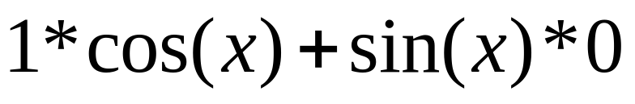
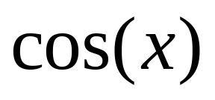
sin’(x) = .
sin’(x) =
sin’(x) =

Slide 11
Trig. Derivatives
sin’(x) = cos(x) cos’(x) = - sin(x)

Slide 12
If y = sin(x) + 2x², find dy/dx
- cos(x) + 4x
cos(x) + 4
cos(x) + 4x

Slide 13



Trig. Derivatives
sin’(x) = cos(x) cos’(x) = - sin(x)
A) sin’(0) = cos(0) = 1
B) sin’(π/4) = cos(π/4) = 0.707
C) sin’(-π/3) = cos(-π/3) = 0.5

Slide 14

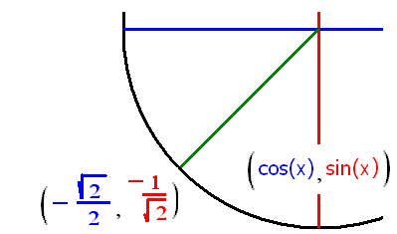
x= 0, 2π/3, - 3π/4
cos’(x) = - sin(x)
A) cos’(0) = - sin (0) = 0
B) cos’(-3π/4) = - sin(5π/4) = 0.707
C) cos’(2π/3) = - sin(2π/3) = - 0.866

Slide 15
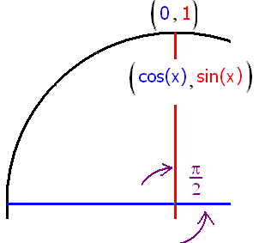
Evaluate cos’(π/2)
-1
-.707
1
0.707

Slide 16
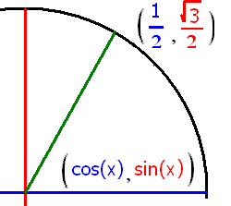
Evaluate sin’(π/3)
- 0.5
0.5
0.707
0.866

Slide 17
Trig. Derivatives
sin’(x) = cos(x) cos’(x) = - sin(x)
tan’(x) = sec²(x) cot’(x) = - csc²(x)
sec’(x) = sec(x)tan(x) csc’(x) = -csc(x)cot(x)

Slide 18
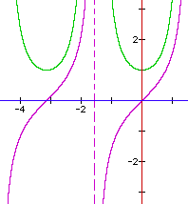
Trig. Derivatives
Theorem tan’(x) = sec²(x)
Proof : tan’(x) = [sin(x)/cos(x)]’

Slide 19
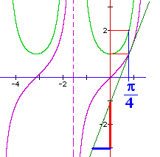
Trig. Derivatives
Theorem tan’(x) = sec²(x)
tan’(π/4) =

Slide 20
Trig. Derivatives
Theorem tan’(x) = sec²(x)
tan’(π/4) = sec²(π/4) = 2 while tan(π/4) =
1

Slide 21
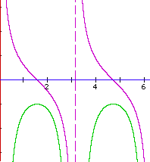
Trig. Derivatives
Theorem cot’(x) = - csc²(x)
Proof : cot’(x) = [cos(x)/sin(x)]’

Slide 22
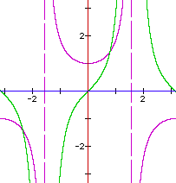
Trig. Derivatives
Theorem sec’(x) = sec(x)tan(x)
Proof : sec’(x) = [1/cos(x)]’

Slide 23
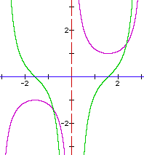
Trig. Derivatives
Theorem csc’(x) = - csc(x)cot(x)
Proof : csc’(x) = [1/sin(x)]’

Slide 24
Trig. Derivatives
sin’(x) = cos(x) cos’(x) = - sin(x)
tan’(x) = sec²(x) cot’(x) = - csc²(x)
sec’(x) = sec(x)tan(x) csc’(x) = - csc(x)cot(x)

Slide 25
If y = tan(x) sec(x) find the velocity and y’(π/3)
sec’(x) = sec(x)tan(x) tan’(x) = sec²(x)
y ’ = tan(x)sec(x)tan(x) + sec(x)sec²(x)
y’=sec(x)[sec² (x)-1] + sec³(x)=2sec³(x)-sec(x)
y’(π/3) = 2sec³(π/3)-sec(π/3) =
sin²x+cos²x=1 dividing by cos²⁽x)
tan² (x)+1=sec² (x)

Slide 26
If y = tan(x) cos(x) find the acceleration and y’’(π/3)
y’ = cos(x)
y’’ = -sin(x) y’’(π/3)=

Slide 27
If y = tan(x) + cos(x) find the initial acceleration, y’’(0)
tan’(x) = sec²(x) sec’(x) = sec(x)tan(x)
y’ = sec(x)sec(x) - sin(x) y’’ =
sec(x) sec(x)tan(x) + sec(x) sec(x)tan(x) - cos(x)
= 2 sec²(x) tan(x) – cos(x)
y’’(0) = 2 * 1 * 0 - . . . . . .

Slide 28


y” = 2 sec²(x) tan(x) – cos(x) y”(0) =
-1.0
0.1

Slide 29

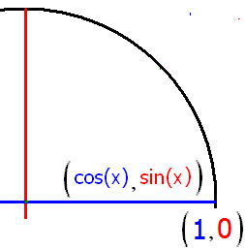
If y = sec(x), find the acceleration, y’’(0) using the product rule on sec’(x).
1.0
0.1

Slide 30
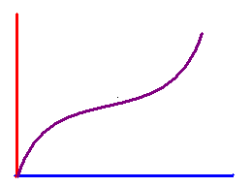
Find the slope of the tangent line to y = x + sin(x) when x = 0
2.0
0.1

Slide 31


Write the equation of the line tangent to y = x + sin(x) when x = 0
y = 2x + 1
y = 2x + 0.5
y = 2x

