Slide 1
Implicit Differentiation

Slide 2
If h(x) = [g(x)]^{n} then h’(x) = n [g(x)]^{n-1}g’(x)
We review the power rule.

Slide 3


If y = 4(2x + 2)⁵ then y’ =
20 (2x + 2)⁴ 2 = 40 (2x + 2)⁴
20 (2x + 2)⁵ 2 = 40 (2x + 2)⁵
20(2)⁴ = 20 (16) = 320
20 (2x + 2)⁴ = 20 (2x + 2)⁴

Slide 4
If h(x) = [3x + cos(x)]⁷
^{h’(x) =}
21 x + 7 cos(x)
7 [3x + cos(x)] ⁶[3 + sin(x)]
7 [3x + cos(x)] ⁶[3 - sin(x)]
7 [3 - sin(x)]⁶

Slide 5
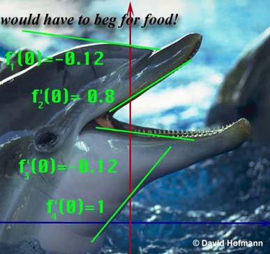
Replace g(x) with y.
Instead of ([g(x)]^{n} )’ = n [g(x)]^{n-1}g’(x)
We get (y ^{n} )’ = n [ y ]^{n-1} y’

Slide 6
Replace g(x) with y.
We get (y ^{n} )’ = n [ y ]^{n-1} y’

Slide 7
Guidelines for Finding the Derivative Implicitly
Let Y stand for one of any number of functions.
In this case, 4 different functions.

Slide 8
Recall [(x+1)(x²-3)]’
= (x+1)(2x)+ (x²-3)
So [(x+1)y]’ = (x+1)y’ + y
[3 y³ ]’ = 9 y² y’

Slide 9
So [(2x+1)y]’ = ?
2Y’
(2x+1) y’ + 2y
(2x+1) y’ + 2y’
(2x+1) y’

Slide 10
Find [2y⁶ + tan(2x)]’
12y⁵ y’ – sec²(2x) 2
12y⁵ y’ + sec²(2x) 2
12y⁵ y’ + csc²(2x) 2
12y⁵ + sec²(2x) 2

Slide 11
Guidelines for Finding the Derivative Implicitly
Let Y stand for one of any number of functions.
Differentiate both sides of the equation, using chain rule, power rule, product rule, quotient rule.

Slide 12
If x² + y² = 36 find y’.
What is the derivative of x² ?
2x
What is the derivative of y² ?
2yy’
What is the derivative of 36 ?

Slide 13


What is the derivative of 36?
0.0
0.1

Slide 14
Differentiate both sides x² + y² = 36
2x + 2yy’ = 0
2x + 2yy’ = 36
2x + 2y = 0

Slide 15
Guidelines for Finding the Derivative Implicitly
Let Y stand for one of any number of functions.
Differentiate both sides of the equation, using chain rule, power rule, product rule, quotient rule.
Place all of the terms containing Y' on one side and the other terms on the other.

Slide 16
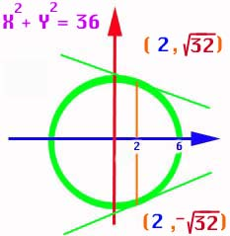
If x² + y² = 36 find y’.
2x + 2yy’ = 0
2yy’ = -2x

Slide 17
Guidelines for Finding the Derivative Implicitly
Differentiate both sides of the equation, using chain rule, power rule, product rule, quotient rule.
Place all of the terms containing Y' on one side and the other terms on the other.
Factor the Y' out if necessary and solve for Y‘.

Slide 18
If x² + y² = 36 find y’.
2yy’ = -2x
yy’ = -x
y’ =

Slide 19
Guidelines for Finding the Derivative Implicitly
Place all of the terms containing Y' on one side and the other terms on the other.
Factor the Y ' out if necessary and solve for Y '.
Replace x and y by the values given.

Slide 20
y’ = x² + y² = 36
Top point only!
Find the slope when x = 2.
When x = 2, y = or
Y =
Thus y’ =

Slide 21
y’ =
Y’ = for top point
Y’ = bottom point

Slide 22
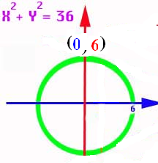
If y’ = find the slope at (-3 , 3)
1.732
0.1

Slide 23
Thus if the dolphins forehead could be approximated by a circle,
we could calculate
the slope there if
we knew the x and
y coordinates.
y’ =

Slide 24
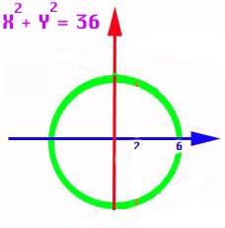
And if the dolphins throat could be approximated by a circle,
we could calculate
the slope there if
we knew the x and
y coordinates.
y’ =

Slide 25
Guidelines for Finding the Derivative Implicitly
Let Y stand for one of any number of functions.
Differentiate both sides of the equation, using
chain rule, power rule, product rule, quotient rule.
Place all of the terms containing Y' on one side and the other terms on the other.
Factor the Y' out if necessary and solve for Y‘.
Replace x and y by the values given.

Slide 26
Let Y stand for one of 5 functions.
If 3x² + xy⁵ = 16x find y’.
What is the derivative of 3x² ?
6x
What is the derivative of xy⁵ ?
x5y⁴y’+y⁵
What is the derivative of 16x ?

Slide 27
Differentiate xy⁵ using the product rule and power rule
x5y⁴y’ + y⁵

Slide 28
3x² + xy⁵ = 16x
Differentiate both sides
6x + 5y⁴ y’= 16
6x +5xy⁴ y’= 16
6x +5xy⁴ y’+y⁵ = 16
6 + 6x +5xy⁴ y’+y⁵ = 0

Slide 29
Guidelines for Finding the Derivative Implicitly
Let Y stand for one of 5 functions.
Differentiate both sides of the equation, using chain rule, power rule, product rule, quotient rule.

Slide 30
If 3x² + xy⁵ = 16x find y’.
6x + x 5y⁴y’ + y⁵ = 16

Slide 31
If 3x² + xy⁵ = 16x find y’.
6x + x 5y⁴y’ + y⁵ = 16
Place all y’s on the left
5xy⁴y’ = 16 – 6x – y⁵

Slide 32
If 3x² + xy⁵ = 16x find y’.
6x + x 5y⁴y’ + y⁵ = 16
Place all y’s on the left
5xy⁴y’ = 16 – 6x – y⁵
solve
Y’ =

Slide 33
If 3xy + x + 5y² = 16 find y’.
3xy’ + 3y + 1 + 10yy’ = 0
Place all (y’)’s on the left and factor
3xy’ + 10yy’ = (3x+10y)y’= -1 - 3y
Y’ =

Slide 34
If 3xy + x + 5y² = 16 find y’’.
3xy’ + 3y + 1 + 10yy’ = 0
3xy’’ + 3y’ + 3y’ + 10yy’’ + 10(y’)² = 0
Place all (y’’)’s on the left and factor
(3x+10y)y’’= -6y’ - 10(y’)²

Slide 35
If 3xy + x + 5y² = 16 find y’’.
Place all (y’’)’s on the left and factor
(3x+10y)y’’=-6y’+10(y’)²
Solve for y’’
y’’ = =
=

Slide 36
If 3xy + x + 5y² = 16 find y’’.
y’’=
=
=

Slide 37
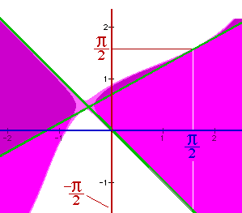
Find the slope of
y² - sin( x + y ) = x² at the points (π/2, π/2) and (π/2, -π/2).
In other words, find the slopes of the two green lines.

Slide 38
y² - sin( x + y ) = x²
Let y stand for the two functions f1 and f2. Differentiating,
2yy' - cos(x + y)[1+y'] = 2x
2yy’ – cos(x+y) – cos(x+y) y’ = 2x
[2y - cos(x+y)]y' = 2x + cos(x+y), or
y' = [2x + cos(x+y)] / [2y - cos(x+y)]

Slide 39
y² - sin( x + y ) = x² y’ =
[2x + cos(x+y)] / [2y - cos(x+y)]
Now substitute (π/2, π/2) and
(π/2, -π/2).
f1 has a slope of [π-1]/[π+1]
and the slope of f2 is [π+1] / [-π-1] =
-1

Slide 40
y’=[2x+cos(x+y)] / [2y-cos(x+y)]
Find y’ at (-π/2,-π/2) to one decimal.
1.933884414
0.1

Slide 41
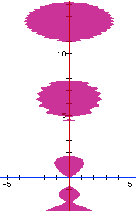
sin(y²) = x² - y cos(y)
Find y’ at the point (0, 0)
cos(y²)2yy’ = 2x – [-y sin(y) y’ + cos(y) y’]
[cos(y²)2y - y sin(y) + cos(y)]y’=2x
(0 + 0 + 1) y’ = 0 so y’ = 0

Slide 42
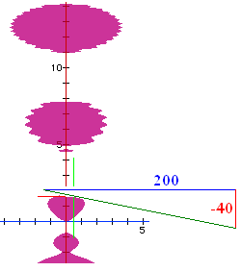
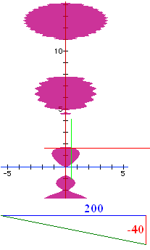
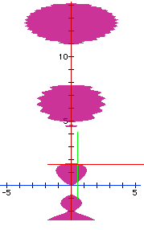
sin(y²) = x² - y cos(y)
Find y’ at the point (.5, 1.65555)
cos(y²)2yy’ = 2x – [-y sin(y) y’ + cos(y) y’]
[cos(y²)2y - y sin(y) + cos(y)]y’=2x
(-3.04876 - 1.64961 -0.08465) y’ = 1
so y’ = -0.2091

Slide 43
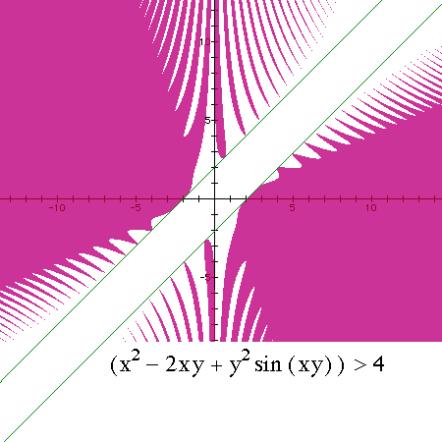
x² – 2xy + y²sin(xy) > 4
Find y’ at the point (-2, 0)
2x -2xy’-2y+y2cos(xy)[xy’+y]+2sin(xy)yy’=0

Slide 44
x² – 2xy + y²sin(xy) = 4 implicitly 2x-2xy’-2y
+y²cos(xy)+sin(xy)2yy’=0
+y²cos(xy)[xy’]+sin(xy)2yy’=0
+y²cos(xy)[xy’+y]+sin(xy)yy’=0
+y²cos(xy)[xy’+y]+sin(xy)2yy’=0

Slide 45
x² – 2xy + y²sin(xy) = 4
Find y’ at the point (-2, 0)
2x -2xy’-2y+y²cos(xy)[xy’+y]+2sin(xy)yy’=0
Next question is ‘Find y’ at the point (-2,0).’

Slide 46
2x -2xy’-2y+y²cos(xy)[xy’+y]+2sin(xy)yy’=0
^{Find y’ at (-2,0)}
0
1
2
-1

Slide 47
Theorem – If n is an integer, [x^{n}]’ =nx^{n-1}
Use mathematical induction for positive n
Use mathematical induction for nonnegative n
n=0 ; 1’ = 0
Assume [x^{k}]’ =kx^{k-1} for k<0 but fixed
Prove [x^{k-1}]’ =(k-1)x^{k-2}

Slide 48
Theorem – If q is rational, [x^{q}]’ =qx^{q-1}
Since q is rational, there exist integers, m and n such that q = m/n and n is not 0.
Then y = x^{q} = x^{m/n} and y^{n} = x^{m} thus
ny^{n-1} y’ = m x^{m-1}
y’ = mx^{m-1}/[ny^{n-1}] = q x^{m-1}/x^{m/n(n-1)}
y’ = qx^{m-1-m+q} = qx^{q-1}

Slide 49
Implicit Differentiation
Related Rates

