Slide 1
Implicit Differentiation

Slide 2
If 3x² +16x-y-17 = xy⁵ find y’ @ (1,-1)
6x +
16 -
y’ =

Slide 3


[xy⁵ ]’ =
5xy⁴
5xy⁴ y’
x5y⁴ y’+y⁵
x5y⁴ y’+y⁵ y’

Slide 4
If 3x² +16x-y-17 = xy⁵ find y’ @ (1,1)
6x + 16 – y’ = x5y⁴ y’+y⁵

Slide 5
6x + 16 – y’ = x5y⁴ y’+y⁵
6x + 16 - y⁵ = y’ + 5 x y⁴ y’
6x + 16 - y⁵ = - y’ - 5 x y⁴ y’
6x + 16 + y⁵ = - y’ + 5 x y⁴ y’

Slide 6
6x + 16 - y⁵ = y’ + 5 x y⁴ y’
6x + 16 - y⁵ = y’ (1 + 5 x y⁴ )
6x + 16 - y⁵ = y’ (y’ + 5 x y⁴ )
6x + 16 + y⁵ = y’ ( 5 x y⁴ )

Slide 7
6x + 16 - y⁵ = y’ (1 + 5 x y⁴ ) y’ =
(6x + 16 - y⁵) / (1 + 5 x y⁴ )
6x + 16 - y⁵ = /(-1 – 5 x y⁴ )

Slide 8
y’=(6x+16-y⁵) /(1+5xy⁴)
@ (1,-1)
-23/6
23/6
21/6
-21/6

Slide 9
s = 4 π r ²
Relate ds/dt to dr/dt.

Slide 10
s = 4 π r ² ds/dt = 8 π r dr/dt
True
False

Slide 11
ds/dt = 8 π r dr/dt If r=1
& ds/dt = 8 then dr/dt = π
True
False

Slide 12
V = I R
V’ = I R’ + I’ R
#5 Enter answer on next slide.
d) Find the rate of dR/dt when V is increasing at 1 volt per second and I is decreasing at 1/3 amp per second, V = 12 and I = 2.

Slide 13


[Enter question here]
1.5
0.1

Slide 14
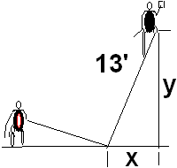
If x’=1 when x=5 find y’
-0.417
0.05

Slide 15
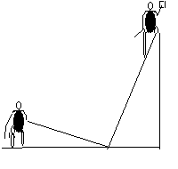
Related Rates
Back to the calculus with y = 12,
x = 5, and x’ = 1 ft/sec
xx’ + yy’ =0
5(1) + 12(y’) = 0
y’ = -5/12 ft./sec.

Slide 16
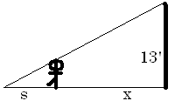
Related Rates
Suppose a 6 ft tall person walks away from a 13 ft lamp post at a speed of 5 ft per sec. How fast is the tip of his shadow moving when 12 ft from the post?

Slide 17
Find ?
s
x
s + x
3

Slide 18
Related Rates
The tip of the shadow has a speed of
(s+x)’, not s’. What is s’?
s’ is the growth of the shadow and includes getting shorter on the right.

Slide 19
Related Rates
Cross multiplying
Since x’ = 5

Slide 20
Related Rates
Thus s’ is
and
Note that the tip is moving almost
twice as fast as the walker, and more than twice as fast as the shadow regardless of x.

Slide 21
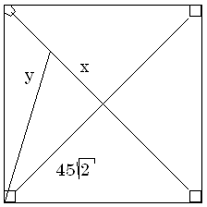

Related Rates
Suppose a radar gun on first base catches a baseball 30 feet away from the pitcher and registers 50 feet per second. How fast is the ball really traveling?

Slide 22
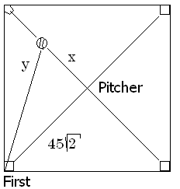
a baseball 30 feet away from the pitcher and registers 50
. feet per second.
x=30 y’=50
x=30 y =50
x’=30 y’=50
x’=30 y=50

Slide 23
Related Rates
The calculus.
x = 30 y’ = 50 y = ?
The algebra.

Slide 24
Differentiate implicitly
2x = 2y y’
2x = y y’
2x x’ = y y’
2x x’ = 2y y’

Slide 25
Related Rates
x = 30 y’ = 50 y = ?
Back to the calculus.

Slide 26
a baseball 30 feet away from the pitcher and registers 50
. feet per second.
x’ = 0.6 root(4950)
x’ = 50 root(4950)
x’ = 30 root(4950)
x’ = 5/3 root(4950)

Slide 27
Related Rates
Back to the calculus.
x = 30 y’ = 50 y = ?

Slide 28
Related Rates
Back to the calculus.
x = 30 y’ = 50 y = ?

Slide 29
Related Rates
x’ = 117.260 feet/sec.
X = 30 y’ = 50 y = ?

Slide 30
Related Rates
Read the problem, drawing a picture
No non-constants on the picture
Write an equation
Differentiate implicitly
Enter non-constants and solve

Slide 31


Related Rates
Suppose air is entering a balloon at the rate of 25 cubic feet per minute. How fast is the radius changing when r = 30 feet?

Slide 32
Related Rates
r’ = 0.00221
ft per min

