Slide 1
Related Rates
Read the problem, drawing a picture
No non-constants on the picture
Write an equation
Differentiate implicitly
Enter non-constants and solve

Slide 2
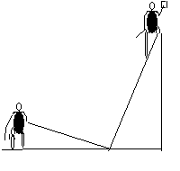
Related Rates
Suppose a painter is standing on a 13 foot ladder and Joe ties a rope to the bottom of the ladder and walks away at the rate of 2 feet per second.

Slide 3
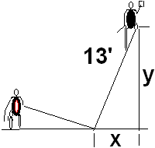
Related Rates
Suppose a painter is standing on a 13 foot ladder and Joe ties a rope to the bottom of the ladder and walks away at the rate of 2 feet per second.
How fast is the painter
falling when x = 5 feet?

Slide 4


What does the Pythagorean Theorem say about
x² + y² = 13
2x² + y² = 169
x² + 2y² =13
x² + y² = 169

Slide 5
Related Rates
Write an equation
Differentiate the equation
implicitly
2x x’ + 2y y’ = 0 or xx’ + yy’ = 0
If Joe pulls at 2 ft./sec., find the speed
of the painter when x = 5.

Slide 6
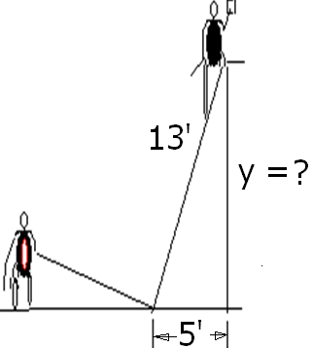
Find y when x = 5
5
8
12
13

Slide 7
Related Rates
Use algebra to find y.
x² + y² = 169
5² + y² = 169
y² = 169 – 25 = 144
y = 12

Slide 8
Related Rates
Back to the calculus with y = 12,
x = 5, and x’ = 2 ft/sec
xx’ + yy’ =0
5(2) + 12(y’) = 0
y’ = -10/12 = -5/6 ft./sec.

Slide 9
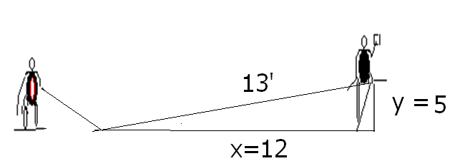
Related Rates
Summary
Even though Joe is walking 2 ft/sec,
the painter is only falling -5/6 ft/sec.
If the x and y values were reversed,

Slide 10
xx’ + yy’ =0 Find y’ if x’=2, y=5, and x = 12
-24/5
5/24
-5/24
-5

Slide 11
Related Rates
Summary

Slide 12


Related Rates
Suppose air is entering a balloon at the rate of 25 cubic feet per minute. How fast is the radius changing when r = 30 feet?

Slide 13
Related Rates
r’ = 0.00221
ft per min

Slide 14
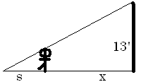
Related Rates
Suppose a 6 ft tall person walks away from a 13 ft lamp post at a speed of 5 ft per sec. How fast is the tip of his shadow moving when 12 ft from the post?

Slide 15
Related Rates
Suppose a 6 ft tall person walks away from a 13 ft lamp post at a speed of 5 ft per sec. How fast is the tip of his shadow moving when 12 ft from the post?

Slide 16
Find ?
s
x
s + x
3

Slide 17
Related Rates
The tip of the shadow has a speed of
(s+x)’, not s’. What is s’?
s’ is the growth of the shadow and includes getting shorter on the right.

Slide 18
Related Rates
Cross multiplying
Since x’ = 5

Slide 19
Related Rates
Thus s’ is
and
Note that the tip is moving almost
twice as fast as the walker, and more than twice as fast as the shadow regardless of x.

Slide 20
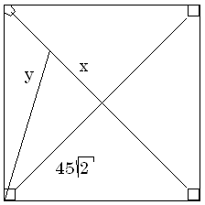

Related Rates
Suppose a radar gun on first base catches a baseball 30 feet away from the pitcher and registers 50 feet per second. How fast is the ball really traveling?

Slide 21
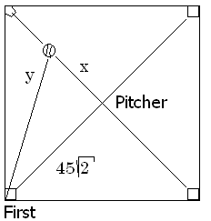
a baseball 30 feet away from the pitcher and registers 50
. feet per second.
x=30 y’=50
x=30 y =50
x’=30 y’=50
x’=30 y=50

Slide 22
Related Rates
The calculus.
x = 30 y’ = 50 y = ?
The algebra.

Slide 23
Differentiate implicitly
2x = 2y y’
2x = y y’
2x x’ = y y’
2x x’ = 2y y’

Slide 24
Related Rates
x = 30 y’ = 50 y = ?
Back to the calculus.

Slide 25
Related Rates
Back to the calculus.
x = 30 y’ = 50 y = ?

Slide 26
Related Rates
Back to the calculus.
x = 30 y’ = 50 y = ?

Slide 27
a baseball 30 feet away from the pitcher and registers 50
. feet per second.
x’ = 0.6 root(4950)
x’ = 50 root(4950)
x’ = 30 root(4950)
x’ = 5/3 root(4950)

Slide 28

Related Rates
x’ = 117.260 feet/sec.
X = 30 y’ = 50 y = ?

Slide 29
Related Rates
Read the problem, drawing a picture
No non-constants on the picture
Write an equation
Differentiate implicitly
Enter non-constants and solve

