Slide 1


Definitions:
If f : D -> K is a function and a is in D, then f(a) is a absolute minimum on D iff f(a) <= f(x), for every x in D.
If f : D -> K is a function and a is in D, then f(a) is a absolute maximum on D iff f(x) <= f(a), for every x in D.

Slide 2
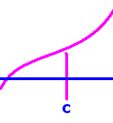
Theorem : If f is continuous on [a,b], then f has a max and a min.

Slide 3
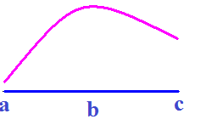
Where is the absolute maximum?
x = a
x = b
x = c

Slide 4


Where is the absolute maximum?
x = a
x = b
x = c
[Default]
[MC Any]
[MC All]

Slide 5
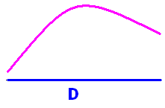
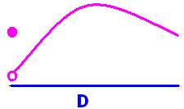
Absolute max and min
Absolute max – no min

Slide 6
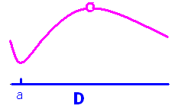
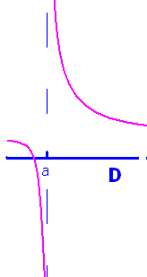
Absolute min – no max
Neither

Slide 7
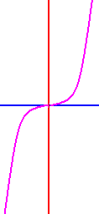
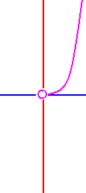
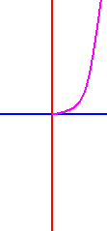
Rule y = x³
Domain Extrema
R = (-oo, +oo) None
[-2, 2] max at 2 min at -2
(0, 2] max at x = 2
[0, +oo) min at x = 0

Slide 8

Where is the absolute minimum?
x = 0
x = 1
x = 2
[Default]
[MC Any]
[MC All]

Slide 9
Where is the absolute minimum?
x = 0
x = 1
x = 2
[Default]
[MC Any]
[MC All]

Slide 10


Definitions:
f : D -> K has a local extrema at x = c iff there is an open interval, I, containing c for which f(c) is an absolute maximum or an absolute minimum on I.
In the above drawing, f has four local extrema. They are at the four blue dots.

Slide 11

Definition:
If c is in the domain of f and
f '(c) is undefined, or
f '(c) = 0,
then c is a critical value of f.
f has three critical values in the above drawing.

Slide 12
Where is the critical value?
x = a
x = b
x = c

Slide 13
Where is the critical value?
x = a
x = b
x = c
[Default]
[MC Any]
[MC All]

Slide 14
Where are the endpoints?
x = a and x = b
x = b and x = c
x = a and x = c

Slide 15
Where are the endpoints?
x = a and x = b
x = b and x = c
x = a and x = c
[Default]
[MC Any]
[MC All]

Slide 16
Theorem
If f has a local extrema at x = c, then c is a critical value of f.
Case 1: If f is not differentiable at x = c, then f has a critical value at x = c.

Slide 17
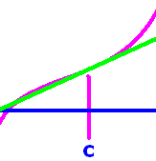
c is a critical value of f.
Case 2: If f is differentiable at x = c, then the limit (f(x+h) - f(x))/h is either positive, negative, or zero.
Positive Case: c is in an open interval denoted by x for which (f(x+h) - f(x))/h is positive everywhere.
When h > 0, f(c+h) > f(c) ➔ c is not a local max
and, when h < 0 f(c+h) < f(c) ➔ c is not a local min.
thus the derivative can not be positive when x = c. Similarly the derivative can not be negative. Therefore it is zero when it exists.

Slide 18
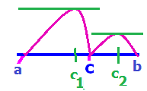
Definition:
If c is in the domain of f and
f '(c) is undefined, or
f '(c) = 0,
then c is a critical value of f.
f has three critical values in the above drawings.

Slide 19
Theorem : If f is continuous on [a,b], then f has a max and a min.

Slide 20
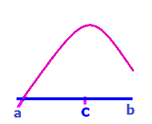
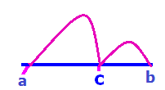
Theorem : If f is continuous on [a,b], then f has a max and a min.
How do you find them?

Slide 21
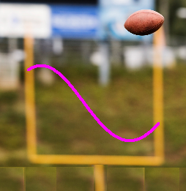
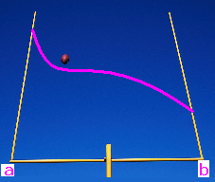
Finding extrema of continuous functions on a closed interval, [a,b]
Differentiate f
Set numerator = 0 and solve for c
Set denominator = 0 and solve if c in the domain
Evaluate f (c) for all critical points and end points

Slide 22
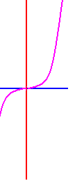
Find absolute extrema of f(x) = x³ on [-1, 2]
f ’ (x) = 3x² = 0 when x = 0
f(-1) = -1 f(0) = 0 f(2) = 8
Absolute minimum Absolute maximum
@ x = -1 @ x = 2

Slide 23
f(x) = x³ - 6x on [-1, 2] find f ’(x) and write it down
x³ - 6
3x² – 6x
3x² – 6
3x – 6

Slide 24
f(x) = x³ - 6x on [-1, 2] find f ’(x) and write it down
x³ - 6
3x² – 6x
3x² – 6
3x – 6

Slide 25
f’(x) = 3x² – 6 on [-1,2]
Where is f’(x) equal to zero?
2
.
1
- ½

Slide 26
f’(x) = 3x² – 6 on [-1,2]
Where is f’(x) equal to zero?
2
.
1
- ½

Slide 27
f(x) = x³ - 6x on [-1, 2].
Evaluate f(-1), f( ), f(2).
5, - 4 , - 4
- 7, - 4 , - 4
5, - 8 , - 4
- 7, - 8 , - 4

Slide 28
f(x) = x³ - 6x on [-1, 2].
Evaluate f(-1), f( ), f(2).
5, - 4 , - 4
- 7, - 4 , - 4
5, - 8 , - 4
- 7, - 8 , - 4

Slide 29
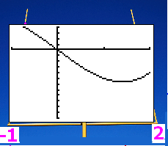
f(-1)=5 f( )=-4 f(2)=- 4 f has an absolute max when x =
-1
.
2
0

Slide 30
f(-1)=5 f( )=-4 f(2)=- 4 f has an absolute max when x =
-1
.
2
0

Slide 31
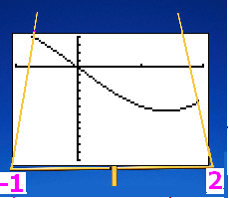
f(-1)=5 f( )=-4 f(2)=- 4 f has an absolute min when x =
-1
.
2
0

Slide 32
f(-1)=5 f( )=-4 f(2)=- 4 f has an absolute min when x =
-1
.
2
0

Slide 33
Find absolute extrema of f(x) = (x²-4x+3)³ on [-1, 2]
f ’ (x) = 3(x² -4x + 3)²(2x – 4)
=3(x-3)²(x-1)²2(x-2)=0 when
x - 3 = 0 or x - 1 = 0 or x – 2 = 0
x = 3 or x = 1 or x = 2
but 3 is not in the domain

Slide 34


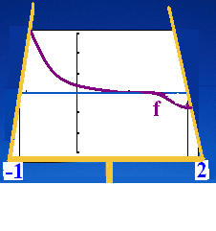
Find absolute extrema of f(x) = (x²-4x+3)³ on [-1, 2]
f(-1)=(1+4+3)³ f(1)=(1-4+3)³ f(2)= -1
8³ @ x = -1 -1 @ x = 2
Absolute maximum Absolute minimum
Nothing at critical pt.

Slide 35
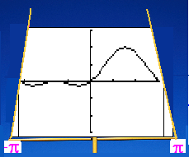
Find absolute extrema of f(x) = sin² (x) + sin(x) on [-π, π]
f ’ (x) = 2sinx cosx + cosx = 0 when
cosx(2sinx+1) = 0 when cosx = 0
2sinx = -1 or sinx = - ½
x = - π/2, π/2, - π/6, - 5π/6
1 - 1 = 0 1 + 1 = 2 ¼ - ½ = - ¼
¼ - ½ = - ¼ f(-π) = 0 f(π) = 0
Absolute minimum Absolute maximum

Slide 36
If f(x) = sin(x) + x on [0, 2π] find f ’(x)
cos(x) + 1
sin(x) + 1
- cos(x) +1

Slide 37
If f(x) = sin(x) + x on [0, 2π] find f ’(x)
cos(x) + 1
sin(x) + 1
- cos(x) +1

Slide 38
Find the critical points of f(x) = sin(x) + x on [0, 2π]
x = π/2
x = π
x = 3π/2

Slide 39
Find the critical points of f(x) = sin(x) + x on [0, 2π]
x = π/2
x = π
x = 3π/2

Slide 40
The only critical point of f(x)=sin(x) + x on [0, 2π] is π.
Where is the absolute max?
x = 0
x = π
x = 2 π

Slide 41
The only critical point of f(x)=sin(x) + x on [0, 2π] is π.
Where is the absolute max?
x = 0
x = π
x = 2 π

Slide 42
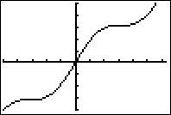

The only critical point of f(x)=sin(x) + x on [0, 2π] is π
Where is the absolute min?
x = 0
x = π
x = 2 π
x = - π

Slide 43
The only critical point of f(x)=sin(x) + x on [0, 2π] is π
Where is the absolute min?
x = 0
x = π
x = 2 π
x = - π

Slide 44
Where is f ’(x)=0 if f(x) = .
1
2
3
4

Slide 45
Where is f ’(x)=0 if f(x) = .
1
2
3
4

Slide 46
If f(x) = evaluate .
1
1
3
0

Slide 47
If f(x) = evaluate .
1
1
3
0

Slide 48
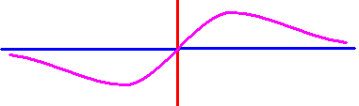
Where is the absolute max?
x = 1
x = 0.5
x = 3
x = 0

Slide 49
Where is the absolute max?
x = 1
x = 0.5
x = 3
x = 0

Slide 50
Theorem : If f is continuous on [a,b], then f has a max and a min.

Slide 51
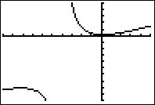
f(x)=(x²+1)/(8+4x) has no extrema on [-6, 0]. Why?
Endpoints not included
f’(x) is not continuous on [-6,0]
f(x) is not continuous on [-6, 0]

Slide 52
f(x)=(x²+1)/(8+4x) has no extrema on [-6, 0]. Why?
Endpoints not included
f’(x) is not continuous on [-6,0]
f(x) is not continuous on [-6, 0]

Slide 53
f(x)=(x²+1)/(8+4x) Find where the extrema are on [-1, 2].
Min @ x = 0, Max @ x = -1,
Min @ x = 0.236, Max @ x = 2
Min @ x = 0.236, Max @ x = -1
Min @ x = 0, Max @ x = 1

Slide 54
f(x)=(x²+1)/(8+4x) Find where the extrema are on [-1, 2].
Min @ x = 0, Max @ x = -1,
Min @ x = 0.236, Max @ x = 2
Min @ x = 0.236, Max @ x = -1
Min @ x = 0, Max @ x = 1

