Slide 1
Find the critical point of f(x) =(2x - 1)² - 3 on [0, 4]
x = ½
x = 1
x = 2
x = 3

Slide 2


Find the critical point of f(x) =(2x - 1)² - 3 on [0, 4]
x = ½
x = 1
x = 2
x = 3

Slide 3
Where is the absolute min of f(x) =(2x - 1)² - 3 on [0,3]
x = 0
x = ½
x = 1
x = 2
x = 3

Slide 4
Where is the absolute min of f(x) =(2x - 1)² - 3 on [0,3]
x = 0
x = ½
x = 1
x = 2
x = 3

Slide 5
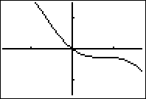
Find the critical point of f(x) =sin²(x)-x on [-π/2, π/2]

Slide 6
Find the critical point of f(x) =sin²(x)-x on [-π/2, π/2]
2sin(x)

Slide 7
Find the critical point of f(x) =sin²(x)-x on [-π/2, π/2]
2sin(x)cos(x)

Slide 8
Find the critical point of f(x) =sin²(x)-x on [-π/2, π/2]
2sin(x)cos(x)-1=0

Slide 9
Find the critical point of f(x) =sin²(x)-x on [-π/2, π/2]
2sin(x)cos(x)-1=0
2tan(x) = sec²(x)

Slide 10
Find the critical point of f(x) =sin²(x)-x on [-π/2, π/2]
2sin(x)cos(x)-1=0
2tan(x) = sec²(x)
tan² (x)-2tan(x)+1=0

Slide 11
Find the critical point of f(x) =sin²(x)-x on [-π/2, π/2]
2sin(x)cos(x)-1=0
2tan(x) = sec²(x)
tan² (x)-2tan(x)+1=0
(tan(x) – 1)² = 0

Slide 12
Find the critical point of f(x) =sin²(x)-x on [-π/2, π/2]
2sin(x)cos(x)-1=0
2tan(x) = sec²(x)
tan² (x)-2tan(x)+1=0
(tan(x) – 1)² = 0
tan(x) = 1

Slide 13
tan(x) = 1 f(x) =sin²(x)-x on [-π/2, π/2]
x = π/6
x = π/4
x = π/3

Slide 14
Find the critical point of f(x) =sin²(x)-x on [-π/2, π/2]
x = π/6
x = π/4
x = π/3

Slide 15
The only critical point of f(x)= sin²(x) - x on [-π /2, π /2] is x= π/4. Where is the absolute max?
x = π/2
x = π/4
x = -π/2

Slide 16
The only critical point of f(x)= sin²(x) - x on [-π /2, π /2] is x= π/4. Where is the absolute max?
x = π/2
x = π/4
x = -π/2

Slide 17
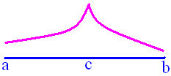
Extreme Value Theorem
If f is continuous on [a, b], then f has an absolute maximum and an absolute minimum on [a, b].

Slide 18
Extreme Value Theorem
If f has an extreme value on an open interval, it must occur at a critical point.
Remember c is a critical point iff f’(c) d.n.e. or f’(c) = 0.

Slide 19
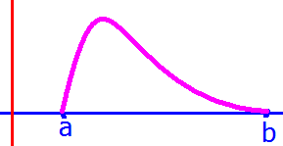
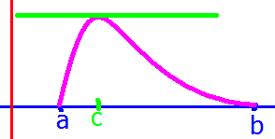

Rolle’s Theorem
If f : [a, b] -> K is
continuous on [a, b],
differentiable on (a, b), and
f(a) = f(b) = 0,
then there exists a c (a, b) such that
f '(c) = 0.

Slide 20
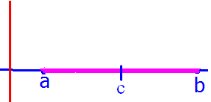
proof:
Case 1:
f(x) = 0 on [a, b]. In this case,
f '[(a+b)/2] = 0 and (a+b)/2 is inbetween
a and b.

Slide 21
proof: case 2:
f(x) > 0 for some x in (a, b). Since f is
continuous on [a, b], the extreme value
theorem states that there is a c in [a, b] such
that f has a maximum at c. Because f is 0 at a
and b, this maximum must occur between a
and b. Since all maximums are critical points
and f is differentiable on (a, b), f '(c) = 0.

Slide 22
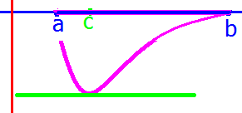
proof: case 3:
f(x) < 0 for some x in (a, b).

Slide 23
Show f(x) =(2x+3)² - 9 on
[-3,0] satisfies the hypothesis of Rolle’s theorem.
f is a polynomial so
f is continuous on [-3,0], and
f is differentiable on (-3,0).
f(-3) = 9 – 9 = 0
f(0) = 9 - 9 = 0

Slide 24
f(x) =(2x+3)² – 9 f’(x)=
f’(x) = 2(2x+3)2
f’(x) = 2(2x+3)
f’(x) = 2(2)

Slide 25
f(x) =(2x+3)² – 9 f’(x)=
f’(x) = 2(2x+3)2
f’(x) = 2(2x+3)
f’(x) = 2(2)

Slide 26
f’(x) = 2(2x+3)2 f has a critical pt when x =
2/3
-2/3
-3/2

Slide 27
f’(x) = 2(2x+3)2 f has a critical pt when x =
2/3
-2/3
-3/2

Slide 28
Find the c in [-3,0] that satisfies the conclusion of Rolle’s theorem.
f(x) =(2x+3)² - 9
f’(x) = 2(2x+3)
4(2x+3) = 0 when
x = - 3/2 therefore f’(-3/2) = 0 and
-3/2 (-3, 0) which means -3<-3/2<0

Slide 29
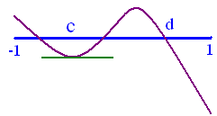
Prove y = x³ – 8x - 3 has a zero in [-1, 1].
y(-1) = 4 > 0
y(1) = -10 < 0
I.V.T. guaranties a d (-1, 1) so that
f(d) = 0 because
f is continuous on [-1, 1]

Slide 30
y = x³ – 8x – 3 dy/dx =
3x - 8
3x² - 8
3x² - 8x - 3

Slide 31
y = x³ – 8x – 3 dy/dx =
3x - 8
3x² - 8
3x² - 8x - 3

Slide 32

Prove y = x³ – 8x - 3 has exactly one zero in [-1, 1].
Proof by contradiction
Suppose y(a) = y(b) = 0 and
{a,b} (-1, 1) and a < b.

Slide 33
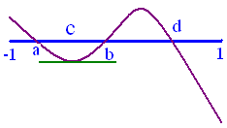
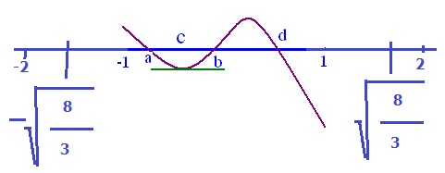
Prove y = x³ – 8x - 3 has exactly one zero in [-1, 1].
If 2, by Rolle’s theorem, there exists a
c (a, b) (-1,1) such that y’(c) = 0.
y’ = 3x² - 8 = 0 when x =

Slide 34
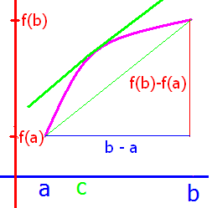
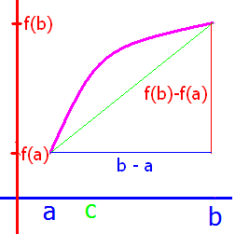
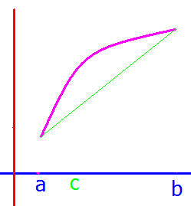
Mean Value Theorem
If f : D -> K is
continuous on [a, b],
differentiable on (a, b),
then there exists a c (a, b) such that

Slide 35
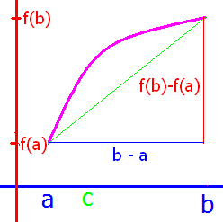
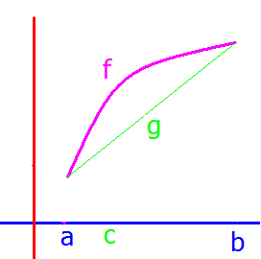
proof:
Let g : [a, b] -> R be the straight line function passing through
(a, f(a)) and (b, f(b)). This means that g(x) =

Slide 36
proof:
g(x) = m(x - a) + f(a) where

Slide 37
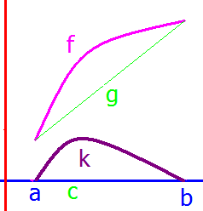
proof:
Next, define a new function
k : [a, b] -> R by k(x) = f(x) - g(x).
Note that :
k is continuous on [a, b],
k is differentiable on (a, b).
I want to apply Rolle’s Theorem

Slide 38
proof:
k(x) = f(x) - g(x).
k(x) = f(x) - m(x - a) - f(a)
k(a) = f(a) - m(0) – f(a)= 0.
k(b) = f(b) –m(b –a) – f(a)
= f(b) – [f(b) – f(a)] – f(a)
= 0

Slide 39
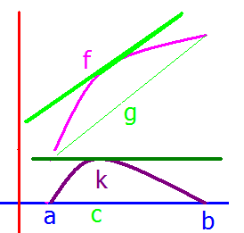
proof:
Thus by Rolle’s Theorem, there exists a c in (a, b) such that k'(c) = 0.
k(x) = f(x) - m (x-a) - f(a)
Differentiating gives k'(x) =

Slide 40
proof:
k(x) = f(x) - m (x-a) - f(a)
Differentiating gives k'(x) = f '(x) – m
and replacing x by c gives

Slide 41
Mean Value Theorem
If f : D -> K is
continuous on [a, b],
differentiable on (a, b),
then there exists a c in (a, b) such that
.

Slide 42
Can we apply the mean value theorem for
on [1, 5]?
Continuous on [1, 5]?
Differentiable on (1, 5)?
Then there exists a c in (1, 5) such that
.

Slide 43
Find f’(x)
Note 2.5 is in (1, 5) so c = 2.5.

Slide 44
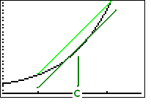
Let f(x) = x³ + 3x + 1 on
[1, 2]. Find f ’(x).
3x + 3
3x³ + 3x
3x² + 3

Slide 45
Let f(x) = x³ + 3x + 1 on
[1, 2]. Find f ’(x).
3x + 3
3x³ + 3x
3x² + 3

Slide 46
f(x) = x³ + 3x + 1 find
8
10
15
20

Slide 47
f(x) = x³ + 3x + 1 find
8
10
15
20

Slide 48
Where does 3x² + 3 = 10 on [1, 2]?

Slide 49


Where does 3x² + 3 = 10 on [1, 2]?
1.53
0.1

Slide 50
Let f(x) =sin(2x)+cos(2x) on [0, π]. Find f ’(x).
2cos(2x) - 2sin(2x)
cos(2) – sin(2)
2cos(2x) + 2sin(2x)

Slide 51
Let f(x) =sin(2x)+cos(2x) on [0, π]. Find f ’(x).
2cos(2x) - 2sin(2x)
cos(2) – sin(2)
2cos(2x) + 2sin(2x)

Slide 52
f(x) =sin(2x)+cos(2x)
Find
1/π
0
2/π

Slide 53
f(x) =sin(2x)+cos(2x)
Find
1/π
0
2/π

Slide 54
On [0, π] find where
2cos(2x) - 2sin(2x) = 0?
9π/8
0
π/8

Slide 55
On [0, π] find where
2cos(2x) - 2sin(2x) = 0?
9π/8
0
π/8

Slide 56
Theorem
Between every 2 zeros of
f(x) = a_{n}x^{n}+a_{n-1}x^{n-1}+ . . . + a₁x + a₀
there lies a zero of
f ’(x) = na_{n}x^{n-1} +(n-1)a_{n-1}x^{n-2}. . . + a₁
proof: Since f is differentiable and continuous everywhere, Rolle’s Theorem applies.

Slide 57
Show f(x) has exactly one zero in the given interval.
f(x) = x³ + 4/x² + 7 on (-oo, 0)
f(-1 ) = -1 + 4 + 7 > 0
f(-10) = -1000 + 4/100 + 7 < 0

Slide 58
f(x) = x³ + 4/x² + 7 f’(x)=
3x² - 8 /x³ + 7
3x² - 8 /x³
3x² + 8 /x³
3x² + 8 /x³ + 7

Slide 59
f(x) = x³ + 4/x² + 7 f’(x)=
3x² - 8 /x³ + 7
3x² - 8 /x³
3x² + 8 /x³
3x² + 8 /x³ + 7

Slide 60
Show f(x) has exactly one zero in the given interval.
By IVT it has at least one because f is
continuous on [-10, -1].
f ’(x) = 3x² - 8 /x³ = 0 or 3x⁵ = 8 or
x is positive.

Slide 61
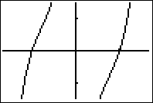
Show f(t) has exactly one zero in the given interval.
f(t) = tan(t) – cot(t) - t on (0, π/2)

Slide 62
f(t) = tan(t) – cot(t) – t f(π/6) <0 and f(π/3) > 0
true
false

Slide 63
Show f(t) has exactly one zero in the given interval.
f(t) = tan(t) – cot(t) - t on (0, π/2)
f(π/6) = root(3)/3 – root(3) - π/6 < 0
f(π/3) = root(3) – root(3)/3 - π/3 > 0

Slide 64
f(t) = tan(t) – cot(t) – t f’(t) =
sec²(t) + csc² (t) - 1
sec²(t) - csc² (t) - 1
sec(t)tan(t) + csc(t)cot(t) - 1

Slide 65
f(t) = tan(t) – cot(t) – t f’(t) =
sec²(t) + csc² (t) - 1
sec²(t) - csc² (t) - 1
sec(t)tan(t) + csc(t)cot(t) - 1

Slide 66
Show f(t) has exactly one zero in the given interval.
By IVT it has at least one because f is continuous on [π/6, π/3].
f ’(t) = sec²(t) + csc²(t) -1 = 0 never
sin²(t) + cos²(t) =1
= tan²(t)+1 + cot²(t) >0

Slide 67
Show g(t) has exactly one zero in (-oo, oo).
#20 g(t) = 2t – cos²(t) + 2
g(-π) = -2 π - 1 + 2 <0
g(0) = -1 + 2 >0
g’(t) = 2 + 2 cos(t) sin(t) = 0 never
= 2 + sin(2t)

