Slide 1
First derivative test

Slide 2
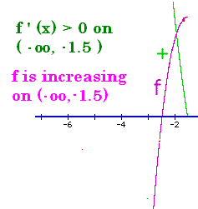
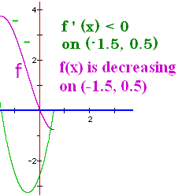
Increasing/Decreasing
If f ’ (x) > 0 on an interval, then f is increasing.
If f ’ (x) < 0 on an interval, then f is decreasing

Slide 3



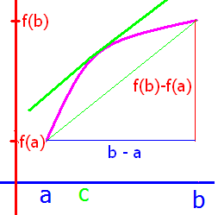
f ’(x) > 0 on an interval I then f is increasing on I
Let a, b be in the interval I so that a<b.
f is differentiable on [a, b]
MVT => there exists a c in (a, b) so
f ’ (c) =

Slide 4
0 < f ’(x) => f increasing
f ’ (c) = > 0
Given 0 < f’(c) & 0 < b – a =>
0 < f(b) – f(a) => f(a) < f(b)
Since a, b were arbitrarily chosen, a<b,
f is increasing on the interval

Slide 5
Where is f(x) = x/(2x²+3) increasing? No asymptote
f ’(x) =
[(2x² + 3)-x(4x)]/(2x² + 3)² = 0 when
the numerator is.

Slide 6

[(2x² + 3)-x(4x)] = 0
- 2x² + 3 = 0
Since there is no x term
3 = 2x² or x = +-root(3/2)

Slide 7
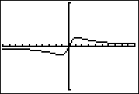
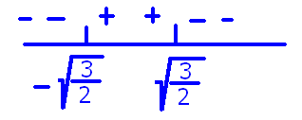
Where is f(x) = x/(2x²+3) increasing? No asymptote
f ’(x) = [(2x² + 3)-x(4x)]/(2x² + 3)²
f ’(-10) = -197/203²<0 f ’(0)=3/9 >0
f ’(10) = -197/203²<0
Answer = ( , )

Slide 8
If y = - cos(2x) - x on [0, 2π] find dy/dx
y’ = 2 sin(2x) - 1
y’ = sin(2) - 1
y’ = 2 sin(2) - 1
y’ = -2 sin(2x) - 1

Slide 9


If y = - cos(2x) - x on [0, 2π] find dy/dx
y’ = 2 sin(2x) - 1
y’ = sin(2) - 1
y’ = 2 sin(2) - 1
y’ = -2 sin(2x) - 1

Slide 10
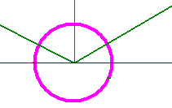
If y = - cos(2x) - x on [0, π] find when 2sin(2x) - 1 = 0
When 2x = 0 or π
When 2x = π/6 or 5π/6
When 2x = 7π/6 or 11π/6
When 2x = π/3 or 2π/3

Slide 11
If y = - cos(2x) - x on [0, π] find when 2sin(2x) - 1 = 0
When 2x = 0 or π
When 2x = π/6 or 5π/6
When 2x = 7π/6 or 11π/6
When 2x = π/3 or 2π/3

Slide 12
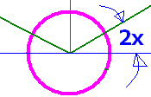
If y’=0 when 2x = π/6 or 5π/6 find x
When x = 0 or π /2
When x = 3π/12 or 4π/12
When x = 7π/6 or 11π/6
When x = π/12 or 5π/12

Slide 13
If y’=0 when 2x = π/6 or 5π/6 find x
When x = 0 or π /2
When x = 3π/12 or 4π/12
When x = 7π/6 or 11π/6
When x = π/12 or 5π/12

Slide 14

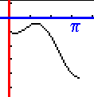
If y’=2 sin(2x) – 1 find where y is increasing
[0, π/12)
(5π/12, π]
(π/12, 5π/12)
[0, π]

Slide 15
If y’=2 sin(2x) – 1 find where y is increasing
[0, π/12)
(5π/12, π]
(π/12, 5π/12)
[0, π]

Slide 16

f’(x) = -(x-3)(x-1)(x+2) where is f decreasing?
(-2, 1) U (1, 3)
Reals = (-oo, oo)
(-2, 1) U (3, +oo)
(-oo, -2) U (1, 3)

Slide 17
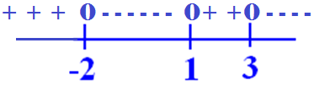
f’(x) = -(x-3)(x-1)(x+2) where is f decreasing?
(-2, 1) U (1, 3)
Reals = (-oo, oo)
(-2, 1) U (3, +oo)
(-oo, -2) U (1, 3)

Slide 18
First derivative test
1. Take the derivative of the function, f’(x)
2. Set f’(x) = 0
3. Solve for x
4. Graph the solutions
5. Increasing followed by decreasing => max
6. Decreasing followed by increasing => min
7. Other cases => neither a max nor a min

Slide 19
First derivative test
1. Take the derivative of the function, f’(x)
2. Set f’(x) = 0
3. Solve for x

Slide 20
First derivative test
Example – If f(x) = 4/3x³+2x²-3x+1
f ’(x) = 4x² + 4x – 3 = 0
(2x - 1)(2x + 3) = 0 so
2x – 1 = 0 or 2x + 3 = 0
2x = 1 or 2x = -3
x = ½ or x=-1½

Slide 21



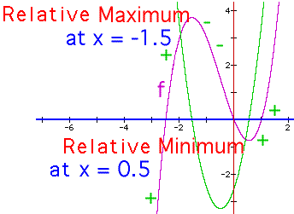
First derivative test f ’(x) = 4x² + 4x – 3
4.
5. f’(-3)= 21 | f’(0) = -3 | f’(1) = 5
6. increasing | decreasing | increasing
max @ -3/2 min @ 1/2

Slide 22
First derivative test
If f(x) = x/(1 + x²)
f ’(x) =

Slide 23
y’ = when
x =
x = 1
x = 2
x =

Slide 24
when
x =
x = 1
x = 2
x =

Slide 25
First derivative test
If f(x) = x/(1 + x²)
f ’(x) =
0 = (1 - x) (1 + x) or x² = 1 when |x|=1
When x = 1 or x = -1

Slide 26

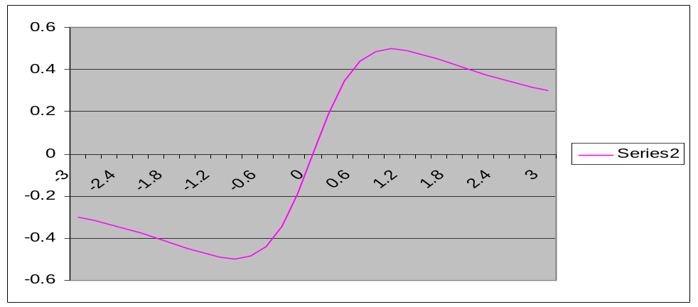
First derivative test f ’(x) = (1-x²)/positive
4.
5. f ’(-3)= -8/p | f ’(0) = 1/p | f ’(3) = -8/p
6. decreasing | increasing | decreasing
relative min @ -1 max @ 1

Slide 27
First derivative test
1. Take the derivative of the function, f’(x)
2. Set f’(x) = 0 3. Solve for x
1. If f(x) = x + 9/x+2 = x + 9x⁻¹ + 2
2. f’(x) = 1 – 9x⁻² = 1 – 9/x²
3. = = 0
Numerator = 0 when x = 3 or x = -3

Slide 28

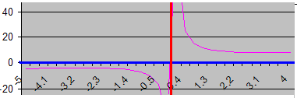
First derivative test f ’(x) =
4.
5. f’(-5)= 16/p f’(-1) = -8/p f’(1) = -8/p f’(5)=16/p
6. increasing | decreasing || decreasing | increasing
relative max @ -3 asymptote min @ 3

Slide 29
First derivative test
1. Take the derivative of the function, f’(x)
2. Set f’(x) = 0
3. Solve for x
4. Graph the solutions
5. Increasing followed by decreasing => max
6. Decreasing followed by increasing => min
7. Other cases => neither a max nor a min

Slide 30
f’(x) = -(x-3)(x-1)(x+2) find location of local mins for f.
x = 1 or x = 3
x = -2 or x = 1 or x = 3
x = 1
x = -2 or x = 3

Slide 31
f’(x) = -(x-3)(x-1)(x+2) find location of local mins for f.
x = 1 or x = 3
x = -2 or x = 1 or x = 3
x = 1
x = -2 or x = 3

Slide 32
Find the critical points for y = - x³ + 12x - 9
x = -2 or 2
x = - 2 or 3
x = 0 or -3

Slide 33
Find the critical points for y = - x³ + 12x - 9
x = -2 or 2
x = - 2 or 3
x = 0 or -3

Slide 34

y = - x³ + 12x - 9 has critical points at 2 and -2. Where is y increasing?
(-oo, -2) U (2, +oo)
(-2, 2)
R
(2, -2)

Slide 35

y = - x³ + 12x - 9 has critical points at 2 and -2. Where is y increasing?
(-oo, -2) U (2, +oo)
(-2, 2)
R
(2, -2)

Slide 36
y = - x³ + 12x - 9 has critical points at 2 and -2. Where is y decreasing?
(-oo, -2) U (2, +oo)
(-2, 2)
R
(2, -2)

Slide 37
y = - x³ + 12x - 9 has critical points at 2 and -2. Where is y decreasing?
(-oo, -2) U (2, +oo)
(-2, 2)
R
(2, -2)

Slide 38

y = - x³ + 12x – 9
Where is the local max?

Slide 39


y = - x³ + 12x – 9
Where is the local max?
2.0
0.1

Slide 40
y = - x³ + 12x – 9
Where is the local min?

Slide 41
y = - x³ + 12x – 9
Where is the local min?
-2.0
0.1

