Slide 1
Graphing

Slide 2
1. Domain
2. Intercepts
3. Asymptotes
4. Symmetry
5. First Derivative
6. Second Derivative
7. Graph

Slide 3
Domain
Denominator can not be zero
D=(-oo,-3)U(-3,3)U(3,oo)
Nonnegatives under even roots
1-x² >= 0
x not 0
D = [-1, 0) U (0, 1]

Slide 4
The domain of y = is x -1 or D =
True
False

Slide 5


The domain of y = is x -1 or D =
True
False

Slide 6
Domain
Denominator can not be zero
Nonnegatives under even roots
1-x²>=0 1-x>=0
and 1+x>=0
D=[-1, 0) U (0, 1]

Slide 7
y = , the domain is x >= 5.
True
False

Slide 8
y = , the domain is x >= 5.
True
False

Slide 9
Intercepts
Set x = 0 and solve for y
Set y = 0 and solve for x

Slide 10


Symmetry
f(-x) = f(x) => Even function
Symmetry about the y axis
f(-x) = -f(x) => Odd function
Symmetry about the origin

Slide 11
Asymptotes
Denominator = 0 when x = c
x = c is an asymptote
y = c is an asymptote

Slide 12
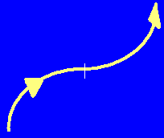
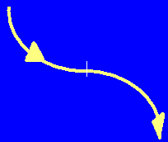
First derivative
Find the critical points
Max, min, or neither
Increasing or decreasing

Slide 13
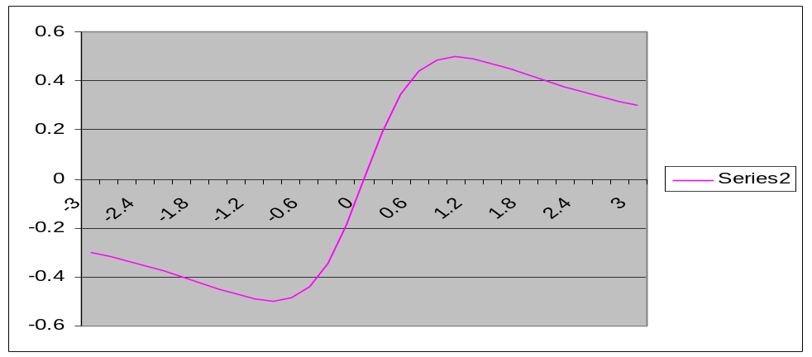
Second derivative
Concavity
Inflection points
Graph

Slide 14
1. Domain
2. Intercepts
3. Asymptotes
4. Symmetry
5. First Derivative
6. Second Derivative
7. Graph

Slide 15
Domain
Denominator can not be zero
No square roots so Domain =
Domain = R

Slide 16
The domain is all real numbers or (-oo, +oo)
True
False

Slide 17
The domain is all real numbers or (-oo, +oo)
True
False

Slide 18

Intercepts
Set x = 0 and solve for y
y intercept
Set y = 0 and solve for x
x intercept

Slide 19
What is the y intercept?

Slide 20


What is the y intercept?
1.0
0.1

Slide 21
Intercepts
Set x = 0 and solve for y
y intercept
Set y = 0 and solve for x
x intercept

Slide 22
What is the x intercept?

Slide 23
What is the x intercept?
-1.0
0.1

Slide 24
Intercepts
Set x = 0 and solve for y
y = 1
Set y = 0 and solve for x
(x + 1)² = 0 when x = -1

Slide 25
Symmetry
f(-x) not equal f(x) => Not even function
f(-x) = (-x+1)²/(1+x²)
-f(x) = (-x²-2x-1)/(1+x²) not equal f(-x)
Not an odd function
No symmetry about the origin

Slide 26
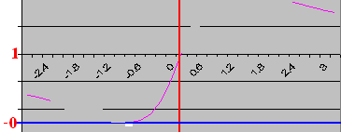
Asymptotes
Where is the denominator zero?

Slide 27
The denominator is zero when x = -1.
True
False

Slide 28
The denominator is zero when x = -1.
True
False

Slide 29
Horizontal asymptote at y =

Slide 30
Horizontal asymptote at y =
1.0
0.1

Slide 31
y =
y’ =
=

Slide 32
What is the absolute value of both critical points?

Slide 33
What is the absolute value of both critical points?
1.0
0.1

Slide 34


Increasing?
y’ =
y’(-2) < 0 y’(0) >0 y’(2) < 0

Slide 35
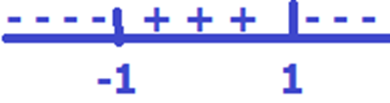
Where is it increasing?
(1, +oo)
(-oo, -1)
(-1, 1)

Slide 36
Where is it increasing?
(1, +oo)
(-oo, -1)
(-1, 1)

Slide 37
Y=
y’ =
y’’ =

Slide 38
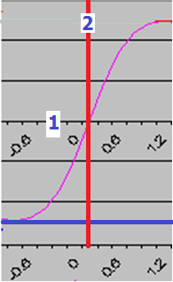
First derivative
Find the critical points
x = -1, 1
y = 0, 2
Decreasing on (-oo, -1) U (1, +oo)
Increasing on (-1, 1)
Local min at x=-1 and local max at x=1

Slide 39
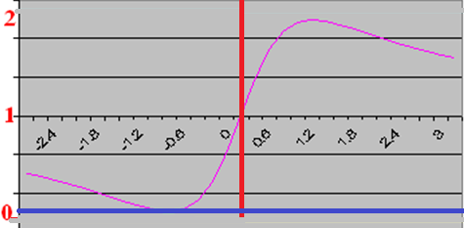
Concavity
Find the inflection points
x = 0 , -root(3), root(3)

Slide 40
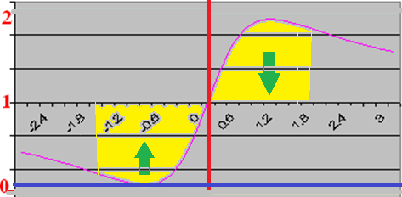
Concavity
Inflection pts at x = 0 ,
y = 1, [root(3) + 1]²/4 , [-root(3) + 1]²/4
1.87 0.13

Slide 41
