Slide 1
Applied max and min

Slide 2
Steps for solving an optimization problem
Read the problem drawing a picture as you read
Label all constants and variables as you read
If you have two unknowns, write a secondary equation
  Usually the first thing given
Find the variable that you want to optimize and write the primary equation
Eliminate one variable from the primary equation using the secondary equation
Determine the domain of the new primary equation
Differentiate the primary equation
  Set the derivative equal to zero
  Solve for the unknown
  Check the endpoints or run a first or second derivative test

Slide 3
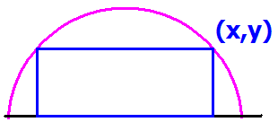
Read the problem drawing a picture as you read
Label all constants and variables as you read
R
Inside a semicircle of radius R.

Slide 4
Semicircle of radius 6.
If you have two unknowns, write a secondary equation. Usually
the first thing given.
6

Slide 5

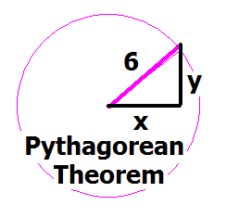

Write the equation of a circle, centered at the origin of radius 6.
x + y = 36
x² + y² = 6
x² + y² = 36
y =

Slide 6
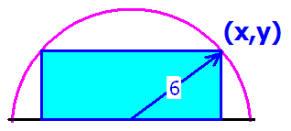
We identify the primary equation by the key word maximizes or minimizes
Find the value of x that
maximizes the blue area.

Slide 7
Find the rectangle with the largest area
Find the value of x that
maximizes the blue area.

Slide 8
Which of the following is the primary equation?
A = x y
A = 2 x y
A = ½ x y
A = 4 x y

Slide 9
Eliminate one variable from the primary equation using the secondary equation
A(x) = 2xy = 2x(6² - x² )^{½}
A² = 4x²(36 - x²) = 144x² - 4x⁴
R

Slide 10
^{Differentiate} A² = 144x² - 4x⁴
^{implicitly.}
A’ = 288x - 16x³
2AA’ = 144x - 8x
A’ = 144x – 16x
2AA' = 288x - 16x³

Slide 11
AA' = 144x - 8x³ = 0
Solve for x
x= 0, 3 root(2), - 3 root(2)
x = 6 root(2), - 6 root(2)
x = 0, 3, -3
x = 3/root(2), - 3/root(2)

Slide 12

Check the endpoints or run a first or second derivative test
AA' = 18x - x³ = x(18 – x²)
A' = 0 when x = 3 root(2) or x = 0
AA’(3)= 54 - 27 > 0
AA’(6) = 108 - 6³ < 0

Slide 13
AA’(3)= 54 - 27 > 0
AA’(6) = 108 - 6³ < 0
There is a local max at x = 3 root(2)
Neither a max nor min at 3 root(2)
There is a local min at x = 3 root(2)
Inflection point at x = 3 root(2)

Slide 14
Steps for solving an optimization problem
Read the problem drawing a picture as you read
Label all constants and variables as you read
If you have two unknowns, write a secondary equation
  Usually the first thing given
Find the variable that you want to optimize and write the primary equation
Eliminate one variable from the primary equation using the secondary equation
Determine the domain of the new primary equation
Differentiate the primary equation
  Set the derivative equal to zero
  Solve for the unknown
  Check the endpoints or run a first or second derivative test

Slide 15
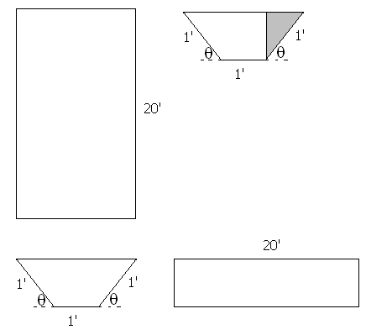
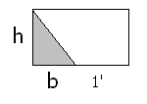


Build a rain gutter with the dimensions shown.
Base Area = h(b+1)
BA = sin(θ)[cos(θ)+1]
V=

Slide 16
BA = sin(θ)[cos(θ)+1]
V=
20 sin(θ)[cos(θ)+1]
20 sin(θ)²[cos(θ)+1]²
sin(θ)[cos(θ)+1]²
sin(θ)²[cos(θ)+1]

Slide 17
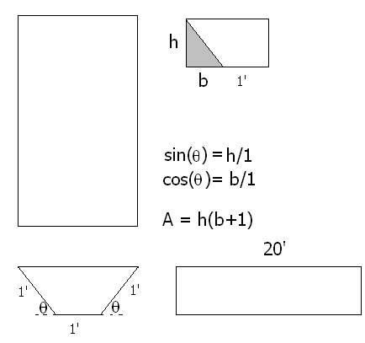
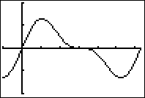
Find θ that maximizes the volume
V = 20 BA
V = 20 sin(θ)[cos(θ) + 1 ]
V’ =

Slide 18
V=20 sin(θ)[cos(θ)+1] dV/dθ =
20 sin(θ)[cos(θ)+1]
20 cos(θ) sin(θ)
20[sin(θ)(-sin(θ))+(cos(θ)+1)cos(θ)]
- 20 cos(θ) sin(θ)

Slide 19
Find θ that maximizes the volume
V’ = 20sin(θ)[-sin(θ)]+[cos(θ) + 1]20 cos(θ)
= 20 cos²(θ) - 20 sin²(θ) + 20 cos(θ)
= 20[2 cos(θ) - 1][cos(θ) + 1] = 0

Slide 20
20[2 cos(θ) - 1][cos(θ) + 1] = 0
Solve for θ on [0, π].
θ = π/3 or θ = 0
θ = π/2 or θ = 0
θ = π/6 or θ = π
θ = π/3 or θ = π

Slide 21
Find θ that maximizes the volume of the gutter
V’ = 20[2 cos(θ) - 1][cos(θ) + 1] = 0
2 cos(θ) = 1 or cos(θ) = -1
θ = π/3 or θ = π

Slide 22
Find θ that maximizes the volume of the gutter
V’ = 20 cos²(θ) - 20 sin²(θ) + 20 cos(θ)
V’’ = -40 cos(θ)sin(θ) – 40 sin(θ)cos(θ) -20 sin(θ)
V’’(π/3) = -40(½) – 40 (½) - 20
a local maximum at x = π/3
V”(π) = 0 -> Test fails

Slide 23
Local max at θ = π/3
V’ = 20 cos²(θ) - 20 sin²(θ) + 20 cos(θ)
V’(π/2) = -20 V’(3π/2) = -20
Second derivative test failed
First derivative test says decreasing on [π/3, π]

Slide 24
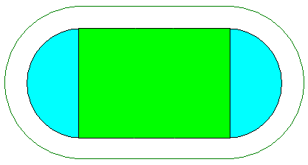
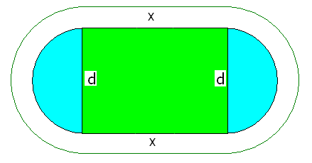
GSU builds 400 meter track.
400 =
2x + π d

Slide 25
Soccer requires a maximum of green area
A =
xd, but d = because 400 = 2x + π d
So A =

Slide 26
Soccer requires a maximum green rectangle
So A =
and A’ = when x = 100 meters
A” =

Slide 27
Soccer requires a maximum green area
400 = 2x + π d and when x = 100 meters
200 = π d or d = 200 / π

