Slide 1
Applied max and min

Slide 2

Georgia owns a piece of land along the Ogeechee River
She wants to fence in her garden using the river as one side.

Slide 3
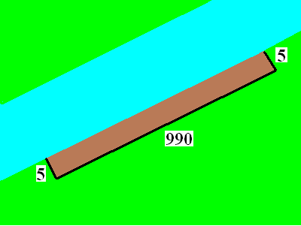
She also owns 1000 ft of fence to make the rectangular garden
She wants to fence in her garden using the river as one side.

Slide 4
What is the area of her garden?
A = L * W
A=5 * 990
A = 4950 sq. ft.

Slide 5
She owns 1000 ft of fence
Write a secondary equation
  Usually the first thing given
  2x + y = 1000 is the secondary
  Solve for y
  y = 1000 – 2x

Slide 6
What is the largest possible area?
Find the variable that you want to optimize and write the primary equation

Slide 7
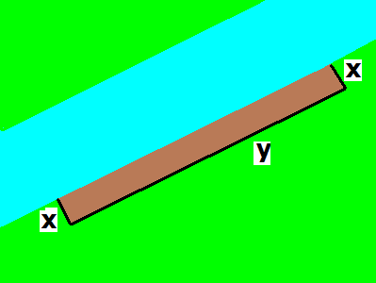
What is the area of the largest possible garden?
A = x * y primary

Slide 8
Place y into the primary
y = 1000 – 2x (secondary)
A = x * y (primary)
A = x * (1000 – 2x)
A = 1000x – 2x²

Slide 9
A = 1000x – 2x²
If A’ = 0, find x.
x = 250 feet
x = 300 feet
x = 350 feet

Slide 10
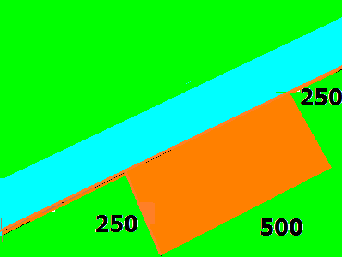
Differentiate the primary and set to zero
A = 1000x – 2x²
A’ = 1000 – 4x = 0
1000 = 4x
250 = x

Slide 11
What is the area of the largest possible garden?
A’ = 1000 – 4x = 0
A’’ = -4 concave down
A’’(250) = -4
Relative max at x = 250
A = 250 * 500 = 125,000 sq. ft.

Slide 12
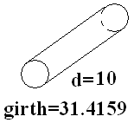
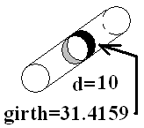


Girth is the smaller distance around the object

Slide 13

Post office says the max Length + girth is 108
108 = L + x
108 = L + 2x
108 = L + 4x

Slide 14
Find x that maximizes the volume
V = 4x + L
V = x² * L
V = 4x * L

Slide 15
V = x² * L
L = 108 – 4x
V = x² * (108 – 4x) = 108 x² - 4 x³
V’ = 216 x – 12 x² = 0
12x(18 – x) = 0
x = 18
V’’ = 216 – 24x and if x = 18, V’’ is
Negative => local max.

Slide 16
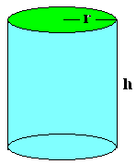
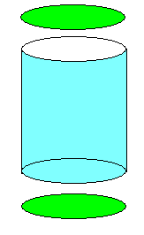
If the volume is 357 cm³
Minimize the aluminum.

Slide 17
V =
V = πr²
V = hr³
V = πr²h

Slide 18
If the volume is 357 cc³
Minimize the aluminum.
V = πr²h = 357
h = 357/(πr²)
A = πr² +
πr² +
2πrh

Slide 19
A =
A = πr²+2πrh
A = 2πr²+2πrh
A = πr²h+2πh

Slide 20
h = 357/(πr²)
A = πr² + πr² + 2πrh
Minimize the aluminum.
A = 2 πr² + 2πr 357 /(πr²)
= 2 πr² + 714r⁻¹
A’ = 4πr - 714r⁻²=0
4πr³ = 714

Slide 21

4π r³ = 714
r³ =
714/(4π)
r =
Diameter = 7.6888 cm = 3.0271 in

Slide 22
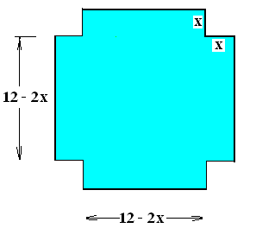
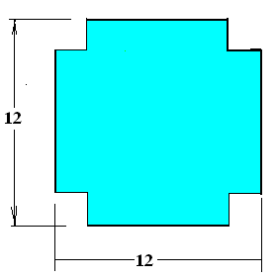
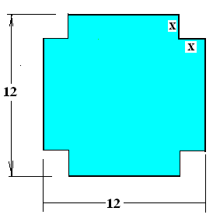
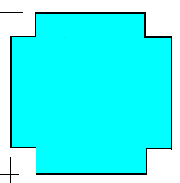
12” by 12” sheet of cardboard
Find the box with the most volume.
V =
x(12 - 2x)(12 - 2x)

Slide 23
12” by 12” sheet of cardboard
Find the box with the most
volume.
V = x(12 - 2x)(12 - 2x)
V’=x(12 - 2x)(-2)+

Slide 24
12” by 12” sheet of cardboard
Find the box with the most
volume.
V = x(12 - 2x)(12 - 2x)
V’=x(12 - 2x)(-2)+x(-2) (12 - 2x)+

Slide 25
12” by 12” sheet of cardboard
Find the box with the most
volume.
V = x(12 - 2x)(12 - 2x)
V’=x(12-2x)(-2)+x(-2)(12-2x)+(12-2x)(12-2x)

Slide 26
12” by 12” sheet of cardboard
Find the box with the most
volume.
V = x(12 - 2x)(12 - 2x)
V’=x(12-2x)(-2)+x(-2)(12-2x)+(12-2x)(12-2x)
=(12-2x)(-2x-2x+(12-2x))

Slide 27
12” by 12” sheet of cardboard
Find the box with the most
volume.
V = x(12 - 2x)(12 - 2x)
V’=x(12-2x)(-2)+x(-2)(12-2x)+(12-2x)(12-2x)
=(12-2x)(-2x-2x+(12-2x))
=(12-2x)(12-6x)=144-24x-72x+12x²
=12(12-8x+x²)

Slide 28
12” by 12” sheet of cardboard
Find the box with the most
V’=x(12-2x)(-2)+x(-2)(12-2x)+(12-2x)(12-2x)
=(12-2x)(-2x-2x+(12-2x))
=(12-2x)(12-6x)=144-24x-72x+12x²
=12(12-8x+x²) = 12(x-6)(x-2) = 0

Slide 29
12” by 12” sheet of cardboard
Find the box with the most
V’=x(12-2x)(-2)+x(-2)(12-2x)+(12-2x)(12-2x)
=(12-2x)(-2x-2x+(12-2x))
=(12-2x)(12-6x)=144-24x-72x+12x²
=12(12-8x+x²) = 12(x-6)(x-2) = 0
x = 2 or x = 6

Slide 30
V = (12-2x)(12-2x)
= 144x - 48x² + 4x³
Find the box with the most volume.
dV/dx =
144 – 96 x + 12 x² = 0 when
12(12 - 8x+ x²) = 0
(6 – x)(2 – x) = 0

Slide 31
dV/dx = 144 – 96 x + 12 x²
X = 2 or x = 6
d²V/dx² ⁼
-96 + 24 x
At x = 2 or at x = 6
negative positive

Slide 32
dV/dx = 144 – 96 x + 12 x²
X = 2 or x = 6
d²V/dx² ⁼
-96 + 24 x
At x = 2 or at x = 6
negative positive
Local max local min

Slide 33
Steps for solving an optimization problem
Read the problem drawing a picture as you read
Label all constants and variables as you read
If you have two unknowns, write a secondary equation
  Usually the first thing given
Find the variable that you want to optimize and write the primary equation
Eliminate one variable from the primary equation using the secondary equation
Determine the domain of the new primary equation
Differentiate the primary equation
  Set the derivative equal to zero
  Solve for the unknown
  Check the endpoints or run a first or second derivative test

Slide 34
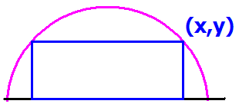
Read the problem drawing a picture as you read
Label all constants and variables as you read
R
Inside a semicircle of radius R.

Slide 35
Semicircle of radius 6.
If you have two unknowns, write a secondary equation. Usually
the first thing given.
6

Slide 36
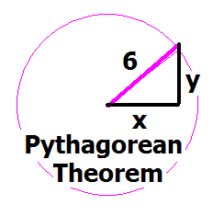
Write the equation of a circle, centered at the origin of radius 6.
x + y = 36
x² + y² = 6
x² + y² = 36
y =

Slide 37
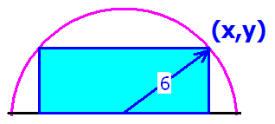
We identify the primary equation by the key word maximizes or minimizes
Find the value of x that
maximizes the blue area.

Slide 38
Find the rectangle with the largest area
Find the value of x that
maximizes the blue area.

Slide 39
Which of the following is the primary equation?
A = x y
A = 2 x y
A = ½ x y
A = 4 x y

Slide 40
Eliminate one variable from the primary equation using the secondary equation
A(x) = 2xy = 2x(6² - x² )^{½}
A² = 4x²(36 - x²) = 144x² - 4x⁴
R

Slide 41
^{Differentiate} A² = 144x² - 4x⁴
^{implicitly.}
A’ = 288x - 16x³
2AA’ = 144x - 8x
A’ = 144x – 16x
2AA' = 288x - 16x³

Slide 42
AA' = 144x - 8x³ = 0
Solve for x
x= 0, 3 root(2), - 3 root(2)
x = 6 root(2), - 6 root(2)
x = 0, 3, -3
x = 3/root(2), - 3/root(2)

Slide 43

Check the endpoints or run a first or second derivative test
AA' = 18x - x³ = x(18 – x²)
A' = 0 when x = 3 root(2) or x = 0
AA’(3)= 54 - 27 > 0
AA’(6) = 108 - 6³ < 0

Slide 44
Check the endpoints or run a first or second derivative test
AA' = 18x - x³ = x(18 – x²)
A' = 0 when x = 3 root(2) or x = 0
AA’(3)= 54 - 27 > 0
AA’(6) = 108 - 6³ < 0
AA”+A’A’ = 18 – 3 x² =0 when ??

Slide 45
Check the endpoints or run a first or second derivative test
AA' = 18x - x³ = x(18 – x²)
A' = 0 when x = 3 root(2) or x = 0
AA’(3)= 54 - 27 > 0
AA’(6) = 108 - 6³ < 0
AA”+A’A’ = 18 – 3 x² =0 when
AA” = (18 – 3x² ) – x²(18 – x²)²

Slide 46
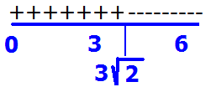
AA’(3)= 54 - 27 > 0
AA’(6) = 108 - 6³ < 0
There is a local max at x = 3 root(2)
Neither a max nor min at 3 root(2)
There is a local min at x = 3 root(2)
Inflection point at x = 3 root(2)

Slide 47
Steps for solving an optimization problem
Read the problem drawing a picture as you read
Label all constants and variables as you read
If you have two unknowns, write a secondary equation
  Usually the first thing given
Find the variable that you want to optimize and write the primary equation
Eliminate one variable from the primary equation using the secondary equation
Determine the domain of the new primary equation
Differentiate the primary equation
  Set the derivative equal to zero
  Solve for the unknown
  Check the endpoints or run a first or second derivative test

Slide 48
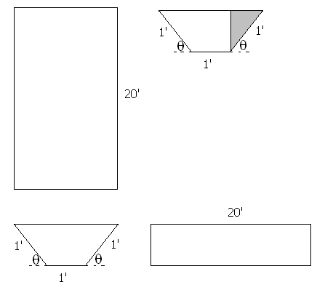
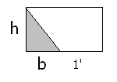


Build a rain gutter with the dimensions shown.
Base Area = h(b+1)
BA = sin(θ)[cos(θ)+1]
V=

Slide 49
BA = sin(θ)[cos(θ)+1]
V=
20 sin(θ)[cos(θ)+1]
20 sin(θ)²[cos(θ)+1]²
sin(θ)[cos(θ)+1]²
sin(θ)²[cos(θ)+1]

Slide 50
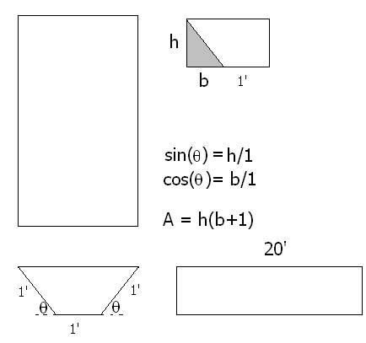
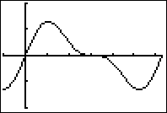
Find θ that maximizes the volume
V = 20 BA
V = 20 sin(θ)[cos(θ) + 1 ]
V’ =

Slide 51
V=20 sin(θ)[cos(θ)+1] dV/dθ =
20 sin(θ)[cos(θ)+1]
20 cos(θ) sin(θ)
20[sin(θ)(-sin(θ))+(cos(θ)+1)cos(θ)]
- 20 cos(θ) sin(θ)

Slide 52
Find θ that maximizes the volume
V’ = 20sin(θ)[-sin(θ)]+[cos(θ) + 1]20 cos(θ)
= 20 cos²(θ) - 20 sin²(θ) + 20 cos(θ)
= 20[2 cos(θ) - 1][cos(θ) + 1] = 0

Slide 53
20[2 cos(θ) - 1][cos(θ) + 1] = 0
Solve for θ on [0, π].
θ = π/3 or θ = 0
θ = π/2 or θ = 0
θ = π/6 or θ = π
θ = π/3 or θ = π

Slide 54
Find θ that maximizes the volume of the gutter
V’ = 20[2 cos(θ) - 1][cos(θ) + 1] = 0
2 cos(θ) = 1 or cos(θ) = -1
θ = π/3 or θ = π

Slide 55
Find θ that maximizes the volume of the gutter
V’ = 20 cos²(θ) - 20 sin²(θ) + 20 cos(θ)
V’’ = -40 cos(θ)sin(θ) – 40 sin(θ)cos(θ) -20 sin(θ)
V’’(π/3) = -40(½) – 40 (½) - 20
a local maximum at x = π/3
V”(π) = 0 -> Test fails

Slide 56
Local max at θ = π/3
V’ = 20 cos²(θ) - 20 sin²(θ) + 20 cos(θ)
V’(π/2) = -20 V’(3π/2) = -20
Second derivative test failed
First derivative test says decreasing on [π/3, π]

Slide 57
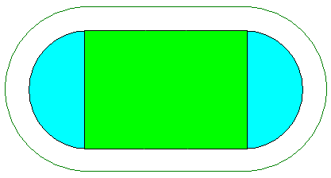
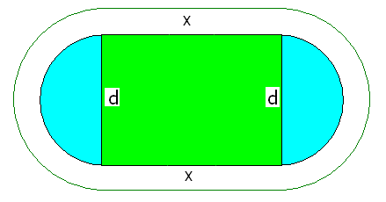
GSU builds 400 meter track.
400 =
2x + π d

Slide 58
Soccer requires a maximum of green area
A =
xd, but d = because 400 = 2x + π d
So A =

Slide 59
Soccer requires a maximum green rectangle
So A =
and A’ = when x = 100 meters
A” =

Slide 60
Soccer requires a maximum green area
400 = 2x + π d and when x = 100 meters
200 = π d or d = 200 / π

