Slide 1
Antiderivative

Slide 2
Buttons on your calculator have a second button
Square root of 100 is 10 because
10 square is 100
Arcsin( ½ ) = π/6 because
Sin( π/6 ) = ½
Recipicol of 20 is 0.05 because
Recipicol of 0.05 is 20

Slide 3

Definition:
F is an antiderivative of f on D if f is the derivative of F on D or F' = f on D.

Slide 4
Definition:
Name an antiderivative of f(x) = cos(x).
F(x) = sin(x) because the derivative of
sin(x) is cos(x) or F’(x) = f(x).

Slide 5
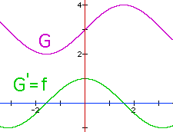
G = F + 3 is also an antiderivative of f
because G' = (F + 3)' = f + 0 = f.
sin(x) and the sin(x) + 3 are both antiderivatives of the Cos(x) on R because when you differentiate either one you get cos(x).

Slide 6
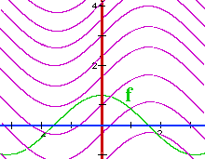
G = F + k is also an antiderivative of f
How many antiderivatives of Cos(x) are there?
If you said infinite, you are correct.
G(x) = sin(x) + k is one for every real number k.

Slide 7


Which of the following is an antiderivative of y = cos(x)?
F(x) = 1 – sin(x)
F(x) = - sin(x)
F(x) = sin(x) + 73
F(x) = cos(x)

Slide 8
Buttons on your calculator have a second button
A square root of 100 is -10 because
(-10) square is 100
arcsin( ½ ) = 5π/6 because
Sin( 5π/6 ) = ½
Recipicol of 20 is 0.05 because
Recipicol of 0.05 is 20

Slide 9
Theorem:
If F and G are antiderivatives of f on an interval I, then F(x) - G(x) = k where k is a real number.

Slide 10
Proof:
Let F and G be antiderivatives of f on I and define H(x) = F(x) - G(x) on I.

Slide 11
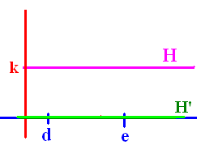
Proof:
Let F and G be antiderivatives of f on I and define H(x) = F(x) - G(x) on I.
H’(x) = F’(x) – G’(x) = f(x) – f(x) = 0 for every x in I.
What if H(d) is different than H(e)?

Slide 12
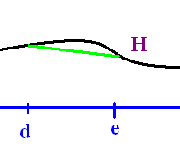
H(x) = F(x) - G(x) = k
If the conclusion of the theorem were false, there would be numbers d < e in I for which H(d) H(e).

Slide 13
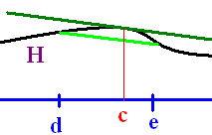
H(x) = F(x) - G(x) = k
Since H is differentiable and continuous on [d, e], the Mean Value Theorem guarantees a c, between d and e, for which H'(c) =
(H(e) - H(d))/(e - d) which can’t be 0.

Slide 14
H(x) = F(x) - G(x) = k
H’(x) = 0 for all x in I
H’(c) = (H(e) - H(d))/(e - d)
This contradicts the fact that H’( c) must be zero.
q.e.d.

Slide 15
Which of the following are antiderivatives of y = 4?
4x
4x + 2
4x - 7
All of the above

Slide 16
Since antiderivatives differ by a constant on intervals, we will use the notation f(x)dx to represent the family of all antiderivatives of f. When written this way, we call this family the indefinite integral of f.

Slide 17
Using our new notation, evaluate

Slide 18
Using our new notation, evaluate

Slide 19
=
True
False

Slide 20
Theorems
because [x + c]’ = 1
What is the integral of dx?
x grandma, x

Slide 21
.
c
3x + c
x² + c
x + c

Slide 22

Theorems
If F is an antiderivative of f => F’=f
and
kF is an antiderivative of kf
because [kF]’ = k F’ = k f
and

Slide 23
Theorems

Slide 24
.
12 x + c
0
- 24 x + c
24 x + c

Slide 25
Theorem
Proof:
F(x)
F’(x) =

Slide 26
Examples

Slide 27
.
3 x² + c
9 x² + c
x³ + c
3 x³ + c

Slide 28
Examples

Slide 29
.
4/x + c
-4/x + c
4/x³ + c
-4/x³ + c

Slide 30
Theorem
If k(x) = 2cos(x) + 3x² – 4,
evaluate

Slide 33
Trigonometry Theorems

Slide 34
.
2 sin(x) – 1/x + c
2 sin(x) – 1/x³ + c
- 2 sin(x) – 1/x + c

