Slide 1

Definite
Integral
We will define
to be the limit as n
approaches oo of
where Δx_{i} = (b-a)/n
and is any point in the ith interval.

Slide 2
where Δx_{i} = (b-a)/n
and is any point in the i^{th} interval, [x_{i-1},x_{i}].

Slide 3
> 0 when f(x) > 0, but it is negative when f(x)<0.
We will define
to be the limit as n
approaches oo of
and is any point in the i^{th} interval, [x_{i-1},x_{i}].

Slide 4
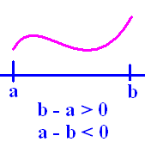
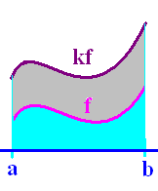
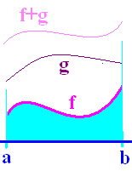
Definition
Theorems
1.
2.
3.
4.

Slide 5
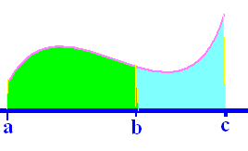
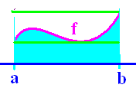
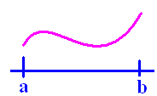
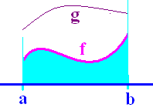
Definition
Theorems
5.
6.
7.
8.

Slide 7
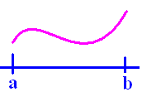
If f(x) >= 0 on [a,b]
then is the area under f(x) and
over the x-axis between a and b.

Slide 8
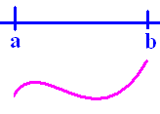
If f(x) <= 0 on [a,b]
then is the negative of the area
over f(x) and under the x-axis between
a and b.

Slide 9
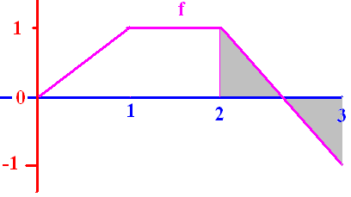

Slide 10
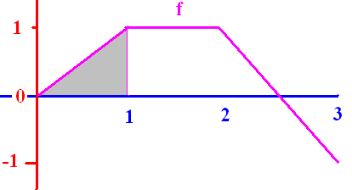


[
0.50
0.1

Slide 11
[
2.0
0.1

Slide 12
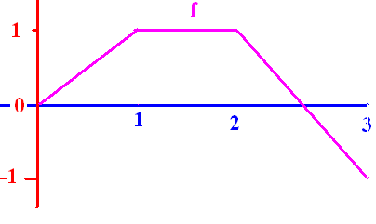
]
0.0
0.1

Slide 13
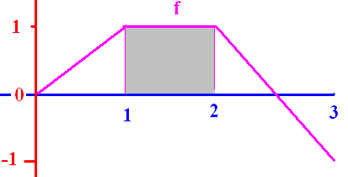
[
1.0
0.1

Slide 14
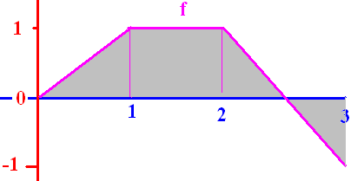
[
1.5
0.1

Slide 15
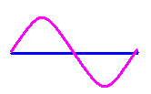
0

Slide 16
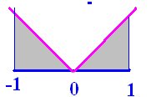
]
1.0
0.1

Slide 17
where Δx_{i} = (b-a)/n
and is any point in the i^{th} interval, [x_{i-1},x_{i}].
If the interval is [-4, 4] evaluate
8π

Slide 18
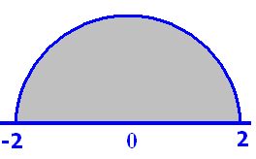
Pi = 3.14
6.28
0.1

Slide 19
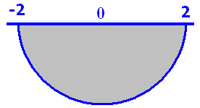
Pi = 3.14
-6.28
0.1

