Slide 1
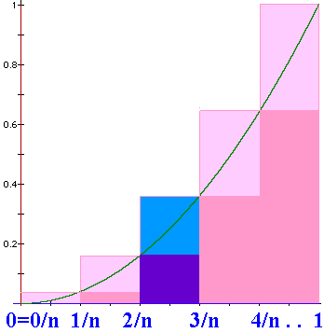
N=n => width = 1/n
US = =1/n³[1+4+9+….+n²]
US =

Slide 2
=

Slide 3

Definite
Integral
We will define
to be the limit as n
approaches +oo of
where Δx_{i} = (b-a)/n
and is any point in the ith interval.

Slide 4
where Δx_{i} = (b-a)/n
and is any point in the i^{th} interval, [x_{i-1},x_{i}].

Slide 5
> 0 when f(x) > 0, but it is negative when f(x)<0.
We will define
to be the limit as n
approaches +oo of
and is any point in the i^{th} interval, [x_{i-1},x_{i}].

Slide 6
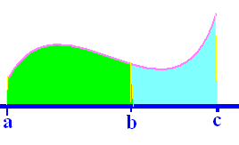
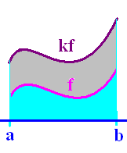
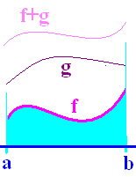
Definition
Theorems
1.
2.
3.
4.

Slide 7
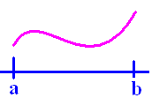
If f(x) >= 0 on [a,b]
then is the area under f(x) and
over the x-axis between a and b.

Slide 8
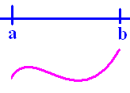
If f(x) <= 0 on [a,b]
then is the negative of the area
over f(x) and under the x-axis between
a and b.

Slide 9
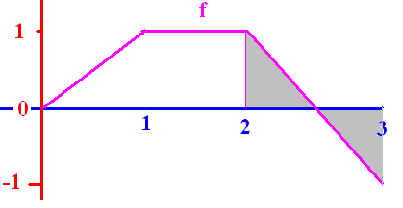
.
½ + (-½) = 0
The definite integral of f from 2 to 3 is 0

Slide 10
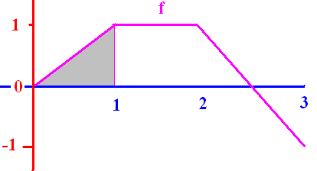


[
0.50
0.1

Slide 11
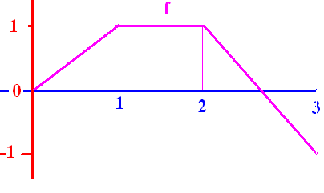
]
0.0
0.1

Slide 12
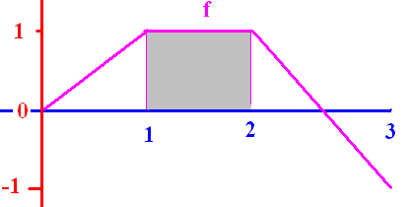
[
1.0
0.1

Slide 13
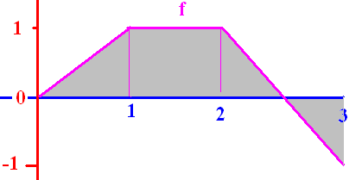
[
1.5
0.1

Slide 14
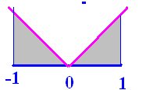
]
1.0
0.1

Slide 15
Fundamental Theorem of Calculus
If f is continuous on [a, b] and F is any antiderivative of f, then

Slide 16
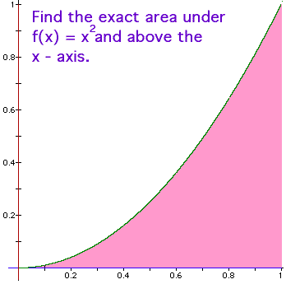
Fundamental Theorem of Calculus
f(x) = x² is continuous on [0, 1] and
F(x) = x³/3 is an antiderivative of f(x), so

Slide 17
Traditional Notation

Slide 18
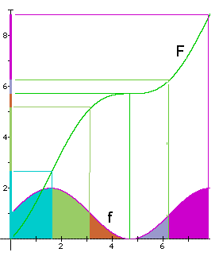
Example
Let f be continuous on
[0,8] and let F be any
antiderivative of f.

Slide 19
What is the green area?
By the F.T.C.,
sq. in.
1.6 3.1

Slide 20
What is the total area?
By the F.T.C.,
sq. in.
0 8

Slide 21
Fundamental Theorem of Calculus
If f is continuous on [a, b] and F is any antiderivative of f, then

Slide 22
Fundamental Theorem of Calculus
If fx) = x² is continuous on [0, 1] and
F(x) = x³/3 is an antiderivative of f(x), so

Slide 23
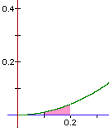
Fundamental Theorem of Calculus
If fx) = x² is continuous on [0.1, 0.2] and
F(x) = x³/3 is an antiderivative of f(x), so
= (0.008 – 0.001)/3 = 0.007/3 = 0.00233..

Slide 24
Using the traditional notation
= (0.008 – 0.001)/3 = 0.007/3 =
0.0023333333….

Slide 25

Find the area under y=-x(x-3) on [0, 3]
= [-54 + 81]/6 = 27/6
= 9/2 = 4.5 sq. in.

Slide 26
Evaluate
1.5
0.1

Slide 27


Slide 28
Evaluate
4.5
0.1

Slide 30
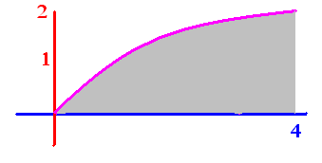
Evaluate
5.33
0.1

Slide 31
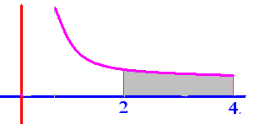
Evaluate
.25
0.1

Slide 32
Get from
Rewriting 1 over x squared as x to the negative two we get

Slide 33
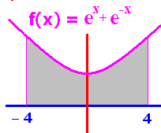


To evaluate we need an antiderivate of e^{x}+e^{-x}
F(X) = e^{x}-e^{-x}
F(X) = e^{x}+e^{-x}
F(x) = 2e^{x}
F(x) = 2e^{-x}

Slide 34
F(x) = e^{x} - e^{-x} is an antiderivative of e^{x} + e^{-x}
F(-4) + F(4)
F(-4) - F(4)
F(4) + F(-4)
F(4) - F(-4)

Slide 35
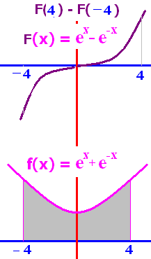
F(x) = e^{x} - e^{-x}
F(4) - F(-4) =
0
1
2e⁴ + 2e⁻⁴
2e⁴ – 2e⁻⁴

Slide 36
F(x) = e^{x} - e^{-x}
F(4) - F(-4)
= [e⁴ - e⁻⁴ ]-[e-⁴ - e⁴ ]
= 2 [e⁴ - e⁻⁴ ]

Slide 37

Evaluate
2.0
0.1

Slide 39

Evaluate
2.0
0.1

Slide 40
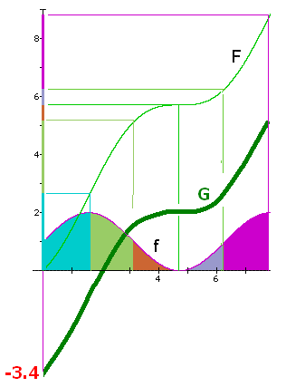
Draw a different
antiderivative G
Evaluate
5.2 – 0 = 5.2
1.8 – (-3.4) = 5.2 square inches

Slide 41
Evaluate
F(6.28) – F(3.14) =
6.3 - 5.2 = 1.1
The orange and grey
area is 1.1 square
inches.

