Slide 1
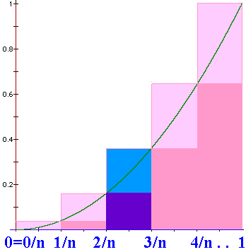
N=n => width = 1/n
US = =1/n³[1+4+9+….+n²]
US =

Slide 2
=

Slide 3
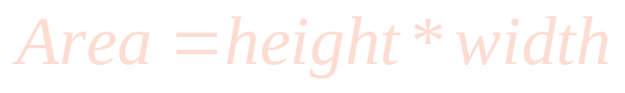
Definite
Integral
We will define
to be the limit as n
approaches +oo of
where Δx_{i} = (b-a)/n
and is any point in the ith interval.

Slide 4
where Δx_{i} = (b-a)/n
and is any point in the i^{th} interval, [x_{i-1},x_{i}].

Slide 5
> 0 when f(x) > 0, but it is negative when f(x)<0.
We will define
to be the limit as n
approaches +oo of
and is any point in the i^{th} interval, [x_{i-1},x_{i}].

Slide 6
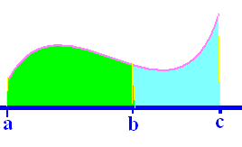
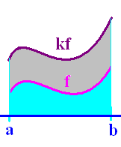
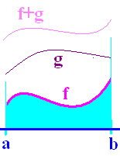
Definition
Theorems
1.
2.
3.
4.

Slide 7
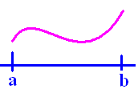
If f(x) >= 0 on [a,b]
then is the area under f(x) and
over the x-axis between a and b.

Slide 8
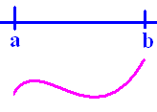
If f(x) <= 0 on [a,b]
then is the negative of the area
over f(x) and under the x-axis between
a and b.

Slide 9
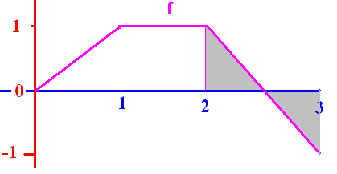
.
¼ + (-¼) = 0
The definite integral of f from 2 to 3 is 0

Slide 10
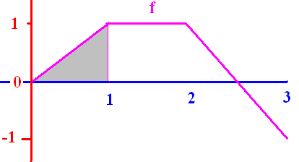


[
0.50
0.1

Slide 11
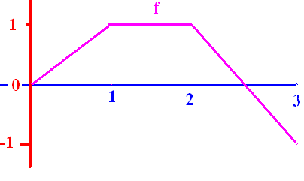
]
0.0
0.1

Slide 12
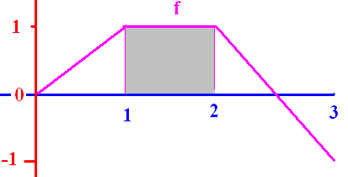
[
1.0
0.1

Slide 13
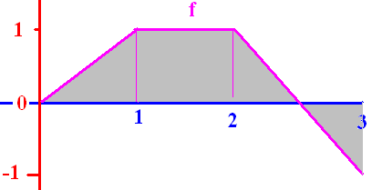
[
1.5
0.1

Slide 14
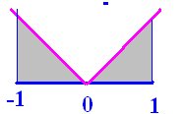
]
1.0
0.1

Slide 15
Fundamental Theorem of Calculus
If f is continuous on [a, b] and F is any antiderivative of f, then

Slide 16
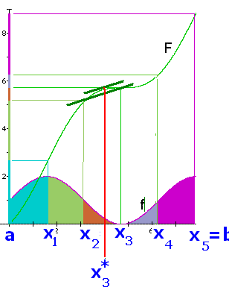
.
Let F be an antiderivative of f
For each i choose x_{i}* so that
F’(x_{i}*) = [F(x_{i})-F(x_{i-1})]/[x_{i}-x_{i-1}]

Slide 17
.
F’(x_{i}*) = [F(x_{i})-F(x_{i-1})]/[x_{i}-x_{i-1}]

Slide 18
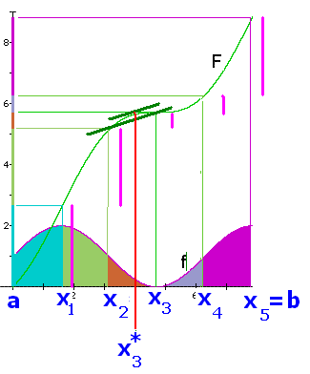
.
. . . . . . . . . . . . . . . . .
= F(b) – F(a)

Slide 19
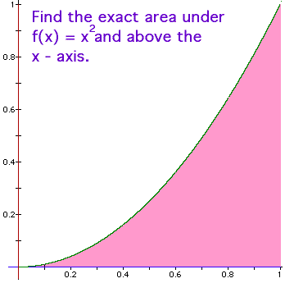
Fundamental Theorem of Calculus
f(x) = x² is continuous on [0, 1] and
F(x) = x³/3 is an antiderivative of f(x), so

Slide 20
Traditional Notation
.

Slide 21
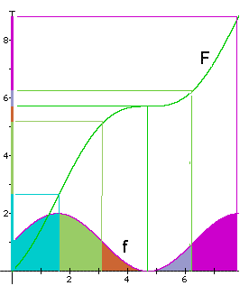
Example
Let f be continuous on
[0,8] and let F be any
antiderivative of f.

Slide 22
What is the green area?
By the F.T.C.,
sq. in.
1.6 3.1

Slide 23
What is the total area?
By the F.T.C.,
sq. in.
0 8

Slide 24
Fundamental Theorem of Calculus
If f is continuous on [a, b] and F is any antiderivative of f, then

Slide 25
Fundamental Theorem of Calculus
If fx) = x² is continuous on [0, 1] and
F(x) = x³/3 is an antiderivative of f(x), so

Slide 26
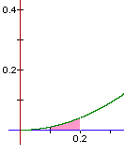
Fundamental Theorem of Calculus
If fx) = x² is continuous on [0.1, 0.2] and
F(x) = x³/3 is an antiderivative of f(x), so
= (0.008 – 0.001)/3 = 0.007/3 = 0.00233..

Slide 27
Using the traditional notation
= (0.008 – 0.001)/3 = 0.007/3 =
0.0023333333….

Slide 28

Find the area under y=-x(x-3) on [0, 3]

Slide 29
Find the area under y=-x(x-3) on [0, 3]
= [-54 + 81]/6 = 27/6
= 9/2 = 4.5 sq. in.

Slide 30
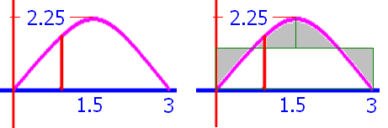
Find the average height y=-x(x-3) on [0, 3]
AH =
4.5 sq. in. / 3 in = 1.5 in

Slide 32
Evaluate
1.5
0.1

Slide 33
Evaluate
4.5
0.1

Slide 35
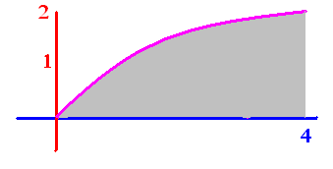
Evaluate
5.33
0.1

Slide 36
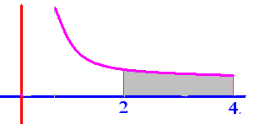
Evaluate
.25
0.1

Slide 37

Evaluate
2.0
0.1

Slide 38
.

Slide 39

Evaluate
2.0
0.1

Slide 40
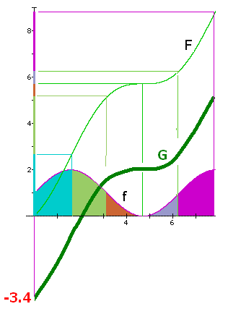
Draw a different
antiderivative G
Evaluate
5.2 – 0 = 5.2
1.8 – (-3.4) = 5.2 square inches

Slide 41
Evaluate
F(6.28) – F(3.14) =
6.3 - 5.2 = 1.1
The orange and grey
area is 1.1 square
inches.

