Slide 1
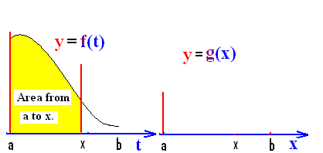
FTC I
Suppose f : [a, b] => R is a positive continuous function. Define g : [a, b] => R by
g(x) = = area under f from a to x.

Slide 2
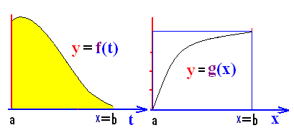
In other words, g(x) is the area over [a, x] and under f(t).

Slide 3


.
1
2
0

Slide 4
FTC I
g(x) = = area under f from a to x.
What is g(a)?

Slide 5
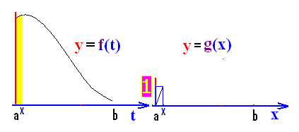
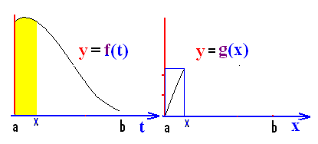
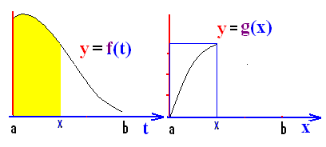
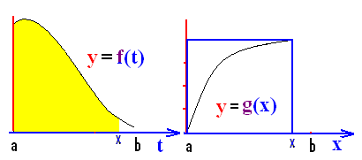
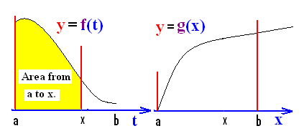
FTC I
g(x) = = area under f from a to x.

Slide 6
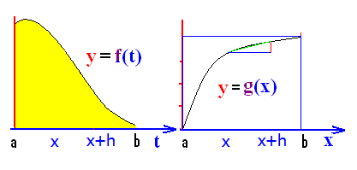
In other words, g(x) is the area over [a, x] and under f(t).
Note that the derivative of g(x) is
defined to be g’(x) =

Slide 7
The definition of g’(x) is
.
.
.

Slide 8
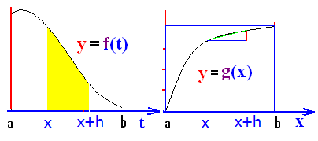
.
.
.
.

Slide 9
.
.
.
.

Slide 10
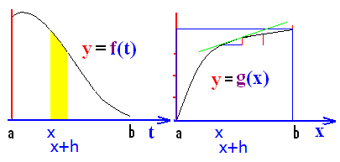
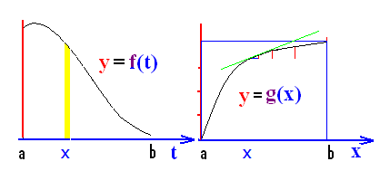
g(x)=
The definition of g’(x) is

Slide 11

g’(x) =

Slide 12
Fundamental theorem of calculus I
If f : [a, b] => R is a continuous function
and g : [a, b] => R is defined by
g(x) = then g’(x) = f(x).

Slide 13

FTC I
If g(x) = then g’(x) = f(x).
If g(x) = find g’(x).
g’(x) = cos(2x)

Slide 14
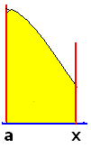
FTC I
If g(x) = then g’(x) = f(x).
If g(x) = find g’(x).
g’(x) = 1/csc⁴x = sin⁴(x)

Slide 15
If then g’(x) =
tan²x
tan x
sec³x

Slide 16
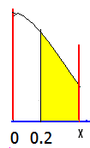
FTC I
If g(x) = then g’(x) = f(x).
If g(x) = find g’(x).
g’(x) = cos(2x)

Slide 17
FTC I
If g(x) = then g’(x) = f(x).
If g(x) = find g’(x).
g’(x) =

Slide 18
FTC I
If g(x) =
then g(x) = find g’(x).
g’(x) = - 3x sin x

Slide 19
If then g’(x) =
- sec³x
tan³x
sec³x

Slide 20
If y = g(x) = .
Let u = x² and recall
dy/dx =

Slide 21
dy/dx =
dy/dx = 3u sin u du/dx
dy/dx =

