Slide 1
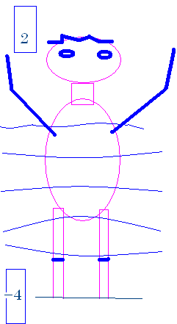
How tall am I?
My head is 232 feet above sea level.
My feet are 226 feet above sea level.
My head is 2 feet above sea level.
My feet are (-4) feet ‘above’ sea level.

Slide 2
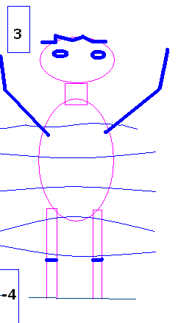


How many feet tall am I?
7.0
0.1

Slide 3
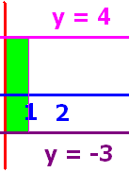
What is the area of the green rectangle?
7.0
0.1

Slide 4
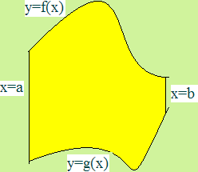
What is the area
below f(x), above g(x) and
between x=a and x=b ?

Slide 5
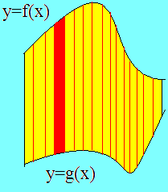
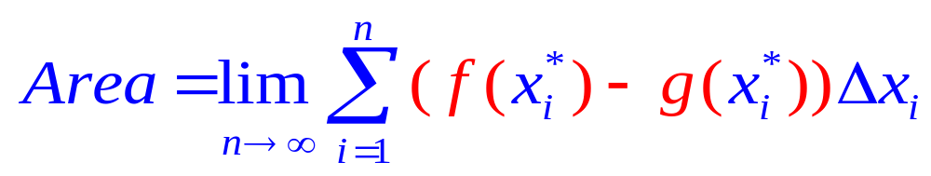
Set up n rectangles of width Δx
And height is top – bottom or f(x) – g(x)

Slide 6
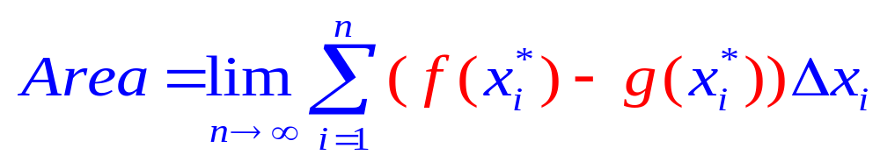
The area of one rectangle is height times width

Slide 7
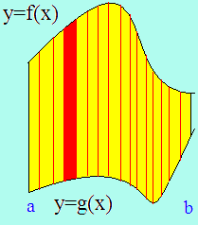
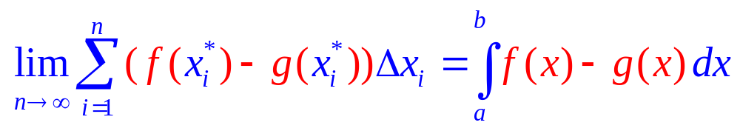
By the definition of the definite integral
Area =

Slide 8
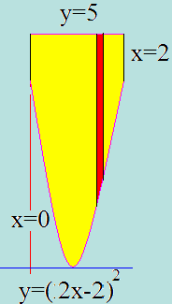
Example 1
Find the area over y=(2x-2)² and under y=5
Between x=0 and x=2
Just add up all of the red rectangles
As they slide from x=0 to x=2
The top function is . . .
Y=5
And the bottom function is . . .
Y=(2x-2)²

Slide 9
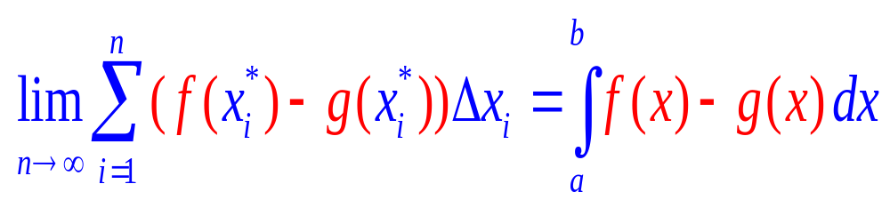
By the definition of the definite integral
Area =

Slide 10

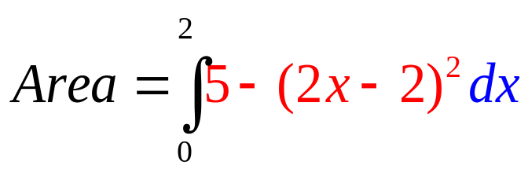
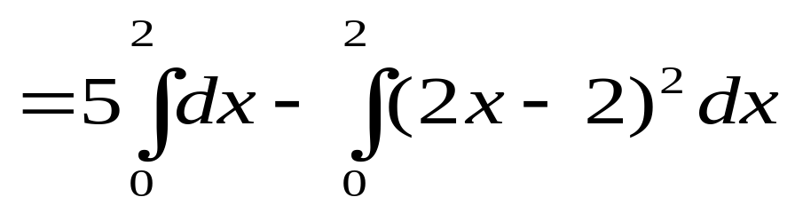
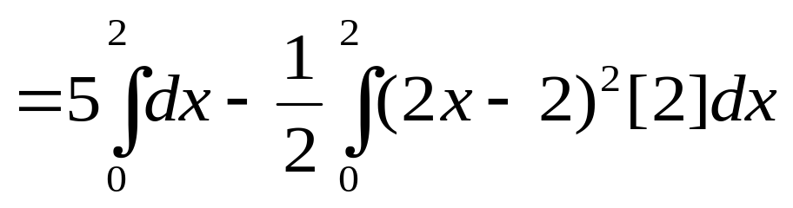

Example 1
Find the area over y=(2x-2)² and under y=5
Between x=0 and x=2
=5x-1/2 (2x-2)³/3
=10 - 0.5 8/3-[0 - 0.5 (-8/3)]
=10 - 4/3 - 4/3 = 10 – 8/3 = 22/3

Slide 11
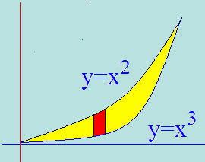
Example 2
Set the two functons equal to each other
Solve for x x² = x³ or 0 = x³ - x²
By factoring 0 = x² ( x – 1 )
so x² =0 or x–1=0
Next we add up all of the red rectangles
From 0 to 1
Area =

Slide 12
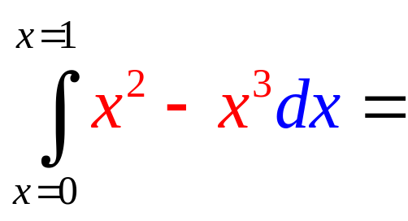
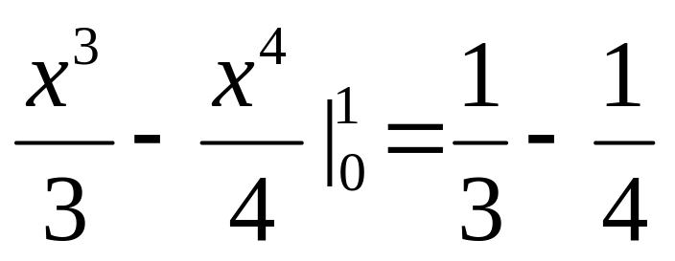
Area =

Slide 13
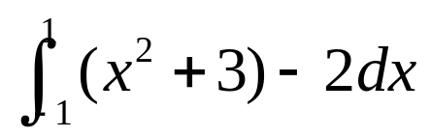
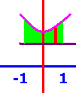

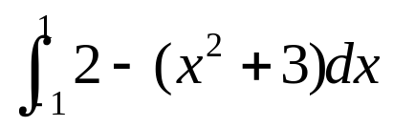
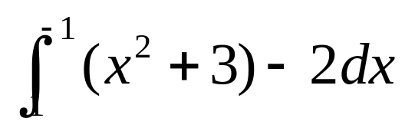
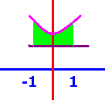
The area over y=2 and under y=x²+3 between x=-1 and x=1
[
[
[

Slide 14
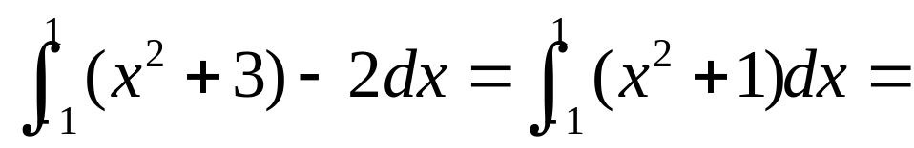
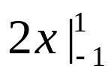
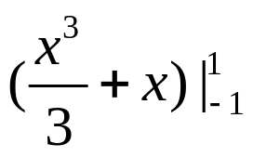
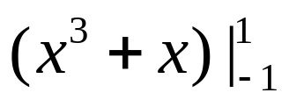
.
[
[
[

Slide 15
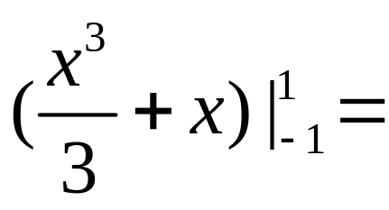
]
2.667
0.1

Slide 16
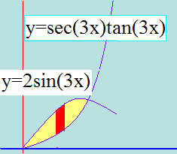
Example 3
Set the two functons equal to each other
Solve for x sin(3x)/cos²(3x)= 2sin(3x)
iff sin(3x) = 0 or 2 cos²(3x) = 1
if 3x = 0 or 3x = ….
3x = π/4 or x = π/12

Slide 17

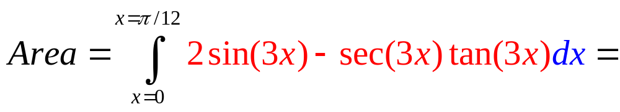
Area =

Slide 18
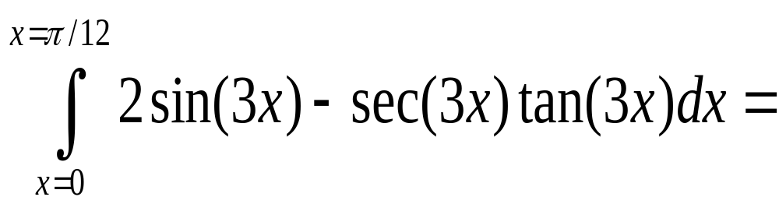
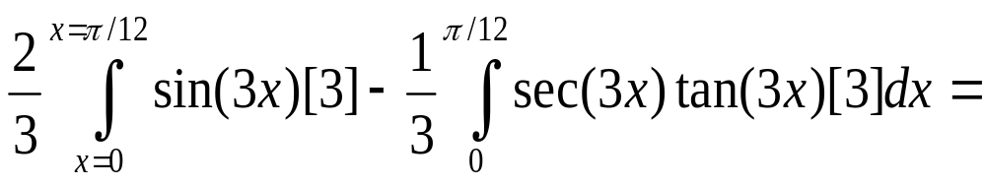
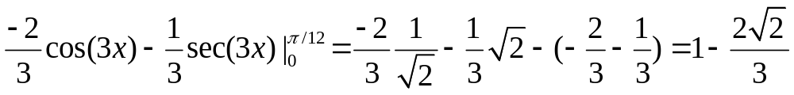
Example 3

Slide 19
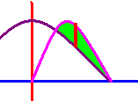
First two places y=cosx and y=2sinxcosx cross?
]
x= π/3, π
x=π/3, π/2
x=π/6, π/2

Slide 20
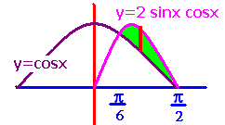
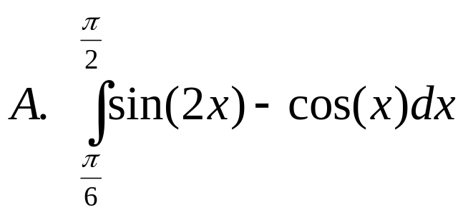
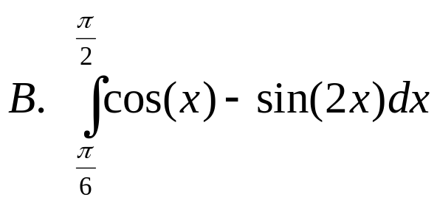
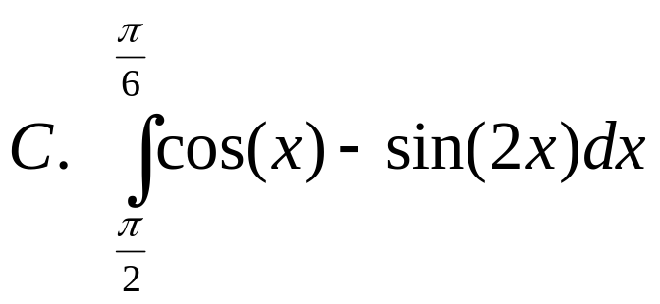
What is the area between them?
.
.
.

Slide 21
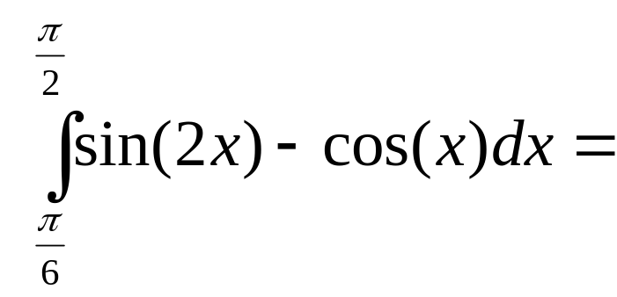
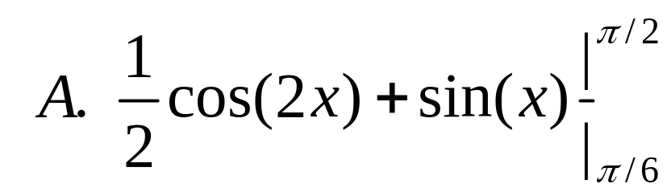
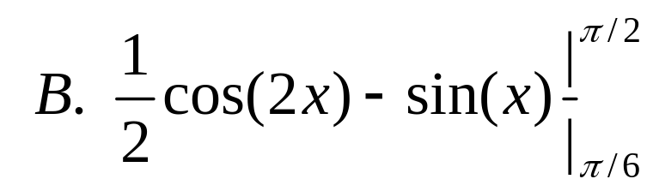
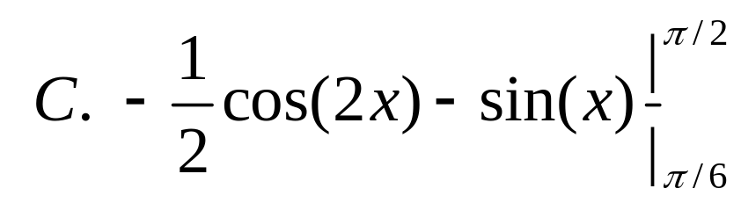
]
]
]
]

Slide 22
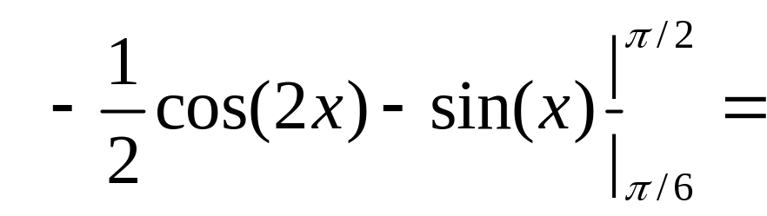
]
0.25
0.1

Slide 23
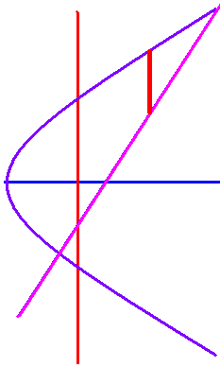
Example 4
Find the area bounded by y² = 2x + 6 and y = x – 1.
Solve for x = 0.5 y² – 3 and we see a parabola opening to the right with the vertex at (-3, 0).
Replacing y by (x-1) gives (x-1)²=2x + 6
x² - 2x + 1 = 2x + 6
x² - 4x – 5 = (x - 5)(x + 1) = 0
x = 5 or x = -1

Slide 24
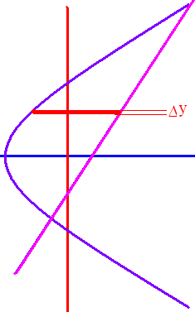
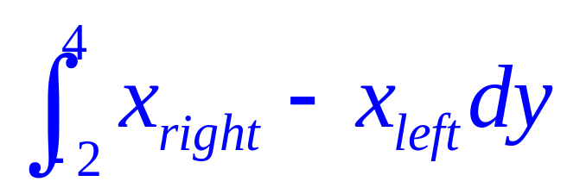
X² - 2x + 1 = 2x + 6
X² - 4x – 5 = (x - 5)(x + 1) = 0
X = 5 or x = -1
y = x – 1 so y = 4 or y = -2.

Slide 25
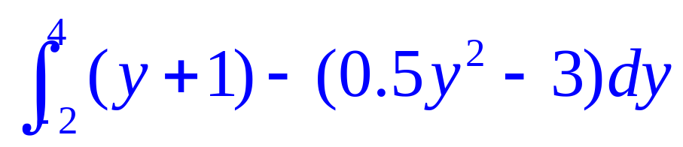
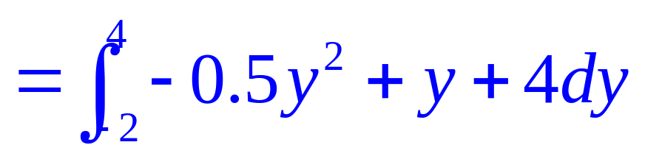
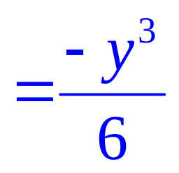
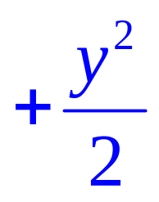
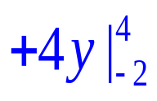









x = y + 1.
x = 0.5 y² – 3 .

