Slide 1
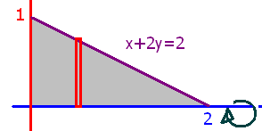
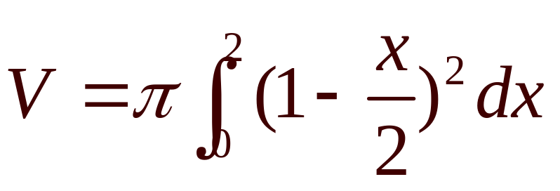
What is the volume if the grey area is revolved about the x-axis?

Slide 2
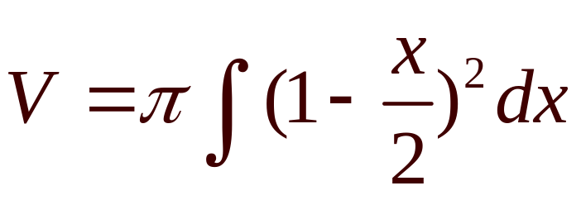
What is the volume if the grey area is revolved about the x-axis?

Slide 3
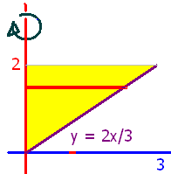
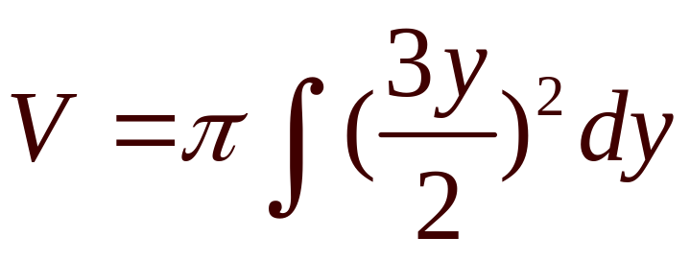
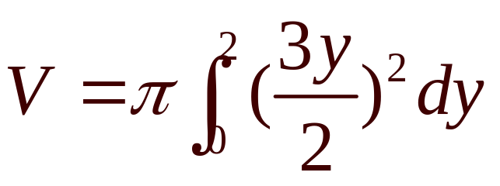
What is the volume if the yellow area is revolved about the x-axis?

Slide 4
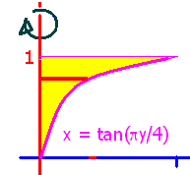
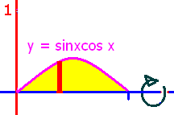
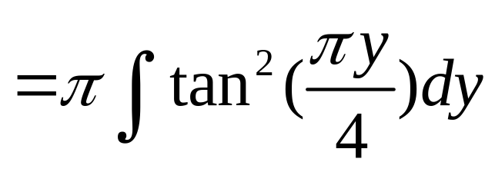
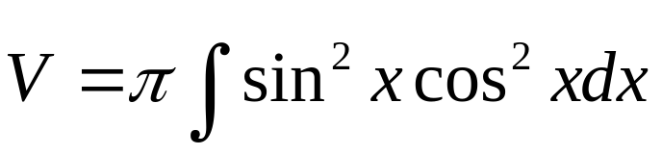
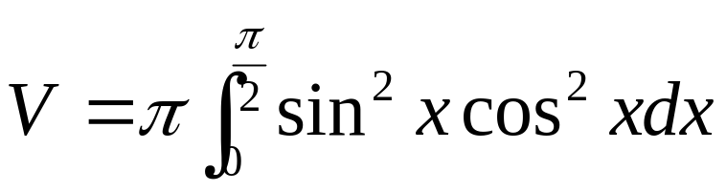
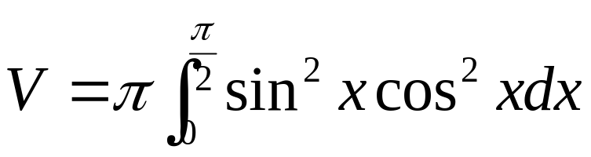

Slide 5
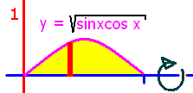
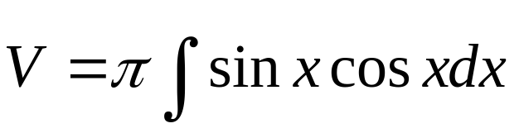
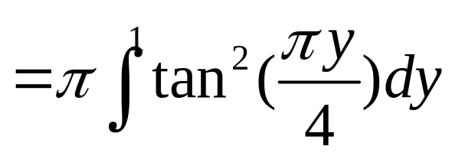
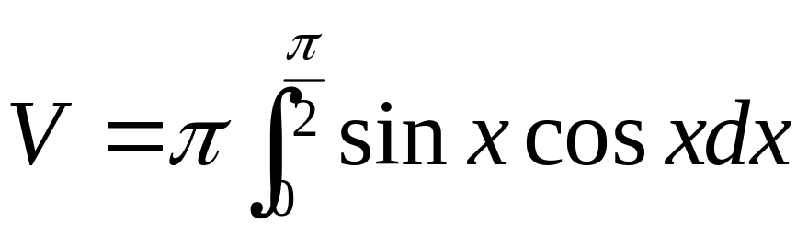

Slide 6


.
0.5
0.1

Slide 7
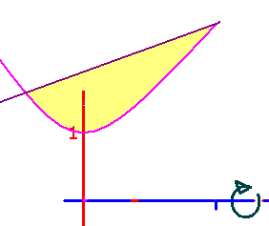
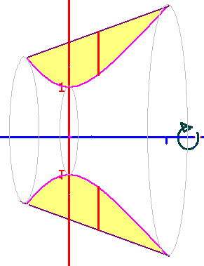
Region bounded by y=x²+1 and y=x+3 is revolved about the x-axis.
23.4
0.2

Slide 8
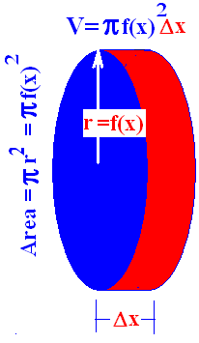
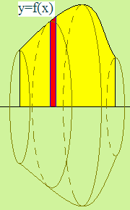
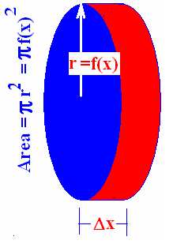
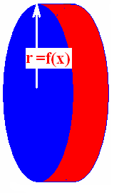
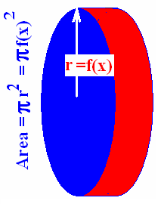
The volume of a nickel is π r² times the width.

Slide 9

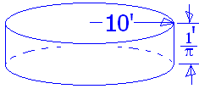
Find the volume of a stool with radius 10 ft. and height 1/π ft.
10/π cubic feet
100 π cubic feet
10 cubic feet
100 cubic feet

Slide 10
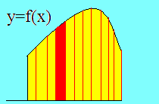
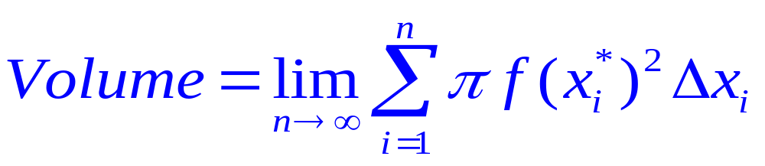
Set up n rectangles of width Δx
And the height
of each is f(x) so . . .

Slide 11
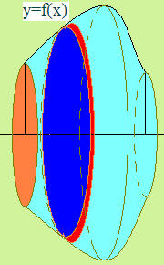
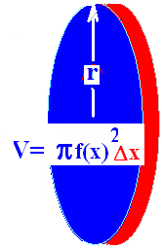
What is the volume if the area between f(x) and y=0 is revolved about the x-axis?

Slide 12
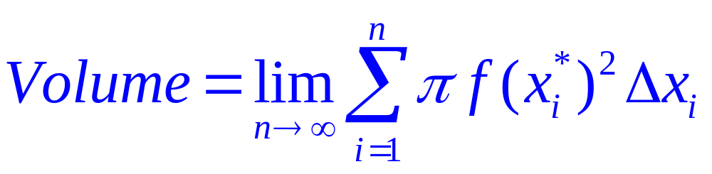
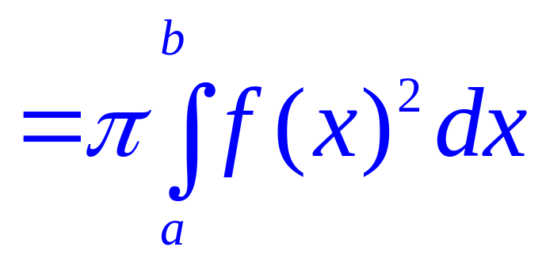

Slide 13

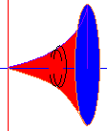
Example 1
Find the volume when the area under y = x² and over the x-axis is revolved about the x-axis.
Between x=0 and x=2
Just add up all of the red nickels
As they slide from x=0 to x=2
The top function is . . .
Y= x²

Slide 14
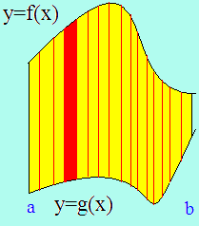
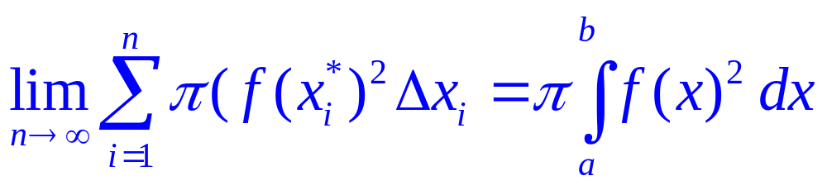
By the definition of the definite integral
Volume =

Slide 15
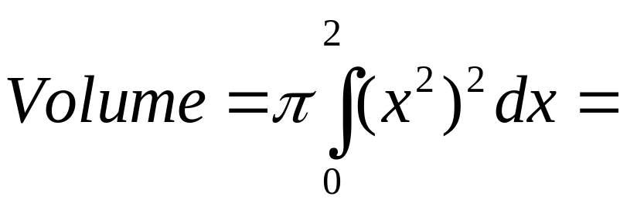

Example 1
Find the volume when the area under y=x²
Between x=0 and x=2
Is revolved about the x-axis
= π x⁵/5
= π 32/5

Slide 16

Example 2
Find the volume when the area under y=the square root of x is revolved about the x-axis between x=0 and x=4.
Volume =

Slide 17
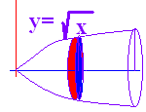
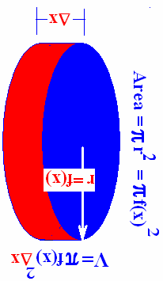
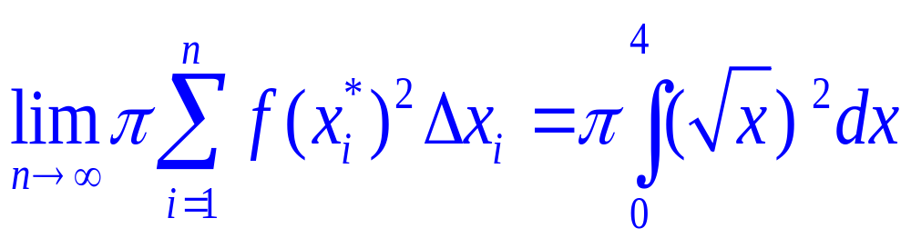
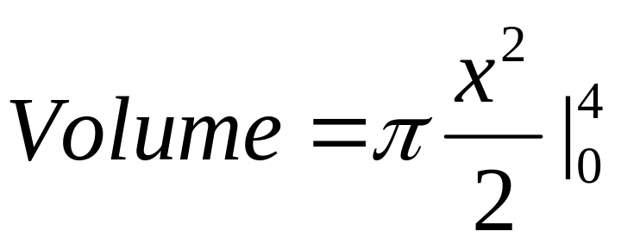
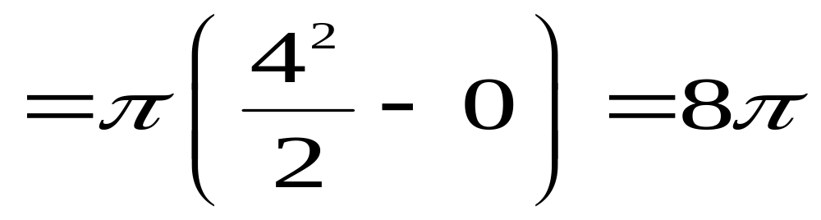
Volume =

Slide 18
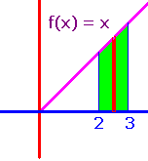
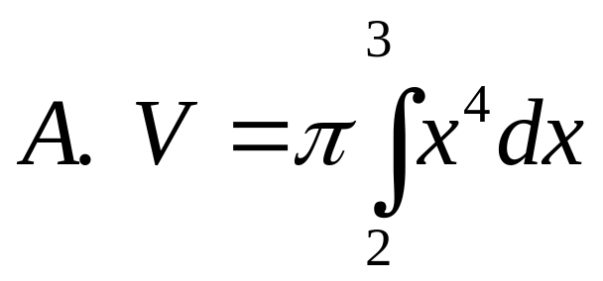
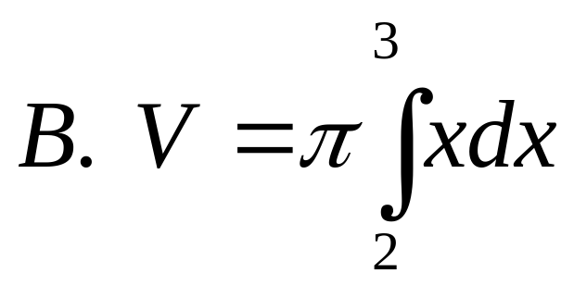
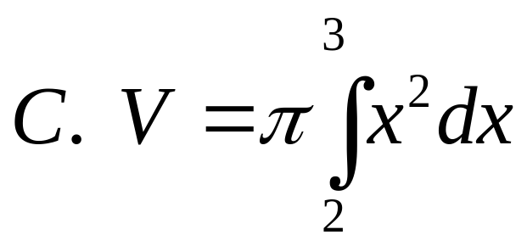
Revolve the shown area about the x-axis.
]
]
]

Slide 19
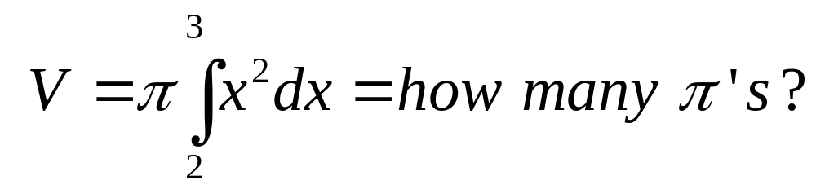
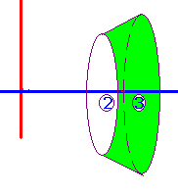
[
6.333
0.1

Slide 20
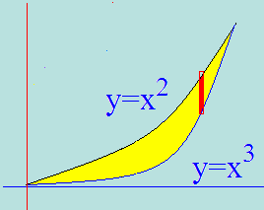
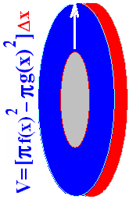
Example 3
Washer Method
Spin the shown region about the x-axis
Show red strip perpendicular to the axis of revolution

Slide 21
Example 3
Washer Method
Use the disc method for the top function
Use it again for the bottom one
Subtract the two answers

Slide 22
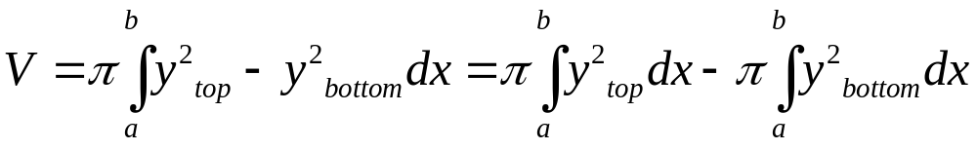
Example 3
Washer Method
.

Slide 23
Speaker
Washer Method
Set the two functons equal to each other
Solve for x x² = x³ or 0 = x³ - x²
By factoring 0 = x² ( x – 1 )
so x² =0 or x–1=0
Next we add up all of the red washers
From 0 to 1
Volume =

Slide 24
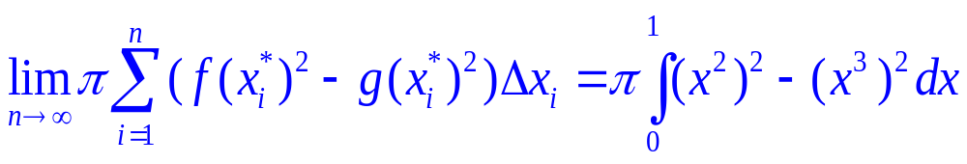
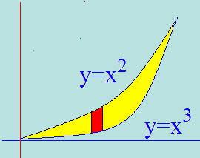

Volume =
= π[(7-5)/35] = 2π /35

Slide 25




Find the volume
[]
[]
[]

Slide 26




.
[]
[]
[]

Slide 27




.
[]
[]
[]

Slide 28

]
9.83
0.2

Slide 29





Slide 30





Example 4
Take the area bounded by x = y² and y = x/2.
Revolve that area about the y-axis
Red strip is perpendicular to axis of rev.

Slide 31


x = y² and y = x/2
Solve for x and set them equal
y² = 2y
y² - 2y = 0
y(y – 2) = 0 so y = 0 or y = 2

Slide 32




