Slide 1
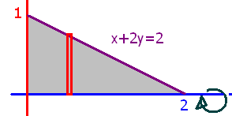
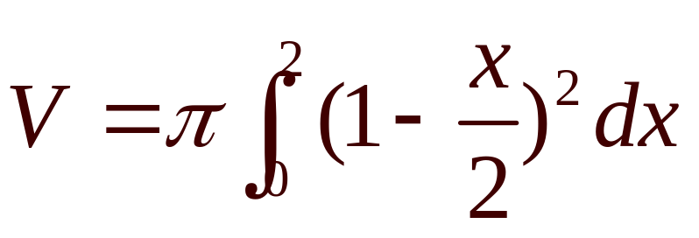
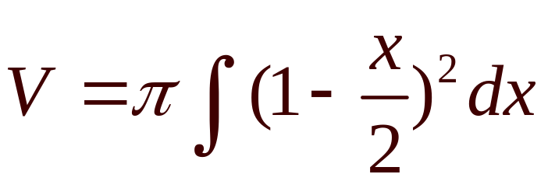
What is the volume if the grey area is revolved about the x-axis?

Slide 2
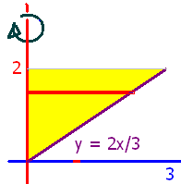
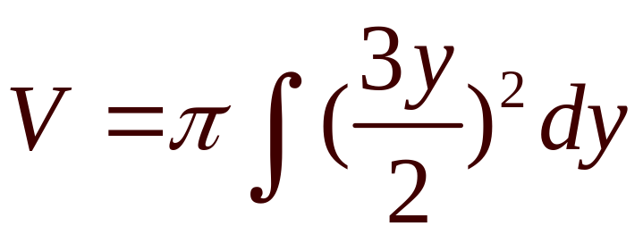
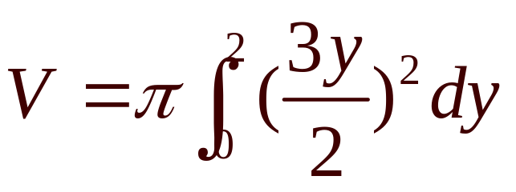
What is the volume if the yellow area is revolved about the y-axis?

Slide 3
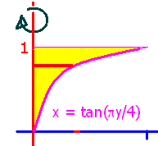
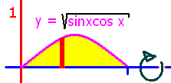
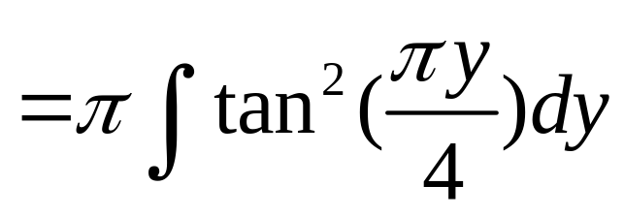
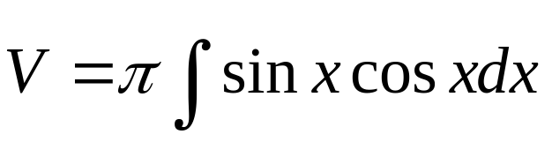
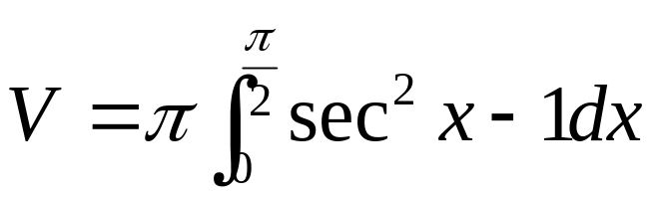
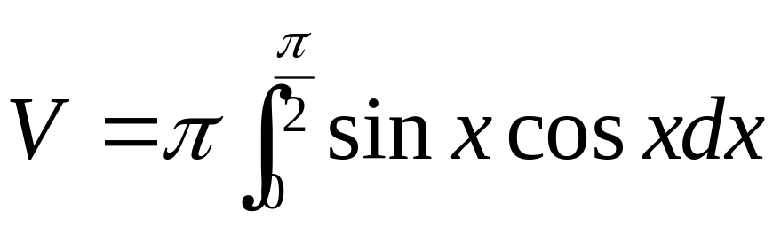

Slide 4


.
0.5
0.1

Slide 5
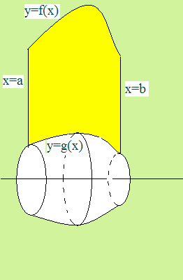

What is the volume if the yellow area is rotated about the y-axis?
Last time we went about the x as shown.

Slide 6
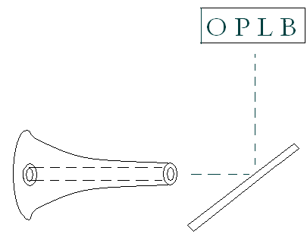
Dr. Jack Tenzel has a
Project-o-Chart in his office
The light reflects off of a mirror and ends up on a wall in front of the patient.

Slide 7
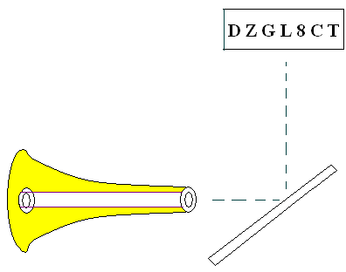
Given the center light source, calculate the volume around it
First write the equation of the surface.

Slide 8
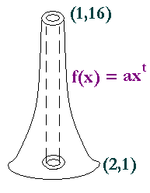

y = 16 = f(1) = a(1)^{t} = a y = 1 = f(2) = 16 2^{t}
The model is f(x) = a x^{t}
When x = 1, y = 16, so a = 16
So f(x) = 16 x^{t}
When x = 2, y = 1, so 1 = 16 2^{t}

Slide 9

y = 16 x^{t}
When x = 2, y = 1, so 1 = 16 2^{t}
Divide both sides by 16 = 2⁴
1/2⁴ = 2^{t}
2⁻⁴ = 2^{t}
t = - 4

Slide 10
y = 16 x⁻⁴
We will come
back to this later.

Slide 11
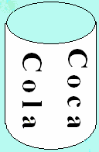
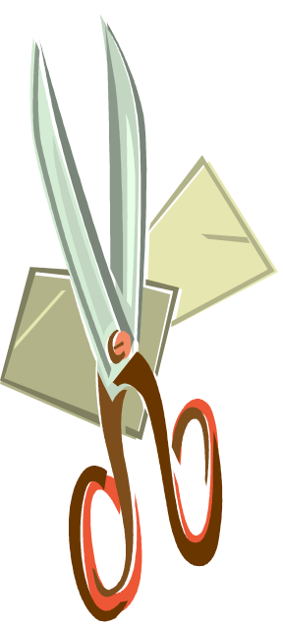
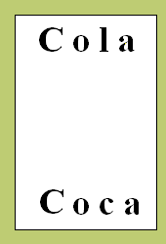

What is the volume of a coke can?
Just the aluminum
Top - Bottom

Slide 12
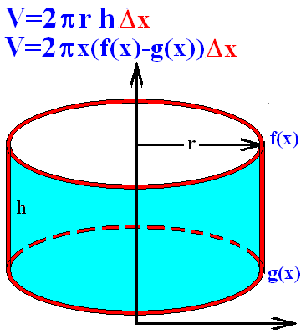
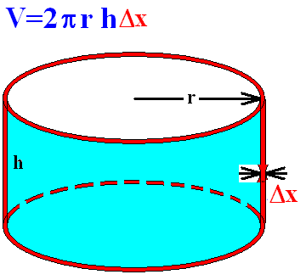
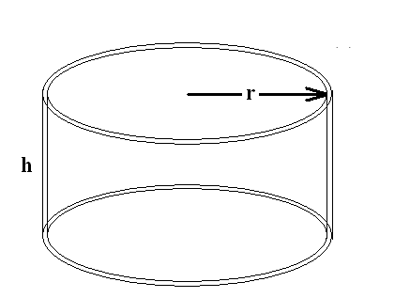
The volume of a can is 2π r times the height times the Δx.

Slide 13
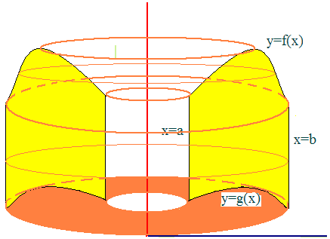
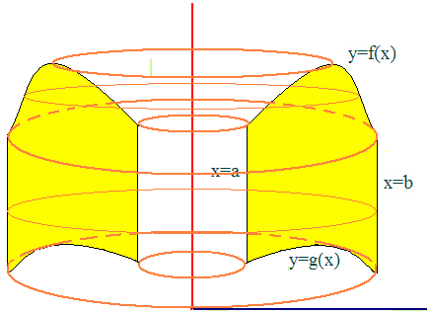
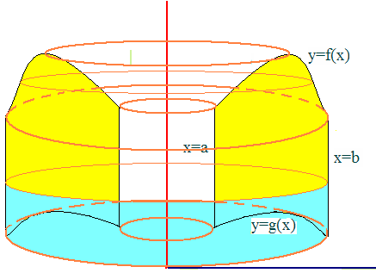
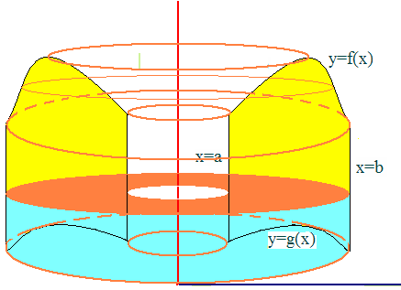
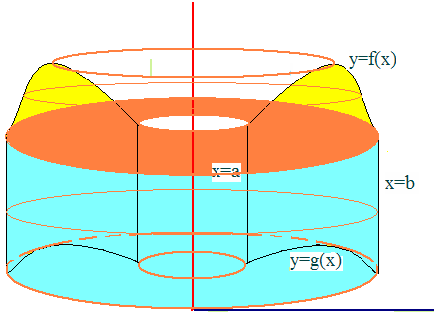
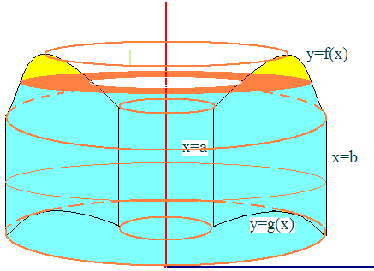
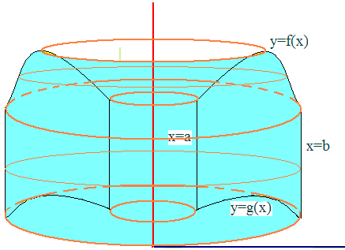
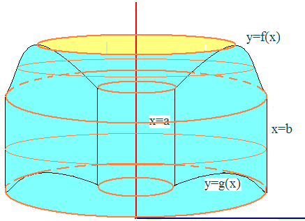

Slide 14
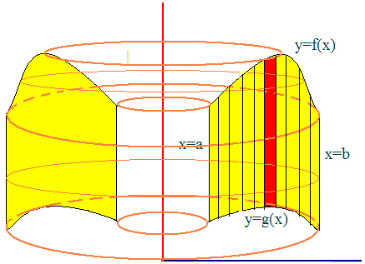
Start like we did for area. Take a narrow Δx red strip and then rotate it about the y-axis.
This makes a red coke can.
The volume of one can is…
2πx(f(x)-g(x))Δx so the desired volume is

Slide 15
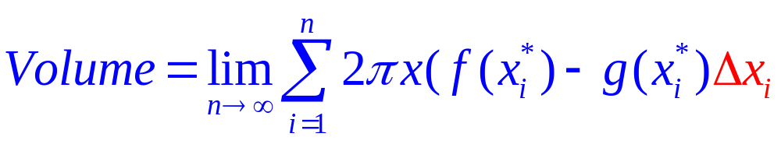
Set up n rectangles of width Δx
Revolve about the y-axis
That produces n cylinders

Slide 16
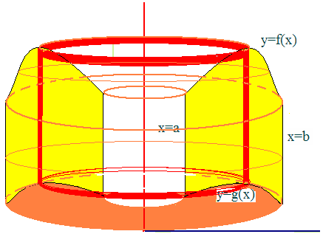
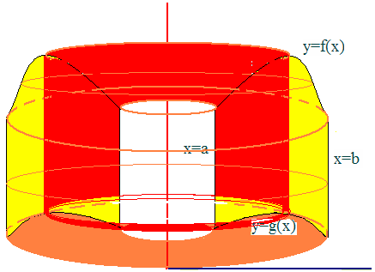
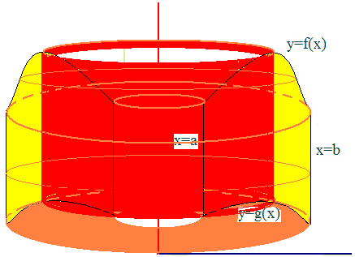
Take a narrow Δx red strip and then rotate it about the y-axis.
This makes a coke can.
The volume of one can with radius x is…
2πx(f(x)-g(x))Δx so the desired volume is

Slide 17
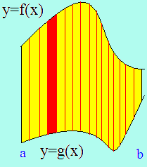
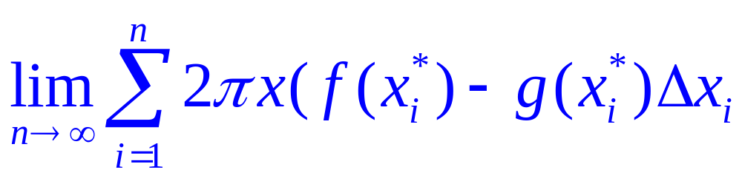
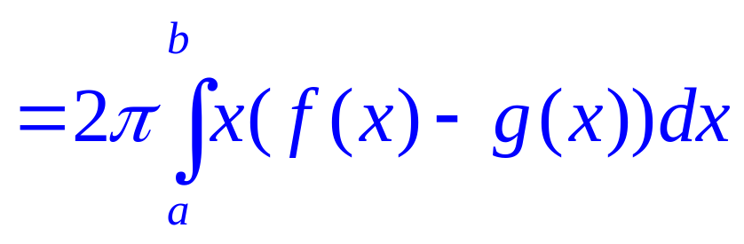
By the definition
Volume =

Slide 18
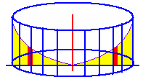

Example 1
Find the volume when the area under y = x² and over the x-axis is revolved about the y-axis.
Between x=0 and x=2
Just add up all of the red coke cans
As they slide from x=0 to x=2
Top function is y= x²
Bottom function is y = 0

Slide 19
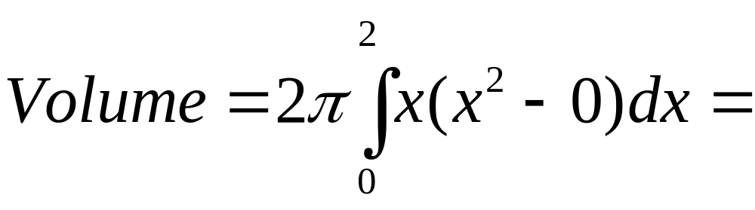

Example 1
Find the volume when the area under y=x²
Between x=0 and x=2
Is revolved about the y-axis
= 2πx⁴/4
= 2π2⁴/4 = 8π

Slide 20
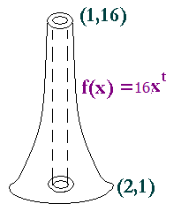
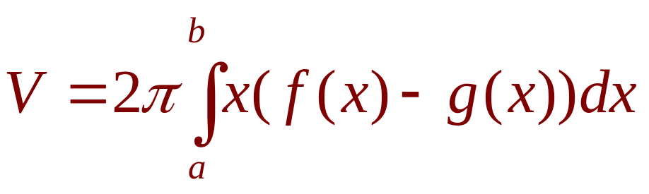
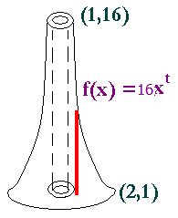
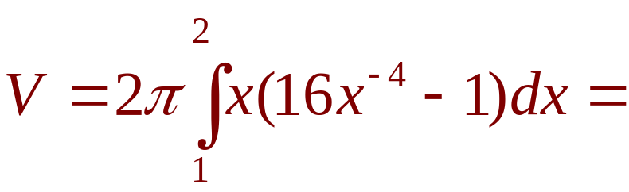
.
Back to the problem
x is the radius times top - bottom

Slide 21
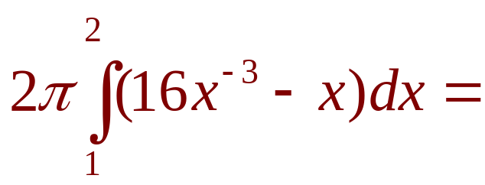
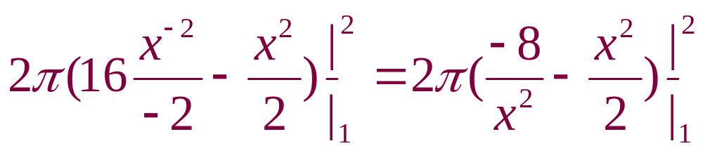
.

Slide 22
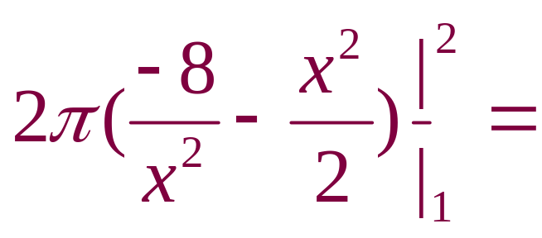

[
2π[−(−2−2) − (−8−0.5)]
2π[(−2−2) + (−8−0.5)]
2π[(−2−2) − (−8−0.5)]

Slide 23
2π[(−2−2)−(−8−0.5)]=
2π[ - 4 + 8.5]
2π[ - 4 - 8.5]
2π[ - 4 + 7.5 ]

Slide 24
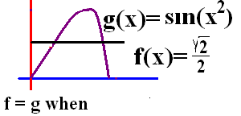
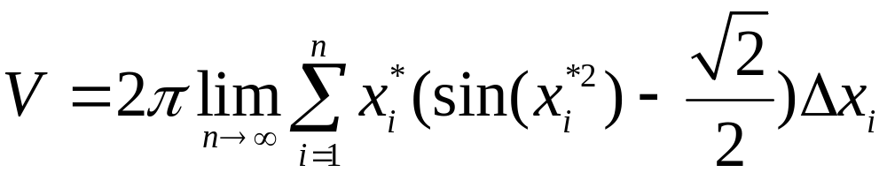
Example 2
Consider the first region in the first quadrant bounded by y=sin(x²) and y=1/root(2)
Set the two functions equal
Solve for x² and then for x
Spin about the y-axis or radius of x
Add the volumes of the n cylinders

Slide 25
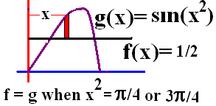

Example 2
sin(x²) = root(2)/2 when x²=π/4 or 3π/4

Slide 26



Example 2

Slide 27





Example 2

Slide 28


Example 3
Revolve the area between x² and x³ about the y-axis
Find the volume generated.
0 = x² ( x – 1 )
so x² =0 or x–1=0
Next we add up all of the red cylinders
From 0 to 1
Volume =

Slide 29



Revolve about the y-axis
[
[
[

Slide 30




.
.
.
.

Slide 31


Volume =
= 2 π[(5-4)/20] = 2 π /20 = π /10

Slide 32


y = x + 1 .……. y = x² + 1 . …1
2 pi radius ( top – bottom) thick.

Slide 33




.
.
.
.

Slide 34
Region of y=x²+1 and y=x+3 is revolved about the line x = -1.
45.95
0.2

Slide 35



Region bounded by y=x²+1 and y=x+3 is revolved about the x-axis.
73.51
0.2

